Slide 1
爐管新人學習進度報告
2025.03.03 ~ 2025.03.14
梁碩智

Slide 2
POLY PM
LP-P1 LP-P2 LP-P3 LP-P4 LP-P6 LP-P7 | POLY
 |  |  | Transfer | Boat | 保溫筒 | (NW50)pipe | Manifold 賓士盤 Ccp Shutter | 內管 外管 | Injector 120mm 250mm 900mm | MV | APC + Pumping line | QSV | Burn box
 | PM Item | Time | Check | 更換 | 更換 | 更換 & Clean | Clean | 更換 | 更換 | Clean & Check | Clean | 更換 | Clean
 | SPM | 9µm ±2 | ● | ●
 | BPM(1PM) | 19µm ±2 | ● | ● | ● | ● | ● | ● | ●
 | SPM | 9µm ±2 | ● | ●
 | BPM(2PM) | 19µm ±2 | ● | ● | ● | ● | ● | ● | ●
 | SPM | 9µm ±2 | ● | ●
 | BPM(3PM) | 19µm ±2 | ● | ● | ● | ● | ● | ● | ●
 | SPM | 9µm ±2 | ● | ●
 | BPM(4PM) | 19µm ±2 | ● | ● | ● | ● | ● | ● | ●
 | SPM | 9µm ±2 | ● | ●
 | BPM(5PM) | 19µm ±2 | ● | ● | ● | ● | ● | ● | ● | ● | ● | ● | ●
Leak rate
SPEC: ≦ 0.00Torr / 130sec

Slide 3
Nitride PM
Nitride 厚
LP-N3 LP-N4 LP-N5 LP-N7 |  |  | Transfer | BOAT (SIC) | (5+7)Fin pedestal 保溫筒 | (NW50)pipe bellow | Cold trap | Manifold 賓士盤 Ccp Spindle Shutter | 內管 | 外管 | Pressure ballow | Injector | MV | APC + pumping line
 | PM Item | Time | Check | 更換 | 更換 | 更換 & Clean | 更換 | Clean | 更換 | 更換 | Clean | 更換 | Clean & Check | Clean
 | SPM | 40µm ±10 | ● |  |  | ● | ●
 | SPM | 80µm ±10 | ● |  |  | ● | ●
 | BPM(1PM) | 120µm ±14 | ● | ● | ● | ● | ● | ● | ● | ● | ● | ●
 | SPM | 40µm ±10 | ● |  |  | ● | ●
 | SPM | 80µm ±10 | ● |  |  | ● | ●
 | BPM(2PM) | 120µm ±14 | ● | ● | ● | ● | ● | ● | ● | ● | ● | ●
 | SPM | 40µm ±10 | ● |  |  | ● | ●
 | SPM | 80µm ±10 | ● |  |  | ● | ●
 | BPM(3PM) | 120µm ±14 | ● | ● | ● | ● | ● | ● | ● | ● | ● | ●
 | SPM | 40µm ±10 | ● |  |  | ● | ●
 | SPM | 80µm ±10 | ● |  |  | ● | ●
 | BPM(4PM) | 120µm ±14 | ● | ● | ● | ● | ● | ● | ● | ● | ● | ● | ● | ●
LP-N1 依產能需求切換厚 or 薄 Nitride
Nitride 薄
LP-N2 LP-N6 |  |  | Transfer | BOAT (SIC) | (5+7)Fin pedestal 保溫筒 | (NW50)pipe bellow | Cold trap | Manifold 賓士盤 Cap Spindle Shutter | 內管 | 外管 | Pressure ballow | Injector | MV | APC + pumping line
 | PM Item | Time | Check | 更換 | 更換 | 更換 & Clean | 更換 | Clean | 更換 | 更換 | Clean | 更換 | Clean & Check | Clean
 | SPM | 150µm ±15 | ● | ● | ● | ● | ●
 | BPM(1PM) | 300µm ±30 | ● | ● | ● | ● | ● | ● | ● | ● | ● | ●
 | SPM | 150µm ±15 | ● | ● | ● | ● | ●
 | BPM(2PM) | 300µm ±30 | ● | ● | ● | ● | ● | ● | ● | ● | ● | ●
 | SPM | 150µm ±15 | ● | ● | ● | ● | ●
 | BPM(3PM) | 300µm ±30 | ● | ● | ● | ● | ● | ● | ● | ● | ● | ●
 | SPM | 150µm ±15 | ● | ● | ● | ● | ●
 | BPM(4PM) | 300µm ±30 | ● | ● | ● | ● | ● | ● | ● | ● | ● | ● | ● | ●
Leak rate
SPEC: ≦ 0.02Torr / 130sec

Slide 4
TEOS PM
TEOS
LP-T1 LP-T2 LP-T3 LP-T4 LP-T5 LP-T6 LP-T8 LP-T9 |  |  | Transfer check | BOAT (SIC) | 5 fin Pedestal 保溫筒 | (NW50)pipe (NW50)銜接環 bellow | Cold trap | Manifold 賓士盤 Ccp Shutter | 內管 | 外管 | Injector 平口 25mm 1000mm | Pressure bellow | MV | APC + pumping line | QSV | Burn box
 | PM Item | Time | Check | 更換 | 更換 | 更換 & Clean | 更換 | Clean | 更換 | 更換 | 更換 | Clean | Clean & Check | Clean | 更換 | Clean
 | SPM | 9µm ±2 | ● | ● | ● | ● | ●
 | SPM | 18µm ±2 | ● | ● | ● | ● | ●
 | BPM(1PM) | 27µm ±2 | ● | ● | ● | ● | ● | ● | ● | ● | ● | ●
 | SPM | 9µm ±2 | ● | ● | ● | ● | ●
 | SPM | 18µm ±2 | ● | ● | ● | ● | ●
 | BPM(2PM) | 27µm ±2 | ● | ● | ● | ● | ● | ● | ● | ● | ● | ●
 | SPM | 9µm ±2 | ● | ● | ● | ● | ●
 | SPM | 18µm ±2 | ● | ● | ● | ● | ●
 | BPM(3PM) | 27µm ±2 | ● | ● | ● | ● | ● | ● | ● | ● | ● | ● | ● | ● | ● | ●
Leak rate
SPEC: ≦ 0.02Torr / 70sec

Slide 5
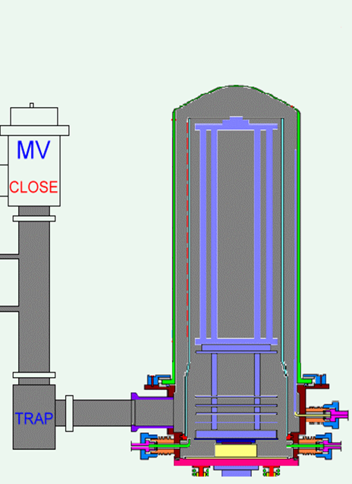
爐管示意圖
Boat
Pedestal
Injector
Cold Trap
Pipe
Shutter

Slide 6
LP-TEOS SPM 流程
Parts 準備
  石英秤重並記錄(洗管室有貼標準)、Boat更換件號要記錄
  檢查是否缺損
  更換Boat、Cold trap、piping、pedestal
傳送檢查
  Boat 承接
  檢查刮管
  C1-C6 Fork-5 傳送檢查
  C1、C3、C8 Fork-1 傳送檢查
測漏
  Purging 1小時
  LK 測試 (Teos < 0.02 torr/70sec、Nitride < 0.02 torr/130sec、 Poly : 0.00 torr/130sec)
  傳送auto purge recipe(PG: TEOS/NI、COT:POLY)

Slide 7
外管:
更換manifold & 軟管 (止洩帶請勿纏太多圈)， elevator往上測試5-10分鐘看會不會漏，後續安裝外管(270 O-Ring)， elevator往上鎖緊螺絲，後續裝入TC、1000mm injector
內管:
裝入內管放入內管套上內管環(PS TEOS內管有特殊環要鎖緊)，放平口injector、25mm injector，換tray(230 O-ring )+Pedestal(5fin)+Boat
確認: check 承接、刮管、傳送→裝pipe heater和shutter cover(檢查校正heat temperature setting)，
傳送:
確認wafer 傳送 C1-C6 Fork-5 (C1、C3、C8 Fork-1 )
測漏:
手動Purge 確認 0.2 tor/ 70sec (不能超過0.2) ，後續跑auto purge(recipe : pg)
LP-TEOS BPM

Slide 8
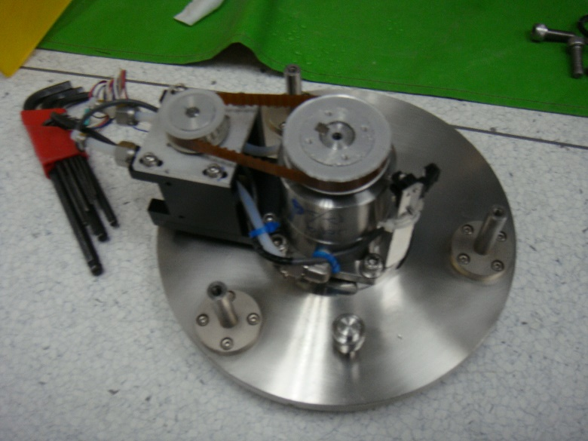
LP-NITRIDE 轉子清潔
Close cap water 、check flowmeter
將水管(記得下方墊布)、motor拔除
壓住cap拆除下方3顆screws
拆除固定轉子的4顆screws，並將轉子上的coating刮除、replace new O-ring
將轉子組回後，將cap裝回
組回水管(放無塵布再把cap water open )、motor、sensor，並測是否會漏水(要記得把布丟掉)

Slide 9
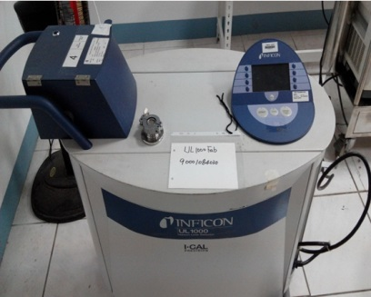
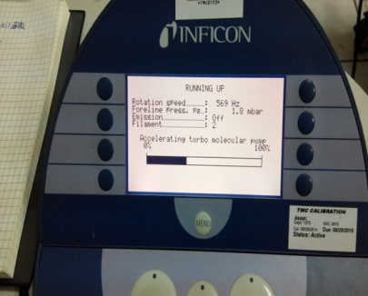
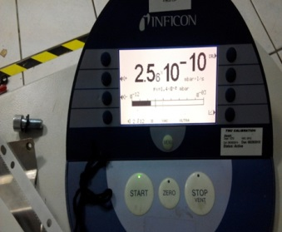
測漏儀測漏步驟
確認測漏儀往前段管路都已經接上、MV已抽真空→開啟測漏儀→暖機→管線連接後按start先抽管內真空→轉開手動閥→面板調整音量大小→使用氦氣高壓氣瓶→以氣槍由後段往前段在各接合面噴氣測漏(標準<E-8)→關手動閥→按stop→畫面顯示stand by→長按stop→關閉測漏儀→冷機
暖、冷機(5-10分鐘)原因為測漏儀內含turbo pump，當高速旋轉時，移動時伴隨的震動容易造成pump損壞。

Slide 10
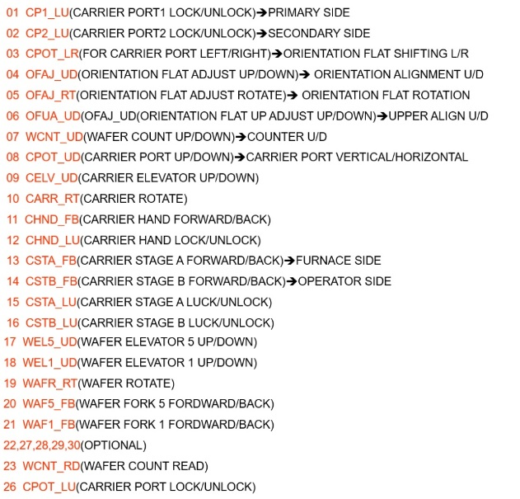

T-Bowl

Slide 11
T-Bowl
01. CPT1_LU
02. CPT2_LU
03. CPOT_LR
04. OFAJ_UD
05. OFAJ_UD
06. OFUA_UD
07. WCNT_UD
08. CPOD_UD
09. CELV_UD
10. CARR_RT
11. CHND_FB
12. CHND_LU
13. CSTA_FB
14. CSTB_FB
15. CSTA_LU
16. CSTB_LU
CARRIER PORT 內側LOCK
CARRIER PORT 外側LOCK
轉平邊平台 左右移
轉平邊平台 上下移
轉平邊滾軸 旋轉
轉平邊平台中心 上下移
計數器平台 上下移
CARRIER PORT 垂直轉
ELEVATOR 上下移
ELEVATOR 左右移(CARRIER)
ELEVATOR 前後移
ELEVATOR LOCK
內CARRIER STAGE 前後移
外CARRIER STAGE 前後移
內CARRIER STAGE LOCK
外CARRIER STAGE LOCK
17.
18.
19. WAFR_RT
20. WAF5_FB
21. WAF1_FB
22.
23. WCNT_RD
24.
25.
26. CPOT_LU
27.
28.
29.
30.
ELEVATOR 左右移(FORK)
FORK-5 前後移
FORK-1 前後移
COUNTER 讀值
CARRIER PORT 下方LOCK

