Slide 1
第七次新人週報
報告人 : 江皓誠
2024/09/11

Slide 2
目錄
E500傳送
GSD傳送
6200傳送
學習紀錄

Slide 3
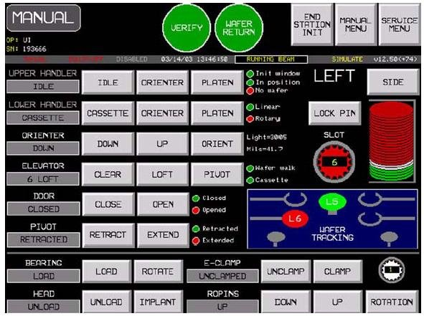
E500傳送
SIDE選擇左右邊LoadLock
Lock Pin為切換Lower Handler 模式Linear或Rotary
SLOT為選擇第幾SLOT
先關門MAPPING好
放好Cassette
PIVOT RETRACT
DOOR CLOSE
MAPPING

Slide 4
LOAD WAFER過程(到PLATEN)
選擇SLOT
ELEVACTOR CLEAR
LOWER HANDLER CASSETTE
ELEVACTOR LOFT
LOWER HANDLER ORIENTER
ORIENTER UP, 做ORIENT
UPPER HANDLER ORIENTER
ORIENTER DOWN
UPPER HANDLER PLATEN
ROPINS UP
UPPER HANDLER IDLE
ROPINS DOWN

Slide 5
LOAD WAFER過程(到IMPLANT)
BEARING ROTATE
E-CLAMP CLAMP
HEAD IMPLANT
植入完成後
HEAD UNLOAD
E-CLAMP UNCLAMP
BEARING LOAD

Slide 6
UNLOAD WAFER過程
ROPINS UP
LOWER HANDLER PLATEN
ROPINS DOWN
LOWER HANDLER ORIENTER
ELEVATOR選擇SLOT後LOFT
LOWER HANDLER CASSETTE
ELEVATOR CLEAR
LOWER HANDLER ORIENTER
DOOR OPEN
PIVOT EXTED

Slide 7
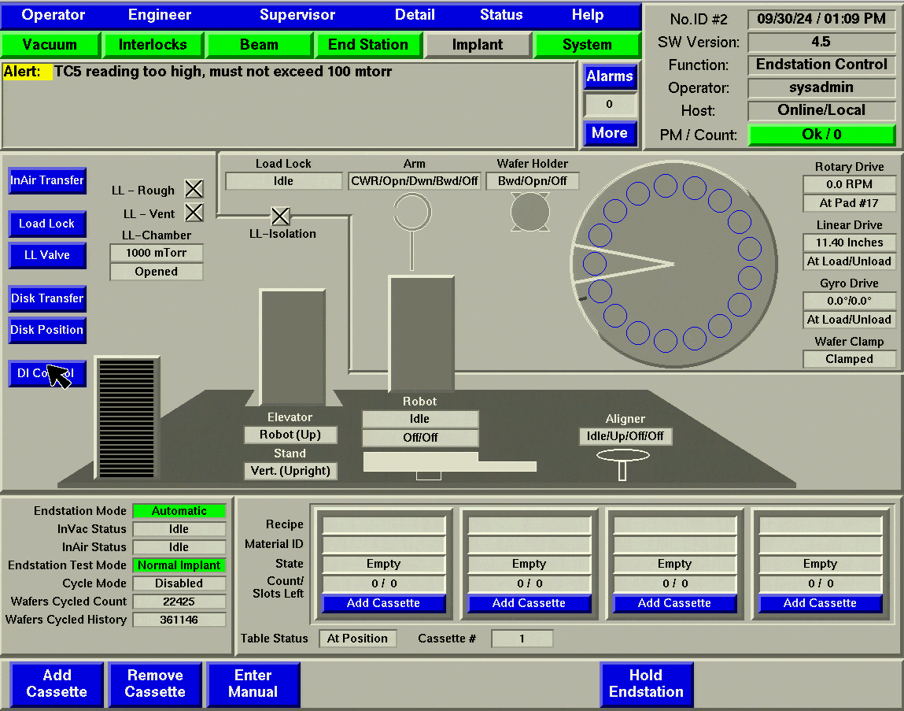
GSD傳送
InAir的傳送
TABLE → ALIGN轉平邊 → VCCS
(若VCCS有WAFER則先傳到BUFFER等VCCS UNLOAD)
ELEVACTOR TILT(DOWN)
STAND HORIZ(TILT)
CHAMBER CLOSE

Slide 8
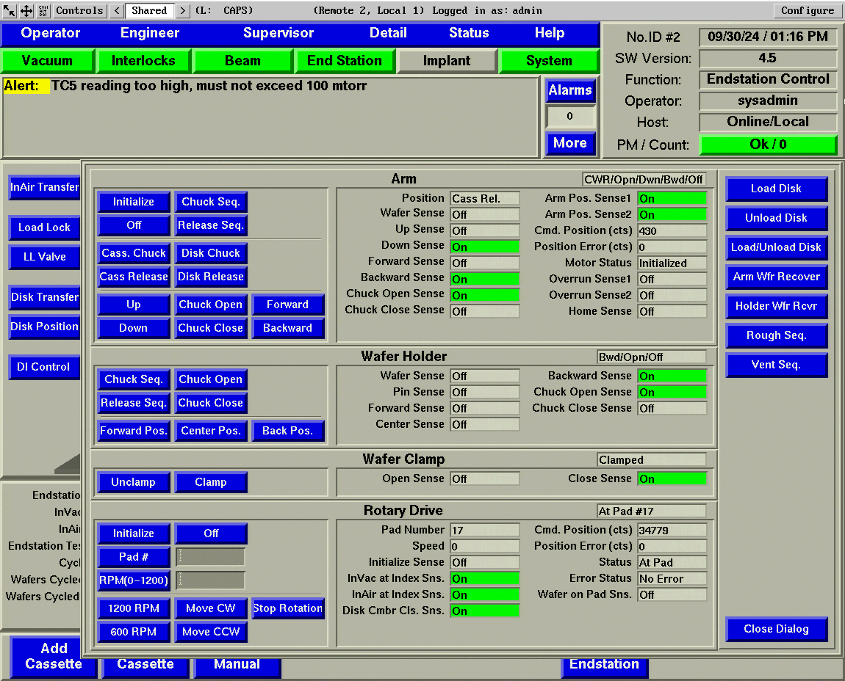
InVac的傳送(Load)
Arm Chuck Seq.
Arm Up
Disk Chuck
Holder Center Pos.
Holder Chuck Close
Arm Release Seq.
Holder Back Pos.
改Mapping(Arm卡interlock)
Arm Cass Release
Unclamp
Holder Forward Pos.
Clamp
Holder Chuck Open
Holder Back Pos.
改Mapping到Disk

Slide 9
InVac的傳送(UnLoad)
Arm Disk Release
Arm Forward
Arm Chuck Seq.
Unclamp
Arm Backward
Arm Cass Chuck
Arm Down
Arm Release Seq.

Slide 10
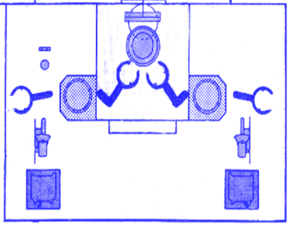
6200傳送
CHUCK
FLAT
LOAD ARM
UNLOAD ARM
OUPUT TRANSFER
INPUT TRANSFER
INPUT LOADLOCK
OUPUT LOADLOCK
INPUT SHUTTLE
OUPUT SHUTTLE
LOAD CASSETTE
UNLOAD CASSETTE

Slide 11
InAir的傳送(Load)
Shuttle從Cassette抓下來
Transport運送到Flat
Flat轉平邊
LoadLock Vent.
Lock Down
Transport傳到Lock放Wafer
Transport回到Shuttle下面
Lock Up
LoadLock Rough.
InVac的傳送(Load)
Bell Up
Arm Down at Lock
Arm Up at Lock
Arm Up at Home
Chuck UnClamp
Arm Up at Chuck
Arm Down at Chuck
Arm Down at Home
Chuck Clamp

Slide 12
InVac的傳送(UnLoad)
Chuck UnClamp
Arm Down at Chuck
Arm Up at Chuck
Arm Up at Home
Chuck Clamp
Bell Up
Arm Up at Lock
Arm Down at Lock
Arm Down at Home
Bell Down
LoadLock Vent
InAir的傳送(UnLoad)
LoadLock Vent.
Lock Down
Transport回到Shuttle下面
Shuttle從Transport抓Wafer回Cassette

Slide 13
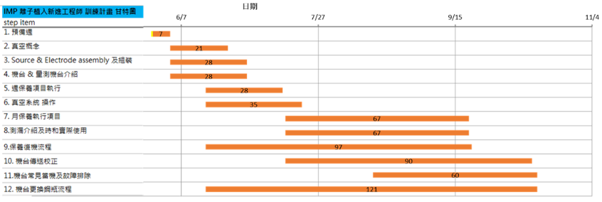
學習紀錄

Slide 14
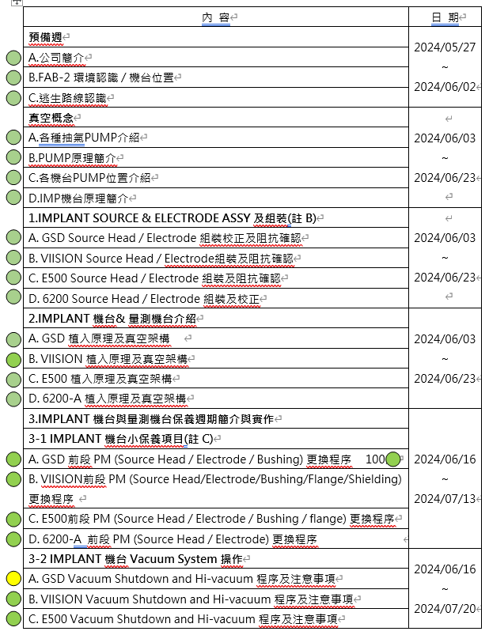
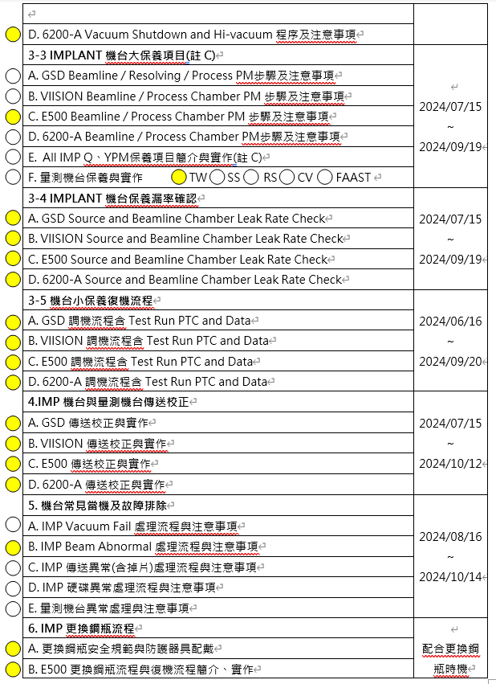
OK
做過(再練習)
不太會

