Slide 1
Beam current大小對RS及TW值的影響

Slide 2
各機台程式Beam current上下限及植入時Beam current之大小
機台 | Recipe | Beam Current(Low Limit) | Beam Current(Upper Limit) | 實際植入Beam Current(Low Limit) | 實際植入Beam Current(Upper Limit)
GSD-1 | AS/60/3E15 | 5mA | 7mA | 5.0X mA | 6.9X mA
RS(Avg) |  |  |  | 34.1 | 34.5
RS(Dev) |  |  |  | 0.97 | 1.024
GSD-2 | AS/60/3E15 | 6mA | 8mA | 6.1X mA | 7.9X mA
RS(Avg) |  |  |  | 35.22 | 35.35
RS(Dev) |  |  |  | 1.06 | 1.11
GSD-4 | P/50/2E15 | 5.2mA | 6.8mA | 5.2X mA~5.3X mA | 6.7X mA
RS(Avg) |  |  |  | 34.952 | 35.019
RS(Dev) |  |  |  | 0.597 | 0.757
GSD-6 | AS/60/3E15 | 5.4mA | 7.2mA | 5.5X mA | 7.1X mA
RS(Avg) |  |  |  | 34.68 | 34.88
RS(Dev) |  |  |  | 1.035 | 1.058
E500-3 | P/180/8E12 | 6 Scan | 12 Scan | 12 Scan(前段:110uA;後段:60uA) | 6 Scan(前段:240uA;後段:110uA)
TW(Avg) |  |  |  | 891.022 | 897.533
TW(Dev) |  |  |  | 0.24 | 0.42
TW(Avg) |  |  |  | 892.0456 | 898.2076
TW(Dev) |  |  |  | 0.19 | 0.25
6200-2 | BF2/70/7.2E12 | 18.5uA | 30uA | 18.8X uA~19.1X uA | 28.8X uA~29.1X uA
TW(Avg) |  |  |  | 749.9684 | 752.0009
TW(Dev) |  |  |  | 0.12 | 0.13
TW(Avg) |  |  |  | 744.7735 | 750.5902
TW(Dev) |  |  |  | 0.1 | 0.1

Slide 3
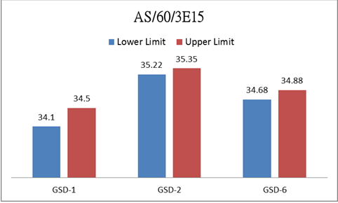
GSD-1.2.6 植入時Beam current上下限RS值之比較，RS值在上限時均較下限時高，但差異並不明顯(均<1)

Slide 4
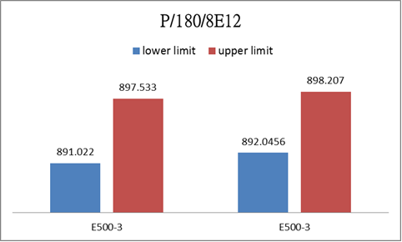
E500-3共測兩筆，植入時Beam current上下限TW值之比較，TW值在上限時均較下限時高，但差異並不明顯(均<10)

Slide 5
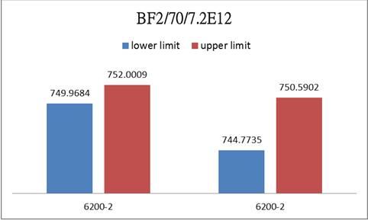
6200-2共測兩筆，植入時Beam current上下限 TW值之比較，TW值在上限時均較下限時高，但差異並不明顯(均<10)

Slide 6
Summary
1.雖然data數不足，但就量測的每筆數據顯示，beam current大時RS.TW及Deviation確實比beam小時高．
2.程式內建beam current的上下限多為target的正負10%左右，beam current在上下限時變異不大，故其RS與TW值在upper limit時雖較low limit高但並無太大差異，若將上下限值放寬，或許更能看出其中差異．

