Slide 1

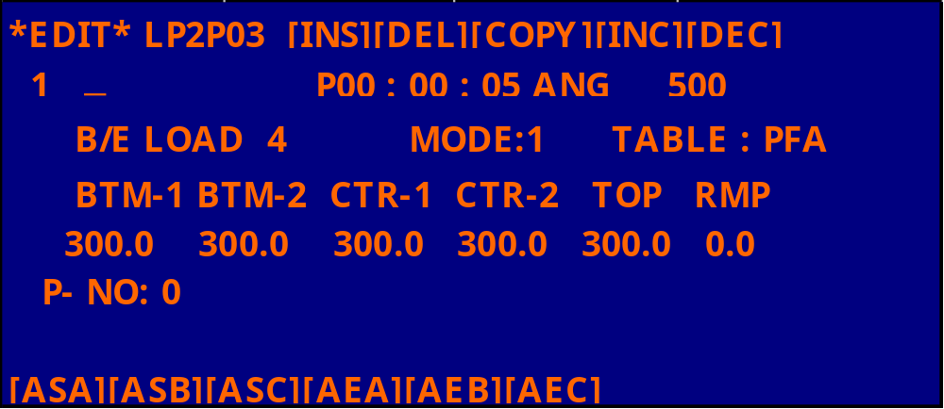
▲ ▼
( I ) ASA – AEA
( II ) ASA , ASB – AEA , AEB
( III ) ASA , ASB , ASC – AEA , AEB , AEC

Slide 2
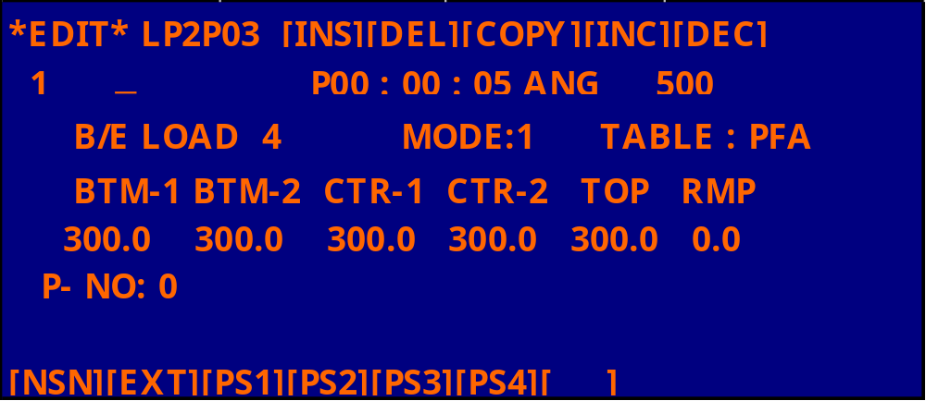
▲ ▼
SET PROCESS PRESSURE

Slide 3
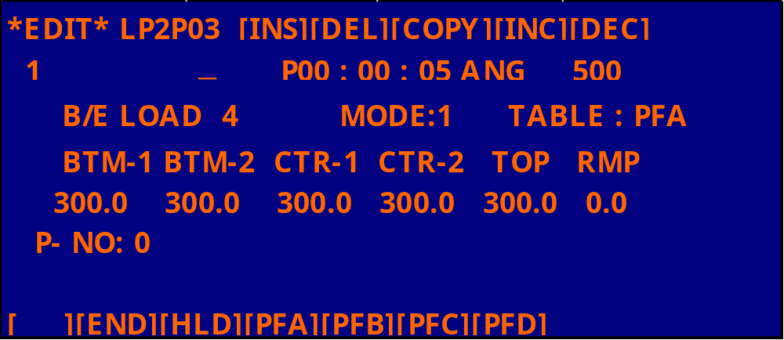
▲ ▼

Slide 4
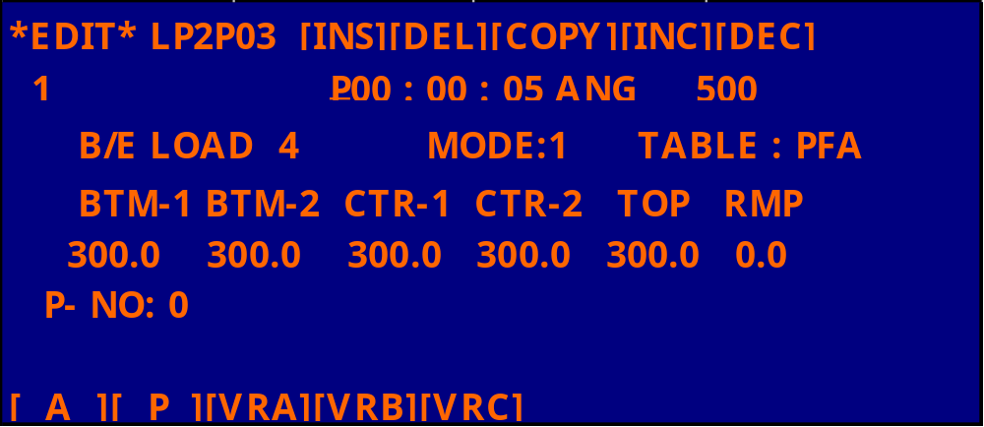
▲ ▼
A : 狀態符合時,時間正數
P : 時間倒數

Slide 5
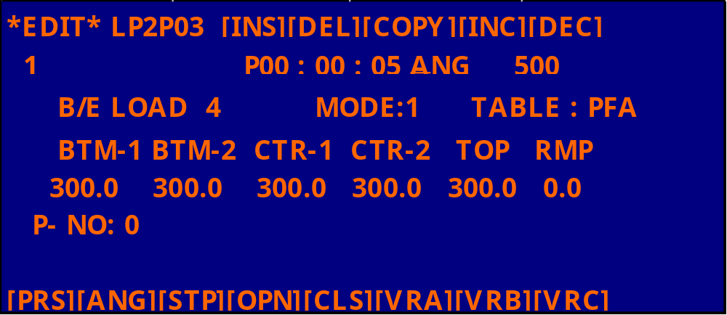
▲ ▼
SET PRESSURE OR APC CONTROLL

Slide 6
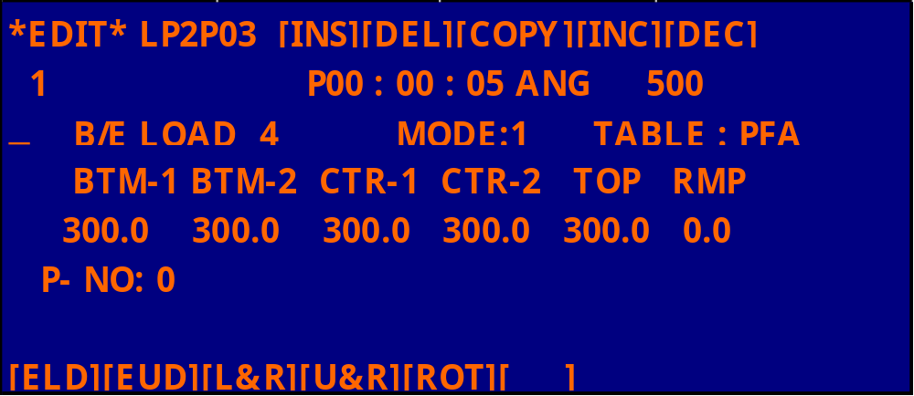
▲ ▼
SET BOAT ELEVATOR OPERATING

Slide 7
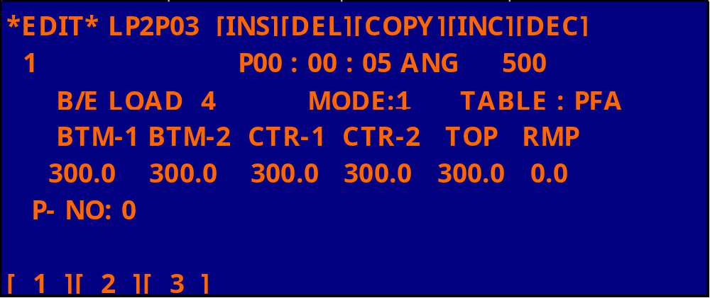
▲ ▼
SET TEMP CONTROL SYSTEM
“ 1 “ SPIKE
“ 2 “ PT/C
“ 3 “ SPIKE & PT/C RATIO-MIX

Slide 8
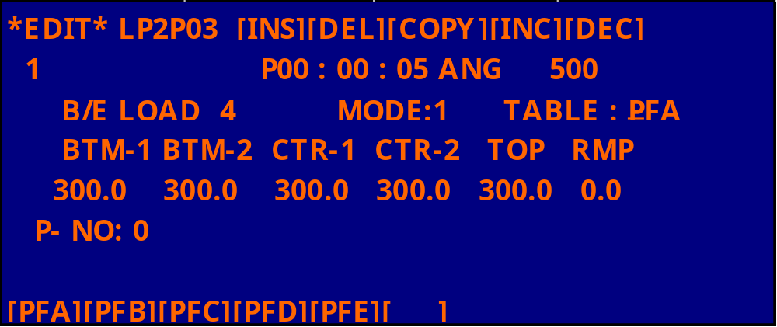
▲ ▼
SET PROFILE CALIBRATION TABLE

Slide 9
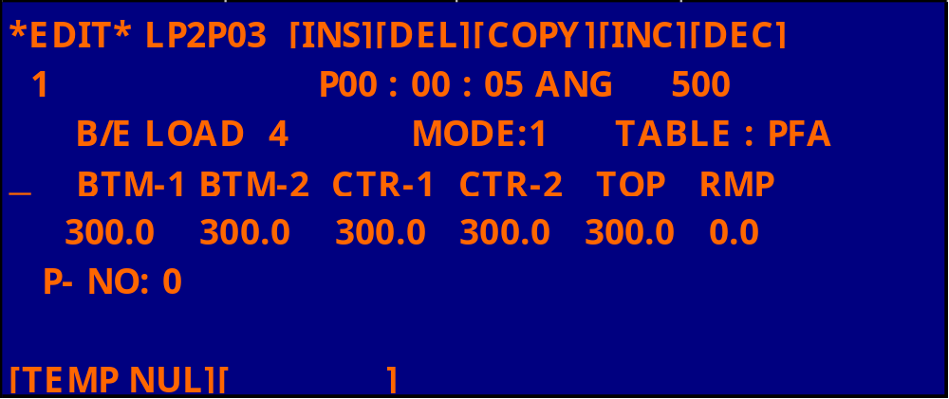
▲ ▼
SET TEMPTURE NULL

Slide 10
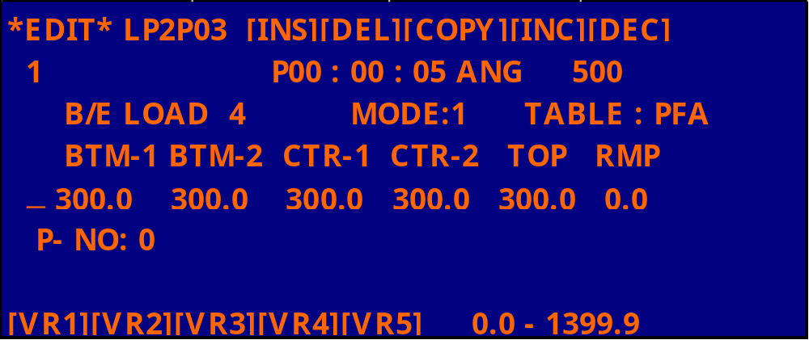
▲ ▼
SET TEMPTURE VR1～VR5 OR 0.0 ～1399.9

Slide 11
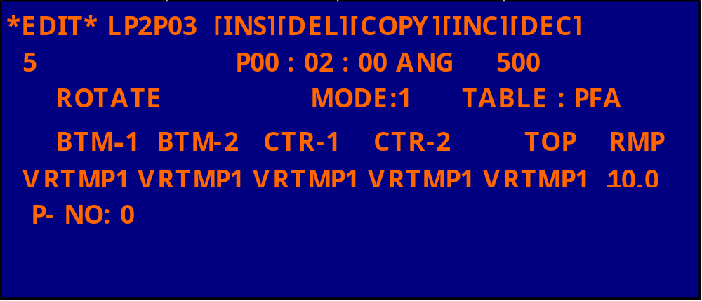
▲ ▼
SET THE RAMPING RATE 0.0 ～25.5 ℃/MIN

Slide 12
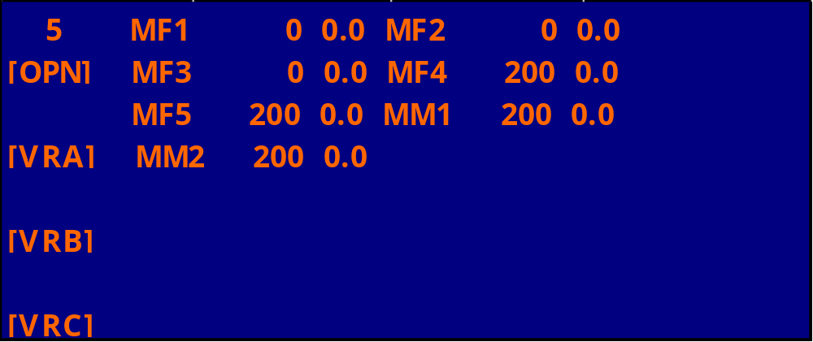
▲ ▼
SET MFC FLOW RATE

Slide 15
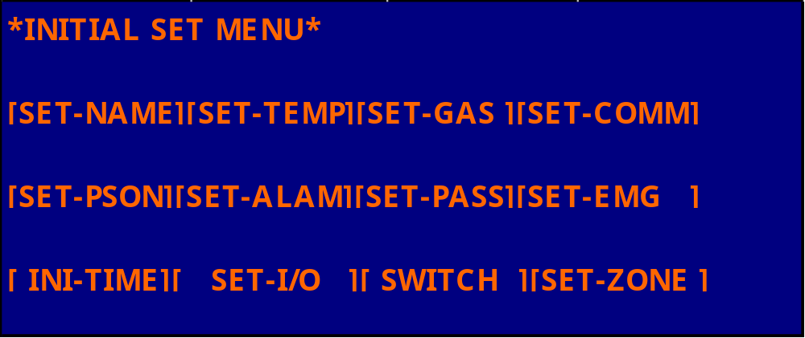
ESC

Slide 16
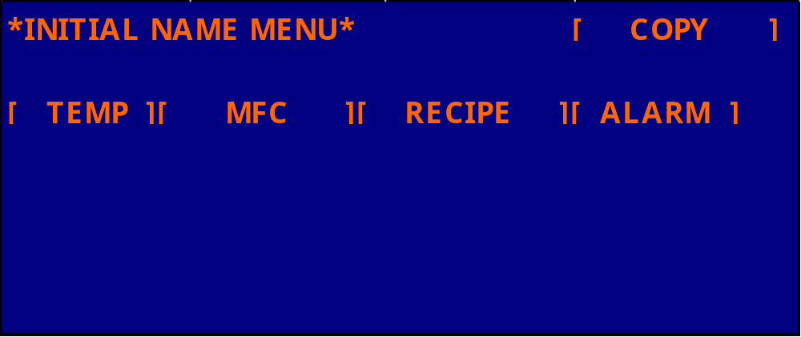
ESC

Slide 17
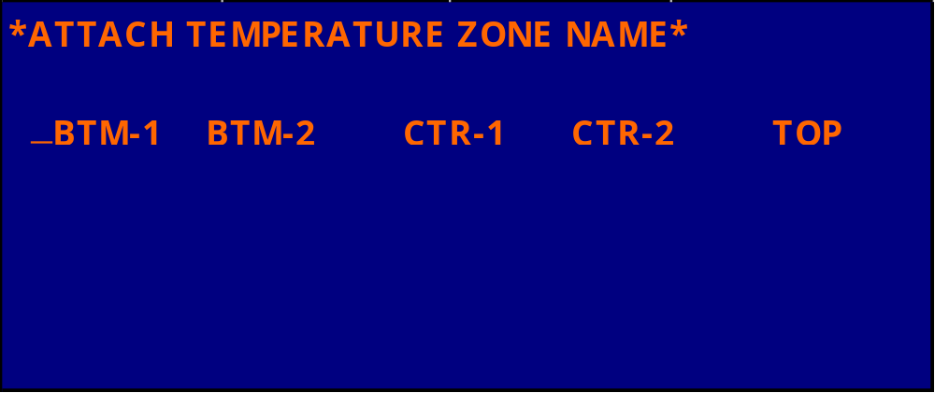
ESC

Slide 18
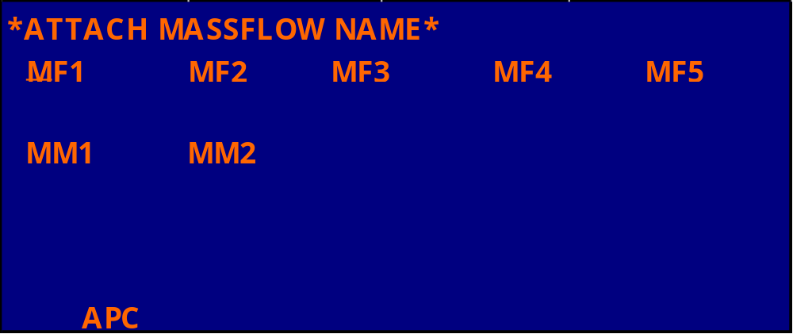
ESC

Slide 19
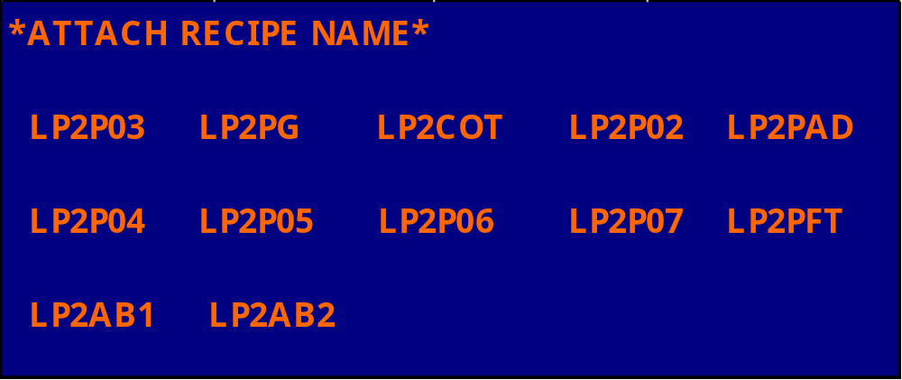
ESC

Slide 20
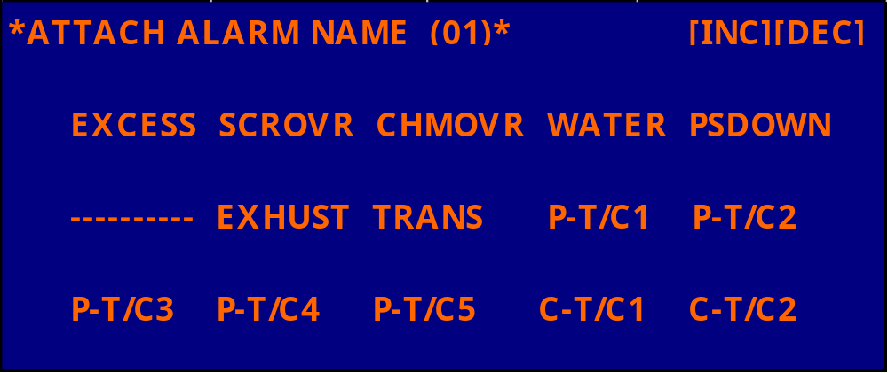
ESC
EXCESS : TEMPERATURE SENSOR ON THE HEATER DETECS ABNORMALITY
SCROVR : SCR COOLING FAN ON THE FURNACE BODY STOPS RUNNING
CHMOVR : TEMPERATURE DETDCTOR ON TOP OF THE FURNACE BODY DETECTOR ABNORMALITY
WATER : WATER COOLING UNIT FOR FURNACE BODY FAILS
PSDOWN : HEATER TRANSFER OPERATES ABNORMALLY
EXHAUST : EXHAUSTSYSTEM ON THE FURNACE FAILS
TRANS : TEMPERATURE DETCTOR ON THE TRANS. DETECTOR ABNORMALITY
P-T/C1 : INTERNAL THERMOCOUPLE (ZONE 1) IS OPEN OR SHORT-CIRCUITED.
P-T/C2 : INTERNAL THERMOCOUPLE (ZONE 2) IS OPEN OR SHORT-CIRCUITED.
P-T/C3 : INTERNAL THERMOCOUPLE (ZONE 3) IS OPEN OR SHORT-CIRCUITED.
P-T/C4 : INTERNAL THERMOCOUPLE (ZONE 4) IS OPEN OR SHORT-CIRCUITED.
P-T/C5 : INTERNAL THERMOCOUPLE (ZONE 5) IS OPEN OR SHORT-CIRCUITED.
C-T/C1 : CONTROLL THERMOCOUPLE (ZONE 1) IS OPEN OR SHORT-CIRCUITED.
C-T/C2 : CONTROLL THERMOCOUPLE (ZONE 2) IS OPEN OR SHORT-CIRCUITED.

Slide 21
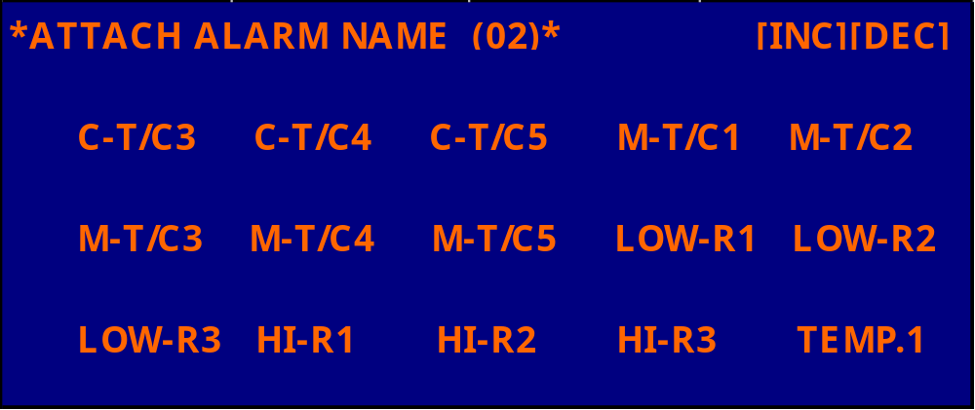
ESC
C-T/C3 : CONTROLL THERMOCOUPLE (ZONE 3) IS OPEN OR SHORT-CIRCUITED.
C-T/C4 : CONTROLL THERMOCOUPLE (ZONE 4) IS OPEN OR SHORT-CIRCUITED.
C-T/C5 : CONTROLL THERMOCOUPLE (ZONE 5) IS OPEN OR SHORT-CIRCUITED.
M-T/C1 : MONITOR THERMOCOUPLE (ZONE 1) IS OPEN OR SHORT-CIRCUITED.
M-T/C2 : MONITOR THERMOCOUPLE (ZONE 2) IS OPEN OR SHORT-CIRCUITED.
M-T/C3 : MONITOR THERMOCOUPLE (ZONE 3) IS OPEN OR SHORT-CIRCUITED.
M-T/C4 : MONITOR THERMOCOUPLE (ZONE 4) IS OPEN OR SHORT-CIRCUITED.
M-T/C5 : MONITOR THERMOCOUPLE (ZONE 5) IS OPEN OR SHORT-CIRCUITED.
L0W-R1 : MODEL 120 HARDWARE ABNORMAL (1)
LOW-R2 : MODEL 120 HARDWARE ABNORMAL (2)
L0W-R3 : MODEL 120 HARDWARE ABNORMAL (3)
HI-R1 : MODEL 120 HARDWARE ABNORMAL (4)
HI-R2 : MODEL 120 HARDWARE ABNORMAL (5)
HI-R3 : MODEL 120 HARDWARE ABNORMAL (6)
TEMP.1 : AFTER FURNACE TEMP. CONVERGENCE, FURNACETEMP. DETCTION (ZONE 1)HAS TURN ON.

Slide 22
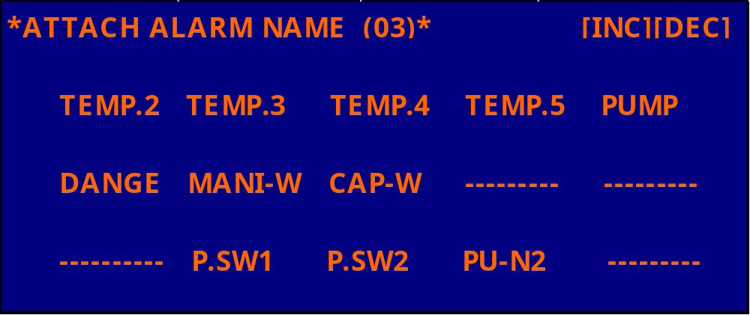
ESC
TEMP.2 : AFTER FURNACE TEMP. CONVERGENCE, FURNACETEMP. DETCTION (ZONE 2)HAS TURN ON.
TEMP.3 : AFTER FURNACE TEMP. CONVERGENCE, FURNACETEMP. DETCTION (ZONE 3)HAS TURN ON.
TEMP.4 : AFTER FURNACE TEMP. CONVERGENCE, FURNACETEMP. DETCTION (ZONE 4)HAS TURN ON.
TEMP.5 : AFTER FURNACE TEMP. CONVERGENCE, FURNACETEMP. DETCTION (ZONE 5)HAS TURN ON.
PUMP : ALARM AT THE PUMP UNIT.
DANGE : PUMP TEMP ALARM
MANI-W: MANIFOLD COOLING WATER LOWER THAN SET VALUE
CAP-W : MAGNETIC SEAL COOLING WATER LOWER THAN SET VALUE
P.SW1 : N2 NO.1 PRESSURE SWITH LOWER THAN SET VALUE
P.SW2 : N2 NO.2 PRESSURE SWITH LOWER THAN SET VALUE
PU-N2 : N2 PRESSURE FOR THE PUMP UNIT LOWER THAN SET VALUE

Slide 23
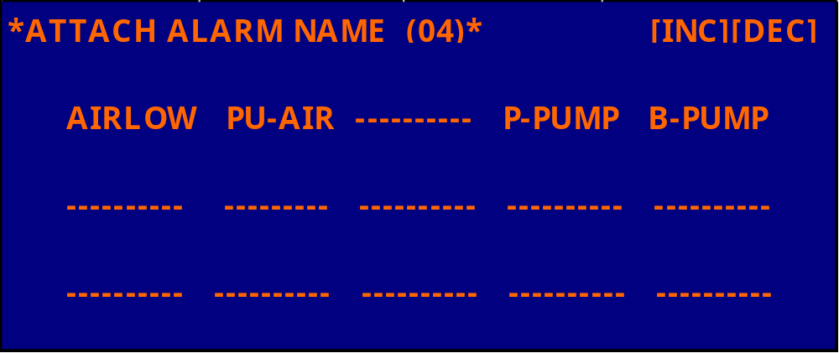
ESC
AIR LOW : AIR LOWER
PU-AIR : PURGE AIR
P-PUMP : ROTARY PUMP INSIDE THE PUMP UNIT ABNORMAL
B-PUMP : BOOSTER PUMP INSIDE THE PUMP UNIT ABNORMAL

Slide 24
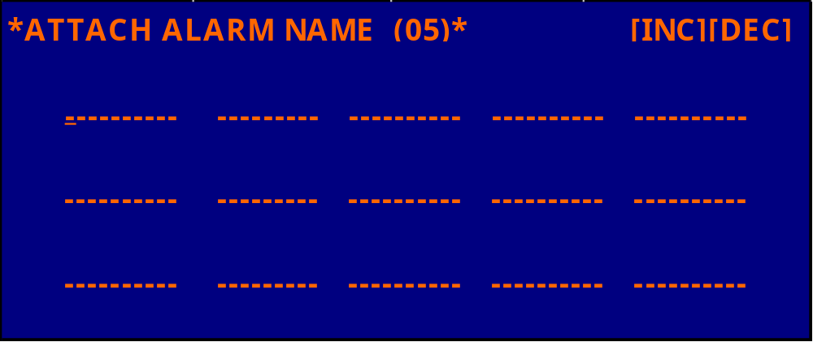
ESC

Slide 25

ESC

Slide 26
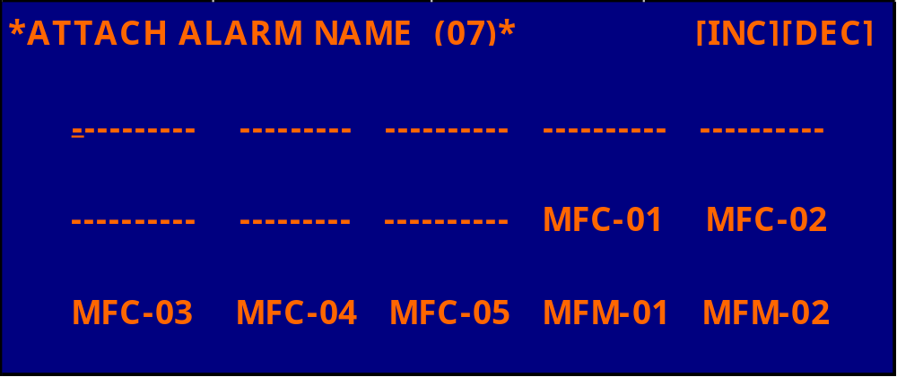
ESC
MFC-01 : MFC-01 ACTUAL VALUE EXCEEDS CONVERGENCE MONITOR LIMIT VALUE.
MFC-02 : MFC-02 ACTUAL VALUE EXCEEDS CONVERGENCE MONITOR LIMIT VALUE.
MFC-03 : MFC-03 ACTUAL VALUE EXCEEDS CONVERGENCE MONITOR LIMIT VALUE.
MFC-04 : MFC-04 ACTUAL VALUE EXCEEDS CONVERGENCE MONITOR LIMIT VALUE.
MFC-05 : MFC-05 ACTUAL VALUE EXCEEDS CONVERGENCE MONITOR LIMIT VALUE.
MFM-01 : MFM-01 ACTUAL VALUE EXCEEDS CONVERGENCE MONITOR LIMIT VALUE.
MFM-02 : MFM-02 ACTUAL VALUE EXCEEDS CONVERGENCE MONITOR LIMIT VALUE.

Slide 27
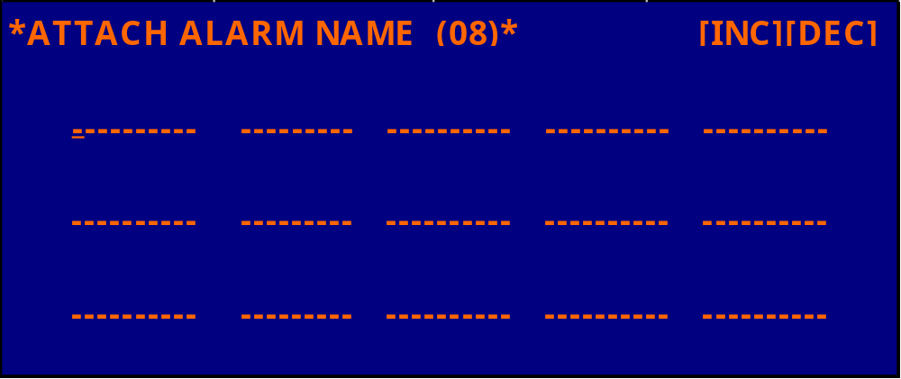
ESC

Slide 28
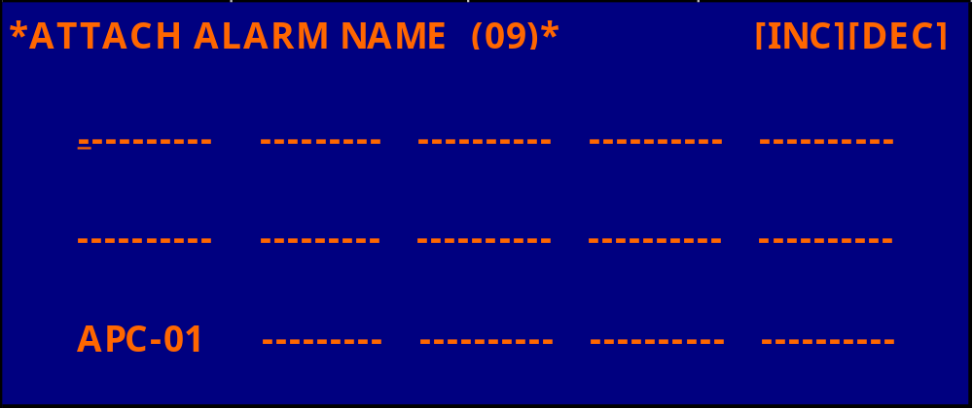
ESC
APC-01 : PRESSURE SENSOR #1 MONOTOR FUNCTION HAS TURNED ON.

Slide 29
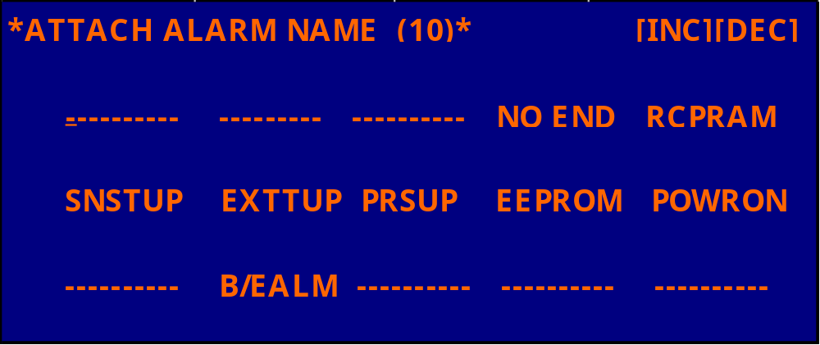
ESC
NO END : THE EXECUTION RECIPE PROGRAM HAS NO END STEP.
RCPRAM : RECIPE STORAGE AREA PARTLY OR TOTALLY DESTROYED.
SNSTEP : ALARM SET TIME RUNS OUT WHILE WAITING FOR SNS SIGNAL.
EXTTUP : ALARM SET TIME RUNS OUT WHILE WAITING FOR EXT SIGNAL.
PRSUP : ALARM SET TIME RUNS OUT WHILE WAITING FOR PRS SIGNAL.
EEPROM : E2PROM AREA PARTYL OR TOTALLY DESTROYED.
POWON : ( NOT CURRENTLY USED )
B/EALM : BOAT ELEVATOR ABNORMAL

Slide 30
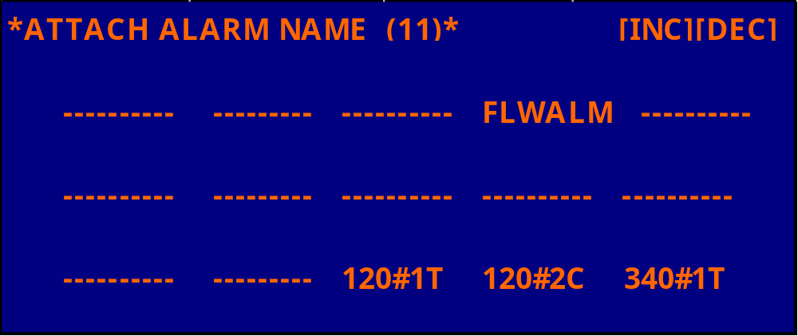
ESC
FLWALM :
120#1T : TIMER-OUT WHILE COMMUNICATING WITH MODEL 120 #1.
120#2C : COMPARE ERROR WHILE COMMUNICATING WITH MODEL 120 #1.
340#1T : TIMER-OUT WHILE COMMUNICATING WITH MODEL 340 #1.

Slide 31
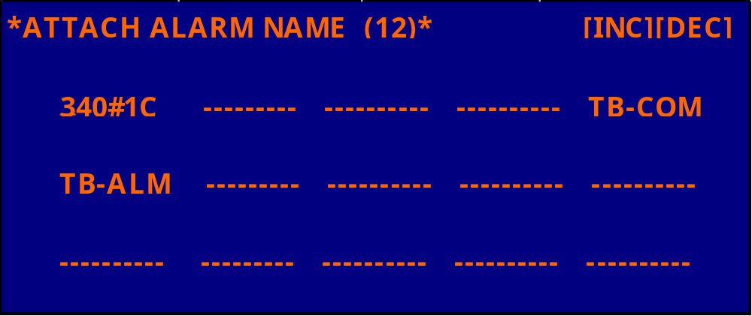
ESC
340#1C : COMPARE ERROR WHILE COMMUNICATING WITH MODEL 340 #1.
TB-COM : ERROR WHILE COMMUNICATING WITH T-BAWL CONTROLLER.
TB-ALM : ALARM FROM T-BAWL CONTROLLER.

Slide 32
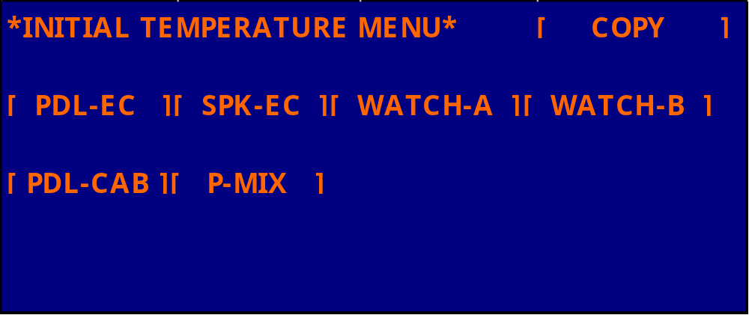
ESC

Slide 33
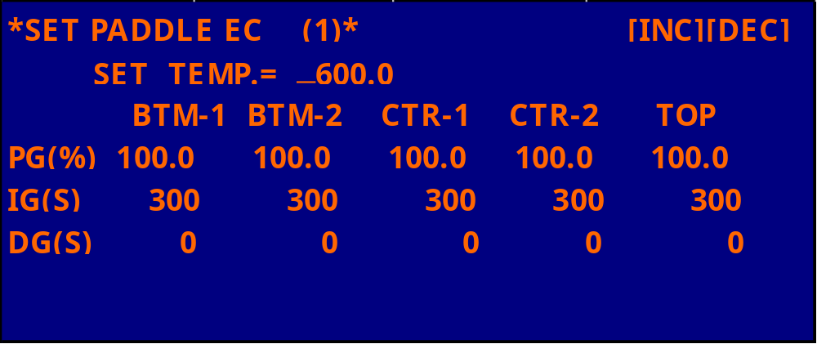
ESC
SET PID COEFFICIENTS FOR PADDLE THERMOCOUPLE

Slide 34
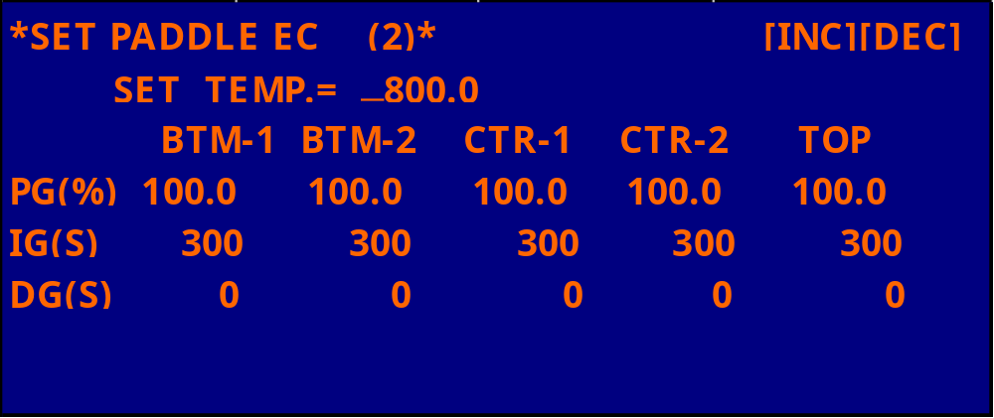
ESC

Slide 35
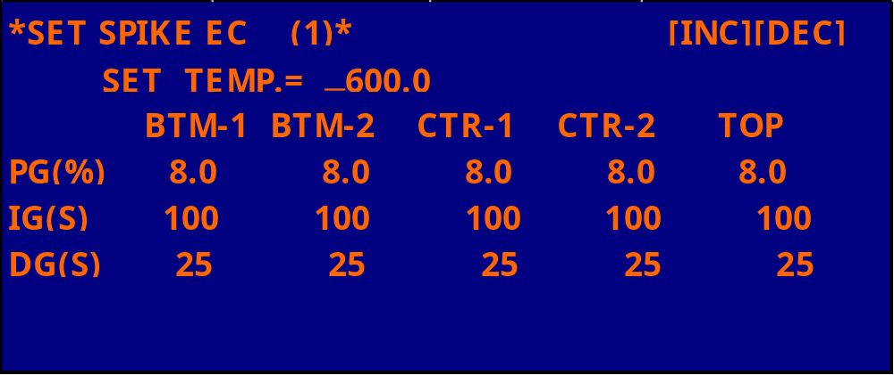
ESC
SET PID COEFFICIENTS FOR SPIKE THERMOCOUPLE

Slide 36
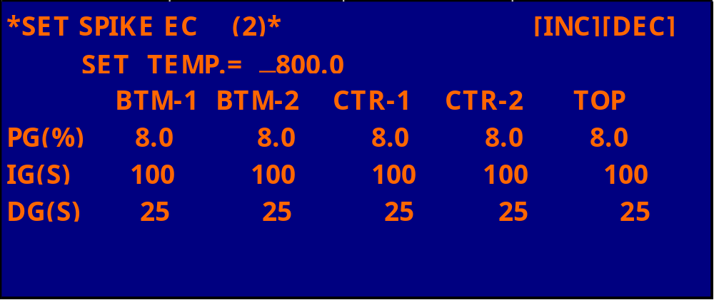
ESC

Slide 37
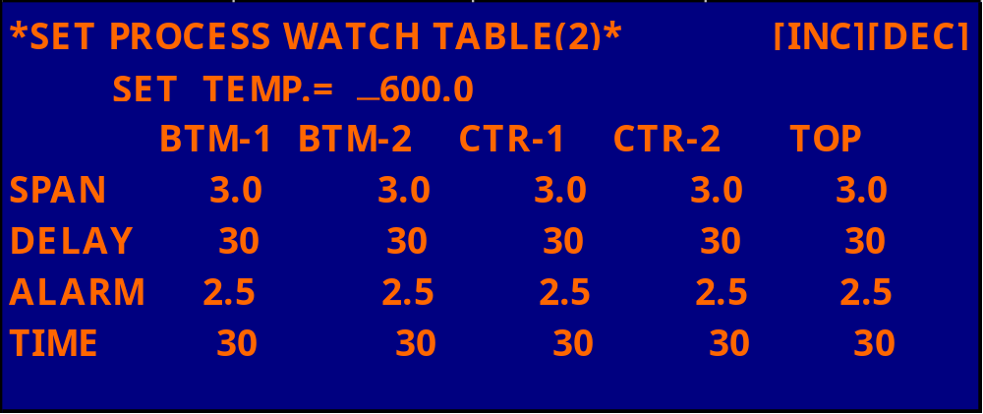
ESC
CONVER LIMIT VALUES FOR PROCESS CONTROL.
SPAN : SET CONVERGENCE LIMIT VALUE.
DELAY : SET CONVERGENCE JUDGMENT TIME.
ALARM : SET AFTER CONVERGENCE CONFIRMATION POINT CONVERGENCE MONITOR VALUE.
TIME : SET CONVERGENCE MONITOR JUDGMENT TIME.
EX : SET 600℃
597 ℃～7603 ℃ LONGER THAN 30 SEC IS TEMPTURE NULL SET IN.
AFTER TEMPTURE NULL THE TEMPERATURE RATE OF IESS THAN 597.5 ℃ OR MORE THAN 602.5 ℃ FOR
LONGER THAN 30 SECENDS WILL CAUSE THE ALARM SET IN

Slide 38
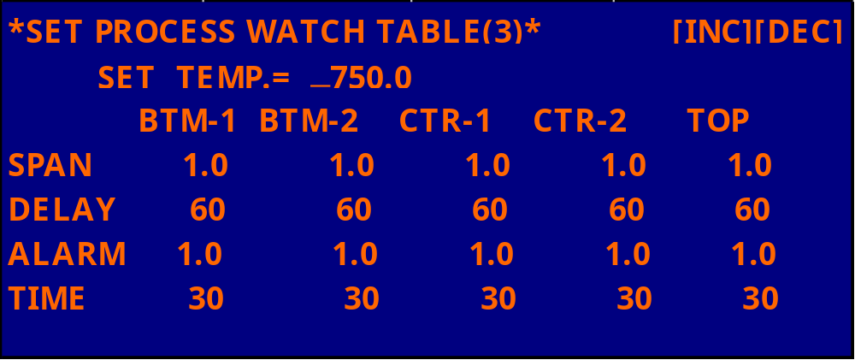
ESC
CONVER LIMIT VALUES FOR PROCESS CONTROL.
SPAN : SET CONVERGENCE LIMIT VALUE.
DELAY : SET CONVERGENCE JUDGMENT TIME.
ALARM : SET AFTER CONVERGENCE CONFIRMATION POINT CONVERGENCE MONITOR VALUE.
TIME : SET CONVERGENCE MONITOR JUDGMENT TIME.
EX : SET 750℃
749 ℃～701 ℃ LONGER THAN 30 SEC IS TEMPTURE NULL SET IN.
AFTER TEMPTURE NULL THE TEMPERATURE RATE OF IESS THAN 749 ℃ OR MORE THAN 701 ℃
FOR LONGER THAN 30 SEC WILL CAUSE THE ALARM SET IN

Slide 39
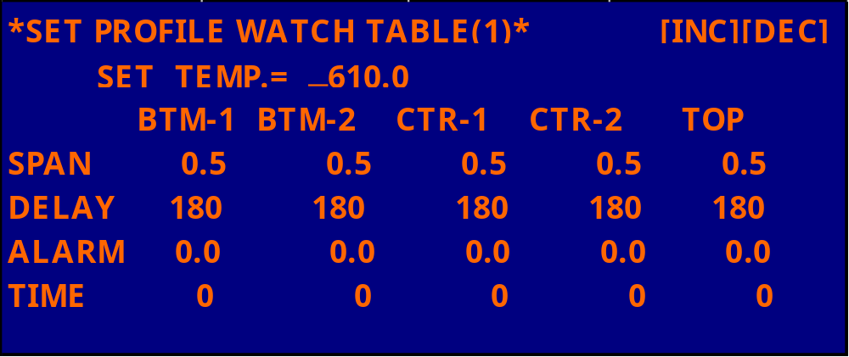
ESC
CONVER LIMIT VALUES FOR PROFILE CONTROL.
SPAN : SET CONVERGENCE LIMIT VALUE.
DELAY : SET CONVERGENCE JUDGMENT TIME.
ALARM : SET AFTER CONVERGENCE CONFIRMATION POINT CONVERGENCE MONITOR VALUE.
TIME : SET CONVERGENCE MONITOR JUDGMENT TIME.
EX : SET 610℃
609.5 ℃～610.5 ℃ AFTER 30 SEC IS TEMPTURE NULL.

Slide 40
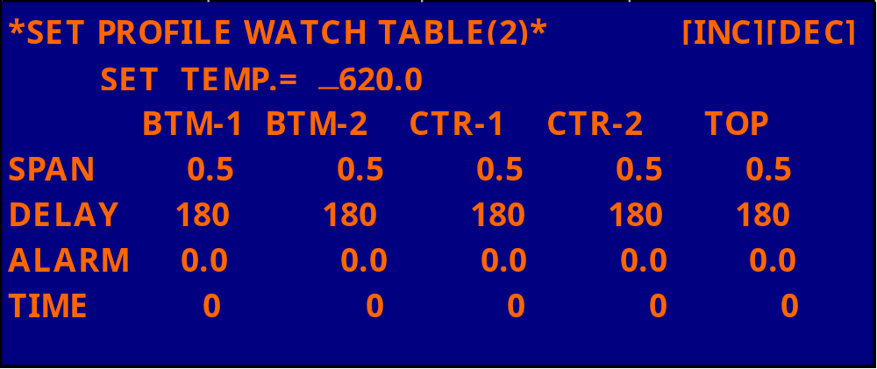
ESC
CONVER LIMIT VALUES FOR PROFILE CONTROL.
SPAN : SET CONVERGENCE LIMIT VALUE.
DELAY : SET CONVERGENCE JUDGMENT TIME.
ALARM : SET AFTER CONVERGENCE CONFIRMATION POINT CONVERGENCE MONITOR VALUE.
TIME : SET CONVERGENCE MONITOR JUDGMENT TIME.
EX : SET 620℃
619.5 ℃～620.5 ℃ AFTER 30 SEC IS TEMPTURE NULL.

Slide 41
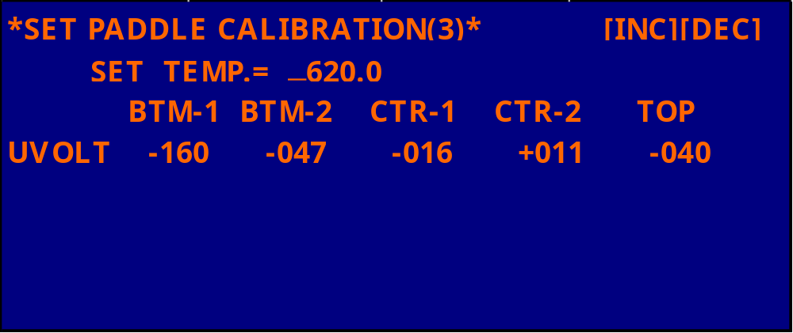
ESC
THIS IS THE CALIBRATION TABLE FOR PADDLE THERMOCOUPLES.
INPUTS ARE REGISTERED IN μ V (microvolts) .
SINCE THE FONT “μ” CANNT DISPLAYED ON TH SCREEN “ U ” IS USED INSTEAD.

Slide 42
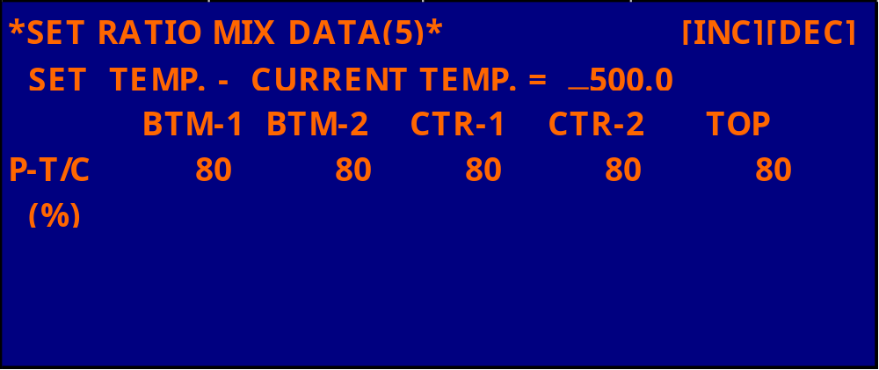
ESC
THE RATIO-MIX EXECUTES TEMPERATURE CONTROL BY MEANS OF REFERENCING BOTH THE
THERMOCOUPLE (PADDLE) AND EXTERNAL THERMOCOUPLE (SPIKE) AT THE SAME TIME.
THIS ENABLES THE FURNACE TEMPERATURE TO STABILIZE IN A SHORT TIME.
0% : THE EXTERNAL THERMOCOUPLE CONTROLS THE TEMPERATURE ONLY BY ITSELF.
100% : THE INTERNAL THERMOCOUPLE CONTROLS THE TEMPERATURE ONLY BY ITSELF.
50% : BOTH OF THE THERMOCOUPLES ARE REFERRED AT 50:50 RATIO.

Slide 43
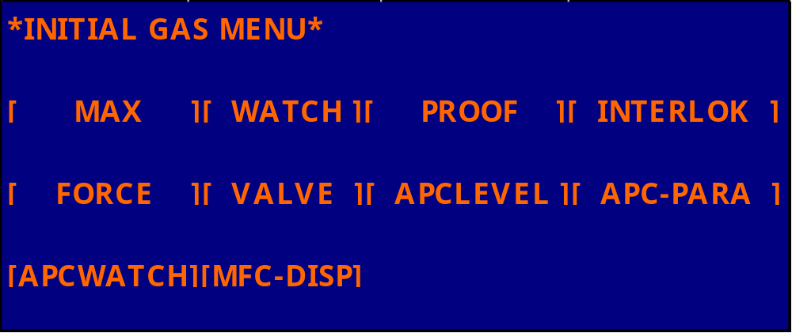
AP
ESC

Slide 44
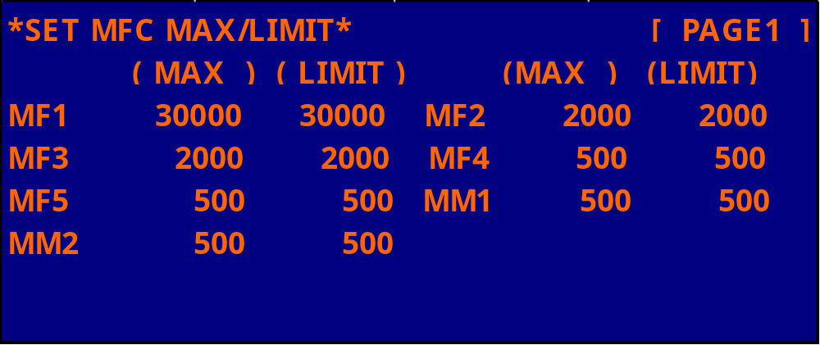
ESC
SET MFC FLOW RATE MAXIMUM
THE FLOW RATE OF AN MFC NORMALLY SET BY A SIGNAL OF 0～5V

Slide 45
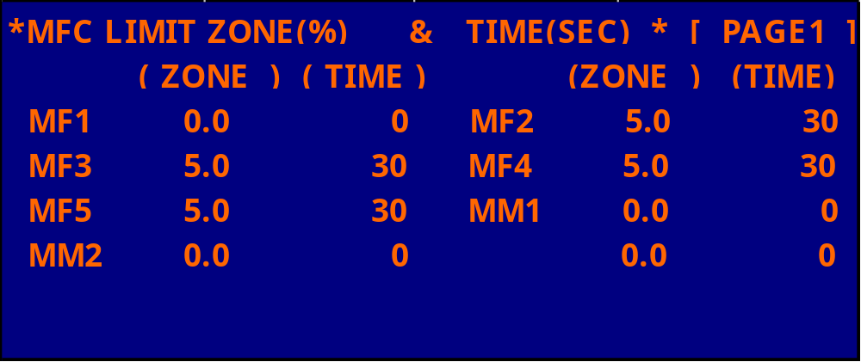
ESC
WHEN A DEVIATION OUT OF THE RANGE SET IN THE ZONE LASTSLONGERTHEN SPECIFIED TIME,
AN ALARM CONDITION SETS IN
EX: MAXIMUM FLOW RATE : 1000
SET FLOW RATE : 800
ZONE : 5%
TIME : 30 SEC
THE FLOW RATE OF IESS THAN 750 OR MORE THAN 850 CC FOR LONGER THAN 30 SEC
WILL CAUSE THE ALARM SET IN

Slide 46
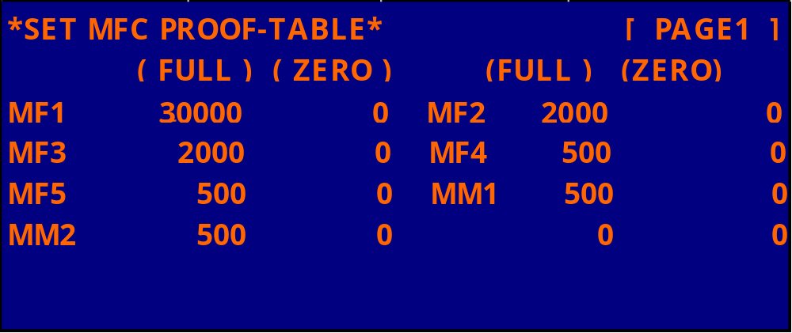
ESC

Slide 47
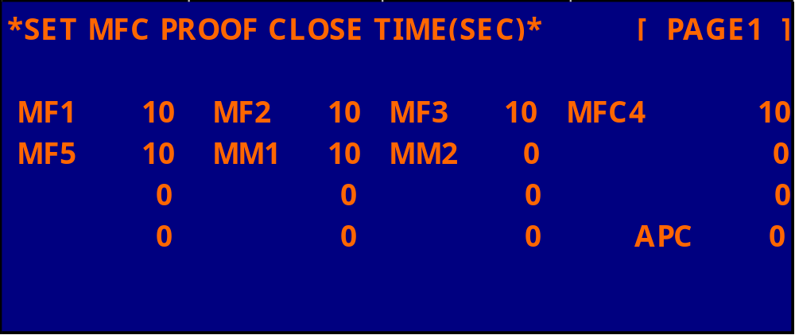
ESC
USUALLY A PERIOD OF 10～20SECONDS IS SET.
THE LARGER THR MFC RATED FLOW, THE LONGER TIME IS SET.

Slide 48
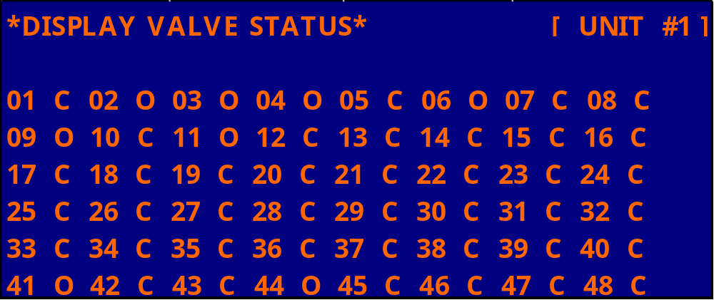
ESC
THE SPCIFICATION OF EACH VALVE (“0” FOR A NORMALLY OPENED, AND “C” FOR NORMALLY
CLOSED) IS INDICATED.
THIS DISPLAY SCREEN IS ONLY FOR DISPLAY WITHOUT ANY SETTING FUNCTION.

Slide 49
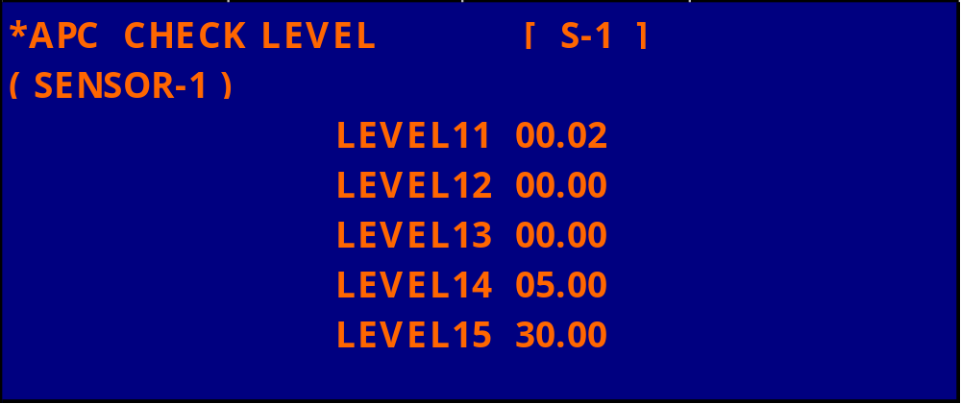
ESC

Slide 50
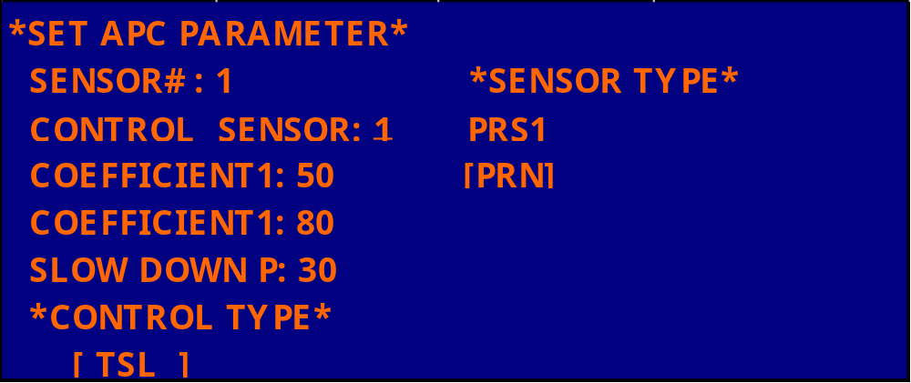
ESC
BN1 : 0～1
BN2 : 0～10
BN3 : 0～100
BN4 : 0～1000
PRN : 0～30

Slide 51
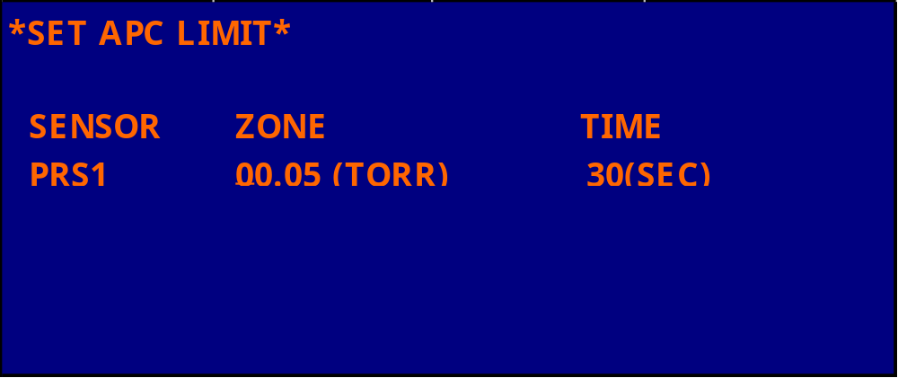
ESC
EX : SET PRESSURP : 0.53
ZONE : 0.05
TIME : 30
AN ALARM IS OUTPUT WHEN THE PRESSURE VALUE OF LESS THAN 0.48 (TORR)
OR MORE THAN 0.58 (TORR) LASTS FOR MORE THAN 30 SEC.

Slide 52
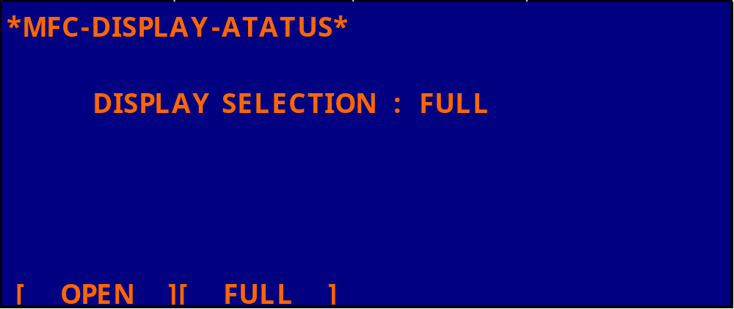
ESC

Slide 53
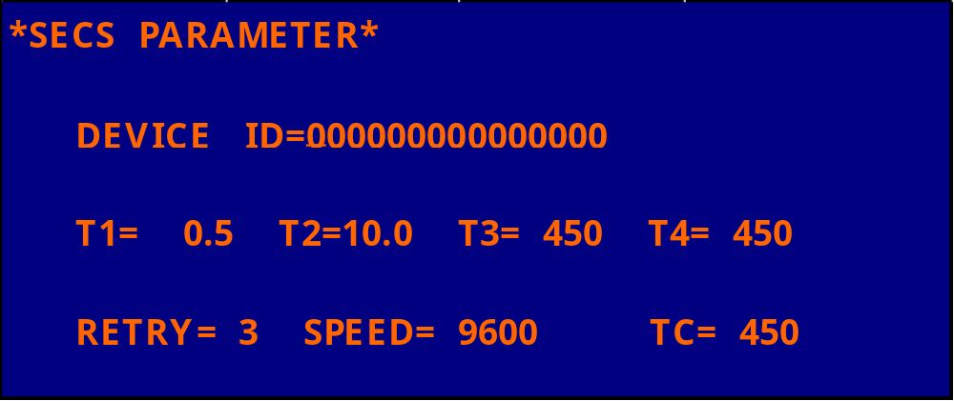
ESC

Slide 54

ESC

Slide 55

ESC

Slide 56

ESC

Slide 57

1=+5V,0=0V
ESC
LP AP
“0” NO ABORT “ 0” NO ABORT
“1” FOR ABORT 1 (JUMP ASE , AEA ) “1” FOR ABORT 1 (RECIPE 11)
“2” FOR ABORT 2 (RECIPE 11) “2” FOR ABORT 2 (RECIPE 12)
“3” FOR ABORT 3 (RECIPE 12) “3” FOR ABORT 3 (RECIPE 13)
“4” FOR REVERTING TO STANDBY (STEP 0 ) “4” FOR ABORT 4 (RECIPE 14)
“5” FOR ABORT 5 (RECIPE 15)
“6” JUMP BETWEEN THE STEPS.
“7” FOR REVERTING TO STANDBY (STEP 0 )

Slide 58

ESC

Slide 59

0: INVALID
1: VALID
ESC
EDIT MSG : EDITING MESSAGES
REV TEMP. : RESERVED TEMPERATURE SETTING
EDIT PRF. : EDITING PROFILE
SET RCP : SETTING EXECUTION RECIPES
COPY RCP : COPYING RECIPES
EDIT RCP : EDITING RECIPES
INITIAL : INITIAL SETTING

Slide 60

ESC

Slide 61

ESC

Slide 62

ESC

Slide 63

ESC

Slide 64

ESC

Slide 65

ESC

Slide 66

ESC

Slide 67

ESC

Slide 68

ESC

Slide 69

ESC

Slide 70

ESC

Slide 71

ESC

Slide 72

ESC

Slide 73

ESC

Slide 74

ESC

Slide 75

ESC

Slide 76

ESC

Slide 77

ESC

Slide 78

ESC

Slide 79

ESC

Slide 80

ESC

Slide 81

ESC

Slide 82

ESC

Slide 83

ESC

Slide 84

ESC

Slide 85

ESC

Slide 86
ESC

Slide 87
ESC

