Slide 1
爐管新人週報
2024.09.09 ~ 2024.09.20
吳致佑
Notes:
115/11/07
Confidential

Slide 2
報告內容
一、兩週內學習內容
二、GRD 簡介
三、GRD MPM
四、OSC-2 MPM
五、OSC-1 MPM
六、貼膠機
七、撕膠機
八、結論

Slide 3
一、兩週內學習內容
日期 | 機台 | PM項目 | 內容
2024.09.09 | LP-N6 | 4PM | Replace DCS regulator
2024.09.10 | GRD | MPM | Introduce GRD
2024.09.11 | LP-P6 | 1PM | Install tube
2024.09.12 | LP-P3 | SPM | Do SPM together
2024.09.13 | LP-N5 | SPM | Do SPM together
2024.09.16 | LP-N3 | SPM | Do SPM together
2024.09.17 | None | None | Celebrate for moonfestival
2024.09.18 | LP-N3 | 4PM | Hands-on
2024.09.19 | LP-T2 | 3PM | Clean APC, MV and take course in statistics
2024.09.20 | GRD | MPM | Hands-on

Slide 4
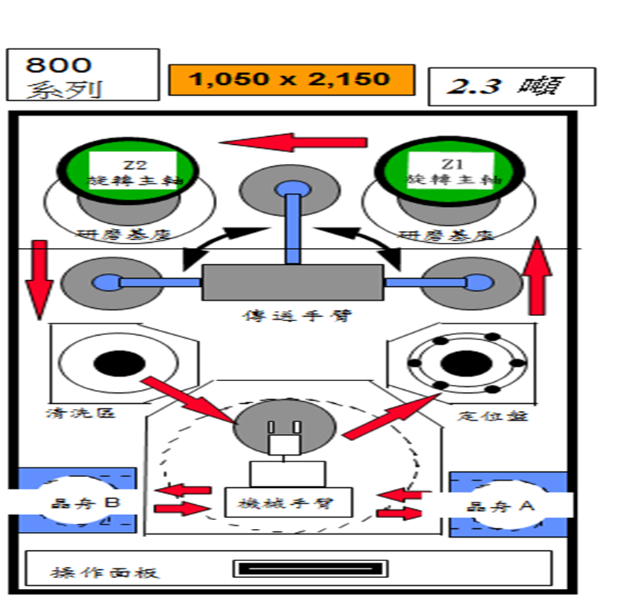
二、GRD 簡介

Slide 5
三、GRD MPM
STEP1：make spindle stopped
STEP2：let spindle move up and clean GRD machine
STEP3：check Z1、Z2 usable tooth and record
STEP4：check H-Gauge 是否符合 100±10μm

Slide 6
STEP5：check T-ARM motions
STEP6：check Z1、Z2 brash rotation 不會 to bump into
M-pad and Chuck table
STEP7：to do machine initial → to start warming up the machine
STEP8：test transfer by using the recipe “ bypass Z1/Z2 ”

Slide 7
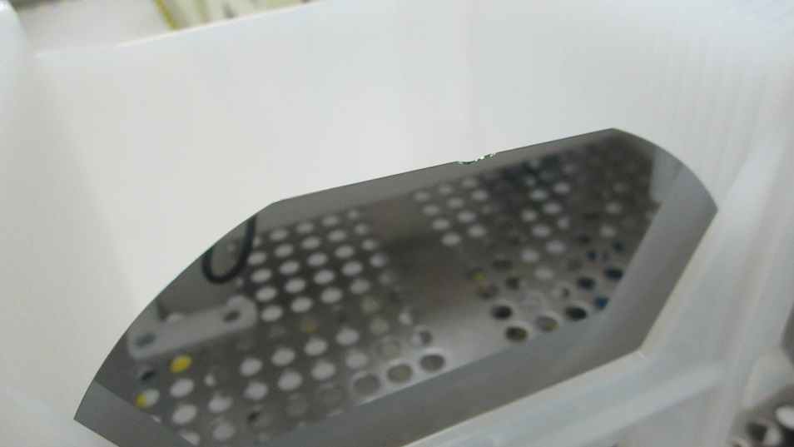
STEP9：根據 “item table”, check vacuum setting value
STEP10：select recipe to do grinding test run(11.5Mil/20.0Mil)
STEP11：measure wafer thickness by using Outside Micrometer(分厘卡尺)
Grinding notch

Slide 8
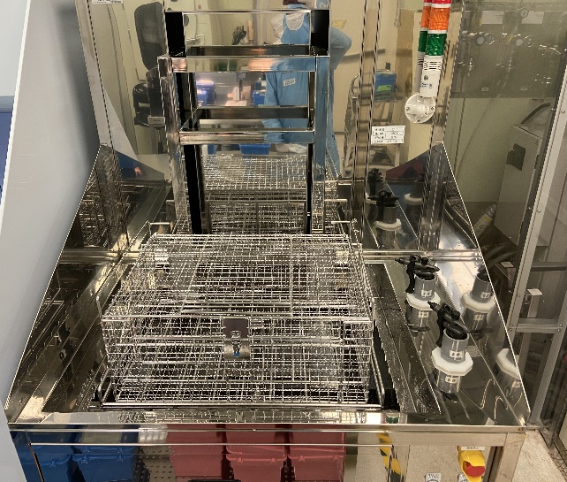
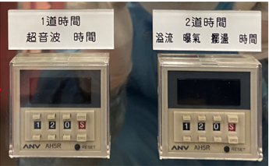
四、OSC-2 MPM
進行空LOAD，讓機台清洗一次、Clean DI TANK & Basket
注意：嚴禁將GaN使用之晶舟、晶舟盒與一般晶舟、晶舟盒混 RUN。

Slide 9
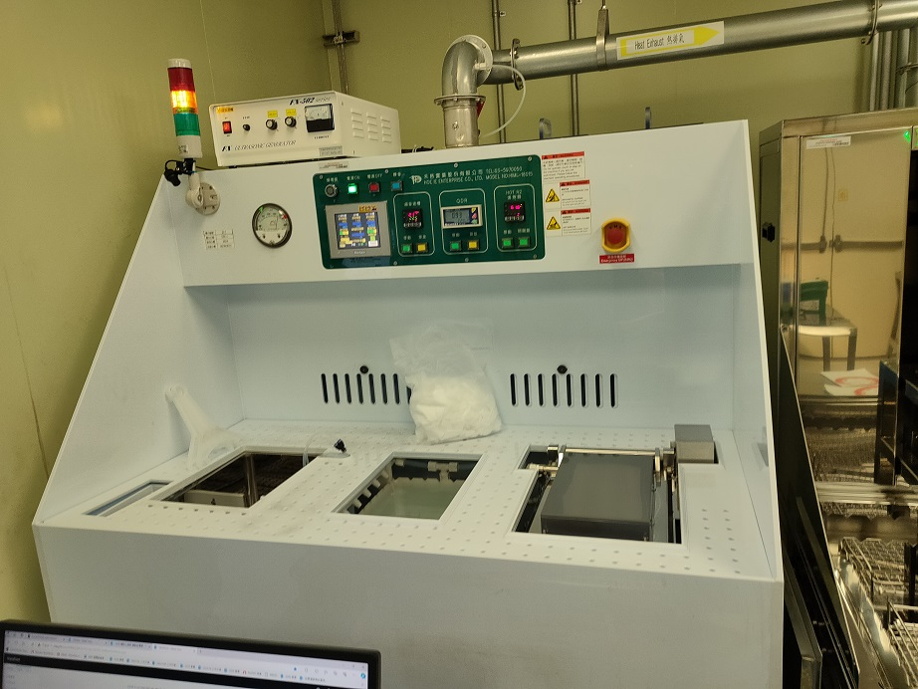
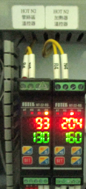
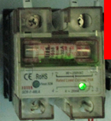

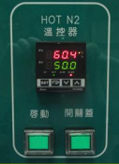
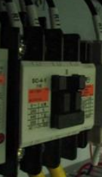
五、OSC-1 MPM
STEP1：Clean 左中右 Three TANK
STEP2：Check interlock
STEP3：Check interlock
OVER TEMP.
Green light off
OVER TEMP.
ALARM、MEGNETIC跳脫

Slide 10
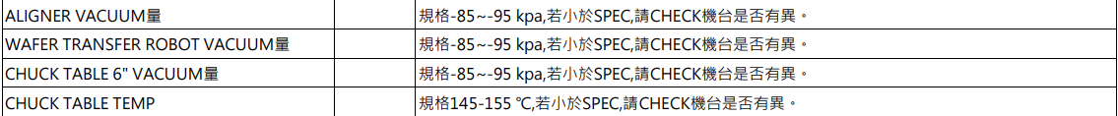
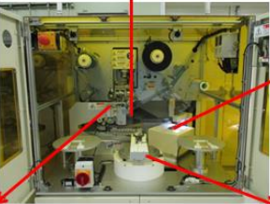

六. 貼膠機
STEP1：Clean chuck table、Aligner、Roller
STEP2：test run 幾片, Check 切膠完整度、有無氣泡…etc
STEP3：Check vacuum setting value

Slide 11
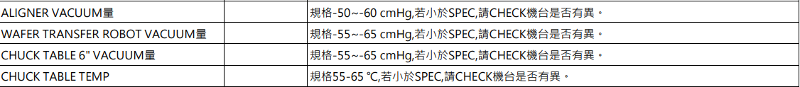
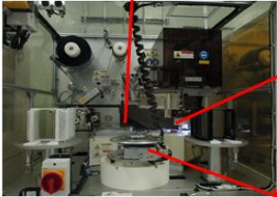
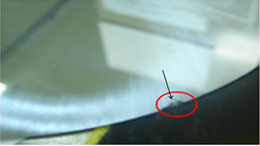
七. 撕膠機
STEP1：Clean chuck table、Aligner、Roller
STEP2：test run 幾片, Check 撕膠後，有無缺角、破片、刮傷…etc
STEP3：Check vacuum setting value
Wafer notch

Slide 12
八.結論(目前為止熟悉知識)
Type | progress | Need more practice
LP-P SPM | 100% | NONE
LP-T SPM | 100% | NONE
LP-N SPM | 100% | NONE
LP-P BPM | 85% | manifold、cap、shutter、inner tube、outer tube、injector、pressure bellow Burn box.
LP-T BPM | 85%
LP-N BPM | 85% | manifold、cap、shutter、inner tube、outer tube、injector、pressure bellow
GRD MPM | 85% | OSC-1
WSIX BPM | 50% | NO hands-on experience
AP YPM | 0% | NONE
RTP 25PM | 0% | NONE
EM MPM | 0% | NONE
KOYO YPM | 0% | NONE
Notes:
115/11/07
Confidential

Slide 13
Thanks for your patience

