Slide 1
爐管新人週報
2024.09.23 ~ 2024.10.04
吳致佑
Notes:
115/11/07
Confidential

Slide 2
報告內容
一、兩週內學習內容
二、CLEAN WSIX BURN BOX 大致程序
三、POLY 內、外管
四、LP-BPM(e.g.：LP-P6 5BPM)程序
五、LP-NITRIDE 轉子清潔
八、結論

Slide 3
一、兩週內學習內容
日期 | 機台 | PM項目 | 內容
2024.09.23 | LP-N7 | SPM | Do SPM together
2024.09.24 | None | None | Take a course on how to wear protective clothing
2024.09.25 | GRD | MPM | Do MPM together
2024.09.26 | LP-P4 | 3PM | 跟著歐陽學長、take course in statistics
2024.09.27 | None | None | 跟著歐陽學長
2024.09.30 | RTP | None | Uninstall cooler
2024.10.01 | WSIX | MPM | Clean burn box
2024.10.02 | None | None | Typhoon day-off
2024.10.03 | None | None | Typhoon day-off
2024.10.04 | LP-T2 | SPM | Do SPM together

Slide 4
二、CLEAN WSIX BURN BOX 大致程序
1. 將機台程式Stop
2. 將四個Chamber Offline and Close Throttle Valve
3. To 1F Clean Burn Box
4. 將螺帽 & Spring拆下 → 拆下Cover 用 Low Vacuum 吸起 Powder
5. Clean完畢再將Cover & Spring & 螺帽鎖緊
6. 將機台復歸
補充：Clean A64 Burn Box時，先將Vesda警報關閉

Slide 5
三、LP-BPM(e.g.：LP-P6 5BPM)程序
Close 208V Power
卸下 Boat 、 pedestal(5fin+7fin)、pedestal cover、dust tray、T/C port cover
拆下 shutter、 PSI接頭、vacuum pipe、SIH4(1)L=950mm and SIH4(2)L=310mm injector、pressure bellow
放置 inner tube jig in capping flange and 往上 to unload inner tube
降下 B/E to P01 slowly and then bring inner tube to 洗管間 by using cart

Slide 6
拆下 N2 injector 、T/C(Poly為Injector cap)、manifold water bellow
7. 放置 outer tube jig in capping flange and 往上 to unload outer tube(當cap與manifold之gap約為1mm時 → 拆除4顆Screw → B/E to P01)
8. 降下 B/E to P01 slowly → 依序拆下Holder、Teflon ring、tube and bring tube to 洗管間 by using cart
9. 拆下 小砲管、MV、大砲管、APC、SV、VV1 and VV2
清潔 MV、APC、replace new O-ring、砲管口
Test APC OPEN：490~510 & CLOSE：20~30、MV是否正常收縮
12. 裝回outer tube、inner tube、injector 、pressure bellow、manifold water bellow

Slide 7
13. 裝回大砲管、APC、vacuum pipe、小砲管、MV、SV、VV1、VV2
14. 裝回Boat 、 pedestal(5fin+7fin) 、pedestal cover、dust tray
15. Check transfer、承接、括管
16. To 1F clean Burn box 、 Exhaust pipe
Open pump and 水管
Purge → Test leak rate(高、低溫)，若有漏 => 使用測漏儀測漏
Check cap flowmeter
Perform Auto Purge and then follow EA test run

Slide 8
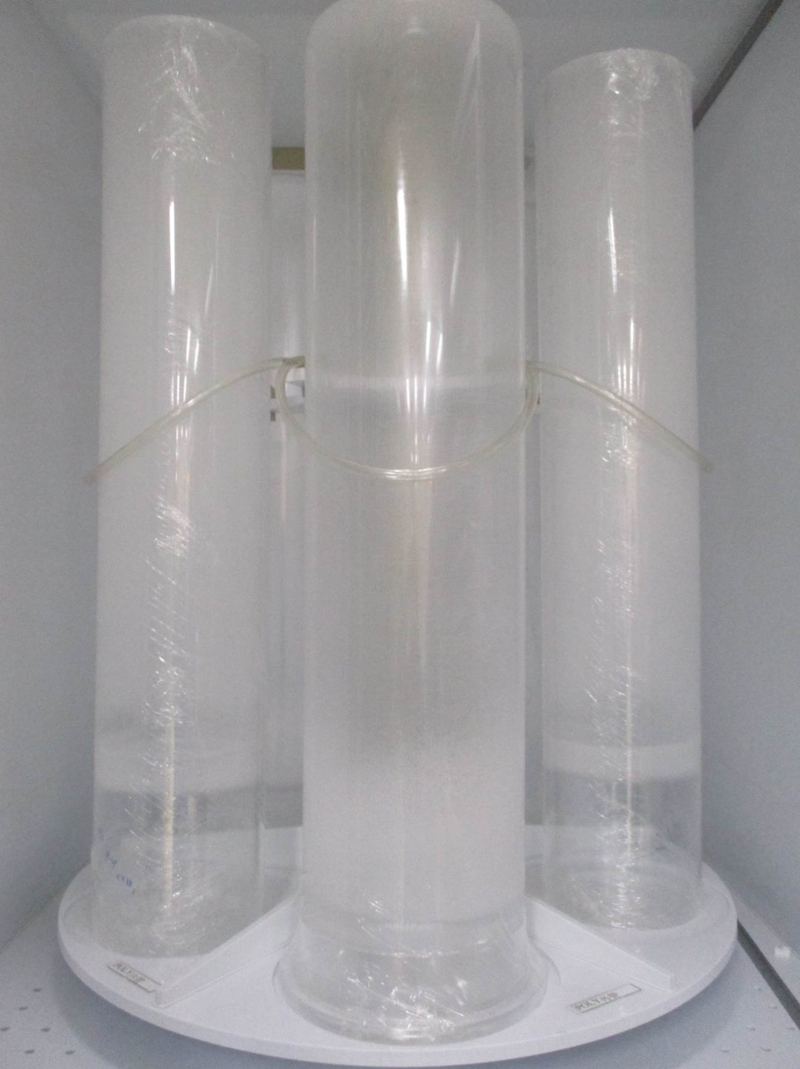
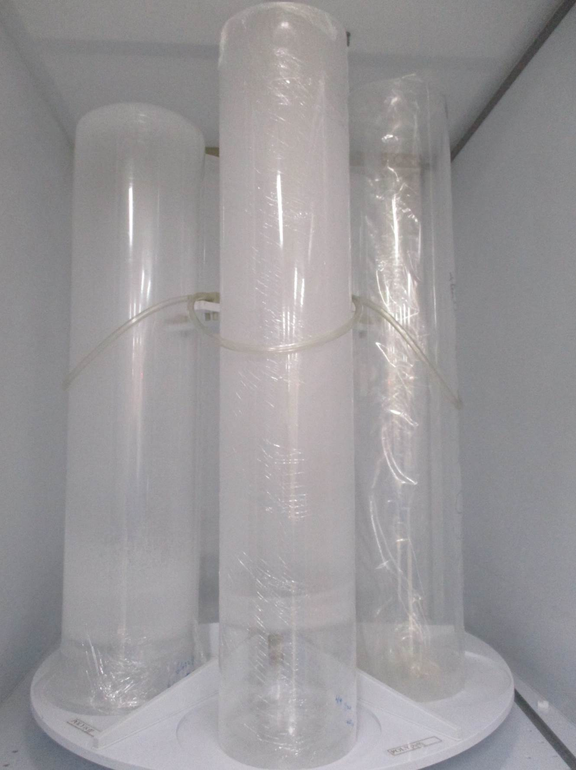
四、POLY 內、外管
Outer tube
Inner tube

Slide 9
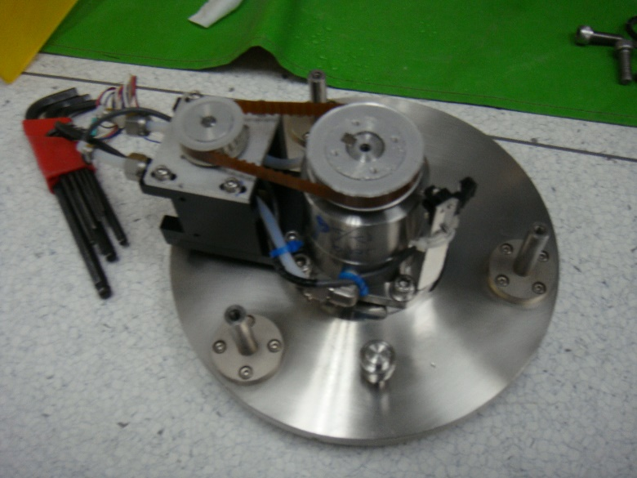
五、LP-NITRIDE 轉子清潔
Close cap water 、check flowmeter
將水管、motor、sensor拔除
壓住cap拆除下方3顆screws
拆除固定轉子的4顆screws，並將轉子上的coating刮除、replace new O-ring
將轉子組回後，將cap裝回
組回水管、motor、sensor，並測是否會漏水

Slide 10
八.結論(Furnace PM progression)
Type | progress | Need more practice
LP-P SPM | 100% | NONE
LP-T SPM | 100% | NONE
LP-N SPM | 100% | NONE
LP-P BPM | 85% | manifold、cap、shutter、inner tube、outer tube、injector、pressure bellow
LP-T BPM | 85%
LP-N BPM | 85% | manifold、cap、shutter、inner tube、outer tube、injector、pressure bellow
GRD MPM | 85% | OSC-1
WSIX BPM | 50% | NO hands-on experience
AP YPM | 0% | NONE
RTP 25PM | 0% | NONE
EM MPM | 0% | NONE
KOYO YPM | 0% | NONE
TEOS BOTTLE | 0% | NONE
RTP-M | 0% | NONE
TRANS-LC | 0% | NONE
Notes:
115/11/07
Confidential

Slide 11
Thanks for your patience

