Slide 1
爐管新人學習進度報告
2023.08.08 ~ 2020.08.22
Notes:
115/11/08
Confidential

Slide 2
報告內容
一、

Slide 3
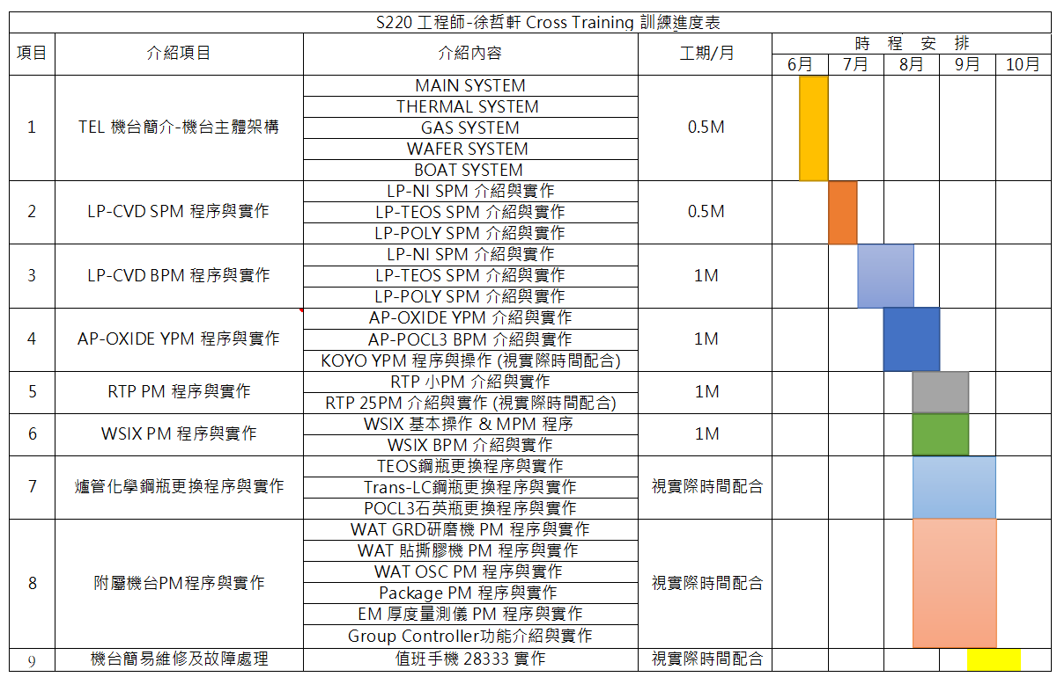
學習進度

Slide 4
紀錄ABORT原因、步驟、時間
ALARM紀錄表
當下機台的ALARM
STATUS
查看溫度
查看氣體流量
跳步驟時會用到
DISPLAY
OFF
READ
MAIL
ALARM
ABORT
POWER
FAIL
STANDBY
ALARM
LOG
TEMP
GAS
WHOLE
WRITE
MAIL
SET
R.TEMP
EDIT
PROFILE
SET
COPY
EDIT
SET
INITIAL
SET
CLOCK
SET
V.DATA
ESC
離開
查看PROFILE溫度補償值
RECIPE
RECIPE選擇、複製、編輯

Slide 5
二、M3200介面
7
8
9
CAL
4
5
6
-
1
2
3
+
0
SPACE
ENTER
NEXT
START
END
RESET
HOLD
SKIP
MANUAL
ALARM
RESET
EMG
ABORT
ON-
LINE
REMOTE
POWER

Slide 6
紀錄ABORT原因、步驟、時間
ALARM紀錄表
當下機台的ALARM
STATUS
查看溫度
查看氣體流量
跳步驟時會用到
DISPLAY
OFF
READ
MAIL
ALARM
ABORT
POWER
FAIL
STANDBY
ALARM
LOG
TEMP
GAS
WHOLE
查看壓力及APC角度
DISPLAY
MANUAL
PRESS
可開關APC及自定義APC角度、氣體流量、壓力大小
WRITE
MAIL
SET
R.TEMP
EDIT
PROFILE
SET
COPY
EDIT
SET
INITIAL
SET
CLOCK
SET
V.DATA
ESC
離開
查看PROFILE溫度補償值
RECIPE
RECIPE選擇、複製、編輯

Slide 7
三、Initial setting介紹
DISPLAY
OFF
READ
MAIL
ALARM
ABORT
POWER
FAIL
STANDBY
ALARM
LOG
TEMP
GAS
WHOLE
DISPLAY
MANUAL
*INITIAL SET MENU*
[SET-NAME] [SET-TEMP] [SET-GAS] [SET-COMM]
[SET-PSON] [SET-ALAM] [SET-PASS] [ SET-EMG ]
[ INI-TIME ] [ SET-I/O ] [ SWITCH ] [ SET-ZONE ]
PRESS
WRITE
MAIL
SET
R.TEMP
EDIT
PROFILE
SET
COPY
EDIT
SET
INITIAL
SET
CLOCK
SET
V.DATA
ESC
按下，輸入2707即可進入

Slide 8
SET-NAME介紹
可以更改MFC的名稱
DISPLAY
OFF
READ
MAIL
ALARM
ABORT
POWER
FAIL
STANDBY
ALARM
LOG
TEMP
GAS
WHOLE
DISPLAY
MANUAL
*INITIAL NAME MENU*
[ TEMP ] [ MFC ] [ RECIPE ] [ ALARM ]
PRESS
可以更改ZONE的名稱
可以更改ALARM的名稱
WRITE
MAIL
SET
R.TEMP
EDIT
PROFILE
SET
COPY
EDIT
SET
INITIAL
SET
CLOCK
SET
V.DATA
ESC
可以更改RECIPE的名稱

Slide 9
DISPLAY
OFF
READ
MAIL
ALARM
ABORT
POWER
FAIL
STANDBY
ALARM
LOG
TEMP
GAS
WHOLE
DISPLAY
MANUAL
*INITIAL TEMPERATURE MENU*
[ PDL-EC ] [ SPK-EC ] [WATCH-A] [WATCH-B]
[ PDL-CAB ] [ R-MIX ]
PRESS
WRITE
MAIL
SET
R.TEMP
EDIT
PROFILE
SET
COPY
EDIT
SET
INITIAL
SET
CLOCK
SET
V.DATA
ESC

Slide 10
DISPLAY
OFF
READ
MAIL
ALARM
ABORT
POWER
FAIL
STANDBY
ALARM
LOG
TEMP
GAS
WHOLE
DISPLAY
MANUAL
*INITIAL GAS MENU*
[ MAX ] [ WATCH ] [ PROOF ] [INTERLOK]
[ FORCE ] [ VALVE ] [APCLEVEL] [ APC-PARA ]
[APCWATCH] [MFC-DISP]
PRESS
WRITE
MAIL
SET
R.TEMP
EDIT
PROFILE
SET
COPY
EDIT
SET
INITIAL
SET
CLOCK
SET
V.DATA
ESC

Slide 11
DISPLAY
OFF
READ
MAIL
ALARM
ABORT
POWER
FAIL
STANDBY
ALARM
LOG
TEMP
GAS
WHOLE
DISPLAY
MANUAL
*INITIAL ALARM MENU(01)* [INC][DEC]
[ EXCESS ] [ SCROVR ] [ CHMOVR ] [ WATER ]
[ PSDOWN ] [ SMOKE ] [ EXHUST ] [ TRANS ]
[ P-T/C1 ] [ P-T/C2 ] [ P-T/C3 ] [ P-T/C4 ]
PRESS
WRITE
MAIL
SET
R.TEMP
EDIT
PROFILE
SET
COPY
EDIT
SET
INITIAL
SET
CLOCK
SET
V.DATA
ESC
DISPLAY
OFF
READ
MAIL
ALARM
ABORT
POWER
FAIL
STANDBY
ALARM
LOG
TEMP
GAS
WHOLE
*SET ALARM CONDITION [INC][DEC]
I-MASK(1-ON,0-OFF) 0
I-HOLD(1-ON,0-OFF) 0
EXCESS-I-LEVEL(1-HIGH,0-LOW) 1
I-ABORT(0-7) 0
I-DELAY(00-99SEC) 2
是否顯示ALARM
DISPLAY
MANUAL
PRESS
動作是否暫停
3100:
0是不動做，1是ABORT1程式，2是ABORT2程式
3200:
0是不動做，1是執行內跳，2是ABORT1程式，3是ABORT2程式
持續幾秒後會發出ALARM
WRITE
MAIL
SET
R.TEMP
EDIT
PROFILE
SET
COPY
EDIT
SET
INITIAL
SET
CLOCK
SET
V.DATA
ESC

Slide 12
DISPLAY
OFF
READ
MAIL
ALARM
ABORT
POWER
FAIL
STANDBY
ALARM
LOG
TEMP
GAS
WHOLE
DISPLAY
MANUAL
*SET PASSWORD*
1.EDIT MSG. 0 XXXX 6.EDIT RCP 1 3027
2.REV REMP. 0 XXXX 7.INITIAL 1 2707
3.EDIT PRF . 1 3027
4.SET RCP 1 200
5.COPY RCP 1 3027
PRESS
WRITE
MAIL
SET
R.TEMP
EDIT
PROFILE
SET
COPY
EDIT
SET
INITIAL
SET
CLOCK
SET
V.DATA
ESC

Slide 13
DISPLAY
OFF
READ
MAIL
ALARM
ABORT
POWER
FAIL
STANDBY
ALARM
LOG
TEMP
GAS
WHOLE
DISPLAY
MANUAL
*SELECT ABORT NO. FOR EMG ABORT SW.*
[ NOT USED] [ABORT-01] [ABORT-02] [ABORT-03]
[STANDBY]
CURRENT MODE IS STANDBY
PRESS
選擇按下EMG ABORT會執行哪個動作
WRITE
MAIL
SET
R.TEMP
EDIT
PROFILE
SET
COPY
EDIT
SET
INITIAL
SET
CLOCK
SET
V.DATA
ESC

Slide 14
DISPLAY
OFF
READ
MAIL
ALARM
ABORT
POWER
FAIL
STANDBY
ALARM
LOG
TEMP
GAS
WHOLE
DISPLAY
MANUAL
*INITIAL SET MENU*
[SET-NAME] [SET-TEMP] [SET-GAS] [SET-COMM]
[SET-PSON] [SET-ALAM] [SET-PASS] [ SET-EMG ]
[ INI-TIME ] [ SET-I/O ] [ SWITCH ] [ SET-ZONE ]
PRESS
可以選擇分成3/4/5個ZONE
WRITE
MAIL
SET
R.TEMP
EDIT
PROFILE
SET
COPY
EDIT
SET
INITIAL
SET
CLOCK
SET
V.DATA
ESC
選擇連接的裝置
選擇REMOTE模式和是否啟用ON-LINE KEY

Slide 15
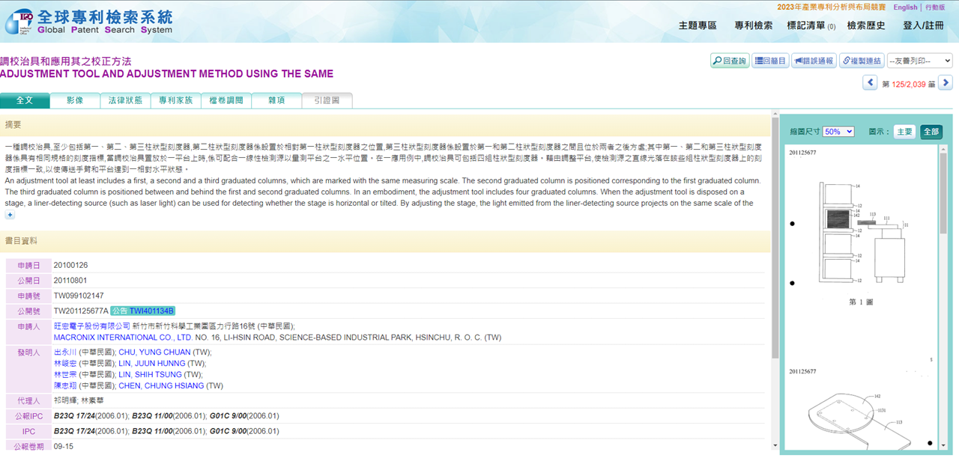

Slide 16
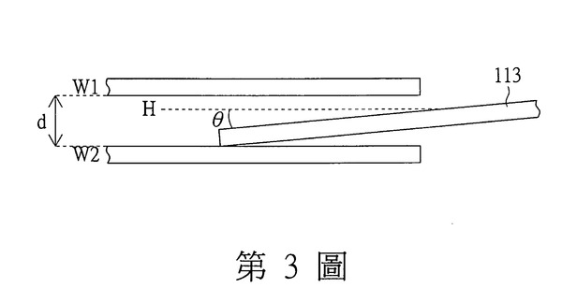
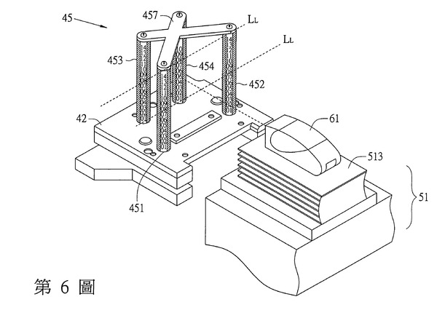
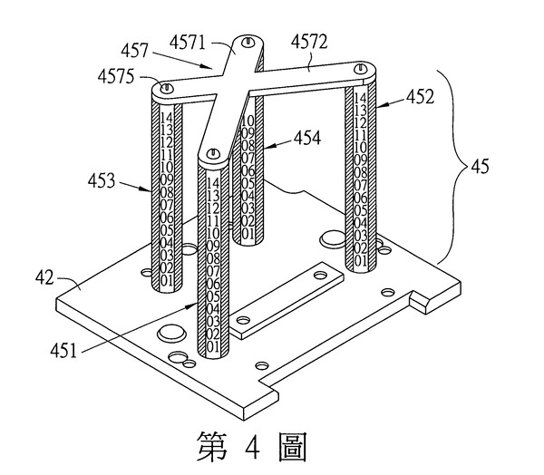
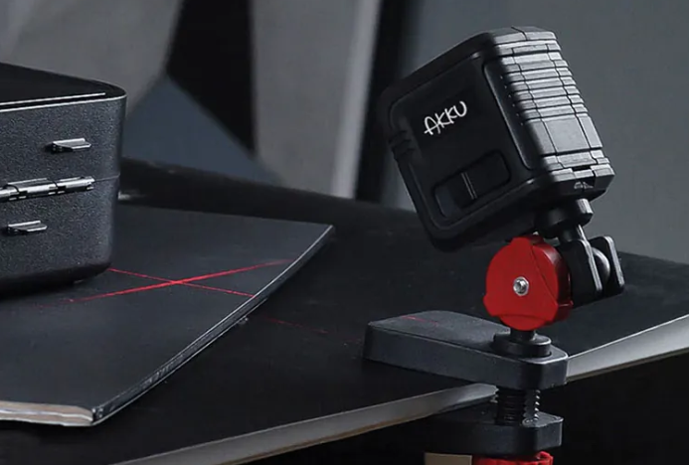

Slide 17
Thank you

