Slide 1
爐管新人學習進度報告
2024.09.09 ~ 2024.09.20

Slide 2
報告內容
一、兩週內學習內容
二、日常交接的專業英文及縮寫
三、PM更換時機
四、PM更換Parts項次
五、VL-800說明
六、VL-800 M01~M06作動
七、承接
八、 T-BAWL ONE MOTION 單軸作動
九、T-BAWL CHECK傳送操作
4

Slide 3
兩週內學習內容
日期 | 課程 | 機台 | 內容
2024/9/09 | None | LP-N6 | 4PM
2024/9/10 | None | GRD-2 | MPM
2024/9/11 | None | LP-P6 | 1PM
2024/9/12 | 基本統計學 | LP-P3 | SPM
2024/9/13 | None | LP-N5 | SPM
2024/9/16 | None | LP-N3 | SPM
2024/9/17 | None | None | None
2024/9/18 | None | LP-N1 | 4PM
2024/9/19 | 基本統計學 | LP-T2 | 3PM
2024/9/20 | 危害性化學品標示及通識規則 | 機台標籤 | 6S
2024.06.03 ~ 2024.06.14

Slide 4
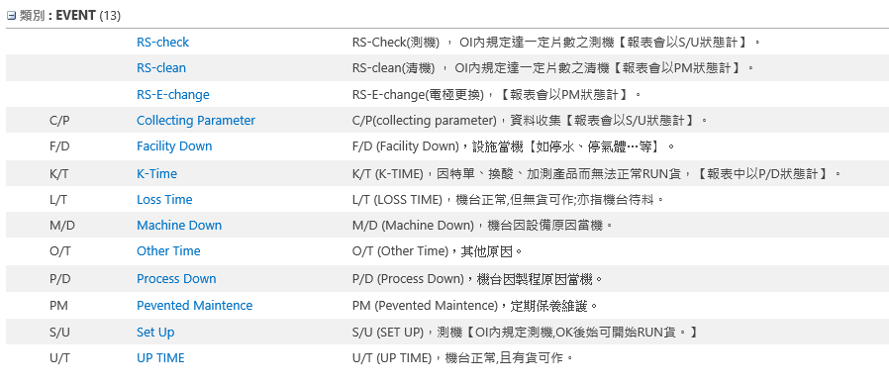
日常交接的專業英文及縮寫

Slide 5
爐管PM時機
LP-POLY：
9 μm±1 → SPM
19 μm±1 → BPM
2*SPM → BPM (1PM)
2*SPM → BPM (2PM)
2*SPM → BPM (3PM)
SPM → BPM (1PM)
SPM → BPM (2PM)
SPM → BPM (3PM)
SPM → BPM (4PM)
SPM → BPM (5PM)
LP-TEOS：
9 μm±1 → SPM
18 μm±1 → SPM
27 μm±1 → BPM
(THIN SIN)
150±15 run → SPM
300±30 run → BPM
LP-NITRIDE：
(SIN)
40±8 run → SPM
80±16 run → SPM
120±12 run → BPM
SPM → BPM (1PM) SPM → BPM (2PM) SPM → BPM (3PM) SPM → BPM (4PM)

Slide 6
PM更換Parts項次
POLY
 | Transfer | Boat | 保溫筒 | (NW50)pipe | Manifold 賓士盤 Cap Shutter | 內管 外管 | Injector 120mm 310mm 950mm | MV | APC + Pumping line | QSV | Burn box
 | Check | 更換 | 更換 | 更換 & Clean | Clean | 更換 | 更換 | Clean & Check | Clean | 更換 | Clean
SPM | ● | ●
BPM(1PM) | ● | ● | ● | ● | ● | ● | ●
SPM | ● | ●
BPM(2PM) | ● | ● | ● | ● | ● | ● | ●
SPM | ● | ●
BPM(3PM) | ● | ● | ● | ● | ● | ● | ●
SPM | ● | ●
BPM(4PM) | ● | ● | ● | ● | ● | ● | ●
SPM | ● | ●
BPM(5PM) | ● | ● | ● | ● | ● | ● | ● | ● | ● | ● | ●
*LP-P1、2、3、4、6 BOAT 為SIC
Leak rate
SPEC: ≦ 0.00Torr / 130sec
*LP-P7 BOAT 為QUARTZ

Slide 7
 | Transfer | BOAT (SIC) | (5+7)Fin pedestal 保溫筒 | (NW50)pipe bellow | Cold trap | Manifold 賓士盤 Cap Spindle Shutter | 內管 | 外管 | Pressure bellow | Injector 25mm 45mm 500mm | MV | APC + pumping line
 | Check | 更換 | 更換 | 更換 & Clean | 更換 | Clean | 更換 | 更換 | Clean | 更換 | Clean & Check | Clean
SPM | ● |  |  | ● | ●
SPM | ● |  |  | ● | ●
BPM(1PM) | ● | ● | ● | ● | ● | ● | ● | ● | ● | ●
SPM | ● |  |  | ● | ●
SPM | ● |  |  | ● | ●
BPM(2PM) | ● | ● | ● | ● | ● | ● | ● | ● | ● | ●
SPM | ● |  |  | ● | ●
SPM | ● |  |  | ● | ●
BPM(3PM) | ● | ● | ● | ● | ● | ● | ● | ● | ● | ●
SPM | ● |  |  | ● | ●
SPM | ● |  |  | ● | ●
BPM(4PM) | ● | ● | ● | ● | ● | ● | ● | ● | ● | ● | ● | ●
Nitride 厚
LP-N3 LP-N4 LP-N5 LP-N7
Leak rate
SPEC: ≦ 0.03Torr / 130sec
LP-N1 依產能需求切換厚 or 薄，厚薄切換需要test run
 | Transfer | BOAT (SIC) | (5+7)Fin pedestal 保溫筒 | (NW50)pipe bellow | Cold trap | Manifold 賓士盤 Cap Spindle Shutter | 內管 | 外管 | Pressure bellow | Injector 25mm 45mm 500mm | MV | APC + pumping line
 | Check | 更換 | 更換 | 更換 & Clean | 更換 | Clean | 更換 | 更換 | Clean | 更換 | Clean & Check | Clean
SPM | ● | ● | ● | ● | ●
BPM(1PM) | ● | ● | ● | ● | ● | ● | ● | ● | ● | ●
SPM | ● | ● | ● | ● | ●
BPM(2PM) | ● | ● | ● | ● | ● | ● | ● | ● | ● | ●
SPM | ● | ● | ● | ● | ●
BPM(3PM) | ● | ● | ● | ● | ● | ● | ● | ● | ● | ●
SPM | ● | ● | ● | ● | ●
BPM(4PM) | ● | ● | ● | ● | ● | ● | ● | ● | ● | ● | ● | ●
Nitride 薄
LP-N2 LP-N6

Slide 8
TEOS
 | Transfer check | BOAT (SIC) | 5 fin Pedestal 保溫筒 | (NW50)pipe (NW50)銜接環 bellow | Cold trap | Manifold 賓士盤 Cap Shutter | 內管 | 外管 | Injector 平口 25mm 1000mm | Pressure bellow | MV | APC + pumping line | QSV | Burn box
 | Check | 更換 | 更換 | 更換 & Clean | 更換 | Clean | 更換 | 更換 | 更換 | Clean | Clean & Check | Clean | 更換 | Clean
SPM | ● | ● | ● | ● | ●
SPM | ● | ● | ● | ● | ●
BPM(1PM) | ● | ● | ● | ● | ● | ● | ● | ● | ● | ●
SPM | ● | ● | ● | ● | ●
SPM | ● | ● | ● | ● | ●
BPM(2PM) | ● | ● | ● | ● | ● | ● | ● | ● | ● | ●
SPM | ● | ● | ● | ● | ●
SPM | ● | ● | ● | ● | ●
BPM(3PM) | ● | ● | ● | ● | ● | ● | ● | ● | ● | ● | ● | ● | ● | ●
*LP-T1、2、3、4、5、6、8 BOAT 為SIC
Leak rate
SPEC: ≦ 0.02Torr / 70sec
*LP-T9 BOAT 為QUARTZ

Slide 9
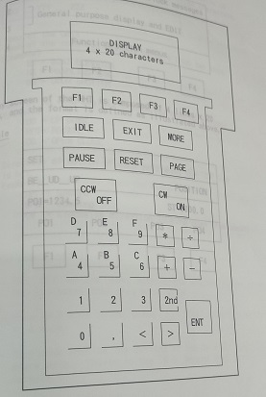
VL-800 面板說明
F1 ~ F4：螢幕上的各種選項
IDLE ：進入閒置畫面
EXIT ：退出當時畫面回到上一層目錄
MORE ：顯示其他選項
PAUSE：暫停動作
RESET：Alarm時可按此鍵停止Alarm聲響，排除後 再按此鍵解除Alarm
PAGE ：發生Interlock連鎖時可按此鍵設定或解除
Interlock
CCW / OFF：逆時針旋轉 / 關 / 下
CW / ON：順時針旋轉 / 開 /上
ENT：確認鍵

Slide 10
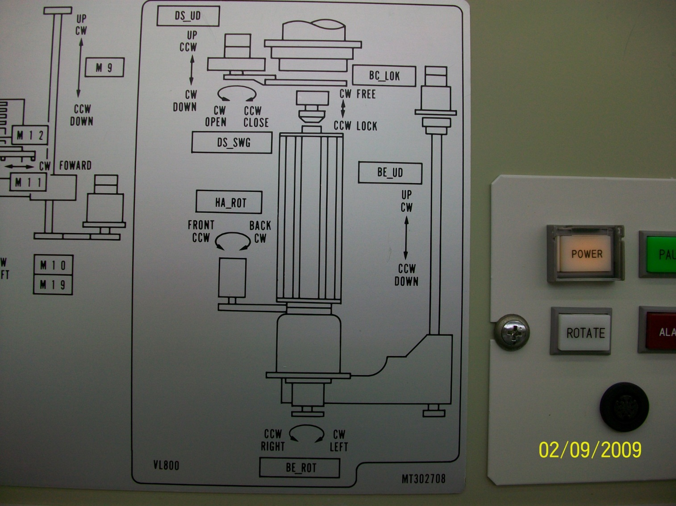
VL-800 M01~M06作動
M01：BE_UD_UP
➔ BOAT ELEVATOR UP/DOWN
M02：HA_ROT_CW
➔ HANDLING ARM ROTATE
M03：DS_UD_DOWN
➔ DOOR SHUTTER UP/DOWN
M04：DS_SWG_OPEN
➔ DOOR SHUTTER SWING
M05：BC_LOK_FREE
➔ BOAT CLAMP LOCK/FREE
M06：BE_ROT_CW
➔ BOAT ELEVATOR ROTATE
M03
M05
M04
M02
M01
M06

Slide 11
承接
更換Boat後
先調整保溫筒是否於正中間
將Arm移至P02位子
Elevator升至P02位子，check保溫筒在承接 Boat 時有無摩擦聲
將Arm移開後，check並調整Boat銜接於保溫筒之正中間
Arm移回P02位子，再檢查Boat位子和stopper、quartz之間約1mm左右
調整並Check Boat在承接過程中，有無晃動
Check並調整 LOCK 位置

Slide 12
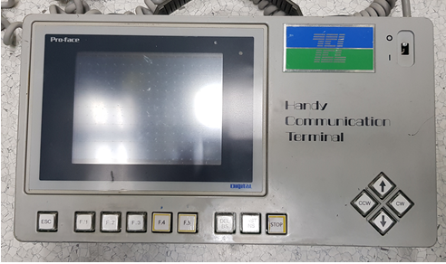
T-BAWL
ONE MOTION 單軸作動
01. CPT1_LU
02. CPT2_LU
03. CPOT_LR
04. OFAJ_UD
05. OFAJ_RT
06. OFUA_UD
07. WCNT_UD
08. CPOD_UD
09. CELV_UD
10. CARR_RT
11. CHND_FB
12. CHND_LU
13. CSTA_FB
14. CSTB_FB
15. CSTA_LU
16. CSTB_LU
CARRIER PORT 內側LOCK
CARRIER PORT 外側LOCK
轉平邊平台 左右移
轉平邊平台 上下移
轉平邊滾軸 旋轉
轉平邊平台中心 上下移
計數器平台 上下移
CARRIER PORT 垂直轉
ELEVATOR 上下移
ELEVATOR 左右移(CARRIER)
ELEVATOR 前後移
ELEVATOR LOCK
內CARRIER STAGE 前後移
外CARRIER STAGE 前後移
內CARRIER STAGE LOCK
外CARRIER STAGE LOCK
17.
18.
19. WAFR_RT
20. WAF5_FB
21. WAF1_FB
22.
23. WCNT_RD
24.
25.
26. CPOT_LU
27.
28.
29.
30.
ELEVATOR 左右移(FORK)
FORK-5 前後移
FORK-1 前後移
COUNTER 讀值
CARRIER PORT 下方LOCK

Slide 13
T-BAWL CHECK傳送操作
選擇T- BAWL EVAL MENU(CARRIER LOAD)
將檔片傳送至CARRIER 放置區
選擇T-BAWL EVAL MENU(WAFER TRANSFER)
SEQ:選擇 FORK 5 OR FORK 1傳送
CARRIER NO: 選擇 CARRIER
CARRIER PITCH: 選擇從第幾片抓取
BOAT PITCH:選擇放至BOAT 的位置
當FORK接近CASSTTE前,後皆須 CHECK位置,不可碰觸或摩擦WAFER
當FORK 將WAFER 傳送至BOAT時,亦須CHECK位置,不可與BOAT有摩擦情況發生
若須修改位置則到EDIT MENU(POSITION OF MOTOR)修正
1.修正時先選擇FORK1 OR FORK 5
2.選擇要修正的位置如 :BOAT,CARRIER 1~6
3.選擇修改 UD;RT;FB 修改完須按ENTER並SAVE
4.再次傳送確認位置是否正確
傳送CHECK完畢後,將WAFER 先傳回CASSETTE
選擇EVAL MENU (CARRIER UNLOAD)

Slide 14
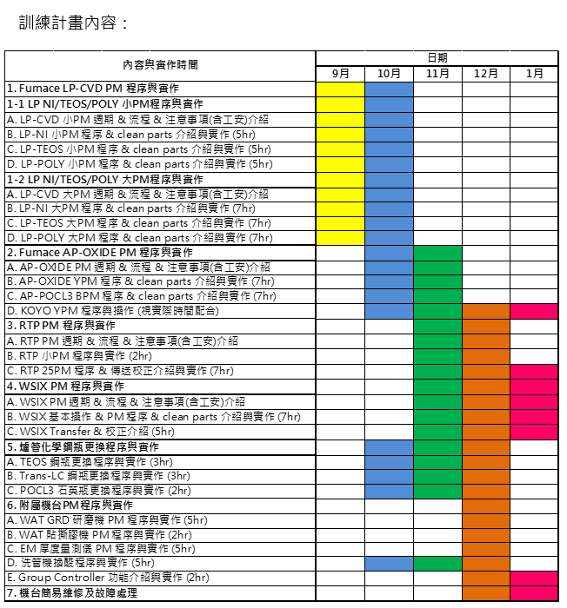

Slide 15
進度表
種類 | 進度
LP-P SPM | 40%
LP-P BPM | 10%
LP-T SPM | 40%
LP-T BPM | 20%
LP-N SPM | 30%
LP-N BPM | 20%
AP QPM | 10%
AP YPM | 0%
POCL3 BPM | 0%
WSIX BPM | 10%
WSIX MPM | 0%
GRD MPM | 20%
RTP 25PM | 0%

