Slide 1
爐管新人學習進度報告
2024.08.26 ~ 2024.09.06

Slide 2
報告內容
一、新人訓練計畫
二、FAB環境 & 逃生路線
三、兩週內學習內容
四、SPM 更換Parts項次
五、爐管製程分類

Slide 3
一、 新人訓練計畫

Slide 4
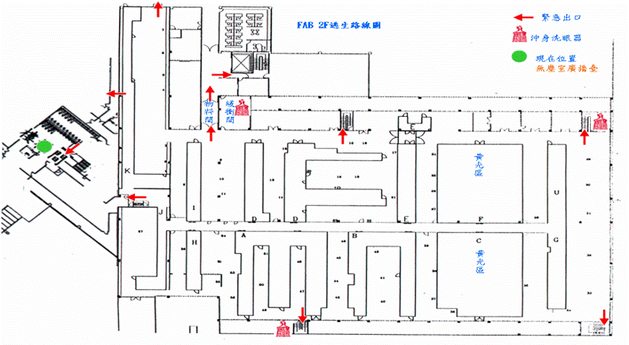
二、 FAB環境 & 逃生路線
出口3：WAT區研磨間
出口2：K-Tunnel 可由2F 出來
D
U
2024.06.03 ~ 2024.06.14
出口1 ：管制台
A
G
：由出口1逃生。
各A、G、U、D-Tunnel的兩旁走道有樓梯可達FAB 1F
：由出口2/3逃生。

Slide 5
三、兩周學習內容
日期 | 機台 | 學習內容
8/26 |  | 報到 | 雲端課程
8/27 |  | FAB環境認識 | 雲端課程
8/28 | P6 | SPM | 雲端課程
8/29 | F19 | QPM | 雲端課程
8/30 | EM-4、5、6 | KPM | NFICON Helium Leak Detector Workshop 網路研討會 teams
9/02 | T3 | 3PM
9/03 | N3 | SPM
9/04 | WSIX-1A | BPM
9/05 | T2 | SPM | 基本統計&統計分析
9/06 | T4 | SPM
2024.06.03 ~ 2024.06.14

Slide 6
四、PM更換Parts項次
LP-P1 LP-P2 LP-P3 LP-P4 LP-P6 LP-P7 | POLY
 |  |  | Transfer | Boat | 保溫筒 | (NW50)pipe | Manifold 賓士盤 Ccp Shutter | 內管 外管 | Injector 120mm 250mm 900mm | MV | APC + Pumping line | QSV | Burn box
 | PM Item | Time | Check | 更換 | 更換 | 更換 & Clean | Clean | 更換 | 更換 | Clean & Check | Clean | 更換 | Clean
 | SPM | 9µm ±2 | ● | ●
 | BPM(1PM) | 19µm ±2 | ● | ● | ● | ● | ● | ● | ●
 | SPM | 9µm ±2 | ● | ●
 | BPM(2PM) | 19µm ±2 | ● | ● | ● | ● | ● | ● | ●
 | SPM | 9µm ±2 | ● | ●
 | BPM(3PM) | 19µm ±2 | ● | ● | ● | ● | ● | ● | ●
 | SPM | 9µm ±2 | ● | ●
 | BPM(4PM) | 19µm ±2 | ● | ● | ● | ● | ● | ● | ●
 | SPM | 9µm ±2 | ● | ●
 | BPM(5PM) | 19µm ±2 | ● | ● | ● | ● | ● | ● | ● | ● | ● | ● | ●
2024.06.03 ~ 2024.06.14
LP-P1、2、3、4、6 BOAT 為SIC
LP-P7 BOAT 為QUARTZ
Leak rate
SPEC: ≦ 0.00Torr / 130sec

Slide 7
Nitride 厚
LP-N3 LP-N4 LP-N5 LP-N7 |  |  | Transfer | BOAT (SIC) | (5+7)Fin pedestal 保溫筒 | (NW50)pipe bellow | Cold trap | Manifold 賓士盤 Ccp Spindle Shutter | 內管 | 外管 | Pressure ballow | Injector | MV | APC + pumping line
 | PM Item | RUN次 | Check | 更換 | 更換 | 更換 & Clean | 更換 | Clean | 更換 | 更換 | Clean | 更換 | Clean & Check | Clean
 | SPM | 40 ±10 | ● |  |  | ● | ●
 | SPM | 80 ±10 | ● |  |  | ● | ●
 | BPM(1PM) | 120 ±14 | ● | ● | ● | ● | ● | ● | ● | ● | ● | ●
 | SPM | 40 ±10 | ● |  |  | ● | ●
 | SPM | 80 ±10 | ● |  |  | ● | ●
 | BPM(2PM) | 120 ±14 | ● | ● | ● | ● | ● | ● | ● | ● | ● | ●
 | SPM | 40 ±10 | ● |  |  | ● | ●
 | SPM | 80 ±10 | ● |  |  | ● | ●
 | BPM(3PM) | 120 ±14 | ● | ● | ● | ● | ● | ● | ● | ● | ● | ●
 | SPM | 40 ±10 | ● |  |  | ● | ●
 | SPM | 80 ±10 | ● |  |  | ● | ●
 | BPM(4PM) | 120 ±14 | ● | ● | ● | ● | ● | ● | ● | ● | ● | ● | ● | ●
LP-N1 依產能需求切換厚 or 薄 Nitride
Nitride 薄
LP-N2 LP-N6 |  |  | Transfer | BOAT (SIC) | (5+7)Fin pedestal 保溫筒 | (NW50)pipe bellow | Cold trap | Manifold 賓士盤 Cap Spindle Shutter | 內管 | 外管 | Pressure ballow | Injector | MV | APC + pumping line
 | PM Item | RUN次 | Check | 更換 | 更換 | 更換 & Clean | 更換 | Clean | 更換 | 更換 | Clean | 更換 | Clean & Check | Clean
 | SPM | 150 ±15 | ● | ● | ● | ● | ●
 | BPM(1PM) | 300 ±30 | ● | ● | ● | ● | ● | ● | ● | ● | ● | ●
 | SPM | 150 ±15 | ● | ● | ● | ● | ●
 | BPM(2PM) | 300 ±30 | ● | ● | ● | ● | ● | ● | ● | ● | ● | ●
 | SPM | 150 ±15 | ● | ● | ● | ● | ●
 | BPM(3PM) | 300 ±30 | ● | ● | ● | ● | ● | ● | ● | ● | ● | ●
 | SPM | 150 ±15 | ● | ● | ● | ● | ●
 | BPM(4PM) | 300 ±30 | ● | ● | ● | ● | ● | ● | ● | ● | ● | ● | ● | ●
Leak rate
SPEC: ≦ 0.02Torr / 130sec

Slide 8
TEOS
LP-T1 LP-T2 LP-T3 LP-T4 LP-T5 LP-T6 LP-T8 LP-T9 |  |  | Transfer check | BOAT (SIC) | 5 fin Pedestal 保溫筒 | (NW50)pipe (NW50)銜接環 bellow | Cold trap | Manifold 賓士盤 Ccp Shutter | 內管 | 外管 | Injector 平口 25mm 1000mm | Pressure bellow | MV | APC + pumping line | QSV | Burn box
 | PM Item | Time | Check | 更換 | 更換 | 更換 & Clean | 更換 | Clean | 更換 | 更換 | 更換 | Clean | Clean & Check | Clean | 更換 | Clean
 | SPM | 9µm ±2 | ● | ● | ● | ● | ●
 | SPM | 18µm ±2 | ● | ● | ● | ● | ●
 | BPM(1PM) | 27µm ±2 | ● | ● | ● | ● | ● | ● | ● | ● | ● | ●
 | SPM | 9µm ±2 | ● | ● | ● | ● | ●
 | SPM | 18µm ±2 | ● | ● | ● | ● | ●
 | BPM(2PM) | 27µm ±2 | ● | ● | ● | ● | ● | ● | ● | ● | ● | ●
 | SPM | 9µm ±2 | ● | ● | ● | ● | ●
 | SPM | 18µm ±2 | ● | ● | ● | ● | ●
 | BPM(3PM) | 27µm ±2 | ● | ● | ● | ● | ● | ● | ● | ● | ● | ● | ● | ● | ● | ●
LP-T1、2、3、4、5、6、8 BOAT 為SIC
LP-T9 BOAT 為QUARTZ
Leak rate
SPEC: ≦ 0.02Torr / 70sec

Slide 9
五、爐管製程分類
FURNACE
AP管
氧化管 40
POCL3 3
LP管
NITRIDE 7
TEOS 7
POLY 5
2024.06.03 ~ 2024.06.14
HTO 1
IN-SITU POLY 1

