Slide 1
M120

Slide 2
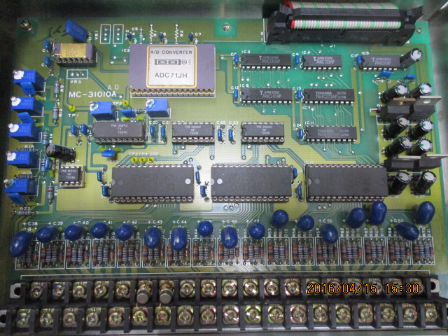
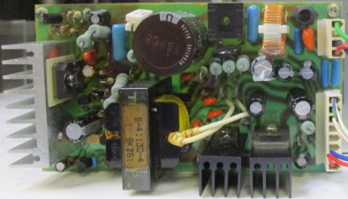
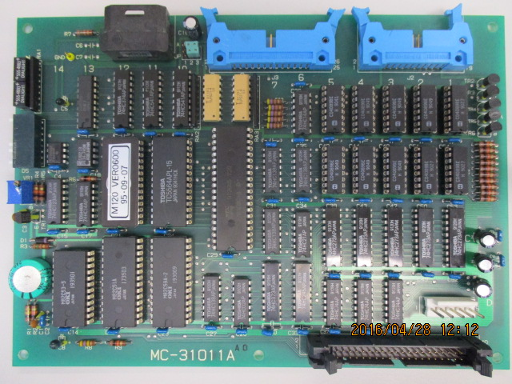
(上)
MC-31010A PCB 負責連接 T/C 讀取溫度
(後)
M120 Power supply
(下)
MC-31011A PCB 負責與 M3100 通訊

Slide 3
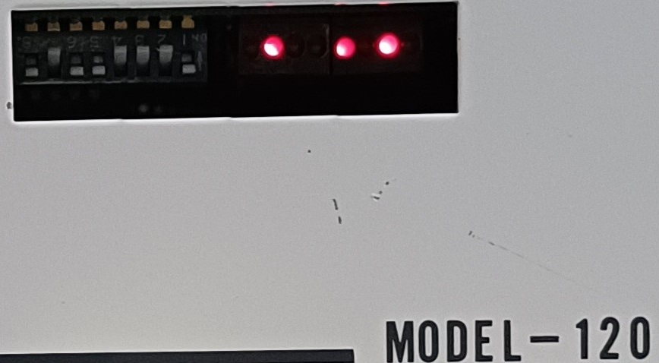
8 7 6 5 4 3 2 1
dip switch ->
1. Keep off, turn on for maintenance mode, turn off for normal use
2. Keep on, turn on for 5 zone heater that use zone 1, turn off for 3 zone, not use zone 1 (BTM-1)
3. Keep on, turn on for 5 zone heater that use zone 2, turn off for 3 zone, not use zone 2 (TOP)
4. Keep on, turn on for 4800BPS, turn off for 9600BPS (光纖速率)
5. Keep off, not used
6. keep off, turn on for select a noise filter to thermocouple
7. Keep on, turn on for 60hz, turn off for 50hz (電源頻率)
8. keep off, not use

Slide 4
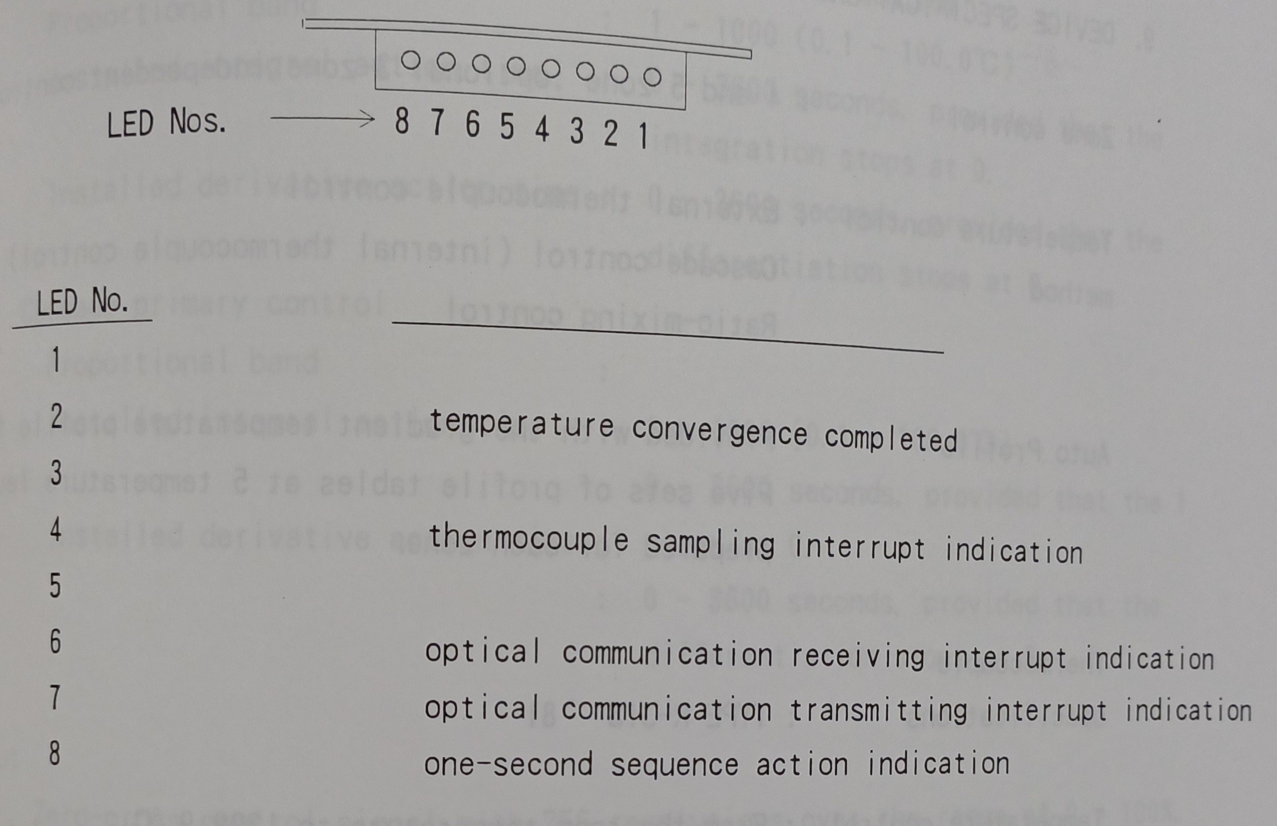
LED 87654321 ->
1-2. lighten when the temp convergence met
3-4. 表示 TC sampling 的速度, 依照dip switch 50Hz: 5mS, 60Hz: 4.16ms 恆亮
5-6. 接收到訊號就亮 (以 character 為單位)
7. 送出訊號就亮
8. 每2秒閃爍一次代表指令正常執行

Slide 5
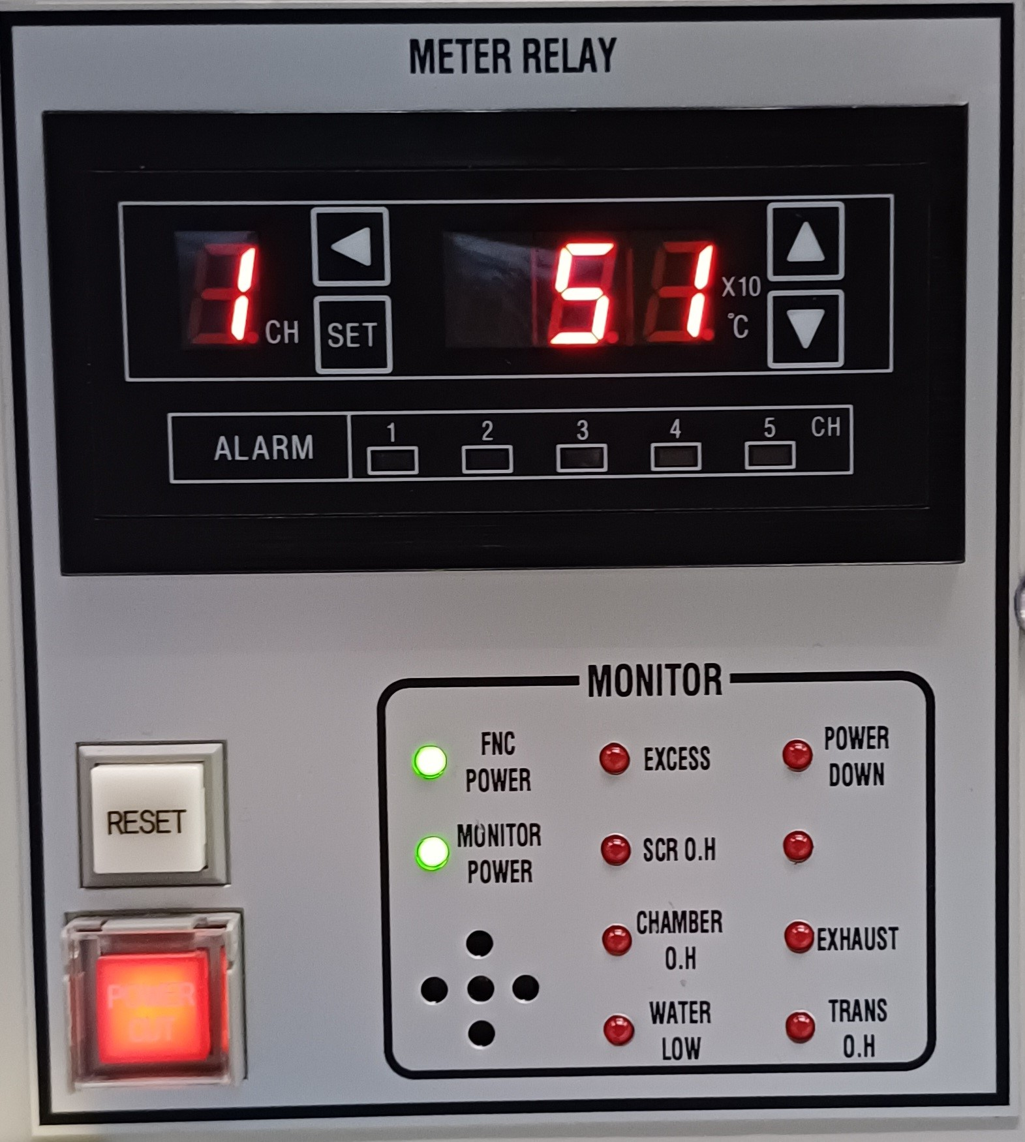
FNC POWER: main power
MONITOR POWER: furnace power(sub power)
EXCESS: furnace overheat
SCR. O.H: SCR heat sink temp has gone up to more than 80 ℃ (散熱器)
CHAMBER O.H.: heater installed spot inside the furnace has gone up to 130 ℃
WATER LOW: furnace cooling water flow rate has dropped below the set level
POWER DOWN: main circuit breaker is opened
SMOKE: not used (特殊機型才有)
EXHAUST: furnace exhaust fan stopped
TRANS O.H.: transformer is overheat more then 130℃ (變壓器)

