Slide 1
Furnace study group

Slide 2
報告內容
一、氫氧點火

Slide 3
一、氫氧點火

Slide 4
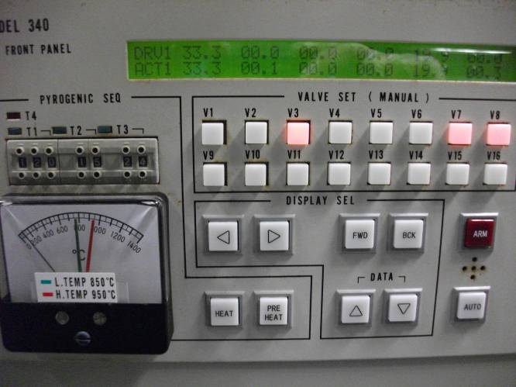
1. Key-function
Display gas flow rate
Only form torch unit interlock
Hold for 3sec turn to manual mode
To adjust parameter
With torch
Go to/Go back to next page

Slide 5
1. Key-function
流量由sccm變成%數，代表為 manual mode
同時按約5sec即可修改panel裡面之參數
按約5sec變為manual mode

Slide 6
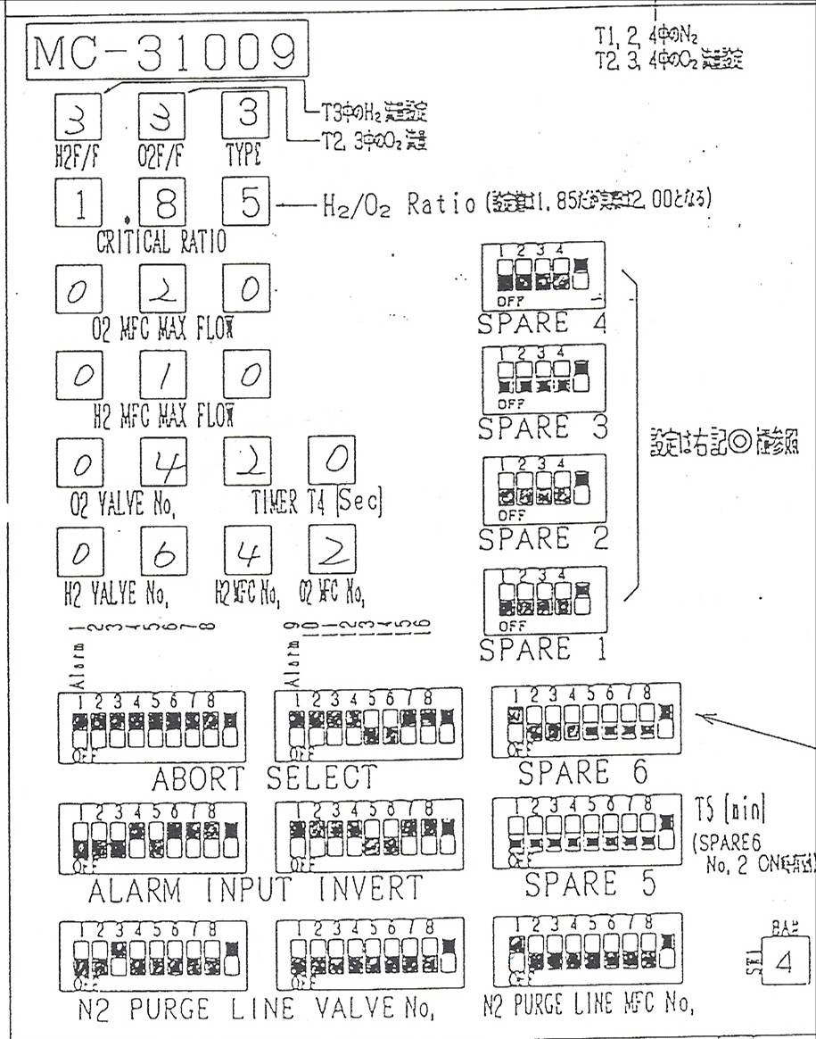
2. 31009 PCB 介紹
6.
5.
4.
2.
1.
3.
7.
T4 N2 purge 時間設定
O2、H2 valve number
O2、H2 MFC number
O2、H2 MFC FLOW maximal value setting
O2、F2 flow valve setting & O2/H2 flow ratio
TYPE3(i.e. Have torch、H2 ) ←→ TYPE0
T4 N2 purge 之 valve and MFC number

Slide 7
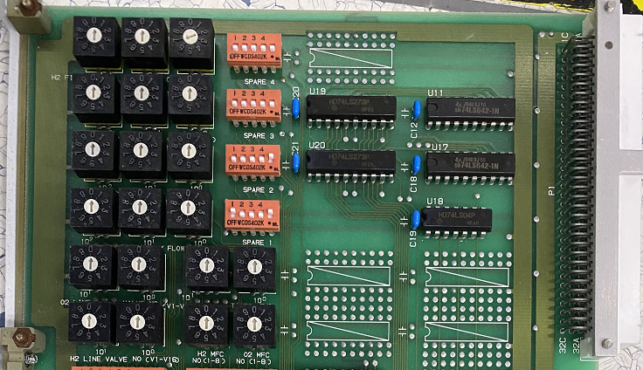
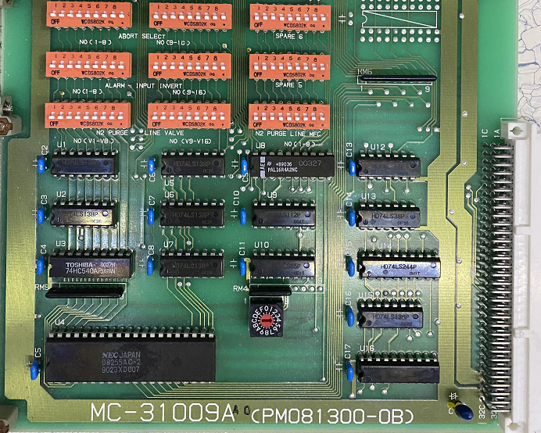
6.
5.
4.
1.
2.
3.
7.

Slide 8
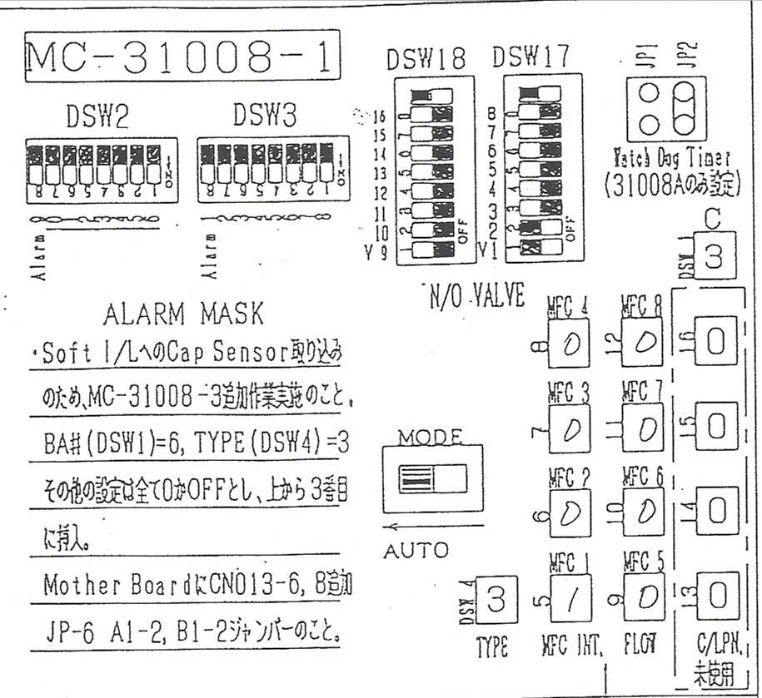
3. 31008-1 PCB 介紹
2.
1.
3.
T4 N2 flow setting
計算方式(採16進制編碼)：(1/15)*30(MAX)=2L(N2)
Flow chart valve NO/NC setting
TYPE3(i.e. Have torch、H2 ) ←→ TYPE0

Slide 9
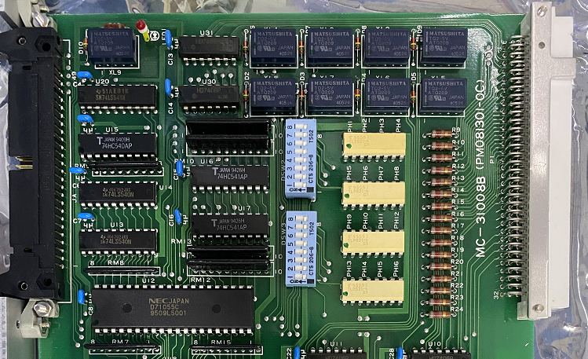
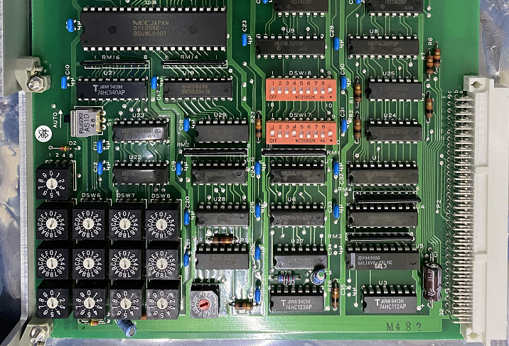
2.
3.
1.

Slide 10
THE END

