Slide 1
爐管新人學習進度報告
2025.05.26 ~ 2025.06.06
JXOu
歐佳鑫

Slide 2
報告內容
兩週學習內容
VL-800 ID 訊號分析
INITIAL SETTING INDRODUCTION

Slide 3
學習進度表
日期 | 課程 | 機台 | 內容
2025/5/26 (一) | None | None | 跟值
2025/5/27 (二) | None | LP-N7 | 4PM
2025/5/28 (三) | TQM 8D report | None | None
2025/5/29 (四) | None | LP-N3 | 4PM
2025/5/30 (五) | 端午放假 | 端午放假 | 端午放假
2025/6/02 (一) | None | None | Test CP8421
2025/6/03 (二) | None | GRD-3 | MPM
2025/6/04 (三) | None | None | RTP傳送調整
2025/6/05 (四) | None | RTP-3 | 20PM
2025/6/06 (五) | None | None | Clean WSIX burn box

Slide 4
VL-800 訊號
ID | Display | Cause | Solution
01 | BE-UD-UP ENC ERRO | M01 Position missing | Trying to find M01 position
02 | HA-ROT-CCW ENC ERRO | M02 Position missing | Trying to find M02 position
31 | OVERTIME | AUTO, REMOTE not be completed in time | Operator decides continue or quit running
32 | NOT READY | A motion can not be executed in remote mod by tube controller | 調回程式該步驟位置
33 | DOOR OPEN ALARM | The maintenance door is open | Operator decides continue or quit running
34 | ILLEGAL REQ.RCV | Tube has made some request other than in remote mode | Switch manual to remote
35 | BE-UD POS. DATA | BE-UD position data is not sorted in ascending order from P1 | System POSC yes adjust no
41 | SET DATA ERROR | The data input in SET mode have some error | Replace PCB -8321/reboot VL-800
63 | EMERGENCY STOP | B/E 防壓 switch | RESET
64 | BE-ROT STOP | M06 Sensor | Adjust driver
65 | CAP CLOSE SENSOR | M01 P04 Sensor | Adjust Sensor /Check 壓縮
66 | HA-ROT BOAT SNS ERR | ARM Sensor | Bypass sensor 下貨後調整位置後，復歸

Slide 5
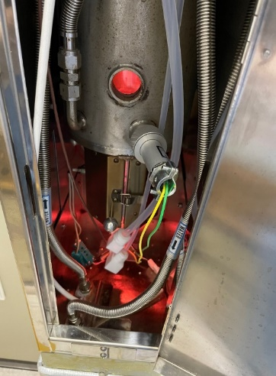
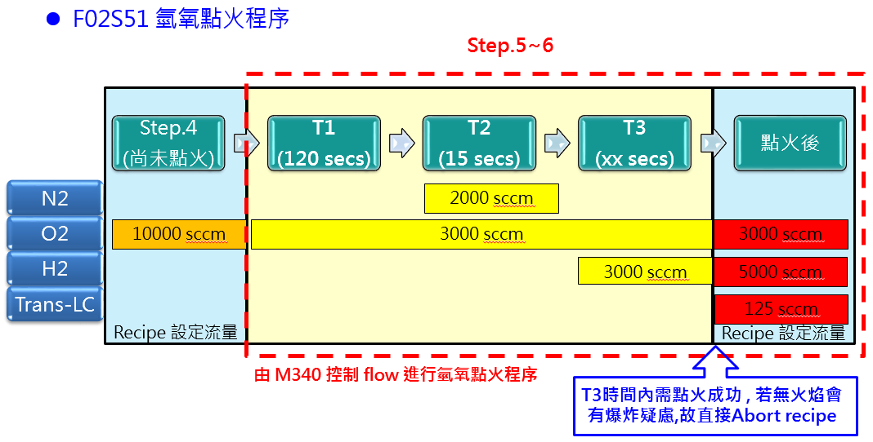
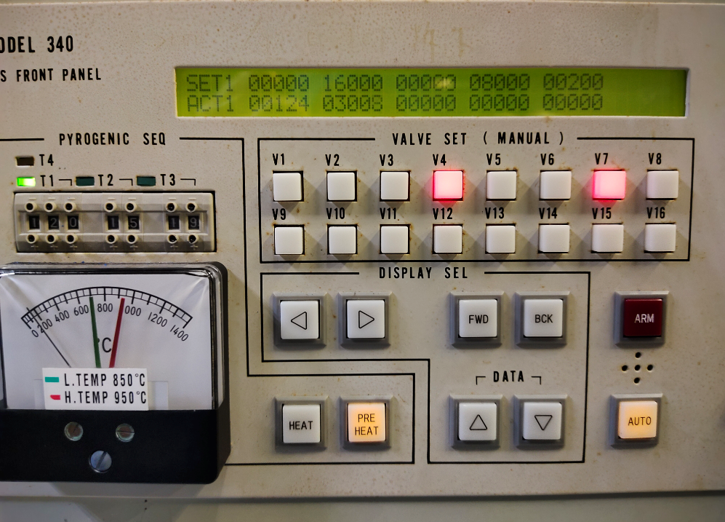
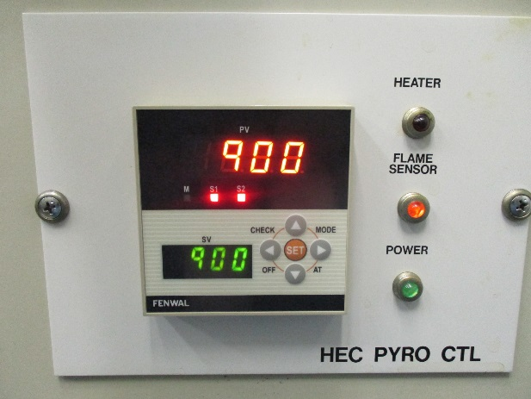
Flame sensor功能測試
一、確認點火失敗 HEC pyro controller 是否會 alarm & 是否正常執行 ABORT recipe
二、測試氫氧點火成功所需時間設定T3時間:T3燈號亮起之時間+5秒

Slide 6
*INITIAL SET MENU*
[SET-NAME]
[SET-TEMP]
[SET-GAS]
[SET-COM]
[SET-POSN]
[SET-ALAM]
[SET-PASS]
[SET-EMG]
[INI-TIME]
[SET-I/O]
[SWITCH]
[SET-ZONE]
Notes:
1.NAME: 更改程式名稱
2.TEMP:溫度控制設定
3.GAS:氣體控制設定
5.POSN: 供電持續過程設定
6.ALAM: 警告設定
7.PASS:密碼設定
8.EMG: 選擇緊急中止切換(有效/無效)
9.TIME:日期/時間 設定
10.I/O:開關相關功能變更
11.SWITCH:爐管控制溫度位置設定
12.Zone :自動機制初始設定

Slide 7
*INITIAL NAME MENU*
[ COPY ]
[ TEMP ]
[MFC]
[RECIPE]
[ALARM]
ESC
Notes:
TEMP:溫度區間名稱
MFC: 流量名稱
RECIPE: 程式名稱
AlARM : 警告名稱

Slide 8
*INITIAL TEMPERAUTRE MENU*
[ COPY ]
[ PDL-EC ]
[ SPK-EC ]
[WATCH-A]
[WATCH-B]
[PDL-CAB]
[P-MIX]
ESC
Notes:
1.設定PADDLE TC 的溫度係數(內部溫度)
2.設定SPIKE TC 溫度係數(外部溫度)
3.在控制過程中限制收斂值
4.限制Profile 收斂值
5.PAD 校準值
6.混合比例參數控制

Slide 9
*INITIAL GAS MENU*
[ MAX ]
[ WATCH ]
[ PROOF ]
[INTERLOCK]
[ FORCE ]
[ VALUE ]
[ APCLEVEL ]
[ APC-PARA ]
[ APCWATCH ]
ESC
Notes:
1.最大流量比的設定
2.收斂流量限制系數設定
3.校正流量值
4.INTERLOCK 設定(沒內文圖)
5.強制關閉時間設定
6.設定正常開關的值
7.APC 水平壓力設定
8.APC 控制參數設定
9.APC 監控壓力設定值

Slide 10
*INITIAL ALARM MENU (01)*
[ INC ]
[ DEC ]
[ EXCESS ]
[ SCROVR ]
[ CHMOVR ]
[ WATER ]
[ PSDOWN ]
[ ------------- ]
[ EXHUST ]
[ TRANS ]
[ P-T/C1 ]
[ P-T/C2 ]
[ P-T/C3 ]
[ P-T/C4 ]
ESC

Slide 11
*INITIAL ALARM MENU (02)*
[ INC ]
[ DEC ]
[ P-T/C5 ]
[ C-T/C1 ]
[ C-T/C2 ]
[ C-T/C3 ]
[ C-T/C4 ]
[ C-T/C5 ]
[ M-T/C1 ]
[ M-T/C2 ]
[ M-T/C3 ]
[ M-T/C4 ]
[ M-T/C5 ]
[ LOW-R1 ]
ESC

Slide 12
*ATTACH TEMPERATURE ZONE NAME*
ZONE1
BOTTOM
CENTER
TOP
ZONE2
ESC
Notes:
溫度名稱

Slide 13
*ATTACH MASS FLOW NAME*
MFC-01
MFC-02
MFC-03
MFC-04
MFC-05
MFC-06
MFC-07
MFC-08
MFC-09
MFM-01
MFM-02
MFM-03
MFM-04
MFM-05
APC
ESC
Notes:
MFC名稱

Slide 14
*ATTACH RECIPE NAME*
RCP-01
RCP-02
RCP-03
RCP-04
RCP-05
RCP-06
RCP-07
RCP-08
RCP-09
RCP-10
RCP-11
RCP-12
ESC
Notes:
更改程式名稱

Slide 15
*ATTACH ALARM NAME*
EXCESS
SCRIVR
CHMOVR
WATER
PSDOWN
SMOKE
EXHUST
……….
P-T/C1
P-T/C2
P-T/C3
P-T/C4
P-T/C5
C-T/C1
C-T/C2
ESC

Slide 16
*SET PADDLE EC (1)*
[ INC ]
[ DEC ]
SET TEMP.=_600.0
PG(M)
IG(S)
DG(S)
BTM-1
100.0
300
0
BTM-2
100.0
300
0
CTR-1
100.0
300
0
CTR-2
100.0
300
0
TOP
100.0
300
0
ESC
Notes:
PG:可輸入五個數字，其中一個在小數點後方
IG,DG 可輸入4個整數數字單位為秒

Slide 17
*SET PADDLE EC (2)*
[ INC ]
[ DEC ]
SET TEMP.=_800.0
PG(%)
IG(S)
DG(S)
BTM-1
100.0
300
0
BTM-2
100.0
300
0
CTR-1
100.0
300
0
CTR-2
100.0
300
0
TOP
100.0
300
0
ESC

Slide 18
*SET SPIKE EC (1)*
[ INC ]
[ DEC ]
SET TEMP.=_600.0
PG(%)
IG(S)
DG(S)
BTM-1
100.0
300
0
BTM-2
100.0
300
0
CTR-1
100.0
300
0
CTR-2
100.0
300
0
TOP
100.0
300
0
ESC

Slide 19
*SET SPIKE EC (2)*
[ INC ]
[ DEC ]
SET TEMP.=_800.0
PG(%)
IG(S)
DG(S)
BTM-1
100.0
300
0
BTM-2
100.0
300
0
CTR-1
100.0
300
0
CTR-2
100.0
300
0
TOP
100.0
300
0
ESC

Slide 20
*SET PROCESS WATCH TABLE (1)*
[ INC ]
[ DEC ]
SET TEMP.=_600.0
SPAN
DELEY
ALARM
TIME
BTM-1
3.0
30
2.5
30
BTM-2
3.0
30
2.5
30
CTR-1
3.0
30
2.5
30
CTR-2
3.0
30
2.5
30
TOP
3.0
30
2.5
30
ESC
Notes:
1.SPAN : DELEY→升溫時的穩定狀態
升溫後爐溫是否穩定在目標溫度，當溫度穩定後，TEMP-NULL出現的話，並可利用此訊號去找正在執行的recipe中的步驟
2.ALARM:TIME→持溫時的穩定狀態
放寬持溫溫度，ALARM設定為0時，TIME 設多少都無效。

Slide 21
*SET PROCESS WATCH TABLE (2)*
[ INC ]
[ DEC ]
SET TEMP.=_700.0
SPAN
DELEY
ALARM
TIME
BTM-1
2.0
60
1.0
30
BTM-2
2.0
60
1.0
30
CTR-1
2.0
60
1.0
30
CTR-2
2.0
60
1.0
30
TOP
2.0
60
1.0
30
ESC

Slide 22
*SET PROCESS WATCH TABLE (3)*
[ INC ]
[ DEC ]
SET TEMP.=_800.0
SPAN
DELEY
ALARM
TIME
BTM-1
1.0
60
1.0
30
BTM-2
1.0
60
1.0
30
CTR-1
1.0
60
1.0
30
CTR-2
1.0
60
1.0
30
TOP
1.0
60
1.0
30
ESC

Slide 23
*SET PROFILE WATCH TABLE (1)*
[ INC ]
[ DEC ]
SET TEMP.=_600.0
SPAN
DELEY
ALARM
TIME
BTM-1
3.0
30
2.5
30
BTM-2
3.0
30
2.5
30
CTR-1
3.0
30
2.5
30
CTR-2
3.0
30
2.5
30
TOP
3.0
30
2.5
30
ESC

Slide 24
*SET PROFILE WATCH TABLE (2)*
[ INC ]
[ DEC ]
SET TEMP.=_700.0
SPAN
DELEY
ALARM
TIME
BTM-1
2.0
60
1.0
30
BTM-2
2.0
60
1.0
30
CTR-1
2.0
60
1.0
30
CTR-2
2.0
60
1.0
30
TOP
2.0
60
1.0
30
ESC

Slide 25
*SET PROFILE WATCH TABLE (3)*
[ INC ]
[ DEC ]
SET TEMP.=_800.0
SPAN
DELEY
ALARM
TIME
BTM-1
1.0
60
1.0
30
BTM-2
1.0
60
1.0
30
CTR-1
1.0
60
1.0
30
CTR-2
1.0
60
1.0
30
TOP
1.0
60
1.0
30
ESC

Slide 26
*SET PADDLE CALIBRATION (3)*
[ INC ]
[ DEC ]
SET TEMP.=_620.0
UVOLT
BTM-1
-160
BTM-2
-047
CTR-1
-016
CTR-2
+11
TOP
-40
ESC
Notes:
校正PADDLE 熱電偶
uv為他的單位

Slide 27
*SET RATIO MIX DATA (5)*
[ INC ]
[ DEC ]
SET TEMP. - CURRENT TEMP. = _500.0
P-T/C
(%)
BTM-1
80
BTM-2
80
CTR-1
80
CTR-2
80
TOP
-40
ESC
Notes:
PADDLE與SPIKE的混合溫度
0% 為外部溫度
50%為混合溫度
100%為內部溫度

Slide 28
*SET MFC MAX/LIMIT*
[ PAGE 1 ]
MFC-01
MFC-03
MFC-05
MFC-07
(MAX)
50000
50000
50000
50000
(LIMIT)
50000
50000
50000
50000
MFC-02
MFC-04
MFC-06
MFC-08
(MAX)
50000
50000
50000
50000
(LIMIT)
50000
50000
50000
50000
ESC

Slide 29
*SET MFC MAX/LIMIT*
[ PAGE 2 ]
MFC-09
MFM-02
MFM-04
MFC-07
(MAX)
50000
50000
50000
50000
(LIMIT)
50000
50000
50000
50000
MFM-01
MFM-03
MFM-05
APC
(MAX)
50000
50000
50000
4095
(LIMIT)
50000
50000
50000
4095
ESC

Slide 30
*MFC LIMIT ZONE (%) & TIME (SEC)*
[ PAGE 1 ]
MFC-01
MFC-03
MFC-05
MFC-07
(ZONE)
99.9
99.9
99.9
99.9
(TIME)
9999
9999
9999
9999
MFC-02
MFC-04
MFC-06
MFC-08
(ZONE)
99.9
99.9
99.9
99.9
(TIME)
9999
9999
9999
9999
ESC
Notes:
當區域設定範圍之外的偏差持續時間超過指定時間時，將觸發警報條件
例如:
EX: MAXIMUM FLOW RATE : 1000
SET FLOW RATE : 800
ZONE : 5%
TIME : 30 SEC

Slide 31
*MFC LIMIT ZONE (%) & TIME (SEC)*
[ PAGE 2 ]
MFC-09
MFM-02
MFM-04
…………
(ZONE)
99.9
99.9
99.9
99.9
(TIME)
9999
9999
9999
9999
MFM-01
MFM-03
MFM-05
APC
(ZONE)
99.9
99.9
99.9
99.9
(TIME)
9999
9999
9999
9999
ESC

Slide 32
*MFC PROOF TABLE*
[ PAGE 1 ]
MFC-01
MFC-03
MFC-05
MFC-07
(FULL)
59999
59999
59999
59999
(ZERO)
0
0
0
0
MFC-02
MFC-04
MFC-06
MFC-08
(FULL)
59999
59999
59999
59999
(ZERO)
0
0
0
0
ESC
Notes:
透過MAX設定mfc 最大流量資料將自動插入 (FULL) 欄位中，如果ZERO值為0就失效。

Slide 33
*MFC PROOF TABLE*
[ PAGE 2 ]
MFC-09
MFM-02
MFM-04
………..
(FULL)
59999
59999
59999
59999
(ZERO)
0
0
0
0
MFM-01
MFM-03
MFM-05
APC
(FULL)
59999
59999
59999
59999
(ZERO)
0
0
0
0
ESC

Slide 34
*MFC FORCE CLOSE TIME (SEC)*
MFC-02
MFC-04
MFC-06
MFC-08
MFC-02
MFC-04
MFC-06
MFC-08
MFC-02
MFC-04
MFC-06
MFC-08
MFC-01
MFC-03
MFC-05
MFC-07
99
99
99
99
99
99
99
99
99
99
99
99
99
99
99
99
ESC
Notes:
正常設定秒數為10~20秒，MFC流量越大時間會越久

Slide 35
*DISPLAY VALVE STATUS *
[ INC ]
[ DEC ]
01 C
09 C
17 C
25 C
33 C
41 C
02 C
10 C
18 C
26 C
34 C
42 C
03 C
11 C
19 C
27 C
35 C
43 C
04 C
12 C
20 C
28 C
36 C
44 C
05 C
13 C
21 C
29 C
37 C
45 C
06 C
14 C
22 C
30 C
38 C
46 C
07 C
15 C
23 C
31 C
39 C
47 C
08 C
16 C
24 C
32 C
40 C
48 C
ESC
Notes:
O為開，C為關

Slide 36
*APC CHECK LEVEL *
[ S-1 ] [S-2] [S-3] [S-4]
(SENDER-1)
LEVEL11 99.99
LEVEL12 99.99
LEVEL13 99.99
LEVEL14 99.99
LEVEL15 99.99
ESC

Slide 37
*SET APC PARAMETER *
*SENSOR TYPE*
PRS1 PRS2 PRS3
[BN1] [BN1] [BN3]
SENDER#:3
CONTROL SENSOR:1
COFFICIENT 1:50
COFFICIENT 2:80
SLOW DOWNP :30
* CONTROL TYPE*
ESC
[TSL]
Notes:
設定APC壓力sensor，基本上不能做任何變更， TSL是東京某廠商製作
BN1 : 0～1
BN2 : 0～10
BN3 : 0～100
BN4 : 0～1000
PRN : 0～30

Slide 38
*SET APC LIMIT *
SENSOR
PRS1
ZONE
00.00 (TORR)
TIME
00 (SEC)
ESC
Notes:
EX : SET PRESSURP : 0.53
ZONE : 0.05
TIME : 30
當小於0.48torr或高於0.58torr時持續30秒後發出ALARM，若將ZONE設定為0時，此功能無動作。

Slide 39
*SET POWERON MODE *
STANDBY
SET UP TIME (SEC) : 10
ESC
Notes:
設定時間為10時，如果程式在run的過程中斷電，在9秒內回復供電會持續進行，若第10秒以後才恢復就會回到standby 模式

Slide 40
*SET ALARM CONDITION *
I-MASK (1-ON,0-OFF) 0
I-HOLD (1-ON,0-OFF) 0
EXCESS- I-LEVEL (1-HIGH,0-LOW) 1
I-ABORT (0-7) 0
I-DELEY (00-99SEC) 2
ESC
Notes:
LP AP
“0” NO ABORT “ 0” NO ABORT
“1” FOR ABORT 1 (JUMP ASE , AEA ) “1” FOR ABORT 1 (RECIPE 11)
“2” FOR ABORT 2 (RECIPE 11) “2” FOR ABORT 2 (RECIPE 12)
“3” FOR ABORT 3 (RECIPE 12) “3” FOR ABORT 3 (RECIPE 13)
“4” FOR REVERTING TO STANDBY (STEP 0 ) “4” FOR ABORT 4 (RECIPE 14)
“5” FOR ABORT 5 (RECIPE 15)
“6” JUMP BETWEEN THE STEPS.
“7” FOR REVERTING TO STANDBY (STEP 0 )

Slide 41
*SET PASSWORD *
EDIT MSG.
REV TEMP.
EDIT PRF.
SET RCP.
COPY RCP.
0 XXXX
0 XXXX
1 3027
1 200
1 3027
EDIT RCP. 1 3027
INTIAL 1 2707
ESC
Notes:
EDIT MSG : EDITING MESSAGES
REV TEMP. : RESERVED TEMPERATURE SETTING
EDIT PRF. : EDITING PROFILE
SET RCP : SETTING EXECUTION RECIPES
COPY RCP : COPYING RECIPES
EDIT RCP : EDITING RECIPES
INITIAL : INITIAL SETTING

Slide 42
*SELECT ABORT NO. FOR EMG ABORT SW. *
[ NOT USED ]
[ ABORT-01 ]
[ ABORT-02 ]
[ ABORT-03 ]
[ STANDBY ]
CURRENT MODE IS NOT USED
ESC

Slide 43
*ENTER TIME DISPLAY*
LINE
1
2
3
4
5
6
DIS-ID
TEMP
MCF
RCIPE
ALARM
PDL-EC
SPK-EC
DATE
87/07/14
87/12/25
87/12/25
87/12/25
00/00/00
00/00/00
TIME
18:27:45
16:25:47
16:25:46
16:25:59
00:00:00
00:00:00
COUNT
999
1
0
0
0
0
ESC
Notes:
DATE/TIME 是登記模式的時間
COUNT 登記頻率

Slide 44
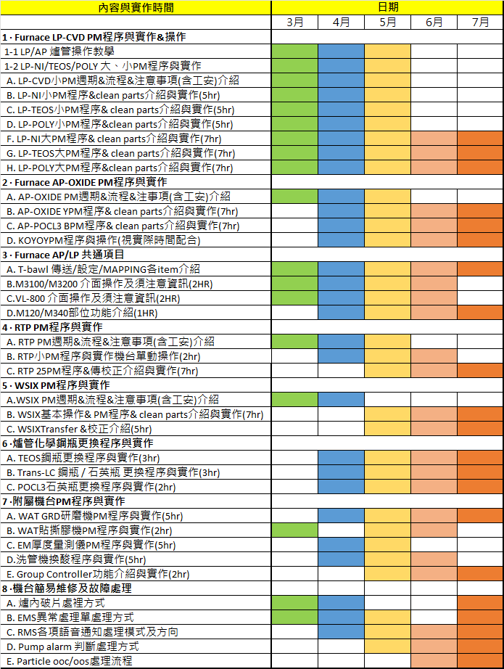
機台保養 | 獨立完成進度
LP-P SPM | 90%
LP-P BPM | 90%
LP-T SPM | 90%
LP-T BPM | 90%
LP-N SPM | 90%
LP-N BPM | 90%
AP QPM | 90%
AP YPM | 90%
POCL3 BPM | 90%
WSIX BPM | 90%
GRD MPM | 90%
RTP 25PM | 60%

Slide 45
END

