Slide 1
11/04 個人咪挺
KD成果討論

Slide 2
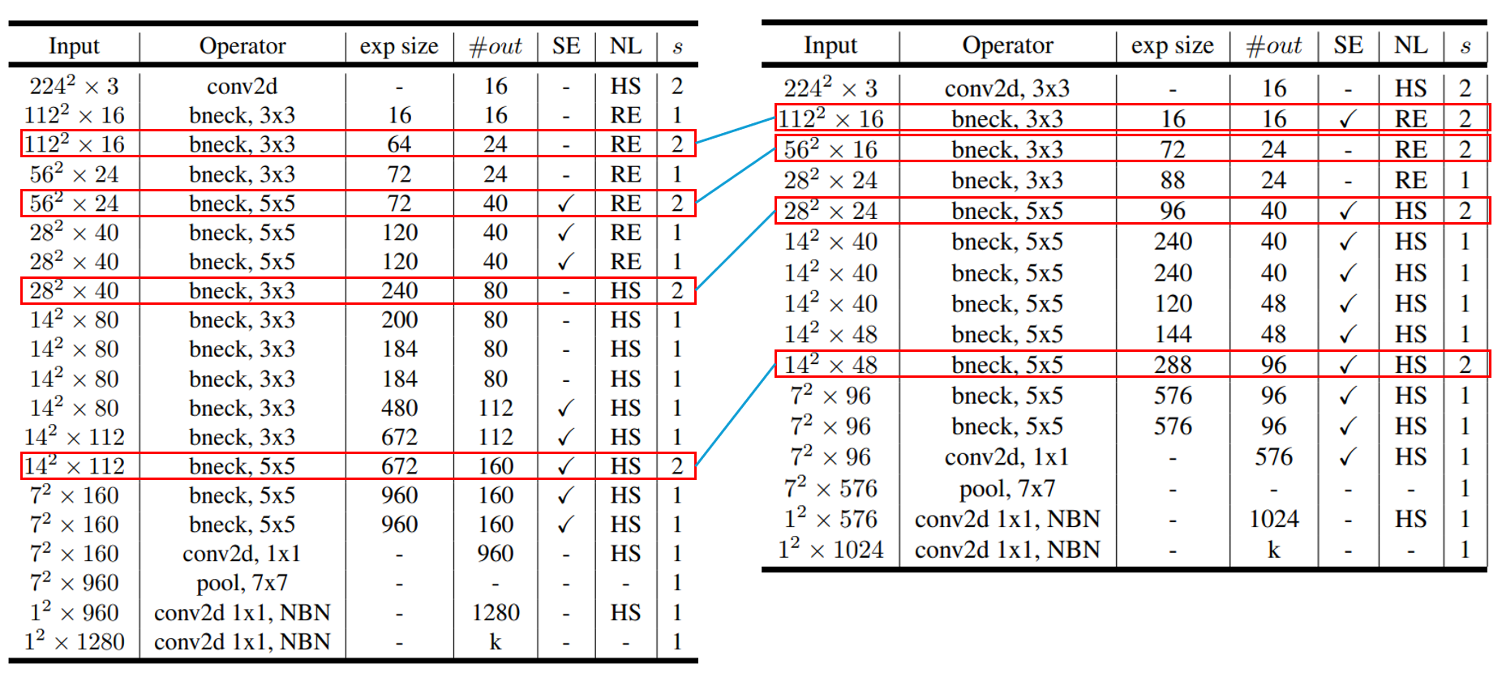
Recall

Slide 3
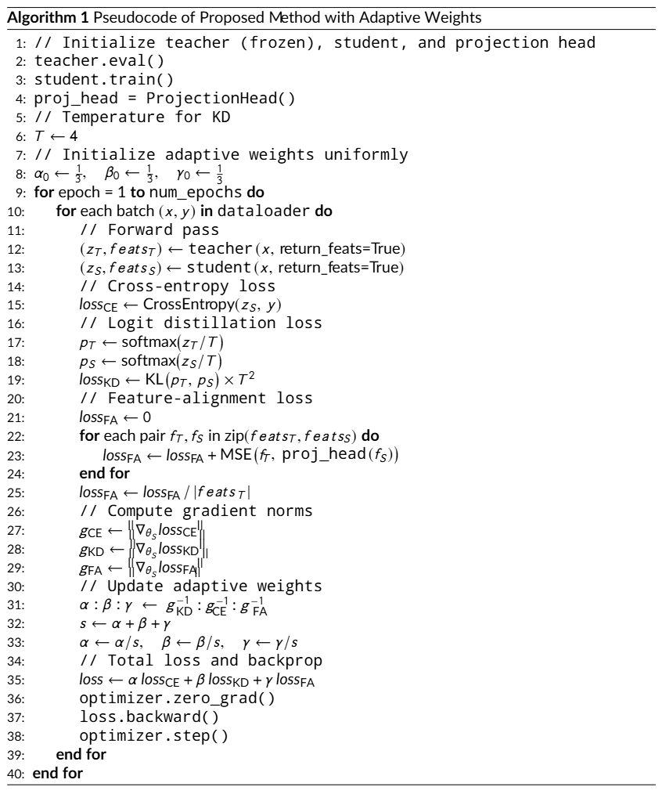
Recall

Slide 4
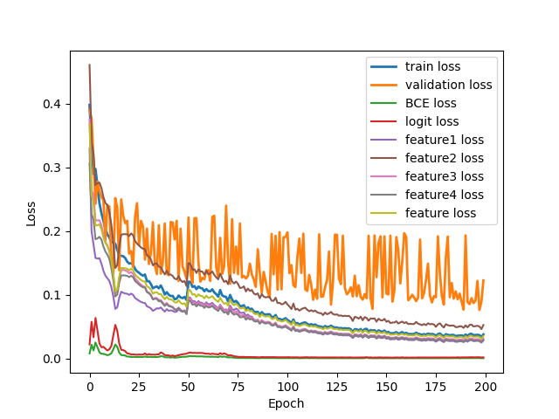
Loss Curve (Train)

Slide 5
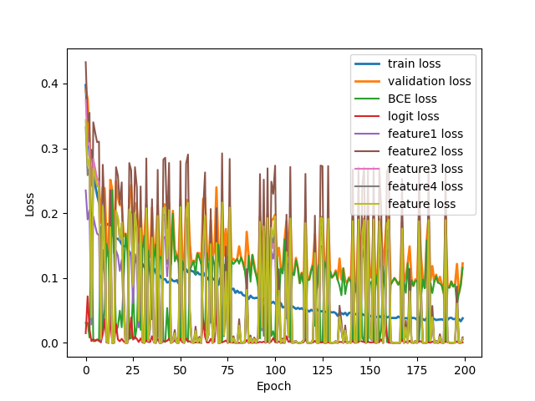
Loss Curve (Validate)

Slide 6
Assumption
Projection head wasn’t trained well
Conv2d(1x1) doesn’t suit to be projection head
  Maybe try nn.Linear() ?
Pick the wrong feature layer
  Maybe try other feature layers ?
MobileNet_V3_Small doesn’t have well generalize ability
  Since the BCELoss in validation is also fluctuate violently

