Slide 1
1/13 個人咪挺 MGD Implementation Result

Slide 2

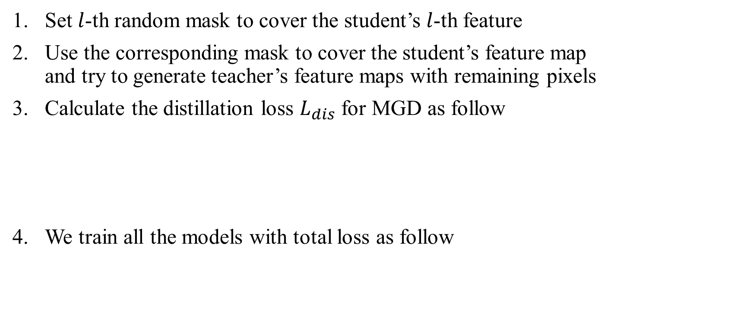
Recall – MGD Process
Set $l$-th random mask to cover the student’s $l$-th feature
Use the corresponding mask to cover the student’s feature map and try to generate teacher’s feature maps with remaining pixels
Calculate the distillation loss $L_{dis}$ for MGD as follow
We train all the models with total loss as follow

Slide 3
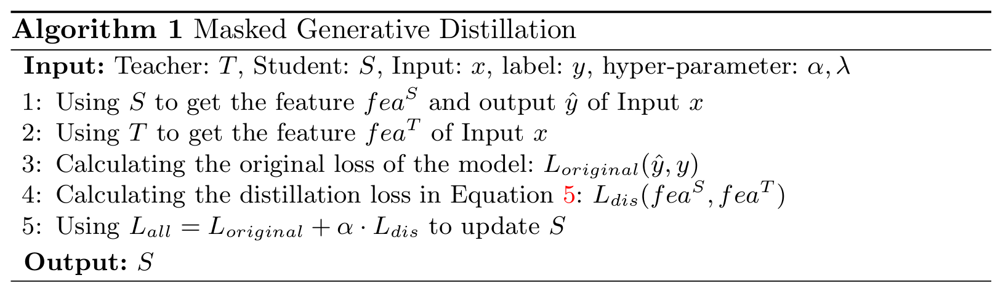
Recall – MGD Pseudo code

Slide 4
Train Setting
I5-10500 + 2080Ti
Random seed = 42
SGD(lr = 0.01, weight_decay = 1e-4) + BCEWithLogitsLoss + CosineAnnealingLR
alpha = 7e-5, lambda = 0.5
ABCD Dataset as training set (0.8 for training and 0.2 for validating)
Google Dataset as testing set
MobileNet_V3_Large as teacher model
MobileNet_V3_Small as student model
Teacher model is trained with 200 epochs

Slide 5
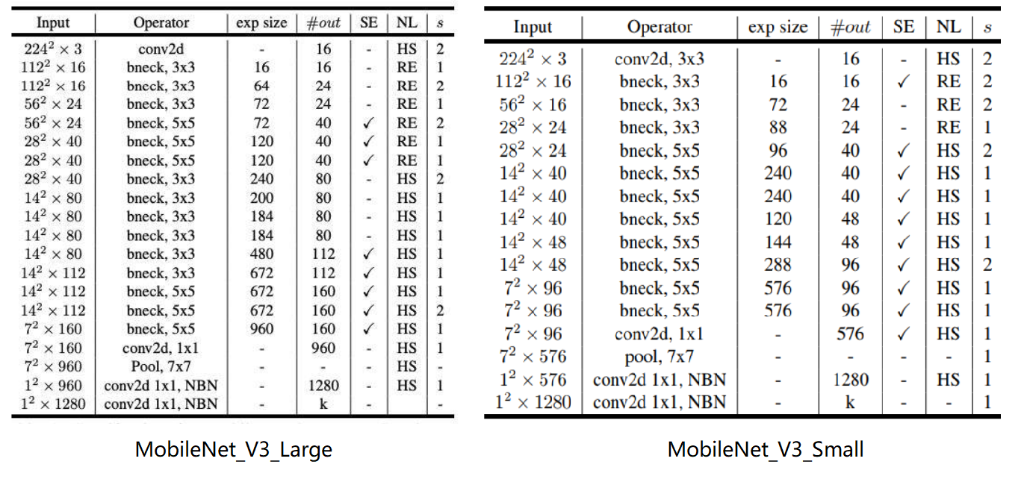
Selected Feature Layers

Slide 6
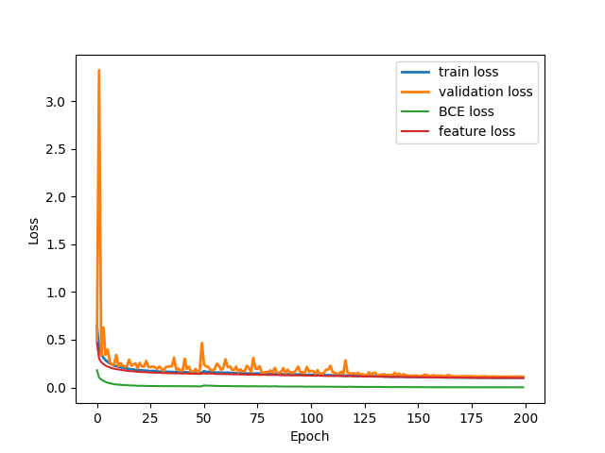
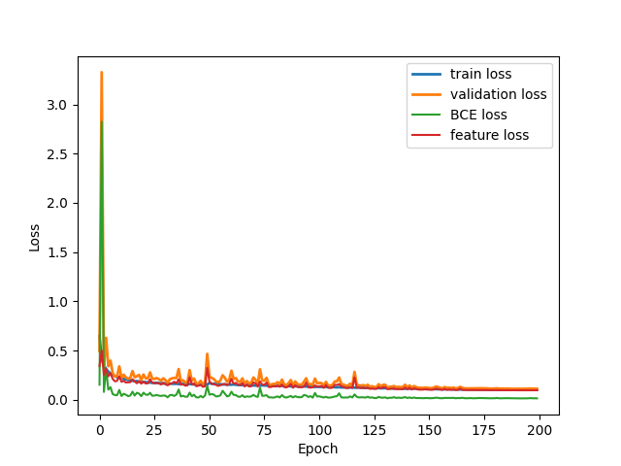
Loss Curve (MGD only)
Train
Validate

Slide 7
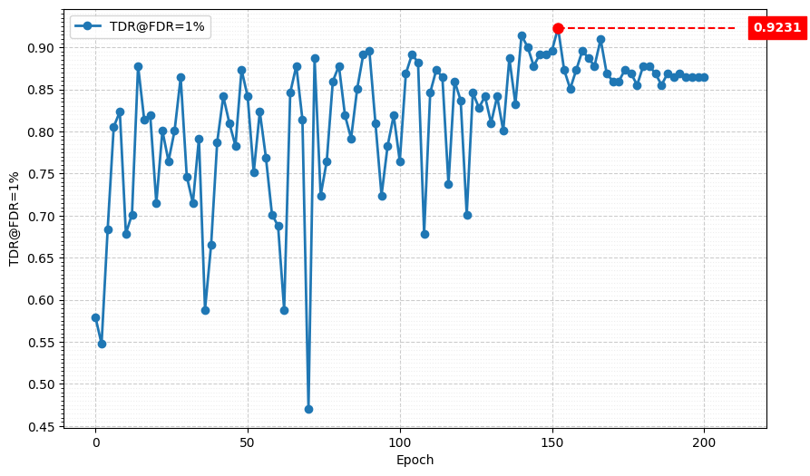
Metric Curve (TDR@FDR=1%)

Slide 8
Combine with Logit KD
I5-10500 + 2080Ti
Random seed = 42
SGD(lr = 1e-4, weight_decay = 1e-4) + BCEWithLogitsLoss + CosineAnnealingLR
alpha = 7e-5, lambda = 0.5
factor[‘BCE’] = factor[‘MGD’] = 1.0, factor[‘logit’] = 1.5
ABCD Dataset as training set (0.8 for training and 0.2 for validating)
Google Dataset as testing set
MobileNet_V3_Large as teacher model
MobileNet_V3_Small as student model
Teacher model is trained with 200 epochs

Slide 9
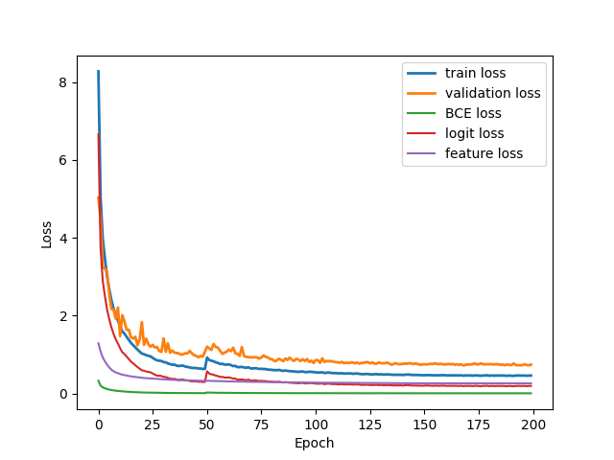
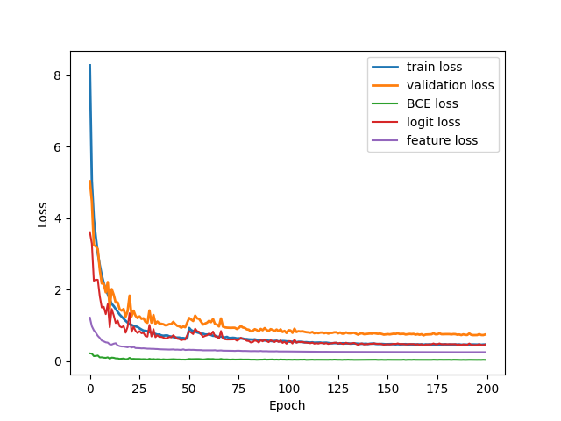
Loss Curve (MGD + logit KD)
Train
Validate

Slide 10
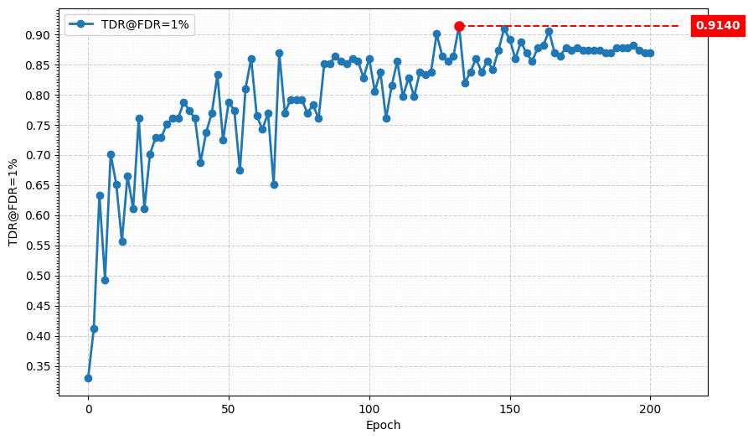
Metric Curve (TDR@FDR=1%)

Slide 11
Result Metric (TDR@FDR=1%)
Epoch Model | 50 | 80 | 100 | 130 | 150 | 180 | 200
Teacher | 69.23% | 80.54% | 94.12% | 54.75% | 91.40% | 72.85% | 89.59%
Student | 66.06% | 65.61% | 63.80% | 70.59% | 71.95% | 80.09% | 85.07%
MGD | 84.16% | 87.78% | 76.47% | 81.00% | 89.59% | 87.78% | 86.43%
MGD + Logit KD | 78.73% | 78.28% | 85.97% | 86.43% | 89.14% | 87.33% | 86.88%
Blue: Performance of the Teacher checkpoint used for KD.
Model | Best | In Epoch
Teacher | 94.12% | 100
Student | 85.07% | 200
MGD | 92.31% | 152
MGD + Logit KD | 91.40% | 132

Slide 12
Next
Try to combine AFL-KD (Adaptive Feature-Logit KD)
Re-train the teacher model with SGD and learning rate scheduler

