Slide 1
1/20 個人咪挺 The result of changing optimizer and lr_scheduler

Slide 2
Train Setting
Old
Adam(lr = 1e-4)
New
SGD(lr = 0.01, weight_decay = 1e-4) + CosineAnnealingLR

Slide 3
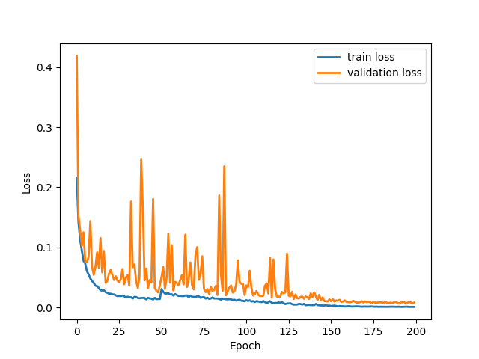
Loss Curve (MobileNet V3 Large)
Train
Validate

Slide 4
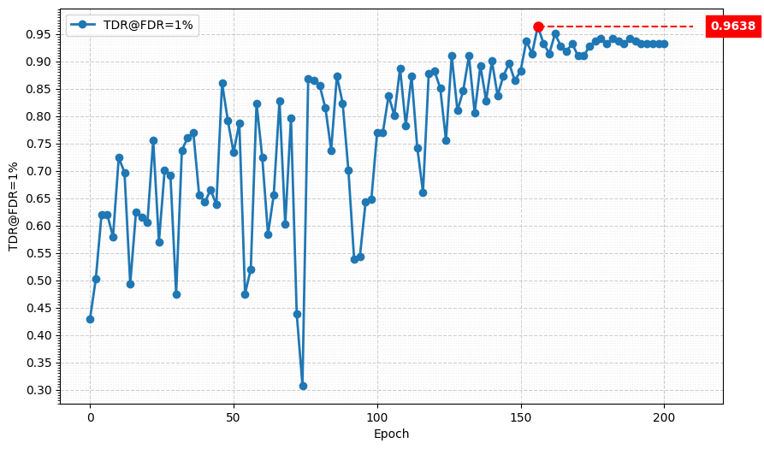
Metric Curve (TDR@FDR=1%)

Slide 5
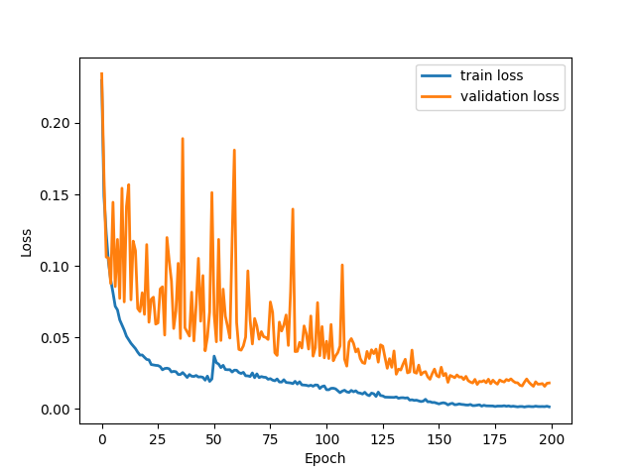
Loss Curve (MobileNet V3 Small)
Train
Validate

Slide 6
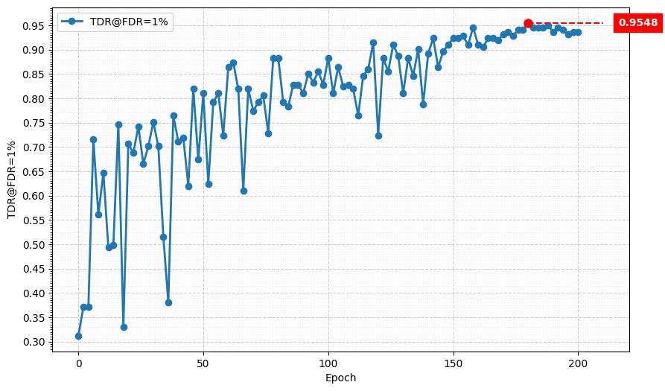
Metric Curve (TDR@FDR=1%)

Slide 7
Result Metric (TDR@FDR=1%)
Epoch Model | 50 | 80 | 100 | 130 | 150 | 180 | 200
Teacher, Adam | 69.23% | 80.54% | 94.12% | 54.75% | 91.40% | 72.85% | 89.59%
Student, Adam | 66.06% | 65.61% | 63.80% | 70.59% | 71.95% | 80.09% | 85.07%
Teacher SGD + lr_scheduler | 73.30% | 85.52% | 76.92% | 84.62% | 88.24% | 93.21% | 93.21%
Student SGD + lr_scheduler | 81.00% | 88.24% | 88.24% | 81.00% | 92.31% | 95.48% | 93.67%
Blue: Performance of the Teacher checkpoint used for KD.
Red: Best Performance in the performance trend table
Model | Best | In Epoch
Teacher, Adam | 94.12% | 100
Student, Adam | 85.07% | 200
Teacher SGD + lr_scheduler | 96.38% | 156
Student SGD + lr_scheduler | 95.48% | 180
HLCFN
best performance: 94.57%

Slide 8
Possible Reason
SGD configuration included “weight_decay” which can prevent overfitting by L2 Regularization
SGD tends to converge to Flat Minima which ensures the model is more roburt to slight variations in testing data
lr_scheduler allowed SGD to explore the loss landscape broadly in the early stage and finetune the weights with high precision
Notes:
L2 Regularization: 在計算 Loss 的時候會加上 weight 的 L2 norm

Slide 9
Re-train with New Teacher Checkpoint
I5-10500 + 2080Ti
Random seed = 42
SGD(lr = 1e-4, weight_decay = 1e-4) + BCEWithLogitsLoss + CosineAnnealingLR
alpha = 7e-5, lambda = 0.5
factor[‘BCE’] = factor[‘MGD’] = 1.0, factor[‘logit’] = 1.5
ABCD Dataset as training set (0.8 for training and 0.2 for validating)
Google Dataset as testing set
MobileNet_V3_Large as teacher model
MobileNet_V3_Small as student model
The performance of teacher model checkpoint is 96.38% (TDR@FDR=1%)

Slide 10
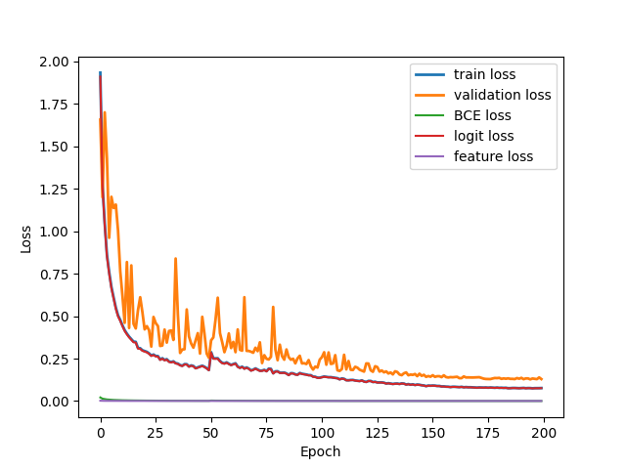
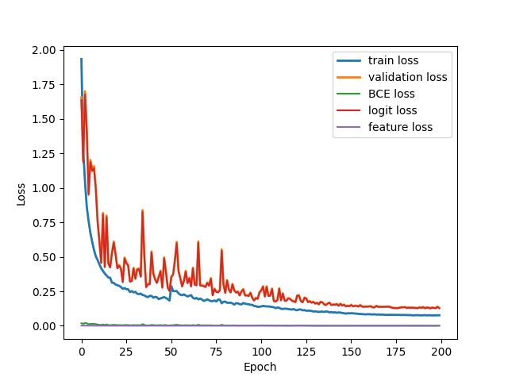
Loss Curve (MGD + logit KD)
Train
Validate

Slide 11
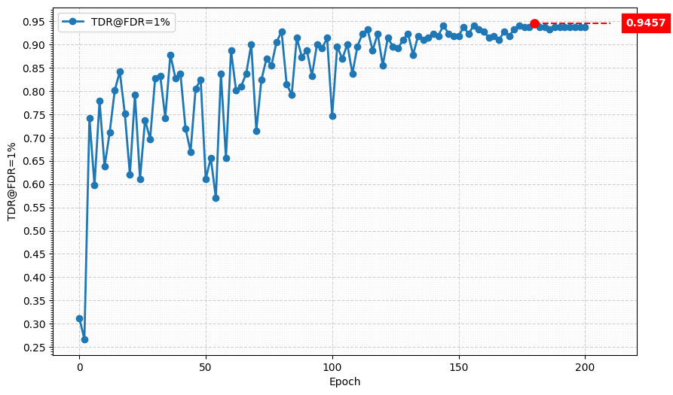
Metric Curve (TDR@FDR=1%)

Slide 12
Result Metric (TDR@FDR=1%)
Epoch Model | 50 | 80 | 100 | 130 | 150 | 180 | 200
MGD + Logit KD Adam | 78.73% | 78.28% | 85.97% | 86.43% | 89.14% | 87.33% | 86.88%
MGD + Logit KD SGD + lr_scheduler | 61.09% | 92.76% | 74.66% | 92.31% | 91.86% | 94.57% | 93.67%
Red: Best Performance in the performance trend table
Model | Best | In Epoch
MGD + Logit KD Adam | 91.40% | 132
MGD + Logit KD SGD + lr_scheduler | 94.57% | 180

Slide 13
Next
Re-train the student model with new teacher checkpoint by only use MGD
Finetune the hyper-parameters to see if we can get a more powerful teacher checkpoint

