Slide 1
1/26 個人咪挺 The result of changing optimizer and lr_scheduler

Slide 2

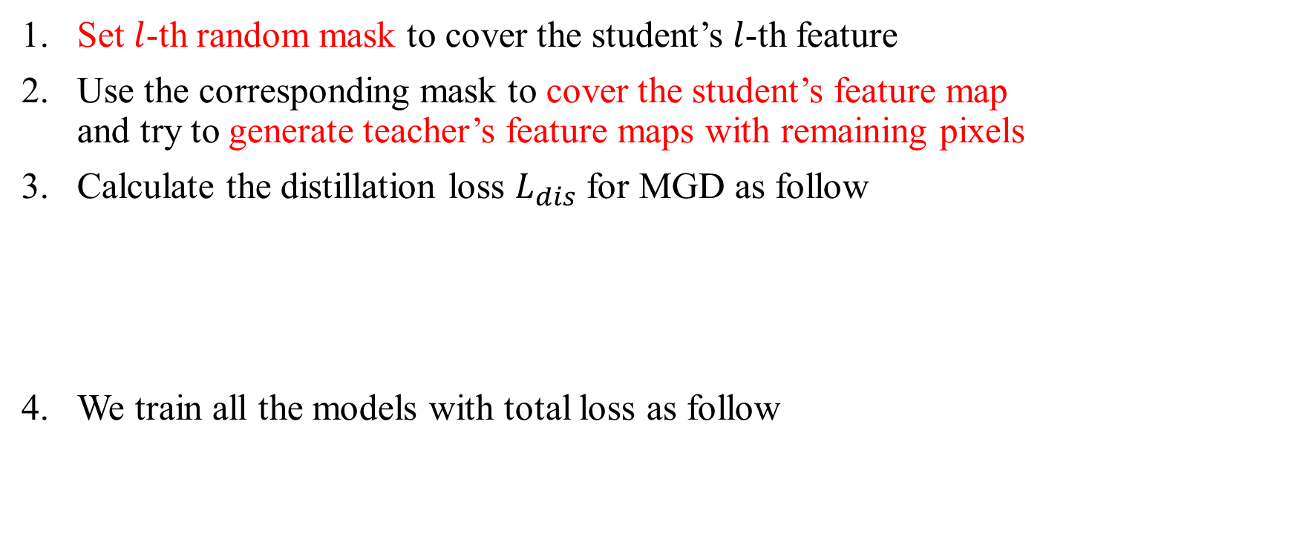
Recall – MGD Process
Set $l$-th random mask to cover the student’s $l$-th feature
Use the corresponding mask to cover the student’s feature map and try to generate teacher’s feature maps with remaining pixels
Calculate the distillation loss $L_{dis}$ for MGD as follow
We train all the models with total loss as follow

Slide 3
Train Setting
I5-10500 + 2080Ti
Random seed = 42
SGD(lr = 1e-4, weight_decay = 1e-4) + BCEWithLogitsLoss + CosineAnnealingLR
alpha = 7e-5, lambda = 0.5
factor[‘BCE’] = factor[‘MGD’] = 1.0
ABCD Dataset as training set (0.8 for training and 0.2 for validating)
Google Dataset as testing set
MobileNet_V3_Large as teacher model
MobileNet_V3_Small as student model
The performance of teacher model checkpoint is 96.38% (TDR@FDR=1%)

Slide 4
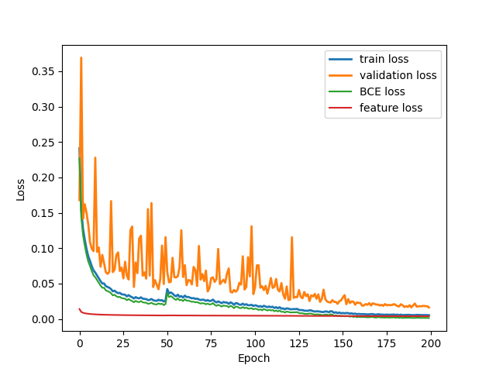
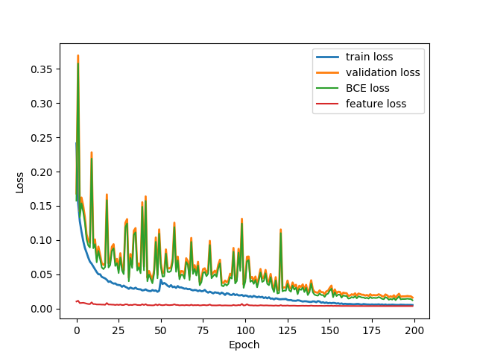
Loss Curve
Train
Validate

Slide 5
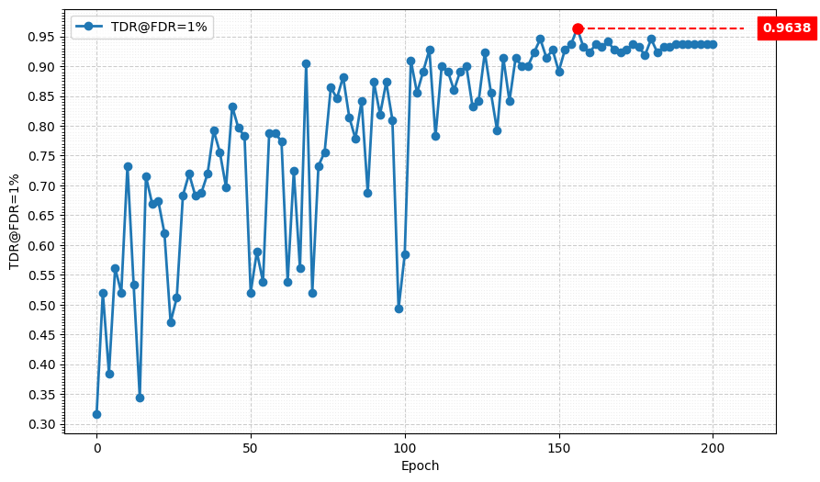
Metric Curve (TDR@FDR=1%)

Slide 6
Result Metric (TDR@FDR=1%)
Epoch Model | 50 | 80 | 100 | 130 | 150 | 180 | 200
Teacher SGD + lr_scheduler | 73.30% | 85.52% | 76.92% | 84.62% | 88.24% | 93.21% | 93.21%
Student SGD + lr_scheduler | 81.00% | 88.24% | 88.24% | 81.00% | 92.31% | 95.48% | 93.67%
MGD | 52.04% | 88.24% | 58.37% | 79.19% | 89.14% | 94.57% | 93.67%
Red: Best Performance in the performance trend table
Blue: Performance of the Teacher checkpoint used for KD.
Model | TDR@FDR=1% | ACE | APCER | BPCER | In Epoch
Teacher SGD + lr_scheduler | 96.38% | 2.26% | 3.62% | 0.90% | 156
Student SGD + lr_scheduler | 95.48% | 2.52% | 3.62% | 1.43% | 180
MGD | 96.38% | 1.71% | 1.81% | 1.62% | 156

