Slide 1
2/3 個人咪挺 The result of changing stride from 2 to 1

Slide 2
Idea
The original image (3x128x80) would be too small for classification after halving the size 5 times
The final dimensions of a 224x224 image after five downsamplings are comparable to those of the original image after four downsamplings (7x7 vs. 8x5)
Removing arbitrary layers will degrade model performance

Slide 3
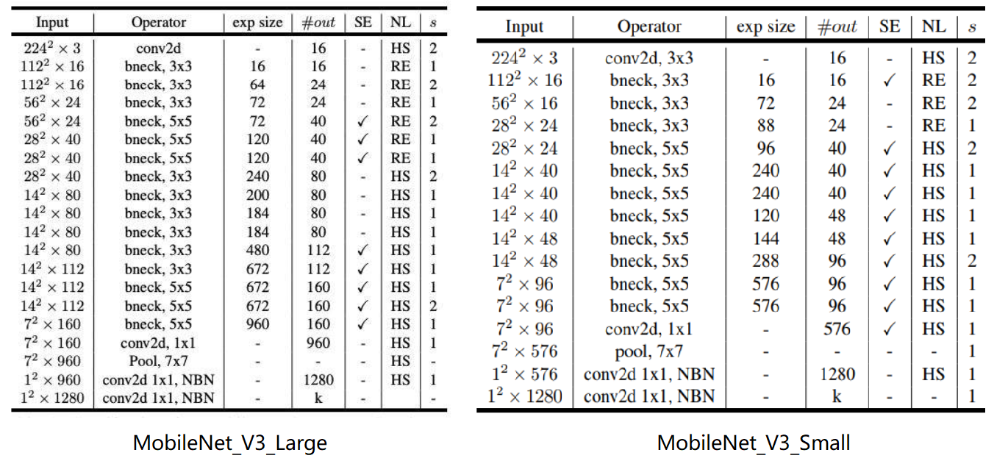
Notation
stride2[0]
stride2[0]
stride2[1]
stride2[1]
stride2[2]
stride2[2]
stride2[3]
stride2[3]
stride2[4]
stride2[4]

Slide 4
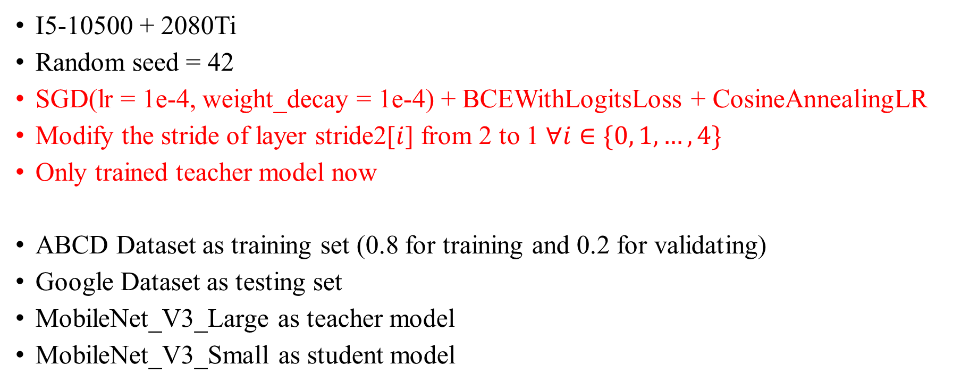
Train Setting
I5-10500 + 2080Ti
Random seed = 42
SGD(lr = 1e-4, weight_decay = 1e-4) + BCEWithLogitsLoss + CosineAnnealingLR
Modify the stride of layer stride2[$i$] from 2 to 1 $∀i∈\{0, 1, …, 4\}$
Only trained teacher model now
ABCD Dataset as training set (0.8 for training and 0.2 for validating)
Google Dataset as testing set
MobileNet_V3_Large as teacher model
MobileNet_V3_Small as student model

Slide 5
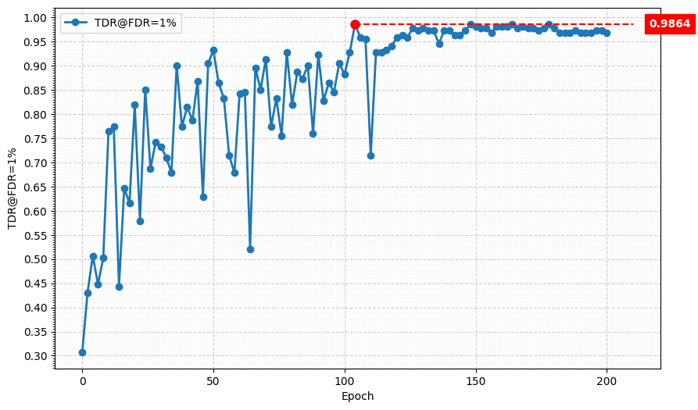
Metric Curve (TDR@FDR=1%, stride2[0])

Slide 6
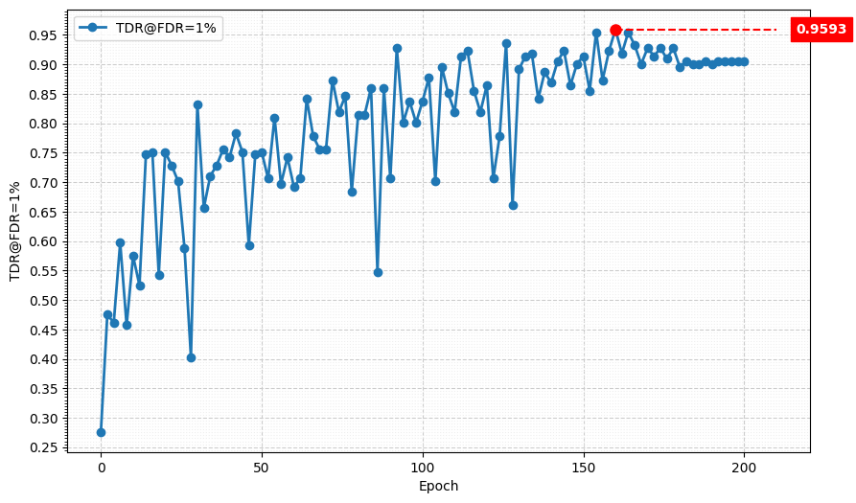
Metric Curve (TDR@FDR=1%, stride2[1])

Slide 7
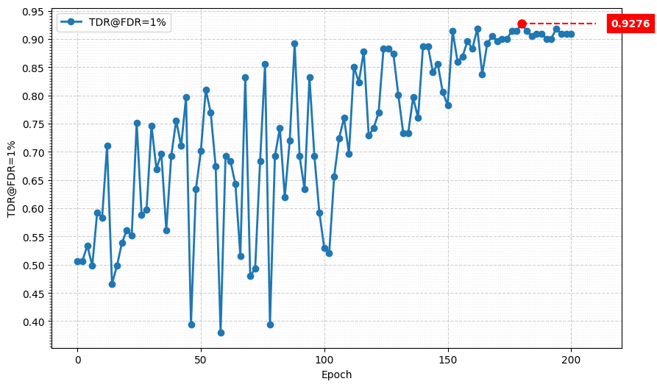
Metric Curve (TDR@FDR=1%, stride2[2])

Slide 8
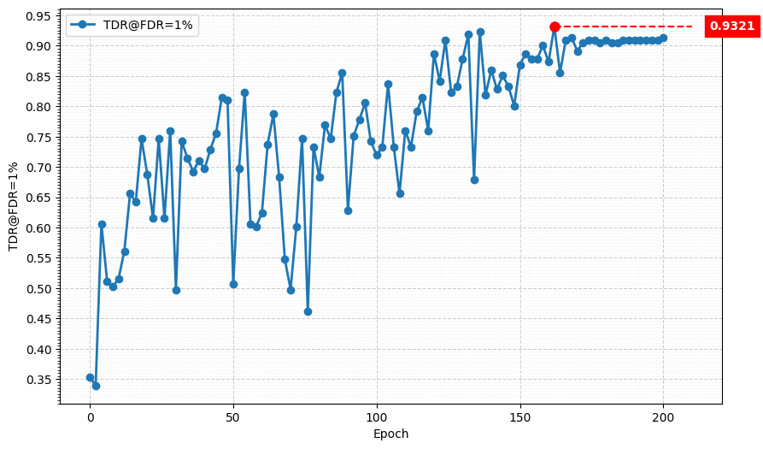
Metric Curve (TDR@FDR=1%, stride2[3])

Slide 9
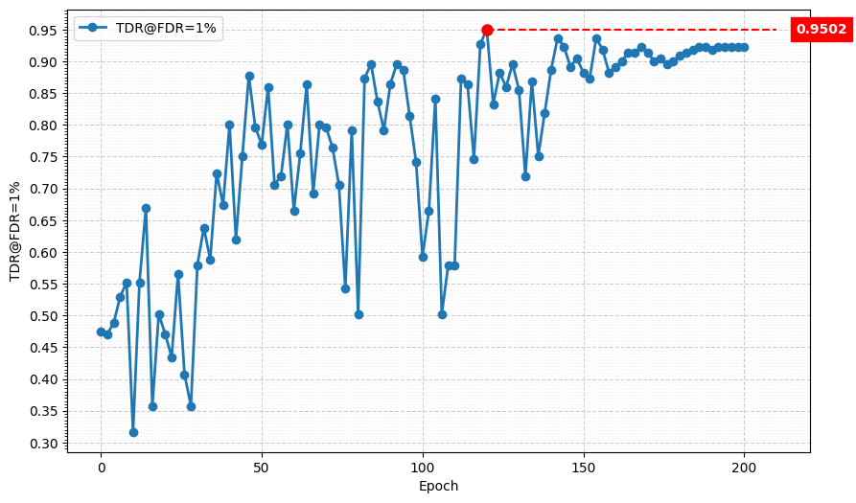
Metric Curve (TDR@FDR=1%, stride2[4])

Slide 10
Result Metric (TDR@FDR=1%)
Model (train image size) (test image size) | TDR@FDR=1% | ACE | APCER | BPCER | In Epoch
Teacher (3x224x224) (3x224x224) | 96.38% | 2.26% | 3.62% | 0.90% | 156
Student (3x224x224) (3x224x224) | 95.48% | 2.52% | 3.62% | 1.43% | 180
Teacher (3x224x224) (3x128x80) | 16.29% | 39.40% | 68.33% | 10.47% | 14
Student (3x224x224) (3x128x80) | 21.27% | 38.99% | 72.58% | 5.14% | 24
Teacher, stride2[0] (3x128x80) (3x128x80) | 98.64% | 1.02% | 0.9% | 1.14% | 104
Teacher, stride2[1] (3x128x80) (3x128x80) | 95.93% | 2.38% | 3.62% | 1.14% | 160
Teacher, stride2[2] (3x128x80) (3x128x80) | 92.76% | 3.74% | 5.43% | 2.05% | 180
Teacher, stride2[3] (3x128x80) (3x128x80) | 93.21% | 2.40% | 2.71% | 2.09% | 162
Teacher, stride2[4] (3x128x80) (3x128x80) | 95.02% | 2.36% | 2.71% | 2.00% | 120
Teacher:
MobileNet V3 Large
Student:
MobileNet V3 Small

Slide 11
Result Metric (MMAC)
Teacher:
MobileNet V3 Large
Student:
MobileNet V3 Small
Model (Test image size) | MACs (Approx. inference time)
Teacher, torchvision version (3x224x224) | 230.04M MAC (136.93 ms)
Teacher, handwrite version (3x224x224) | 230.93M MAC (137.46 ms)
Teacher, torchvision version (3x128x80) | 51.05M MAC (30.39 ms)
Teacher, handwrite version (3x128x80) | 51.24M MAC (30.50 ms)
Teacher, handwrite version, stride2[0] (3x128x80) | 189.02M MAC (112.51 ms)
Teacher, handwrite version, stride2[1] (3x128x80) | 171.57M MAC (102.125 ms)
Teacher, handwrite version, stride2[2] (3x128x80) | 153.8M MAC (91.55 ms)
Teacher, handwrite version, stride2[3] (3x128x80) | 133.03M MAC (79.18 ms)
Teacher, handwrite version, stride2[4] (3x128x80) | 78.1M MAC (76.49 ms)
Model (Test image size) | MACs (Approx. inference time)
Student, torchvision version (3x224x224) | 59.89M MAC (35.65 ms)
Student, handwrite version (3x224x224) | 60.07M MAC (35.76 ms)
Student, torchvision version (3x128x80) | 13.76M MAC (8.19 ms)
Student, handwrite version (3x128x80) | 13.8M MAC (8.21 ms)
Student, handwrite version, stride2[0] (3x128x80) | 49.23M MAC (29.30 ms)
Student, handwrite version, stride2[1] (3x128x80) | 45.66M MAC (27.18 ms)
Student, handwrite version, stride2[2] (3x128x80) | 41.82M MAC (24.89 ms)
Student, handwrite version, stride2[3] (3x128x80) | 36.51M MAC (21.73 ms)
Student, handwrite version, stride2[4] (3x128x80) | 23.63M MAC (14.07 ms)

