Slide 1
2/11 團體咪挺 The result of changing stride from 2 to 1 and MGD

Slide 2
Recall – Idea
The original image (3x128x80) would be too small for classification after halving the size 5 times
The final dimensions of a 224x224 image after five downsamplings are comparable to those of the original image after four downsamplings (7x7 vs. 8x5)
Removing arbitrary layers will degrade model performance

Slide 3
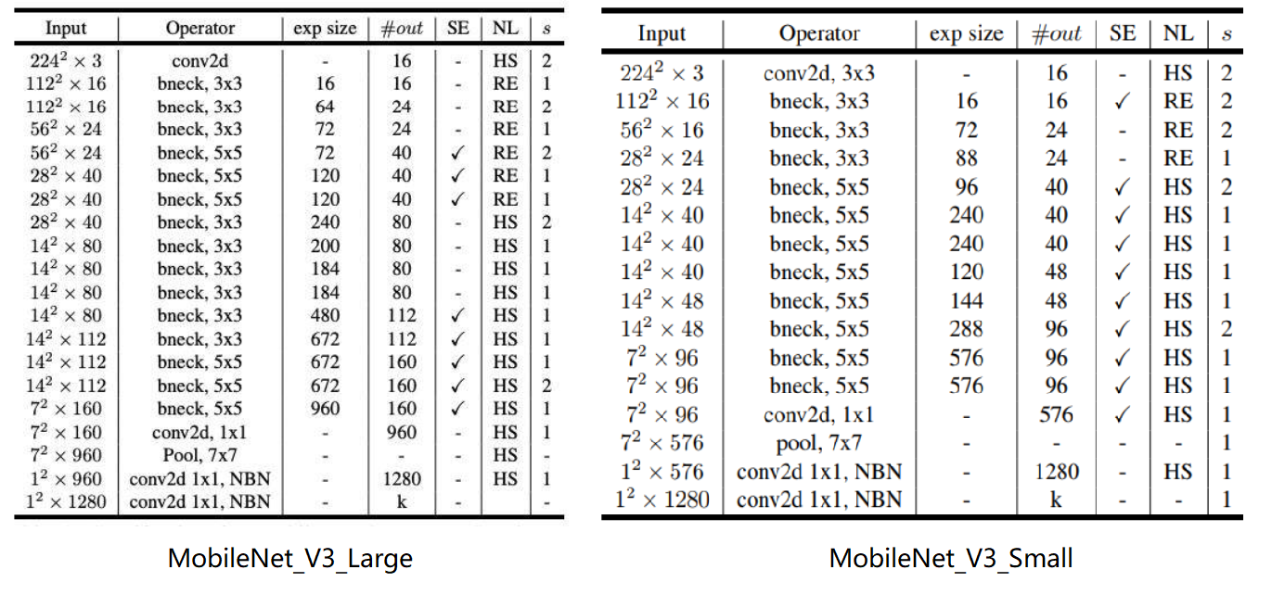
Notation
stride2[0]
stride2[0]
stride2[1]
stride2[1]
stride2[2]
stride2[2]
stride2[3]
stride2[3]
stride2[4]
stride2[4]

Slide 4
Recall – Result Metric (MMAC)
Teacher:
MobileNet V3 Large
Student:
MobileNet V3 Small
Model (Test image size) | MACs (Approx. inference time)
Teacher, torchvision version (3x224x224) | 230.04M MAC (136.93 ms)
Teacher, handwrite version (3x224x224) | 230.93M MAC (137.46 ms)
Teacher, torchvision version (3x128x80) | 51.05M MAC (30.39 ms)
Teacher, handwrite version (3x128x80) | 51.24M MAC (30.50 ms)
Teacher, handwrite version, stride2[0] (3x128x80) | 189.02M MAC (112.51 ms)
Teacher, handwrite version, stride2[1] (3x128x80) | 171.57M MAC (102.125 ms)
Teacher, handwrite version, stride2[2] (3x128x80) | 153.8M MAC (91.55 ms)
Teacher, handwrite version, stride2[3] (3x128x80) | 133.03M MAC (79.18 ms)
Teacher, handwrite version, stride2[4] (3x128x80) | 78.1M MAC (76.49 ms)
Model (Test image size) | MACs (Approx. inference time)
Student, torchvision version (3x224x224) | 59.89M MAC (35.65 ms)
Student, handwrite version (3x224x224) | 60.07M MAC (35.76 ms)
Student, torchvision version (3x128x80) | 13.76M MAC (8.19 ms)
Student, handwrite version (3x128x80) | 13.8M MAC (8.21 ms)
Student, handwrite version, stride2[0] (3x128x80) | 49.23M MAC (29.30 ms)
Student, handwrite version, stride2[1] (3x128x80) | 45.66M MAC (27.18 ms)
Student, handwrite version, stride2[2] (3x128x80) | 41.82M MAC (24.89 ms)
Student, handwrite version, stride2[3] (3x128x80) | 36.51M MAC (21.73 ms)
Student, handwrite version, stride2[4] (3x128x80) | 23.63M MAC (14.07 ms)

Slide 5
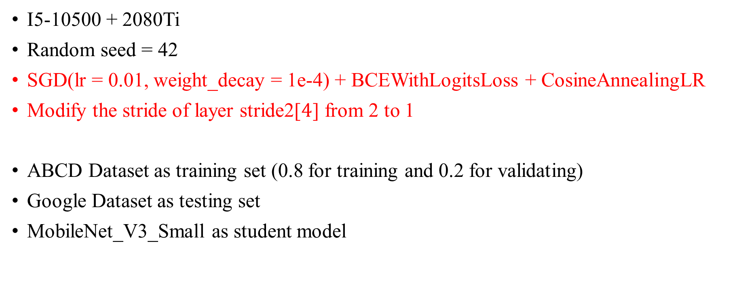
Train Setting – Baseline of Student
I5-10500 + 2080Ti
Random seed = 42
SGD(lr = 0.01, weight_decay = 1e-4) + BCEWithLogitsLoss + CosineAnnealingLR
Modify the stride of layer stride2[$4$] from 2 to 1
ABCD Dataset as training set (0.8 for training and 0.2 for validating)
Google Dataset as testing set
MobileNet_V3_Small as student model

Slide 6
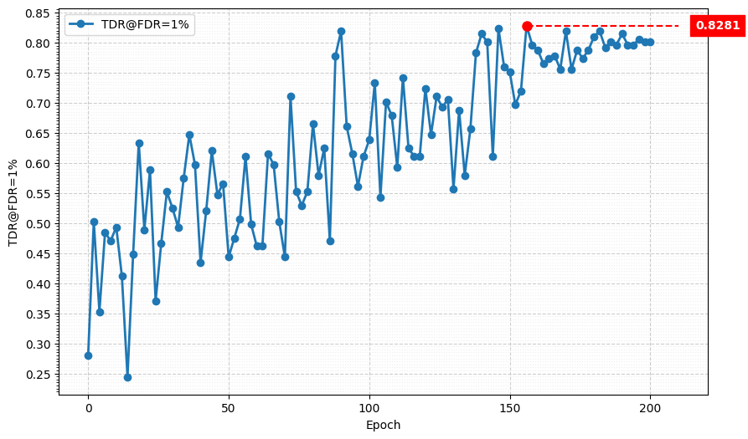
Metric Curve (TDR@FDR=1%, stride2[4])

Slide 7

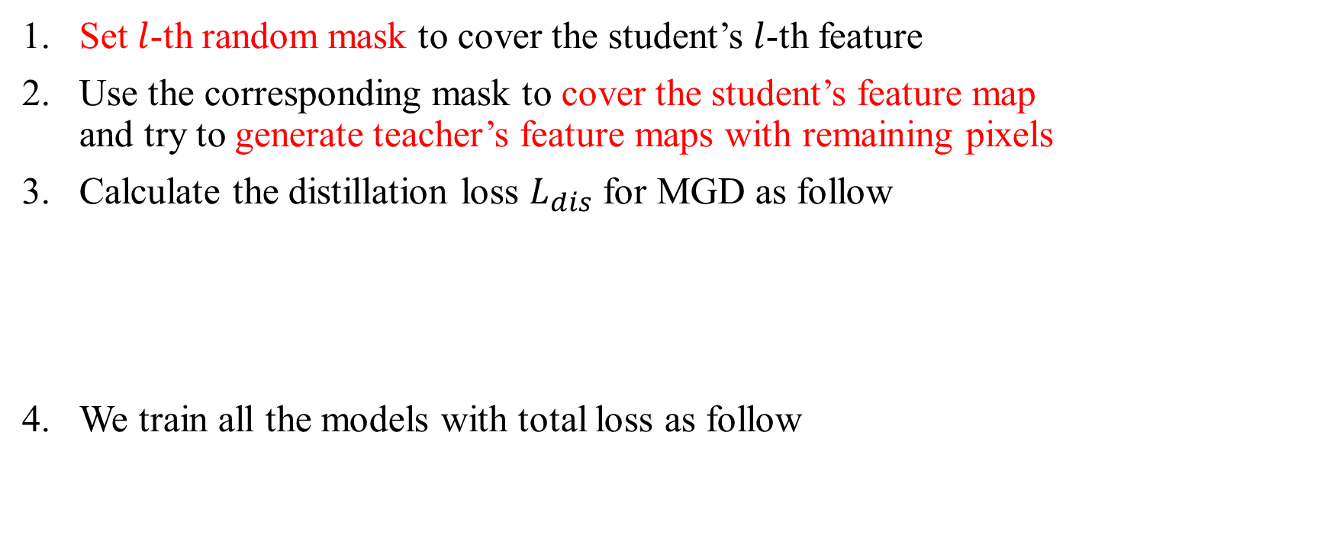
Recall – MGD Process
Set $l$-th random mask to cover the student’s $l$-th feature
Use the corresponding mask to cover the student’s feature map and try to generate teacher’s feature maps with remaining pixels
Calculate the distillation loss $L_{dis}$ for MGD as follow
We train all the models with total loss as follow

Slide 8
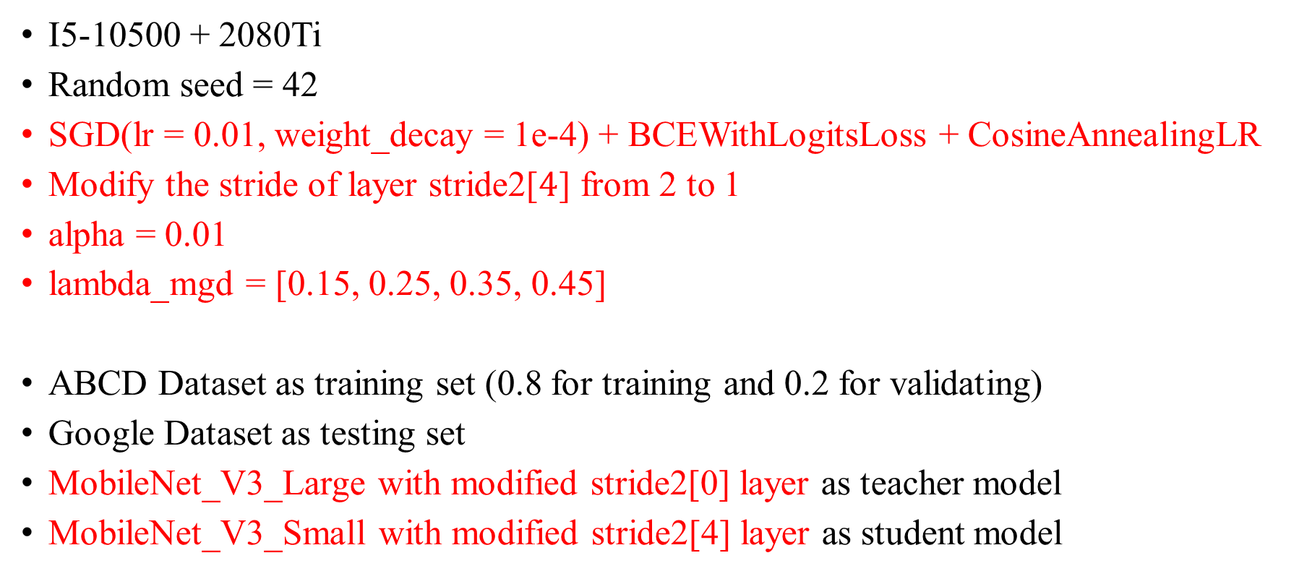
Train Setting – MGD
I5-10500 + 2080Ti
Random seed = 42
SGD(lr = 0.01, weight_decay = 1e-4) + BCEWithLogitsLoss + CosineAnnealingLR
Modify the stride of layer stride2[$4$] from 2 to 1
alpha = 0.01
lambda_mgd = [0.15, 0.25, 0.35, 0.45]
ABCD Dataset as training set (0.8 for training and 0.2 for validating)
Google Dataset as testing set
MobileNet_V3_Large with modified stride2[0] layer as teacher model
MobileNet_V3_Small with modified stride2[4] layer as student model

Slide 9
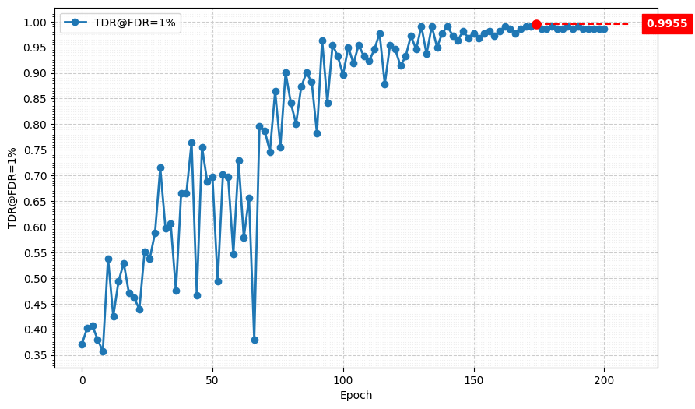
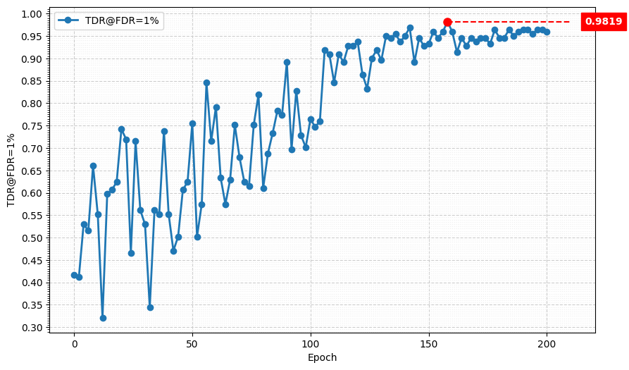
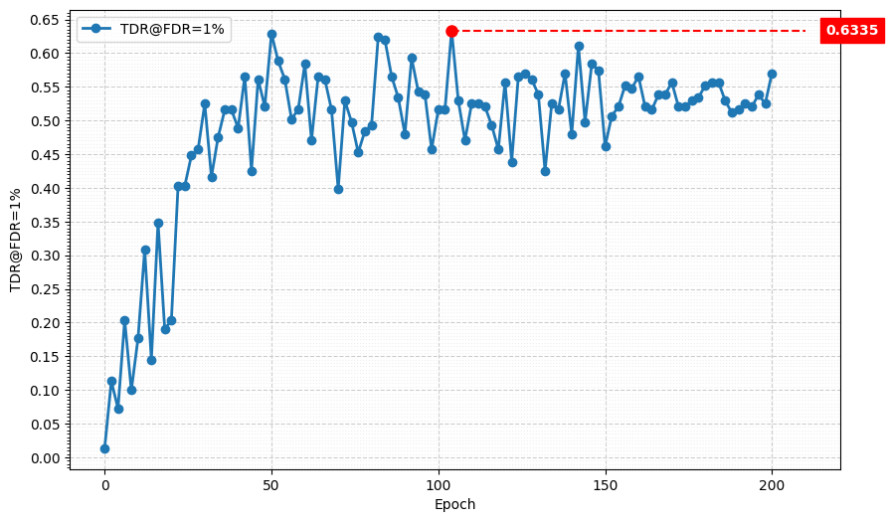
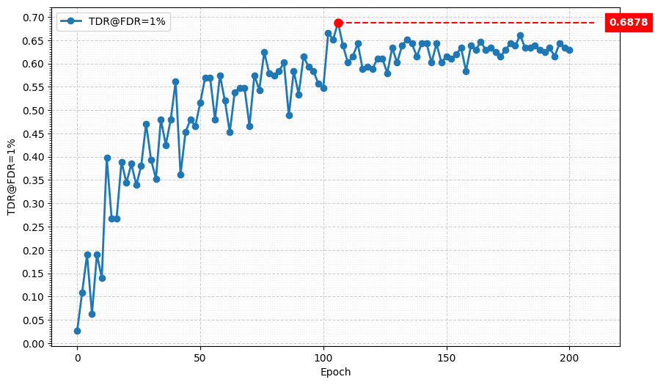
Metric Curve (TDR@FDR=1%)
lambda_mgd = 0.15
lambda_mgd = 0.25
lambda_mgd = 0.35
lambda_mgd = 0.45

Slide 10
Result Metric (TDR@FDR=1%)
Model | TDR@FDR=1% | ACE | APCER | BPCER | In Epoch
Teacher, stride2[0] | 98.64% | 1.02% | 0.9% | 1.14% | 104
Student, stride2[4] | 82.81% | 5.09% | 6.33% | 3.85% | 156
Student, MGD, lambda_mgd = 0.15 | 99.55% | 0.70% | 0.45% | 0.95% | 174
Student, MGD, lambda_mgd = 0.25 | 98.19% | 1.14% | 0.90% | 1.38% | 158
Student, MGD, lambda_mgd = 0.35 | 63.35% | 10.81% | 15.38% | 6.23% | 104
Student, MGD, lambda_mgd = 0.45 | 68.78% | 9.59% | 11.76% | 7.42% | 106
Teacher:
MobileNet V3 Large
Student:
MobileNet V3 Small

