Slide 1
3/3 個人咪挺 The result of changing batch size from 32 to 64

Slide 2
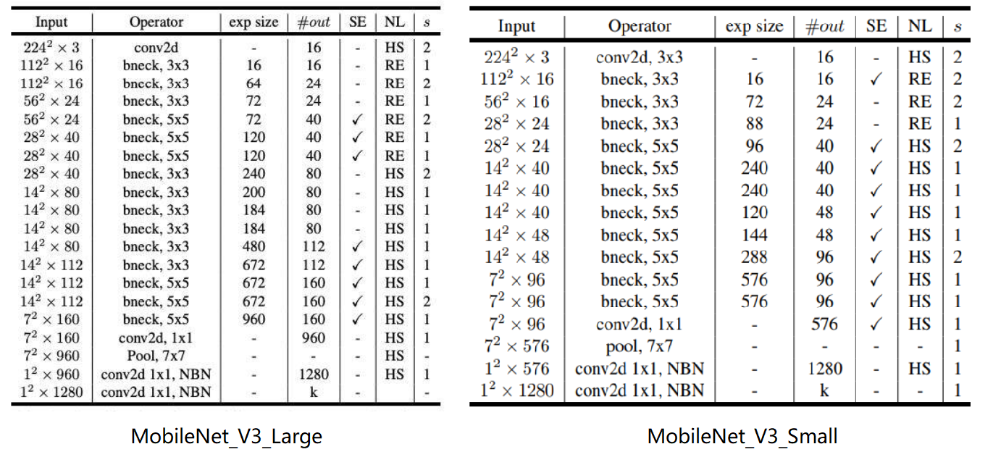
Notation
stride2[0]
stride2[0]
stride2[1]
stride2[1]
stride2[2]
stride2[2]
stride2[3]
stride2[3]
stride2[4]
stride2[4]

Slide 3
Recall – Result Metric (MMAC)
Teacher:
MobileNet V3 Large
Student:
MobileNet V3 Small
Model (Test image size) | MACs (Approx. inference time)
Teacher, torchvision version (3x224x224) | 230.04M MAC (136.93 ms)
Teacher, handwrite version (3x224x224) | 230.93M MAC (137.46 ms)
Teacher, torchvision version (3x128x80) | 51.05M MAC (30.39 ms)
Teacher, handwrite version (3x128x80) | 51.24M MAC (30.50 ms)
Teacher, handwrite version, stride2[0] (3x128x80) | 189.02M MAC (112.51 ms)
Teacher, handwrite version, stride2[1] (3x128x80) | 171.57M MAC (102.125 ms)
Teacher, handwrite version, stride2[2] (3x128x80) | 153.8M MAC (91.55 ms)
Teacher, handwrite version, stride2[3] (3x128x80) | 133.03M MAC (79.18 ms)
Teacher, handwrite version, stride2[4] (3x128x80) | 78.1M MAC (76.49 ms)
Model (Test image size) | MACs (Approx. inference time)
Student, torchvision version (3x224x224) | 59.89M MAC (35.65 ms)
Student, handwrite version (3x224x224) | 60.07M MAC (35.76 ms)
Student, torchvision version (3x128x80) | 13.76M MAC (8.19 ms)
Student, handwrite version (3x128x80) | 13.8M MAC (8.21 ms)
Student, handwrite version, stride2[0] (3x128x80) | 49.23M MAC (29.30 ms)
Student, handwrite version, stride2[1] (3x128x80) | 45.66M MAC (27.18 ms)
Student, handwrite version, stride2[2] (3x128x80) | 41.82M MAC (24.89 ms)
Student, handwrite version, stride2[3] (3x128x80) | 36.51M MAC (21.73 ms)
Student, handwrite version, stride2[4] (3x128x80) | 23.63M MAC (14.07 ms)

Slide 4

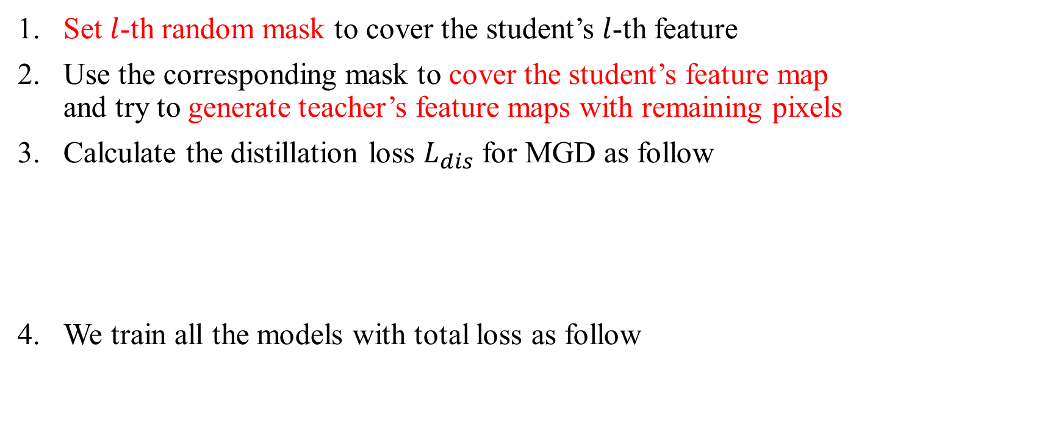
Recall – MGD Process
Set $l$-th random mask to cover the student’s $l$-th feature
Use the corresponding mask to cover the student’s feature map and try to generate teacher’s feature maps with remaining pixels
Calculate the distillation loss $L_{dis}$ for MGD as follow
We train all the models with total loss as follow

Slide 5
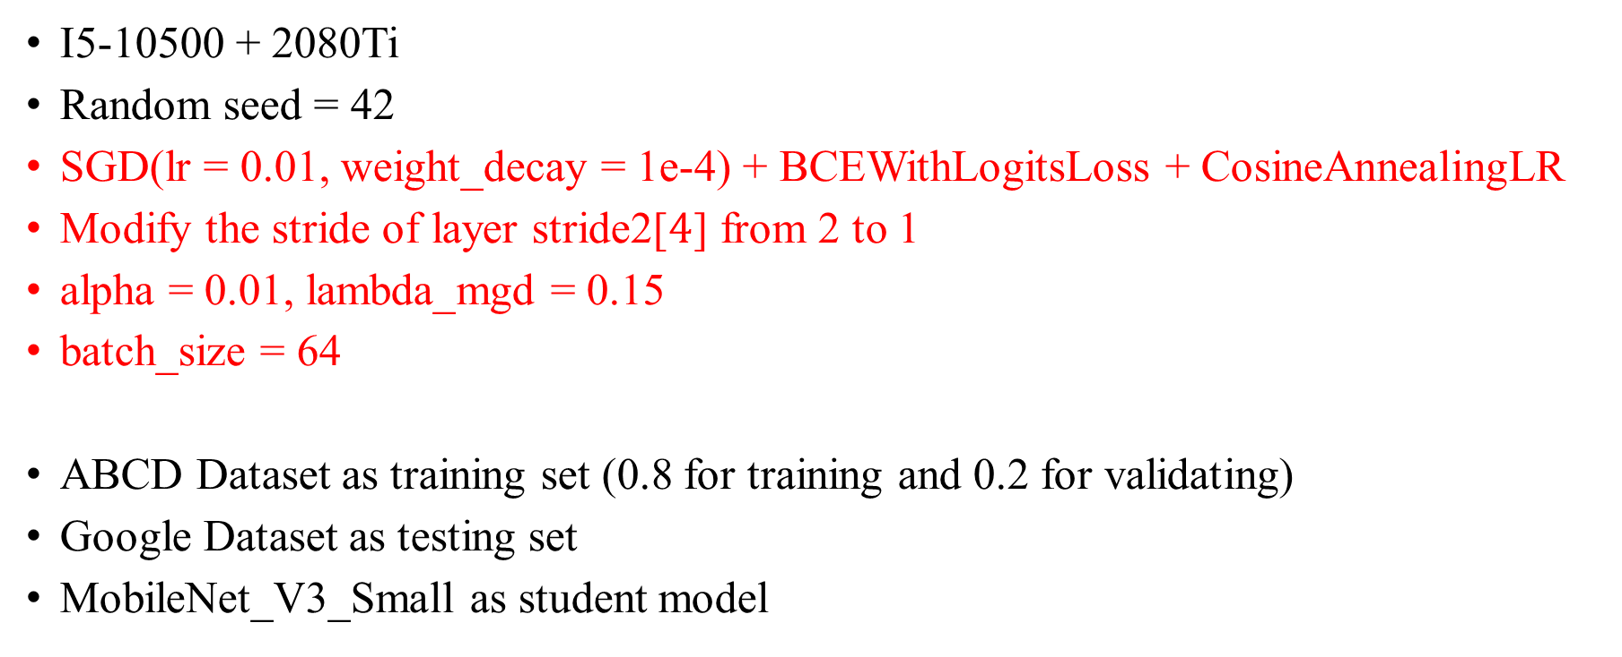
Train Setting I.
I5-10500 + 2080Ti
Random seed = 42
SGD(lr = 0.01, weight_decay = 1e-4) + BCEWithLogitsLoss + CosineAnnealingLR
Modify the stride of layer stride2[$4$] from 2 to 1
alpha = 0.01, lambda_mgd = 0.15
batch_size = 64
ABCD Dataset as training set (0.8 for training and 0.2 for validating)
Google Dataset as testing set
MobileNet_V3_Small as student model

Slide 6
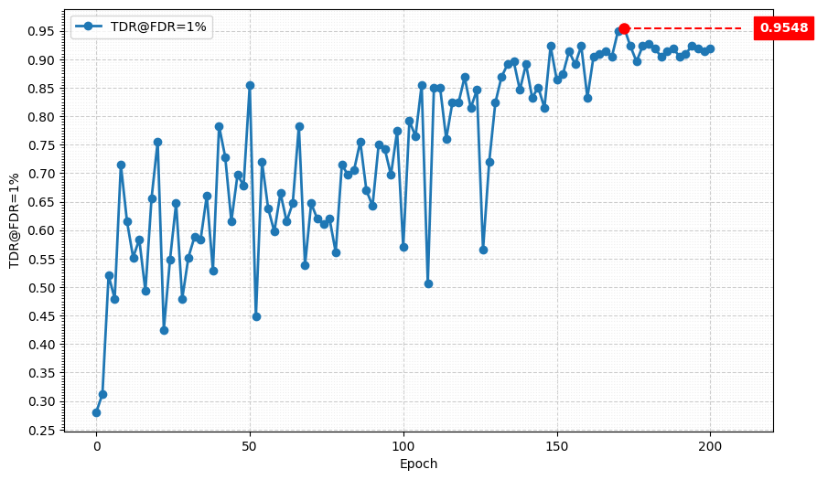
Metric Curve I. (TDR@FDR=1%)

Slide 7
Review I.
Best performance degraded around 4% when increasing the batch size beyond 32
After doing some research, we propose adjusting the learning rate proportionally to the batch size

Slide 8
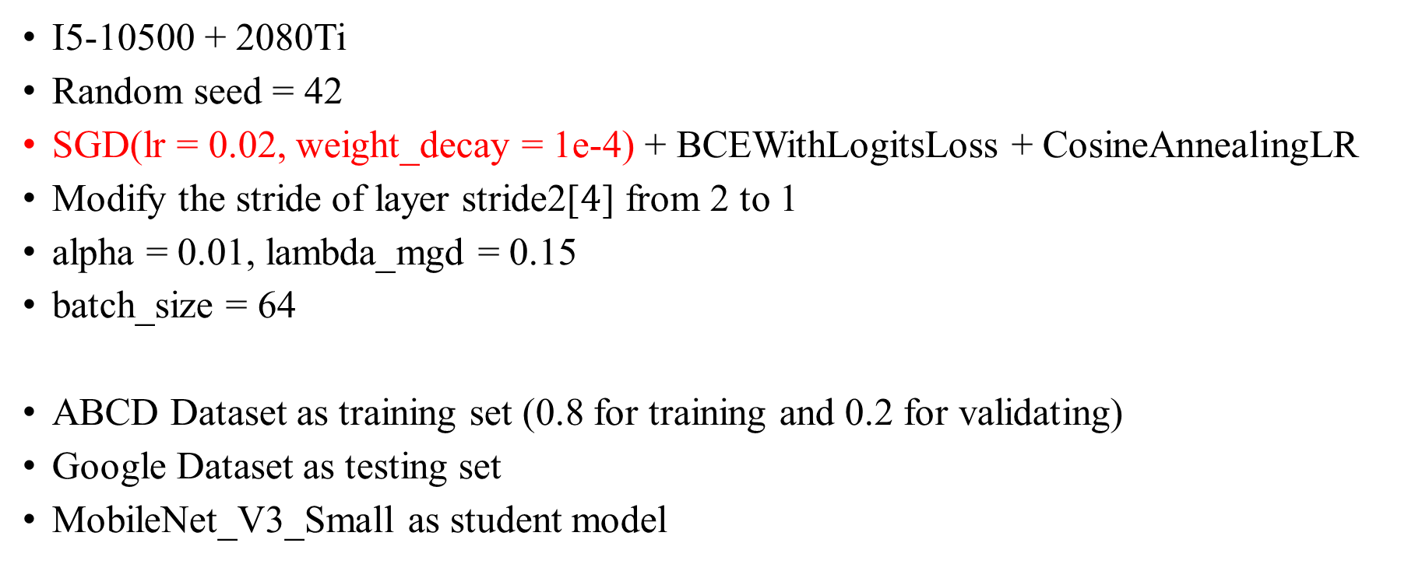
Train Setting II.
I5-10500 + 2080Ti
Random seed = 42
SGD(lr = 0.02, weight_decay = 1e-4) + BCEWithLogitsLoss + CosineAnnealingLR
Modify the stride of layer stride2[$4$] from 2 to 1
alpha = 0.01, lambda_mgd = 0.15
batch_size = 64
ABCD Dataset as training set (0.8 for training and 0.2 for validating)
Google Dataset as testing set
MobileNet_V3_Small as student model

Slide 9
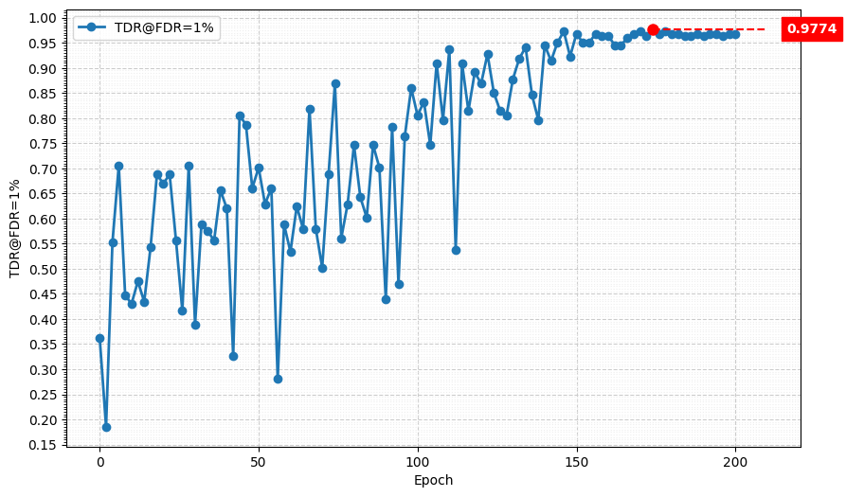
Metric Curve II. (TDR@FDR=1%)

Slide 10
Result Metric (TDR@FDR=1%)
Model | TDR@FDR=1% | ACE | APCER | BPCER | In Epoch | Training Time
Teacher, stride2[0] | 98.64% | 1.02% | 0.9% | 1.14% | 104 | 19hr 29min
Student, stride2[4] | 82.81% | 5.09% | 6.33% | 3.85% | 156 | 12hr 48min
MGD, batch_size = 32, lr = 0.01 | 99.55% | 0.70% | 0.45% | 0.95% | 174 | 21hr 35min
MGD, batch_size = 64, lr = 0.01 | 95.48% | 1.80% | 1.36% | 2.24% | 172 | 13hr 16min
MGD, batch_size = 64, lr = 0.02 | 97.74% | 1.50% | 1.81% | 1.19% | 174 | 13hr 06min
Teacher:
MobileNet V3 Large
Student:
MobileNet V3 Small

