Slide 1
11/18 團體咪挺 AFL-KD 進度報告

Slide 2
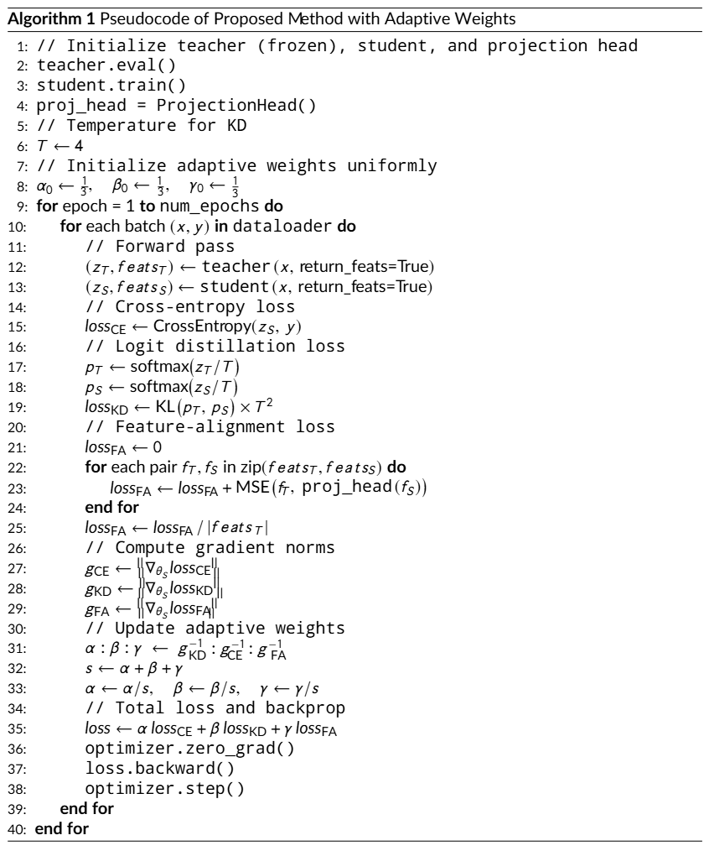
Pseudo Algoithm

Slide 3
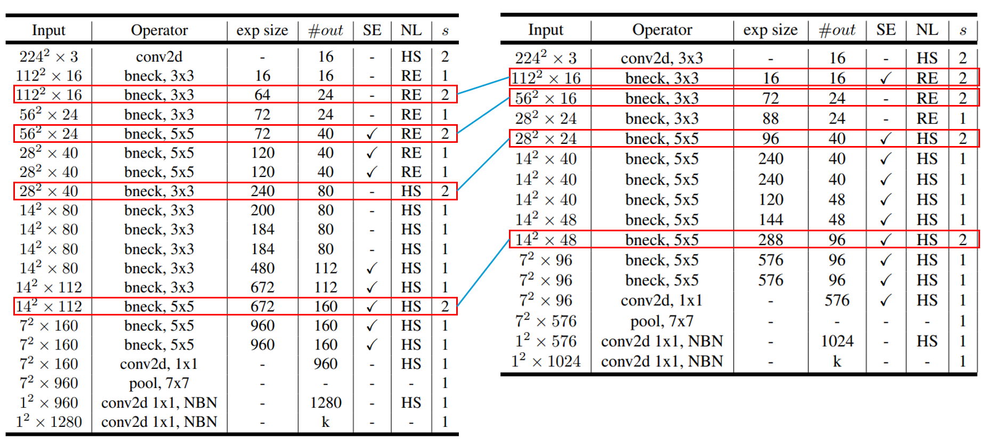
Selected Layers

Slide 4
Train Setting
I5-10500 + 2080Ti
Random seed = 42
Adam(lr = 1e-4) + BCELoss
ABCD Dataset as training set (0.8 for training and 0.2 for validating)
Google Dataset as testing set
MobileNet_V3_Large as teacher model
MobileNet_V3_Small as student
Teacher model is trained with 200 epochs

Slide 5
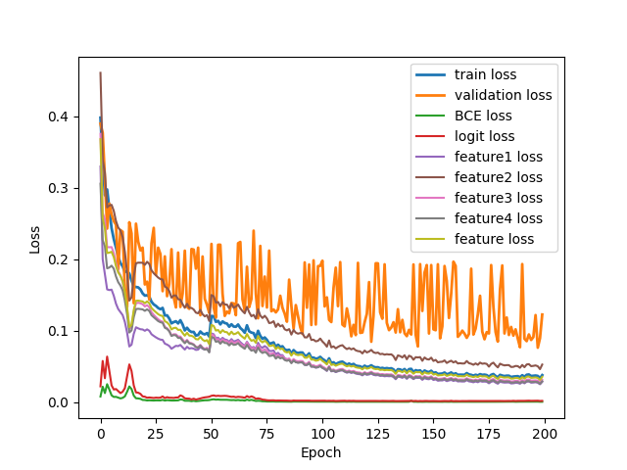
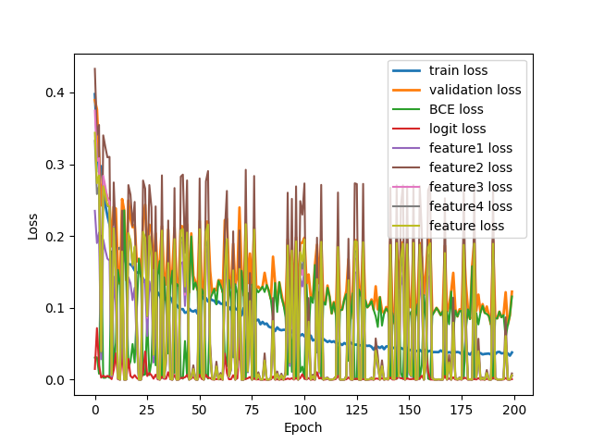
Loss Curve (w/ Adaptive Factors)
Train
Validate

Slide 6
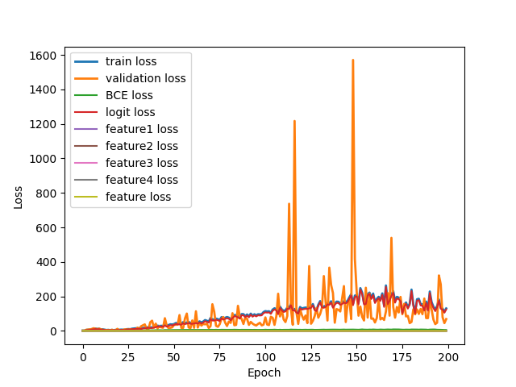
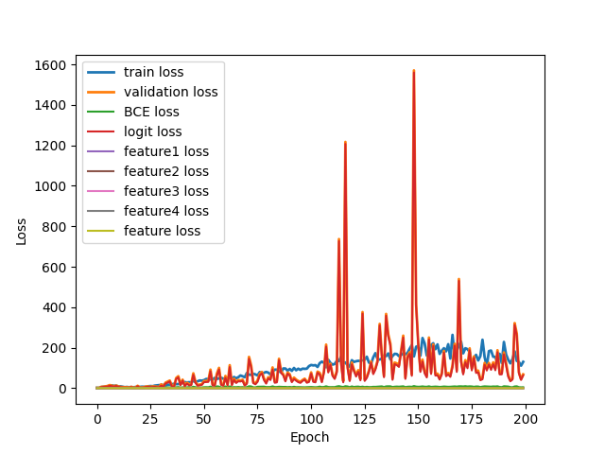
Loss Curve (w/o Adaptive Factors)
Train
Validate

Slide 7
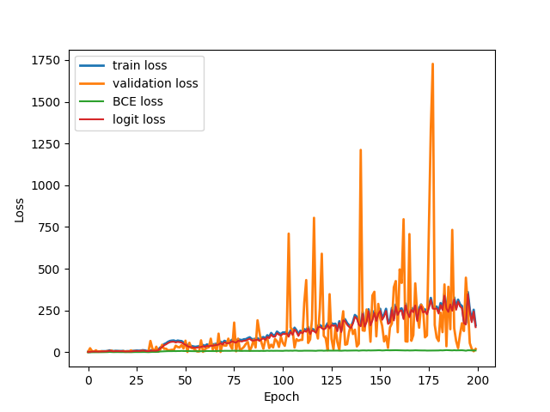
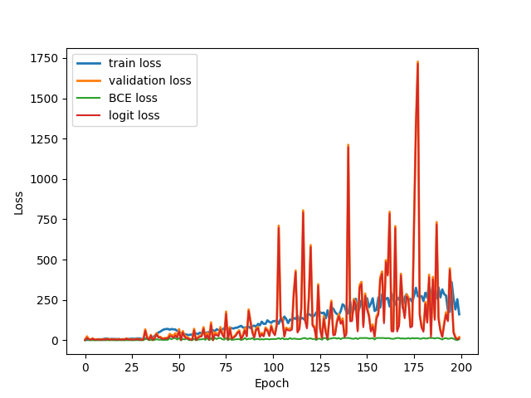
Loss Curve (w/o Adaptive Factors, logit)
Train
Validate

Slide 8
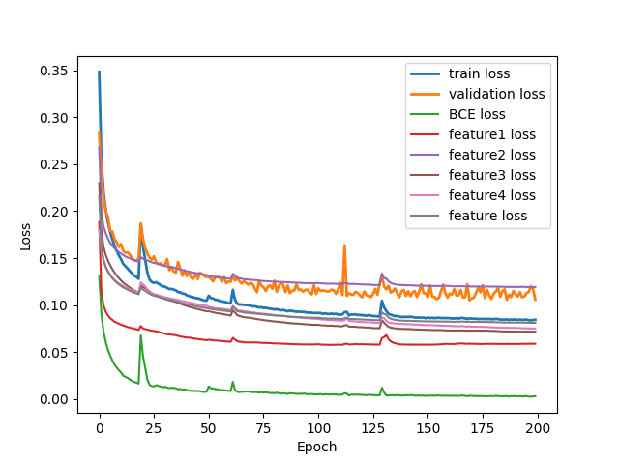
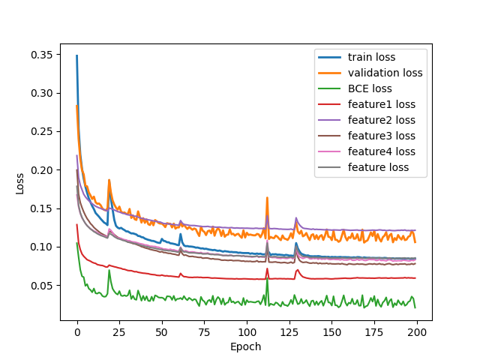
Loss Curve (w/o Adaptive Factors, feature)
Train
Validate

Slide 9
Metrics
 | 50 | 75 | 100 | 125 | 150 | 175 | 200
Teacher | 61.09% | 65.16% | 88.24% | 72.85% | 85.97% | 76.92% | 84.62%
Student | 64.71% | 47.96% | 60.18% | 75.11% | 69.68% | 70.59% | 78.28%
KD w/ Adaptive | 64.71% | 57.92% | 76.02% | 74.66% | 76.02% | 70.59% | 76.92%
KD w/ Adaptive, (logit) | 0.00% | 0.00% | 0.00% | 0.00% | 0.00% | 0.00% | 0.00%
KD w/ Adaptive, feature | 76.92% | 77.38% | 84.16% | 76.47% | 74.21% | 76.92% | 81.90%

