Slide 1
12/02 個人咪挺 KD with static factors（三）

Slide 2
Train Setting
I5-10500 + 2080Ti
Random seed = 42
Adam(lr = 1e-4) + BCELoss
ABCD Dataset as training set (0.8 for training and 0.2 for validating)
Google Dataset as testing set
MobileNet_V3_Large as teacher model
MobileNet_V3_Small as student model
Teacher model is trained with 200 epochs

Slide 3
Train Setting
factor[“BCE”] = 0.2
factor[“logit”] = 0.8
Temp = 0.25
Epoch = 200

Slide 4
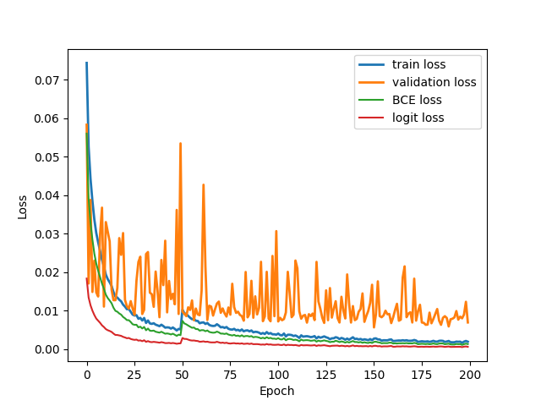
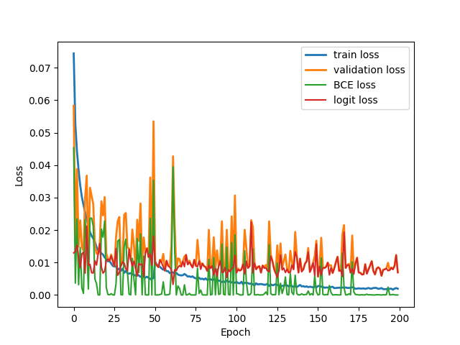
Loss Curve
Train
Validate

Slide 5
Result Metric (TDR@FDR=1%)
Epoch Model | 50 | 75 | 100 | 125 | 150 | 175 | 200
Teacher | 61.09% | 65.16% | 88.24% | 72.85% | 85.97% | 76.92% | 84.62%
Student | 64.71% | 47.96% | 60.18% | 75.11% | 69.68% | 70.59% | 78.28%
KD w/ Adaptive | 64.71% | 57.92% | 76.02% | 74.66% | 76.02% | 70.59% | 76.92%
KD w/ Adaptive, logit | 75.57% | 69.68% | 70.14% | 76.47% | 77.83% | 81.45% | 80.09%
KD w/ Adaptive, feature | 71.04% | 56.11% | 68.78% | 66.52% | 76.92% | 76.92% | 76.02%
KD w/o Adaptive | 0.00% | 0.00% | 0.00% | 0.00% | 0.00% | 0.00% | 0.00%
KD w/o Adaptive, logit | 0.00% | 0.00% | 0.00% | 0.00% | 0.00% | 0.00% | 0.00%
KD w/o Adaptive, feature | 76.92% | 77.38% | 84.16% | 76.47% | 74.21% | 76.92% | 81.90%
KD w/o Adaptive, logit factor[“BCE”] = 0.2 factor[“logit”] = 0.8 Temp = 0.25 | 66.52% | 75.11% | 72.40% | 74.66% | 74.21% | 74.21% | 82.35%
Red: Early Stopping / Potential Overfitting point.
Blue: Performance of the Teacher checkpoint used for KD.
Bold/Large:
Best performance for the specific model.

