Slide 1
12/09 個人咪挺 Feature KD

Slide 2
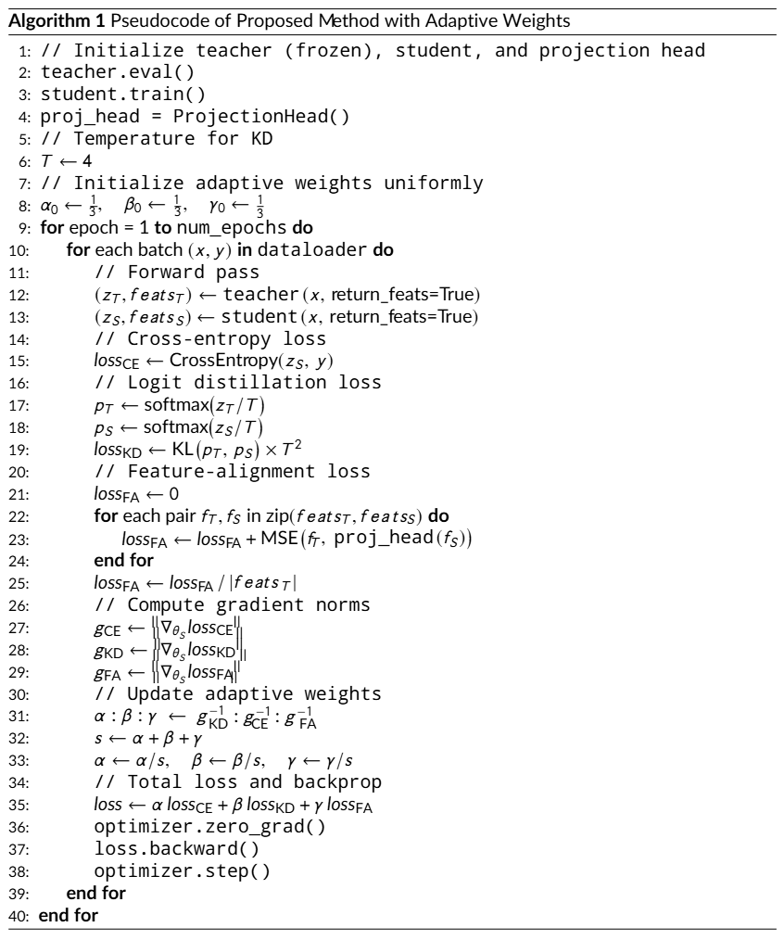
Recall

Slide 3
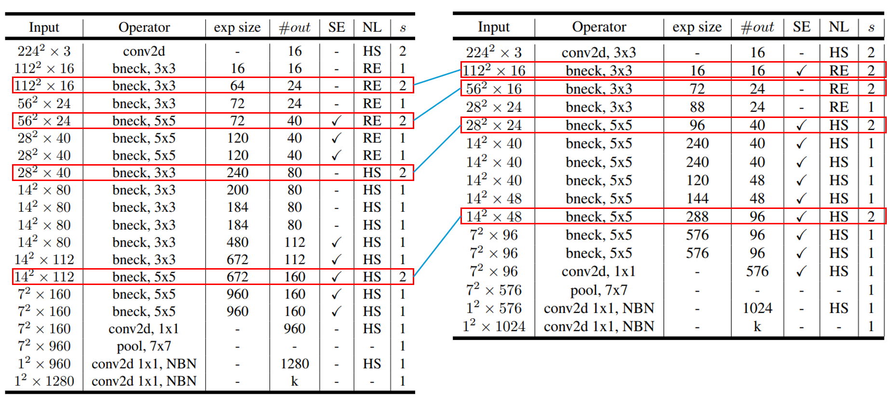
Recall
Teacher
Student

Slide 4
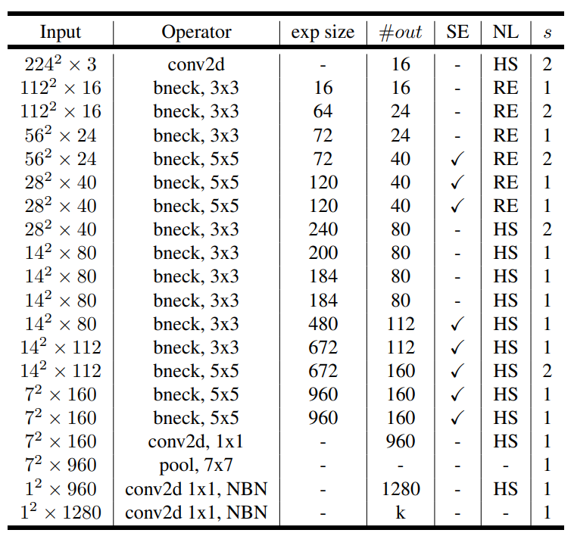
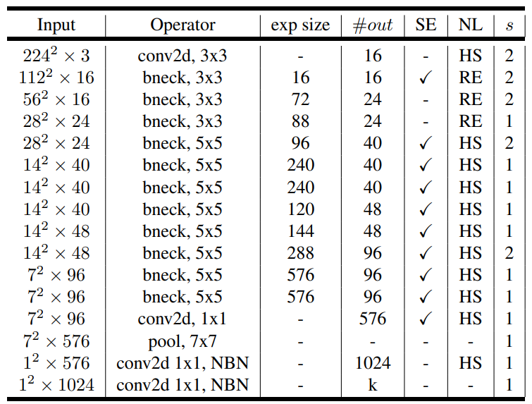
New Selected Layers
Teacher
Student

Slide 5
Train Setting
I5-10500 + 2080Ti
Random seed = 42
Adam(lr = 1e-4) + BCELoss
ABCD Dataset as training set (0.8 for training and 0.2 for validating)
Google Dataset as testing set
MobileNet_V3_Large as teacher model
MobileNet_V3_Small as student model
Teacher model is trained with 200 epochs

Slide 6
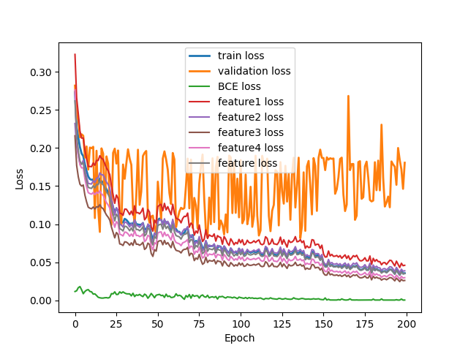
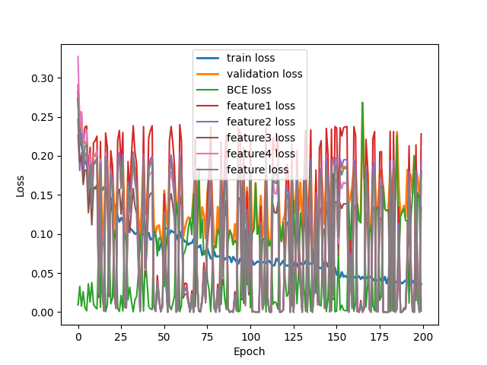
Loss Curve (w/ Adaptive factor)
Train
Validate

Slide 7
Train Setting
factor[“BCE”] = 0.5
factor[“feature”] = 0.5
Temp = 4.0
Epoch = 200

Slide 8
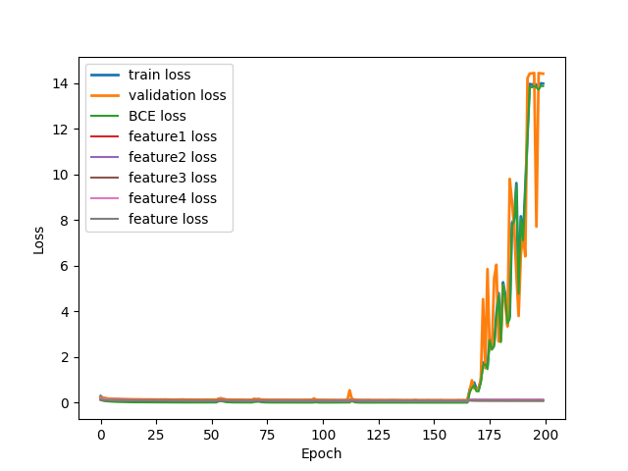
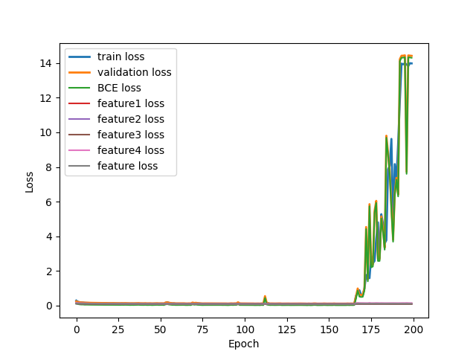
Loss Curve (w/o Adaptive factor)
Train
Validate

Slide 9
Result Metric (TDR@FDR=1%)
Epoch Model | 50 | 75 | 100 | 125 | 150 | 175 | 200
Teacher | 61.09% | 65.16% | 88.24% | 72.85% | 85.97% | 76.92% | 84.62%
Student | 64.71% | 47.96% | 60.18% | 75.11% | 69.68% | 70.59% | 78.28%
KD w/ Adaptive | 64.71% | 57.92% | 76.02% | 74.66% | 76.02% | 70.59% | 76.92%
KD w/ Adaptive, logit | 75.57% | 69.68% | 70.14% | 76.47% | 77.83% | 81.45% | 80.09%
KD w/ Adaptive, feature | 71.04% | 56.11% | 68.78% | 66.52% | 76.92% | 76.92% | 76.02%
KD w/o Adaptive | 0.00% | 0.00% | 0.00% | 0.00% | 0.00% | 0.00% | 0.00%
KD w/o Adaptive, logit | 0.00% | 0.00% | 0.00% | 0.00% | 0.00% | 0.00% | 0.00%
KD w/o Adaptive, feature | 76.92% | 77.38% | 84.16% | 76.47% | 74.21% | 76.92% | 81.90%
(New) KD w/ Adaptive, Feature | 58.82% | 72.40% | 71.04% | 0.00% | 68.33% | 76.92% | 66.06%
(New) KD w/o Adaptive, Feature | 82.81% | 81.00% | 76.47% | 80.54% | 66.97% | 19.00% | 0.00%
Red: Early Stopping / Potential Overfitting point.
Blue: Performance of the Teacher checkpoint used for KD.
Bold/Large:
Best performance for the specific model.

