Slide 1
12/16 個人咪挺 模型訓練改動

Slide 2
Train Setting
I5-10500 + 2080Ti
Random seed = 42
Adam(lr = 1e-4) + BCELoss
ABCD Dataset as training set (0.8 for training and 0.2 for validating)
Google Dataset as testing set
MobileNet_V3_Large as teacher model
MobileNet_V3_Small as student model
Teacher model is trained with 200 epochs

Slide 3
Logit-based KD

Slide 4
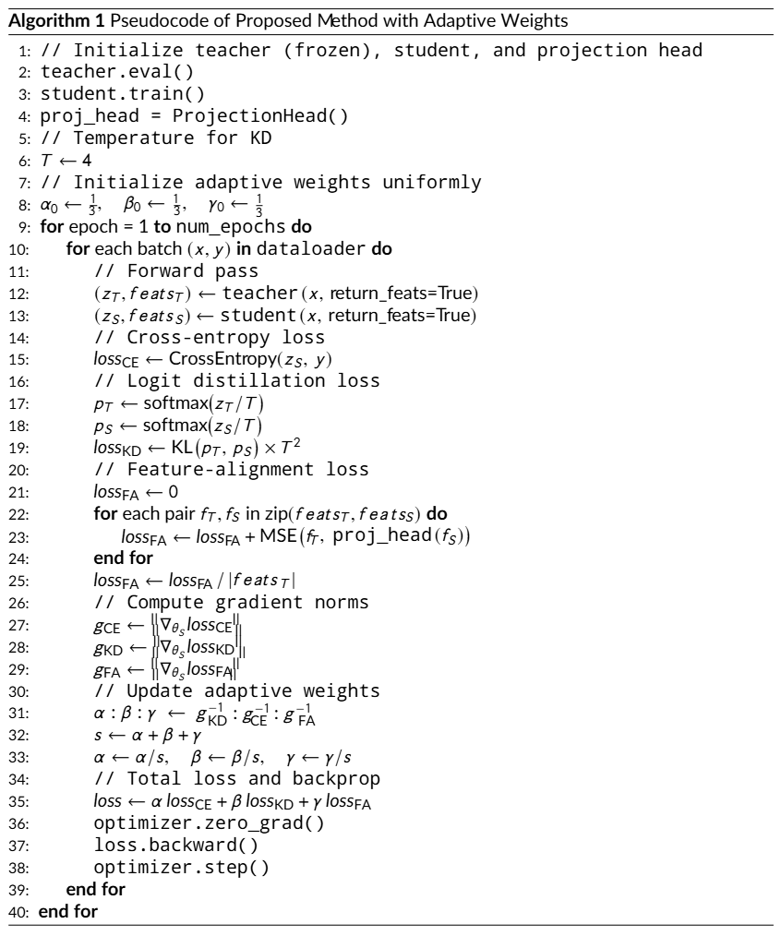
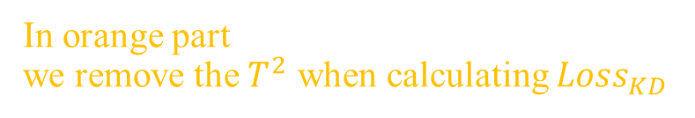
Recall & Modify
In orange part we remove the $T^{2}$ when calculating $Loss_{KD}$
Won’t calculate the red part
In blue part we won’t update the weights of each loss component

Slide 5
Train Setting
factor[“BCE”] = 1/3
factor[“feature”] = 2/3
Temp = 2.0
Epoch = 200

Slide 6
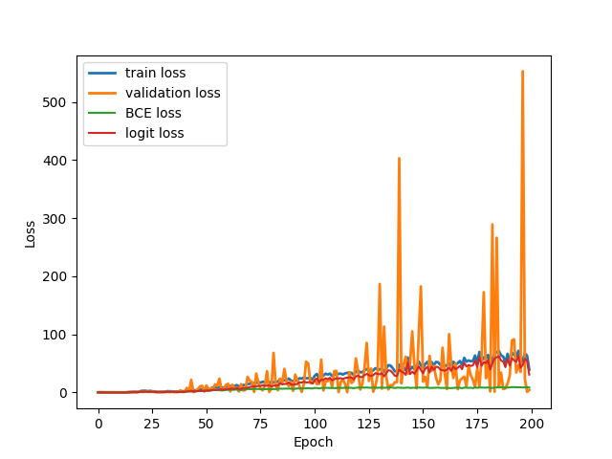
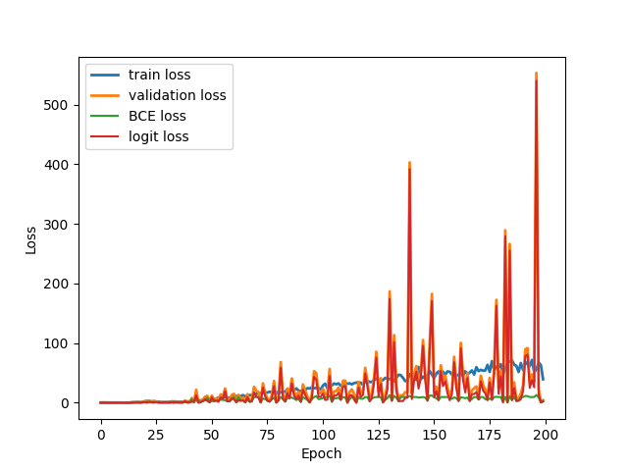
Loss Curve
Train
Validate

Slide 7
Feature-based KD

Slide 8
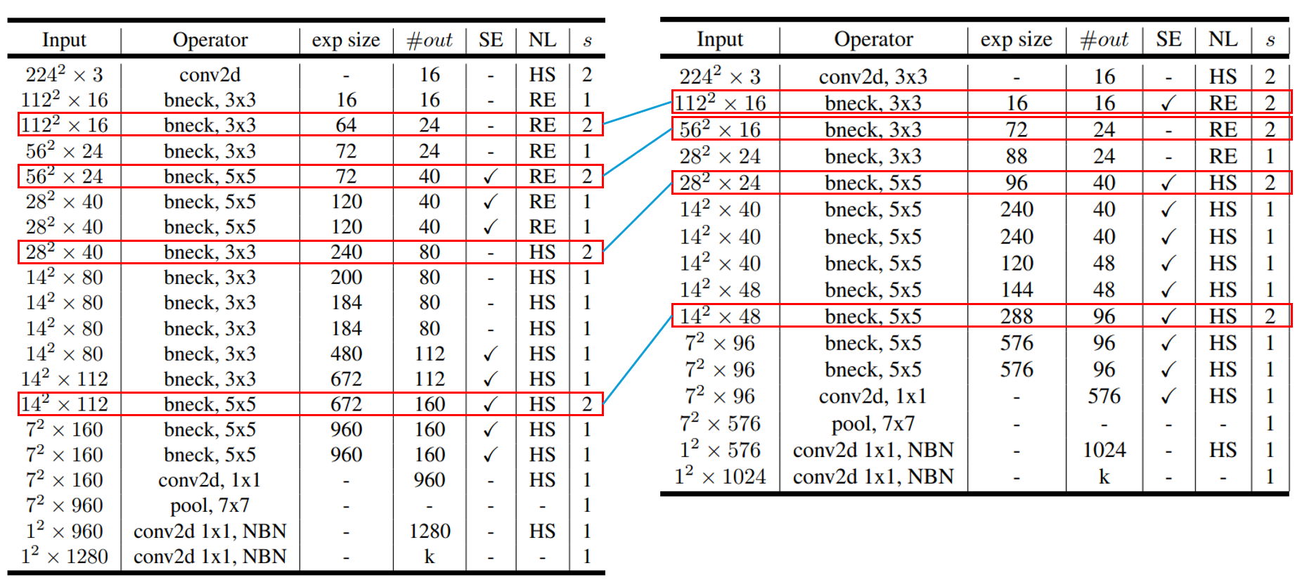
Recall & Modify
Teacher
Student
Red blocks are old feature layer pairs Green blocks are new feature layer pairs

Slide 9
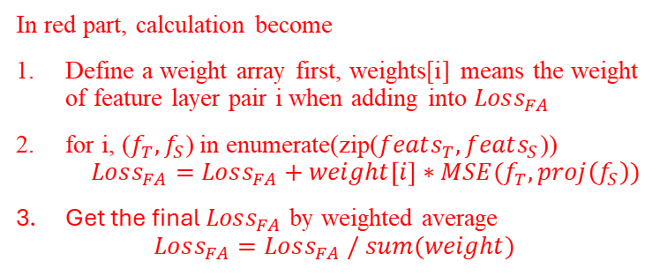
Recall & Modify
In red part, calculation become
Define a weight array first, weights[i] means the weight of feature layer pair i when adding into $Loss_{FA}$
for i, ($f_{T}, f_{S}$) in enumerate(zip($feats_{T}, feats_{S}$)) $Loss_{FA}=Loss_{FA}+weight\left[i\right]∗MSE(f_{T}, proj\left(f_{S}\right))$
Get the final $Loss_{FA}$ by weighted average $Loss_{FA}=Loss_{FA} / sum(weight)$
Won’t calculate the orange part
In blue part we won’t update the weights of each loss component

Slide 10
Train Setting
factor[“BCE”] = 0.5
factor[“feature”] = 0.5
Temp = 4.0
Epoch = 200
Weight = [0.1, 0.3, 0.6, 1.0]

Slide 11
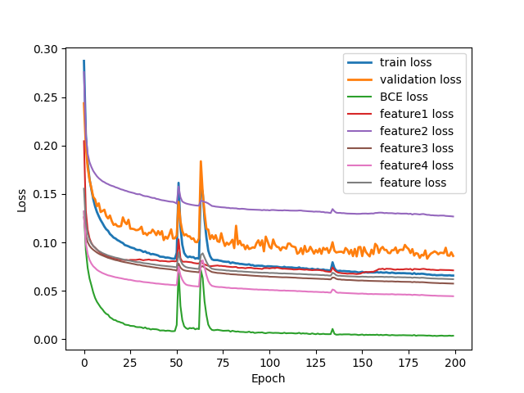
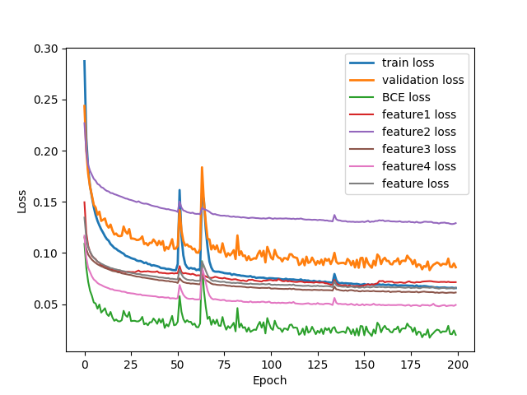
Loss Curve
Train
Validate

Slide 12
Result Metric (TDR@FDR=1%)
Epoch Model | 50 | 75 | 100 | 125 | 150 | 175 | 200
Teacher | 61.09% | 65.16% | 88.24% | 72.85% | 85.97% | 76.92% | 84.62%
Student | 64.71% | 47.96% | 60.18% | 75.11% | 69.68% | 70.59% | 78.28%
KD w/ Adaptive, feature + logit | 64.71% | 57.92% | 76.02% | 74.66% | 76.02% | 70.59% | 76.92%
KD w/ Adaptive, logit | 75.57% | 69.68% | 70.14% | 76.47% | 77.83% | 81.45% | 80.09%
KD w/ Adaptive, feature | 71.04% | 56.11% | 68.78% | 66.52% | 76.92% | 76.92% | 76.02%
KD w/o Adaptive, feature + logit | 0.00% | 0.00% | 0.00% | 0.00% | 0.00% | 0.00% | 0.00%
KD w/o Adaptive, logit | 0.00% | 0.00% | 0.00% | 0.00% | 0.00% | 0.00% | 0.00%
KD w/o Adaptive, feature | 76.92% | 77.38% | 84.16% | 76.47% | 74.21% | 76.92% | 81.90%
(New) KD w/o Adaptive, logit |  |  |  |  |  |  | 27.60%
(New) KD w/o Adaptive, Feature |  |  |  |  |  |  | 76.02%
Red: Early Stopping / Potential Overfitting point.
Blue: Performance of the Teacher checkpoint used for KD.
Bold/Large:
Best performance for the specific model.

