Slide 1
AiRDUNet: All-In-One Residual Dense U-Net with Automated Humidity Quality Assessment for Partial Wet Fingerprint Restoration and Recognition
Jui-Min Hsu∗, Ching-Te Chiu, Senior Member, IEEE∗,
Mao-Hsiu Hsu, Member, IEEE†, Che-Wei Liao∗
Email: s111062574@m111.nthu.edu.tw, chiusms@cs.nth.edu.tw,
mh.hsu@nfu.edu.tw, s112062707@m112.nthu.edu.tw
∗Department of Computer Science, National Tsing Hua University
†Department of Electro-Optical Engineering, National Formosa University

Slide 2

Outline
Introduction
Wet Fingerprint Quality Automated Assessment (WFQA)
All-in-one Residual Dense-UNet (AIRDUNet)
Experimental Results
Conclusion

Slide 3
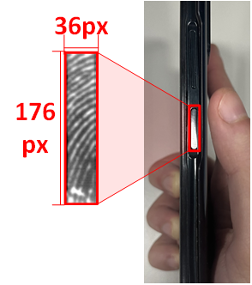
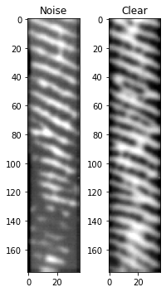




Introduction Background
Figure 1.1.
An illustration depicting a recognition sensor located on the side of a smartphone.
Fingerprint recognition is popular for identity authorization.
With the rise of edge devices, partial fingerprint obtained by side-mounted sensors are popular, accounting for about one-third of usage.
The limited size of fingerprint makes the recognition challenge.
Wet partial fingerprints due to sweat often fail to pass identity verification that requires restoration to enhance the rdiges
Collecting paired, aligned clean and wet fingerprint datasets for restoration training is challenging due to misalignment issues.
Clean
Wet
Figure 1.2
Shows (a) clean and partial wet fingerprint and (b) misalignment problem of collecting clean and wet fingerprint
(a) Clean and Partial Wet Fingerprint
(b) Misalignment problem of real Clean/Wet Fingerprint
3

Slide 4
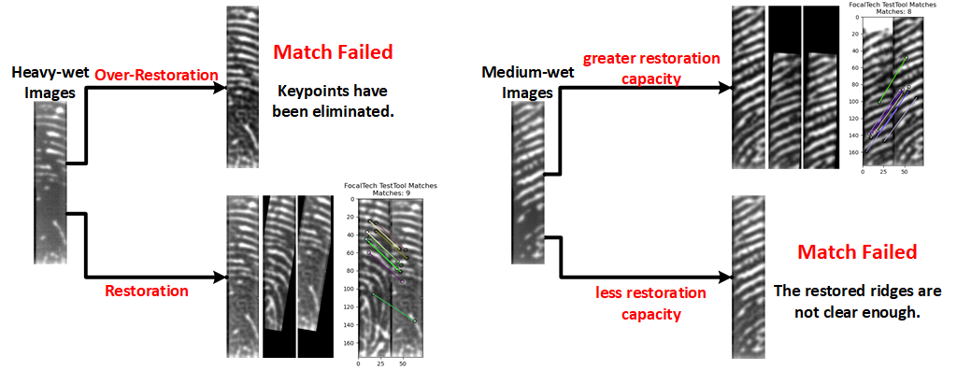
Introduction Background
Over-restoration can loss of identify features. In partial wet fingerprint, it requires various degrees of wet fingerprint restoration capacity.
Without considering fingerprint humidity difference, restoration will face over or under restoration issue, leading to recognition failures.

Slide 5
Introduction Goal
Traditional fingerprint restorations on full or partial images focus on enhancing fingerprint ridge patterns, rather than keeping the identifiable features
Design a wet fingerprint quality automated assessment method that can classify different humidity levels (as light-wet, medium-wet and heavy-wet)
Generate humidity degradation features depending on the humidity levels to help models' restoration abilities on different humidity.
Develop an all-in-one CNN-based model that has better restoration generalization ability across various humidity levels by fusing humidity degradation features and restoration features
Keep the identifiable features for recognition while restoring partial wet fingerprints

Slide 6
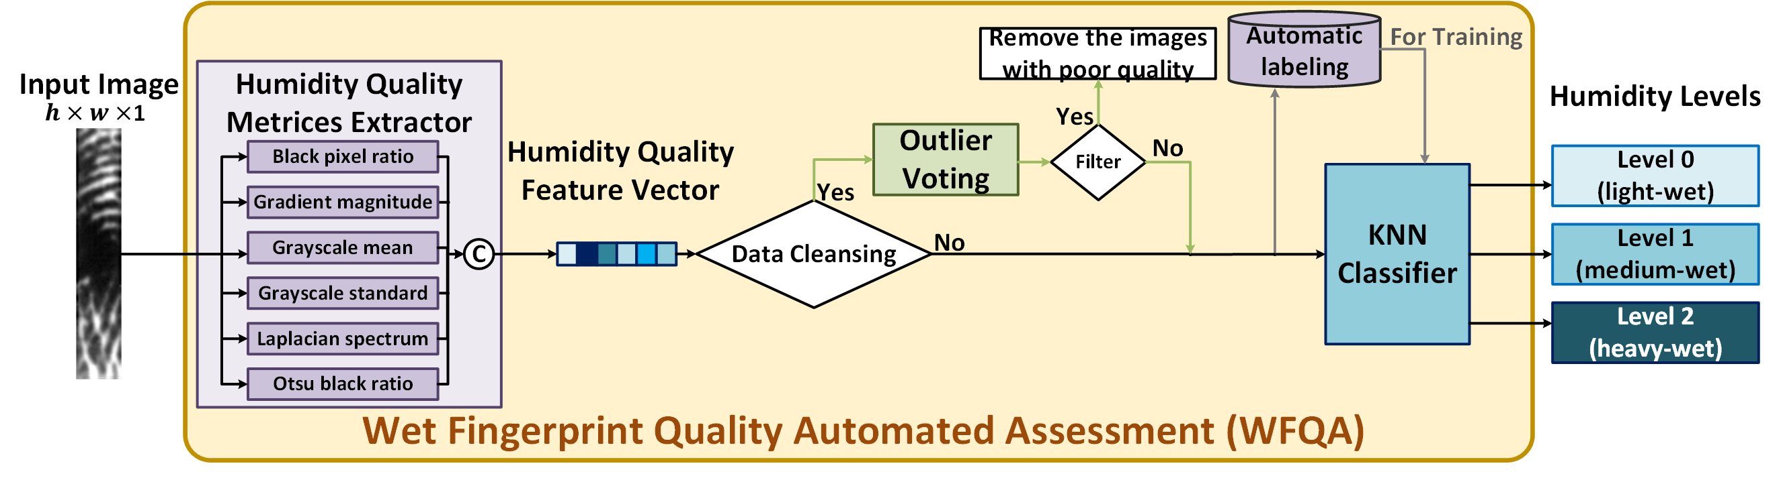
Wet Fingerprint Quality Automated Assessment Overall Flow Chart
Wet Fingerprint Quality Automated Assessment (WFQA) classify fingerprint humidity to 3 levels based on ridge color and ridge clarity
Humidity Quality Metrices Extractor calculate six types of quality metrices and concatenated into Humidity Quality Feature Vector
Outlier Voting filters out poor-quality images by determining outliers.
Automated Labeling use six types of quality metrices and voting algorithm to generate training data for KNN classifier.
K-Nearest Neighbor (KNN) Classifier distinguishes fingerprint humidity into 3 levels using the Humidity Quality Feature Vector.

Slide 7
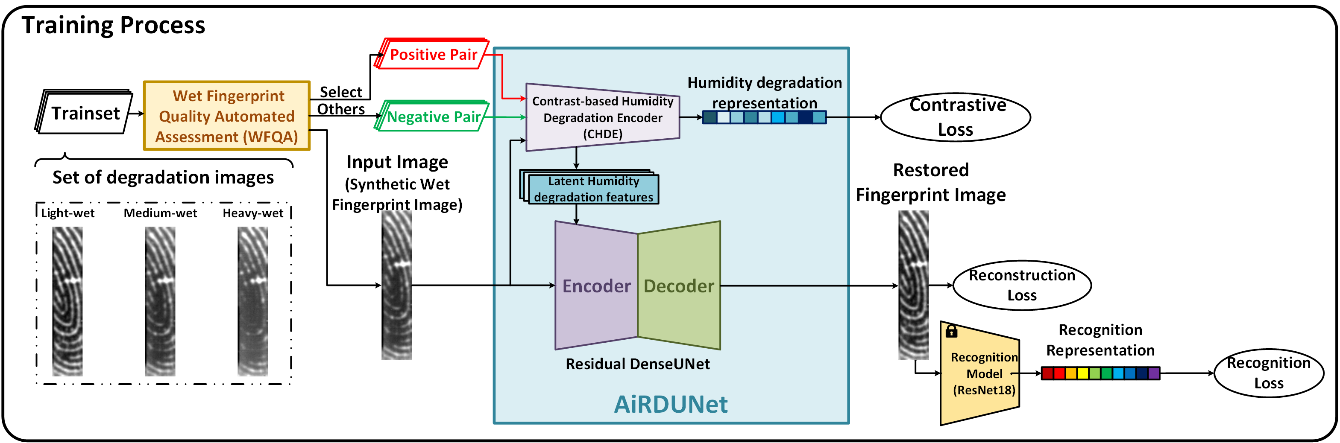
All-in-one Residual Dense-Unet(AiRDUNet) DataFlow Chart
Wet Fingerprint Quality Assessment classify images to 3 humidity levels and selected positive pair and negative pair for the input image
Contrast-based Humidity Degradation Encoder (CHDE) extract humidity degradation representation based on various humidity levels.
Separate 3 humidity clusters by contrast loss
Residual Dense-Unet restore images guided by humidity degradation
Recognition Module ResNet18 performs recognition task
Training Process

Slide 8
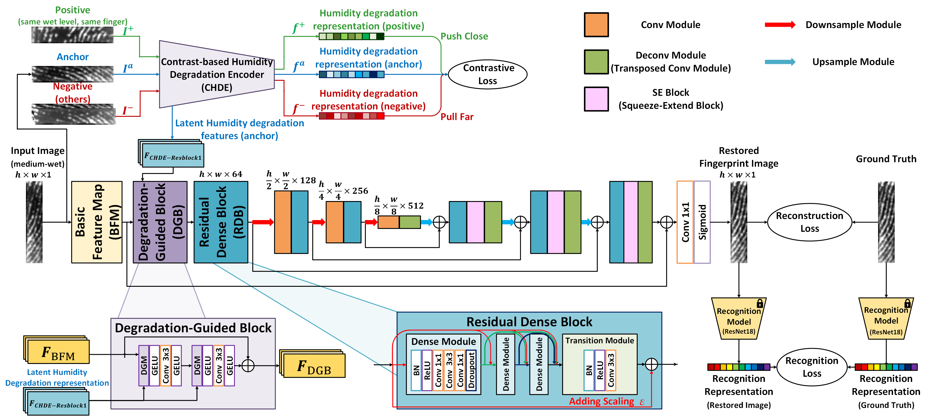
All-in-one Residual Dense-UNet Detail Architecture
Degradation-Guided Block (DGB) integrates the latent humidity degradation representation
and restoration features
Residual Dense Block (RDB) connects local dense convolution with global residual
connections.
Dilated conv to increase receptive field

Slide 9
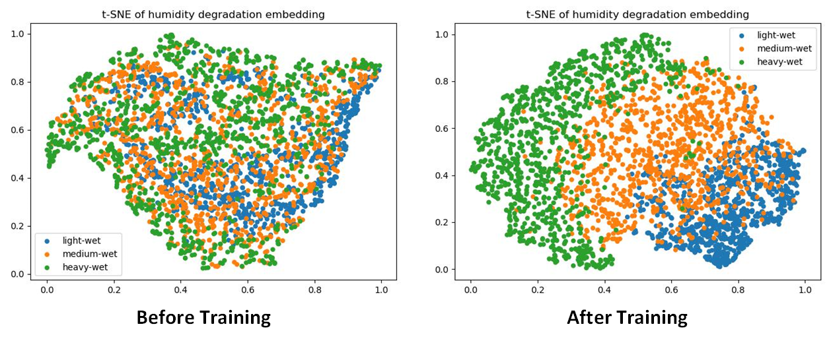
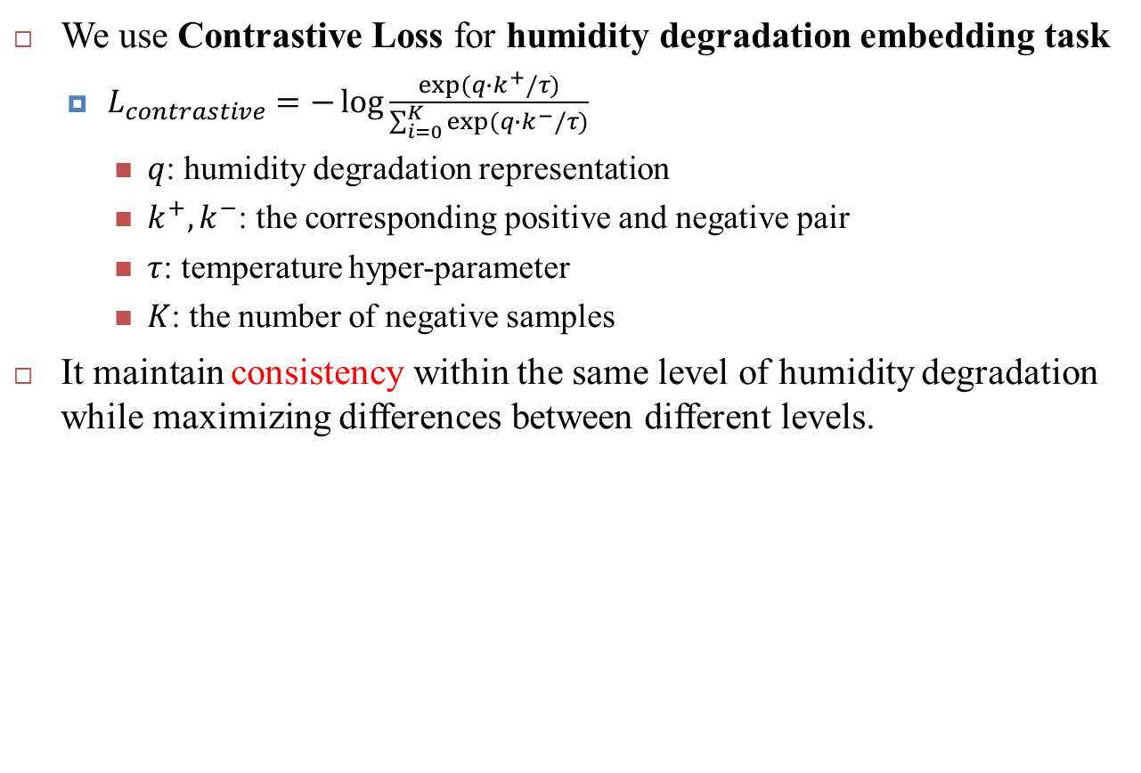
All-in-one Residual Dense-UNet Humidity Degradation Embedding Task
We use Contrastive Loss for humidity degradation embedding task
$L_{contrastive}=−\log{\frac{exp⁡(q∙k^{+}/τ)}{\sum_{i=0}^{K}{exp⁡(q∙k^{−}/τ)}}}$
$q$: humidity degradation representation
$k^{+}, k^{−}$: the corresponding positive and negative pair
$τ$: temperature hyper-parameter
$K$: the number of negative samples
It maintain consistency within the same level of humidity degradation while maximizing differences between different levels.

Slide 10
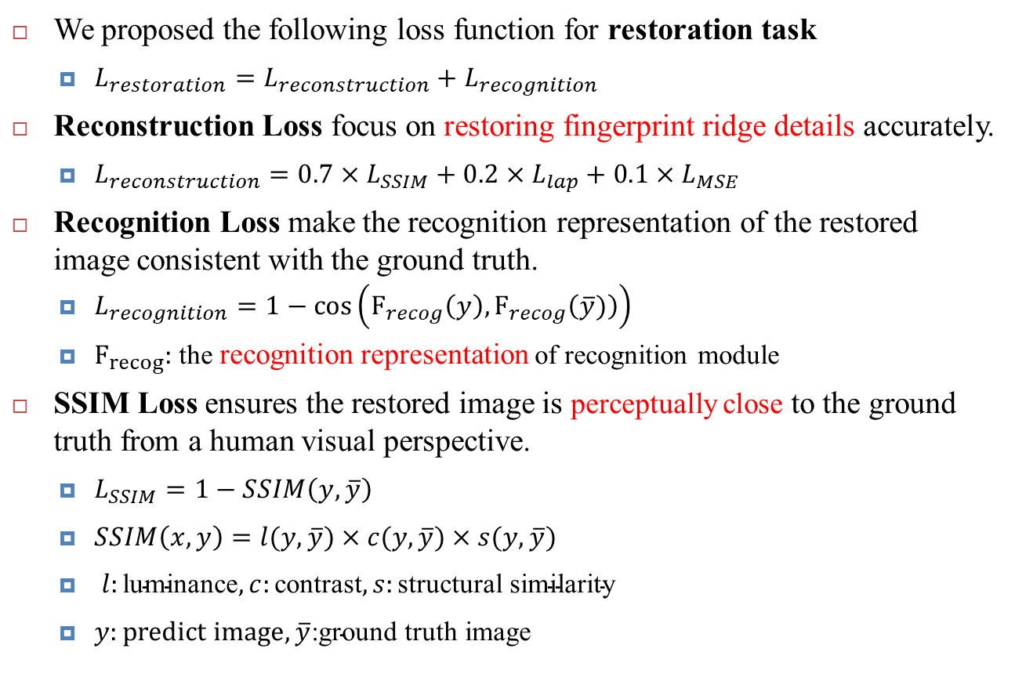
All-in-one Residual Dense-UNet Restoration Task
We proposed the following loss function for restoration task
$L_{restoration}=L_{reconstruction}+L_{recognition}$
Reconstruction Loss focus on restoring fingerprint ridge details accurately.
$L_{reconstruction}=0.7×L_{SSIM}+0.2×L_{lap}+0.1×L_{MSE}$
Recognition Loss make the recognition representation of the restored image consistent with the ground truth.
$L_{recognition}=1−\cos\left(F_{recog}\left(y\right),F_{recog}\left(\overline{y})\right)\right)$
$F_{recog}:$ the recognition representation of recognition module
SSIM Loss ensures the restored image is perceptually close to the ground truth from a human visual perspective.
$L_{SSIM}=1−SSIM\left(y, \overline{y}\right)$
$SSIM\left(x, y\right)=l(y, \overline{y})×c(y, \overline{y})×s(y, \overline{y})$
$l:\text{luminance}, c:\text{contrast}, s:\text{structural} \text{similarity}$
$y:predict image,\overline{y}\text{:}\text{ground} \text{truth} \text{image}$

Slide 11
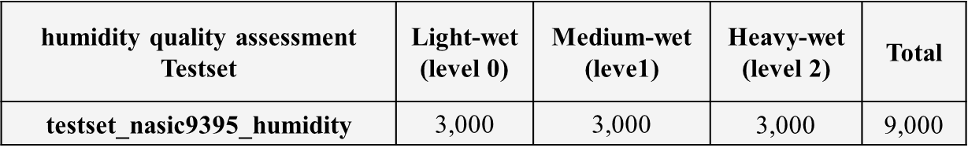
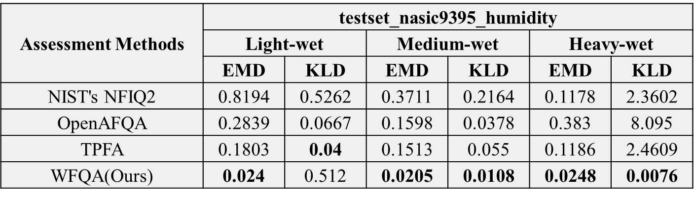
Datasets Humidity Quality Assessment Test Set
The testset_nasic9395_humidity is used as our humidity quality assessment testing set.
Contains 105 fingers, 9000 images
Earth Mover's Distance (EMD) and Kullback-Leibler Divergence (KLD) measure accuracy in assessing the quality of wet fingerprints.
NFIQ2 and OpenAFQA are designed for full fingerprint quality assessment
TPFA and WFQA (ours) are focused on partial wet fingerprint quality

Slide 12
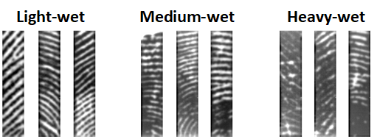
Datasets Real Fingerprint Data Set Collection
Wet Fingerprint Quality Automated Assessment The Classification Results
Nasic9395_1023 Real Dataset partial wet fingerprint dataset
Collected using a capacitive sensor on a mobile device's side fingerprint sensor.
176x36 pixel size.
87,025 clean fingerprint images
63,000 wet fingerprint images
105 different fingers.
Figure 3.5. With WFQA, images are categorized as light, medium, and heavy wet.
Notes:
Nasic9395_1023 Real Dataset is a partial wet fingerprint dataset collected using a capacitive sensor on a mobile device's side fingerprint sensor.
The collected images have a resolution of 176x36 pixels.
The dataset includes 87,025 clean fingerprint images and 63,000 wet fingerprint images from 105 different fingers.
Wet fingerprint images collection process are show below
Hold your fingers 4 cm above a humidifier for approximately 3 seconds.
Collect about 5 images.
Dry your fingers and repeat the process.

Slide 13
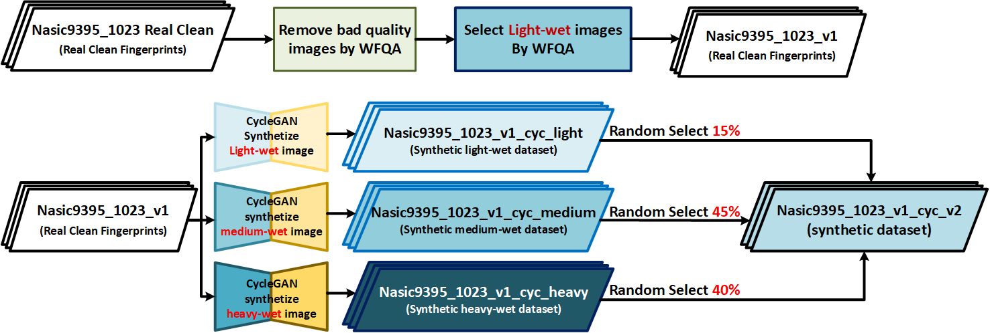
Datasets Synthetic aligned Train Set
[17] Zhu, Jun-Yan, et al. "Unpaired image-to-image translation using cycle-consistent adversarial networks." Proceedings of the IEEE international conference on computer vision. 2017.
The nasic9395_1023_v1_cyc_v2 dataset is used as our training set. It consists of 37,776 pairs.
Clean fingerprint images are selected from the Nasic9395_1023 Real Dataset as the ground truth.
Synthetic wet fingerprint images with three humidity levels are generated using CycleGAN[17] to serve as the model's input.
Figure 5.1 Overall Flow shows the generation process of Nasic9395_1023_v1_cyc_v2 dataset.

Slide 14
Datasets Real Recognition Test Set
[1] Hsieh, An-Ting, et al. "Feature Points based Residual UNet with Nonlinear Decay Rate for Partial Wet Fingerprint Restoration and Recognition." 2024 IEEE International Symposium on Circuits and Systems (ISCAS). IEEE, 2024.
[18] Li, Yu-Ting, et al. "PGT-Net: Progressive Guided Multi-task Neural Network for Small-area Wet Fingerprint Denoising and Recognition." arXiv preprint arXiv:2308.07024 (2023).
The testset_nasic9395_v10.4 is used as our recognition testing set.
Contains 17 fingers.
Enrollment set: 740 clean fingerprint images
Identification set: 984 wet fingerprint images, categorized into 175 light-wet, 545 medium-wet, and 264 heavy-wet fingerprints.
Tested with the same recognition tool as those in [1, 18]
Extracts matches points similar to Scale-Invariant Feature Transform (SIFT).
Table 5.1. The recognition results of testset_nasic9395_v10.4 without enhancement by a model.
Testset | Enroll | Identify | No enhancement |  | Restoration ability
 |  |  | # of Successful recognition | FRR(%) | Light-wet (175/17.78%) | Medium-wet (545/55.39%) | Heavy-wet (264/26.83%)
 |  |  |  |  | FRR(%) | FRR(%) | FRR(%)
testset_nasic9395_v10.4 | 740 | 984 | 804 | 18.29 | 1.14 | 12.11 | 42.42
Notes:
The proposed method is tested with the same recognition tool as those in [PGT-Net, FPN-ResUNet], which extracts keypoints and matches points similar to Scale-Invariant Feature Transform (SIFT).

Slide 15
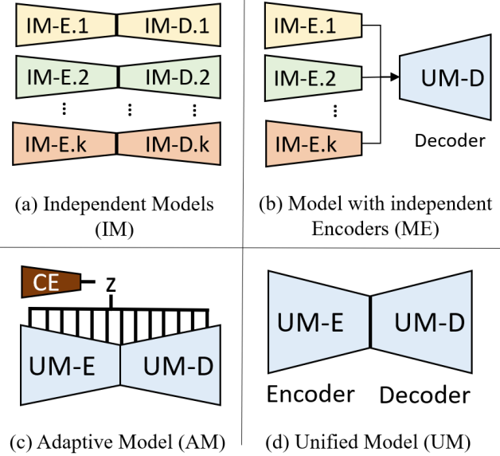
Effect of All-in-One Model Fingerprint Restoration for multiple level of humidity
Examine the effect for All-in-one restoration method
Compare with other restoration methods for multiple degradation
Independent Models (IM):
Trains a separate model for each degradation type, focusing on single types but struggles with multiple degradations.
Unified Model (UM):
Utilizes a shared encoder-decoder architecture for all degradation types.
Adaptive model (AM):
Also known as the all-in-one model, it employs a contrastive encoder to adapt to various degradations and integrates them into a unified framework. (Ours)

Slide 16
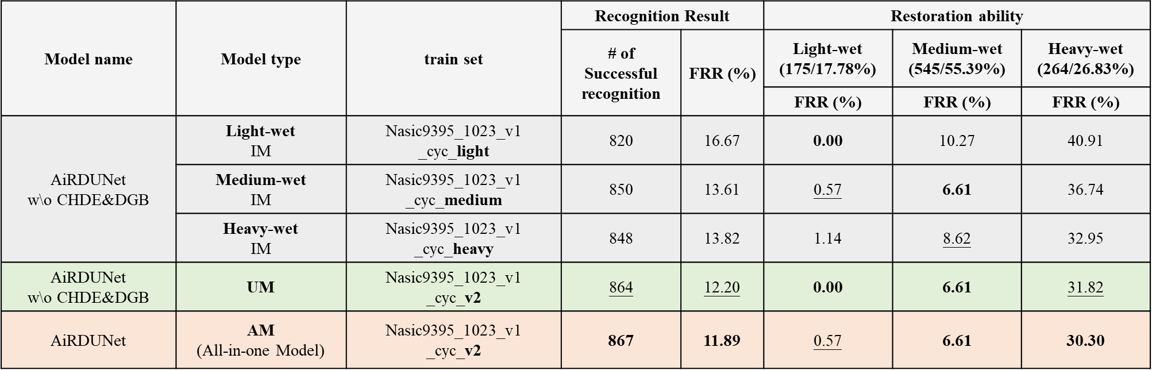
Effect of All-in-One Model Fingerprint Restoration for multiple level of humidity
All-in-One Model (AiRDUNet): Outperforms IM and UM models.
Achieves the lowest FRR (11.89%).
Best performance in medium-wet and heavy-wet conditions.
Slightly underperforms on light-wet fingerprints.

Slide 17
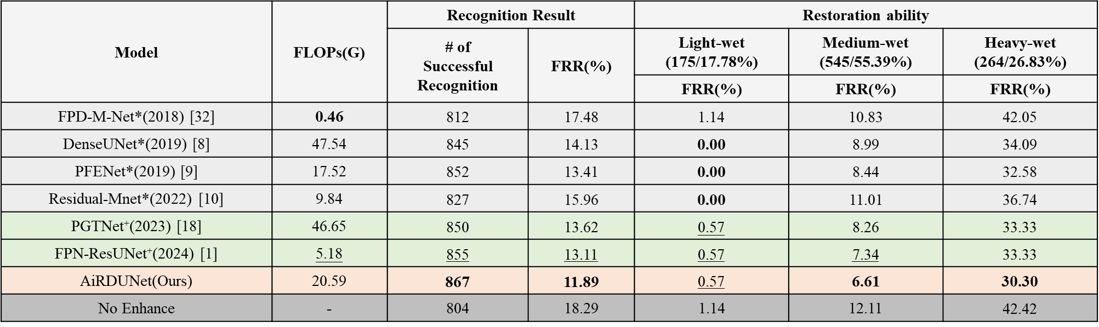
Experimental Results Model Comparisons
[1] Hsieh, An-Ting, et al. "Feature Points based Residual UNet with Nonlinear Decay Rate for Partial Wet Fingerprint Restoration and Recognition." 2024 IEEE International Symposium on Circuits and Systems (ISCAS). IEEE, 2024.
[8] Qian, Peng, Aojie Li, and Manhua Liu. "Latent fingerprint enhancement based on DenseUNet." 2019 international conference on biometrics (ICB). IEEE, 2019.
[9] Shen, Zuolin, Yuanrong Xu, and Guangming Lu. "CNN-based high-resolution fingerprint image enhancement for pore detection and matching." 2019 IEEE Symposium Series on Computational Intelligence (SSCI). IEEE, 2019.
[10] Cunha, Nailson Dos Santos, Herman Martins Gomes, and Leonardo Vidal Batista. "Residual M-net with Frequency-Domain Loss Function for Latent Fingerprint Enhancement." 2022 35th SIBGRAPI Conference on Graphics, Patterns and Images (SIBGRAPI). Vol. 1. IEEE, 2022.
[18] Li, Yu-Ting, et al. "PGT-Net: Progressive Guided Multi-task Neural Network for Small-area Wet Fingerprint Denoising and Recognition." arXiv preprint arXiv:2308.07024 (2023).
[30] Ronneberger, Olaf, Philipp Fischer, and Thomas Brox. "U-net: Convolutional networks for biomedical image segmentation." Medical image computing and computer-assisted intervention–MICCAI 2015: 18th international conference, Munich, Germany, October 5-9, 2015, proceedings, part III 18. Springer International Publishing, 2015.
[31] Zamir, Syed Waqas, et al. "Restormer: Efficient transformer for high-resolution image restoration." Proceedings of the IEEE/CVF conference on computer vision and pattern recognition. 2022.
[32] Adiga V, Sukesh, and Jayanthi Sivaswamy. "Fpd-m-net: Fingerprint image denoising and inpainting using m-net based convolutional neural networks." Inpainting and denoising challenges. Springer International Publishing, 2019.
Comparison results on nasic9395_1023_v1_cyc_v2.
AiRDUNet performance: Achieves the lowest overall FRR: 11.89%.
Medium-wet: FRR: 6.61%. (best among all)
Heavy-wet: FRR: 30.30%. (best among all)
Slightly underperforms in Light-wet: FRR: 0.57%.

Slide 18











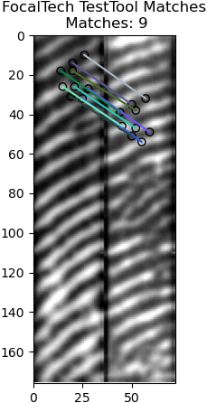
Experimentals Model Comparisons
[1] Hsieh, An-Ting, et al. "Feature Points based Residual UNet with Nonlinear Decay Rate for Partial Wet Fingerprint Restoration and Recognition." 2024 IEEE International Symposium on Circuits and Systems (ISCAS). IEEE, 2024.
[8] Qian, Peng, Aojie Li, and Manhua Liu. "Latent fingerprint enhancement based on DenseUNet." 2019 international conference on biometrics (ICB). IEEE, 2019.
[9] Shen, Zuolin, Yuanrong Xu, and Guangming Lu. "CNN-based high-resolution fingerprint image enhancement for pore detection and matching." 2019 IEEE Symposium Series on Computational Intelligence (SSCI). IEEE, 2019.
[10] Cunha, Nailson Dos Santos, Herman Martins Gomes, and Leonardo Vidal Batista. "Residual M-net with Frequency-Domain Loss Function for Latent Fingerprint Enhancement." 2022 35th SIBGRAPI Conference on Graphics, Patterns and Images (SIBGRAPI). Vol. 1. IEEE, 2022.
[18] Li, Yu-Ting, et al. "PGT-Net: Progressive Guided Multi-task Neural Network for Small-area Wet Fingerprint Denoising and Recognition." arXiv preprint arXiv:2308.07024 (2023).
[30] Ronneberger, Olaf, Philipp Fischer, and Thomas Brox. "U-net: Convolutional networks for biomedical image segmentation." Medical image computing and computer-assisted intervention–MICCAI 2015: 18th international conference, Munich, Germany, October 5-9, 2015, proceedings, part III 18. Springer International Publishing, 2015.
[31] Zamir, Syed Waqas, et al. "Restormer: Efficient transformer for high-resolution image restoration." Proceedings of the IEEE/CVF conference on computer vision and pattern recognition. 2022.
[32] Adiga V, Sukesh, and Jayanthi Sivaswamy. "Fpd-m-net: Fingerprint image denoising and inpainting using m-net based convolutional neural networks." Inpainting and denoising challenges. Springer International Publishing, 2019.
The followings are results comparison for restoration models.
It is obvious that AiRDUNet restores better on ridges.
Unet[30]
Restormer[31]
FPD-M-Net[32]
DenseUNet[8]
PFENet[9]
Input 4_5_1405
(heavy-wet)
Residual Mnet[10]
PGTNet[18]
FPNResUNet[1]
AiRDUNet(Ours)

Slide 19
Conclusion
WFQA Framework:
Proposed to assess partial wet fingerprints humidity levels.
Extracts humidity-related feature index.
Uses KNN classifier to categorize fingerprints into Light-wet, Medium-wet, Heavy-wet.
AiRDUNet Model:
An all-in-one residual dense network.
Designed for restoring partial wet fingerprints under different humidity conditions.
Combines:
Humidity degradation embeddings.
Restored feature representations.
Performance Gains:
4.24% FRR improvement via residual dense Unet.
2.20% improvement from CHDE + DGB.
8.41% total improvement.
AiRDUNet outperforms prior models in partial we Fingerprint restoration.

Slide 20
Thank you!

