Slide 1
AMIE: Affine-Attentive Matching and Interpretive Imprint Evaluation for Partial Fingerprint Verification
Tsai-Chieh Chen*, Ching-Te Chiu* Ned Lin†, Ang Yu†, Paul Lai†, Daniel Chen† Chia-Yi Lin*
* Department of Computer Science, National Tsing Hua University, Taiwan † FocalTech Electronics Co., Ltd., Taiwan

Slide 2
Outline
Introduction
Detector: High-Coverage Keypoint Extraction
Matcher: Affine-Attentive Keypoint Matching
Verifier: Final Decision on Aligned ROI Pair
Experimental Results
Conclusion

Slide 3
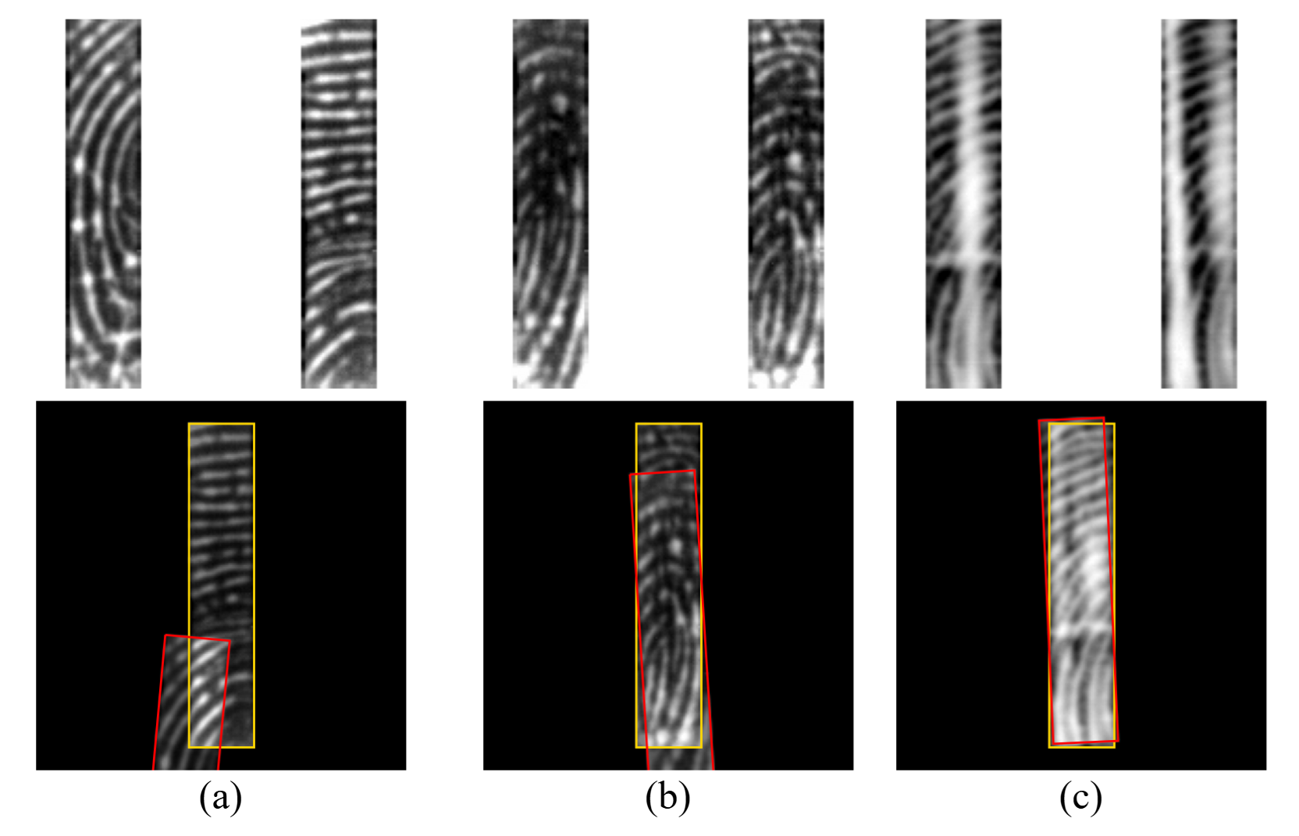
Introduction - Background
Mobile devices now use smaller sensors, capturing only partial fingerprints.
Traditional minutiae-based matchers fail on partial prints due to
Few detectable minutiae and poor overlap.
Distortions from pressure, dry/wet skin, and image degradation.
Accuracy drops sharply when ridge detail is poor.
Fig. 1. Examples of challenging partial fingerprint pairs (top) and overlap showcases (bottom)
Small overlap area + poor quality
Wet fingers causing ridge swelling
Blurry prints with slight distortion from pressure or angle

Slide 4
Introduction - Goal
Aligning pairs reliably under minimal overlap.
Having robustness by detecting keypoints in almost every ridge block.
Generalizing across different sensors without re-training.
Interpretable, CNN-free, avoids heuristic segmentation/cropping .

Slide 5
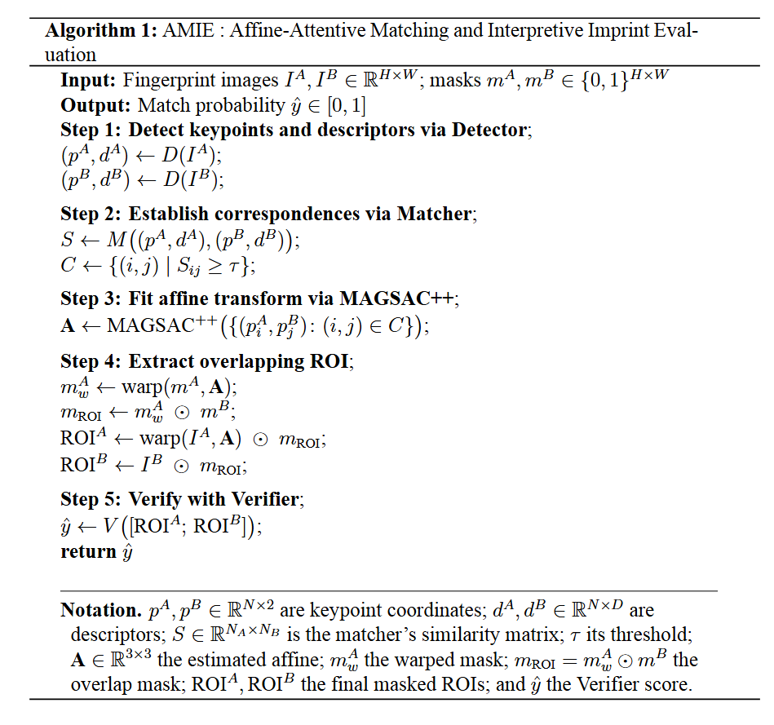
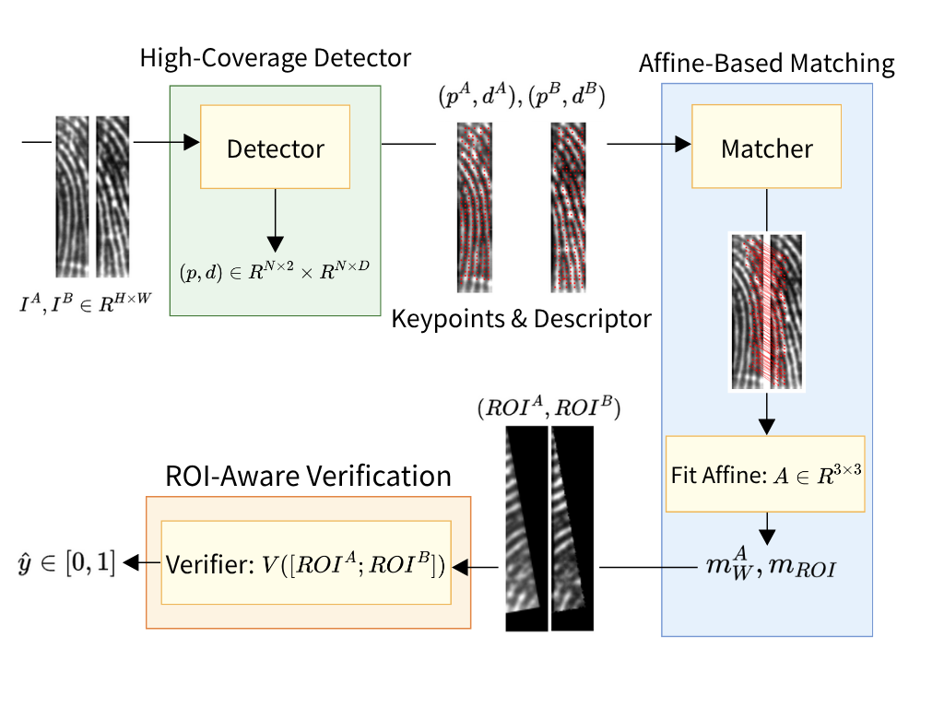
Introduction – Data flowchart
Detector
A SuperPoint-based keypoint detector for high-coverage fingerprint features.
Matcher
An affine-attentive matcher combining LightGlue with FC-GNN and followed by affine alignment via MAGSAC++ for geometry-aware attention.
A pixel-level, affine-warped binary ROI mask enabling interpretable imprint localization.
Verifier
An ROI-aware verifier based on a lightweight ResNet, operating exclusively on aligned and masked regions.
Fig. 2. Pseudo algorithm of AMIE
Fig. 3. Overview of AMIE modules and data flow

Slide 6
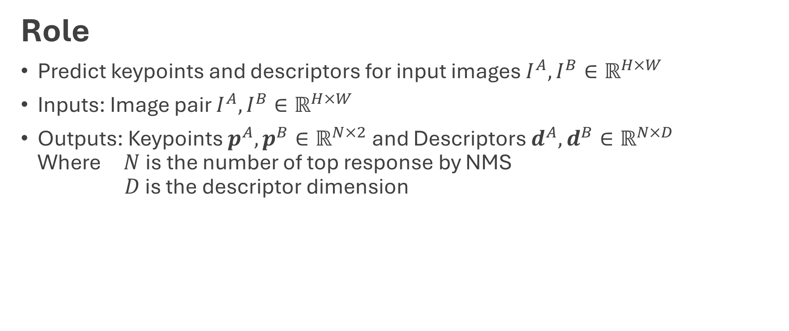
Detector: High-Coverage Keypoint Extraction
Role
Predict keypoints and descriptors for input images $I^{A},I^{B}∈ℝ^{H×W}$
Inputs: Image pair $I^{A}, I^{B}∈ℝ^{H×W}$
Outputs: Keypoints $p^{A}, p^{B}∈ℝ^{N×2}$ and Descriptors $d^{A}, d^{B}∈ℝ^{N×D}$ Where $N$is the number of top response by NMS $D$ is the descriptor dimension

Slide 7
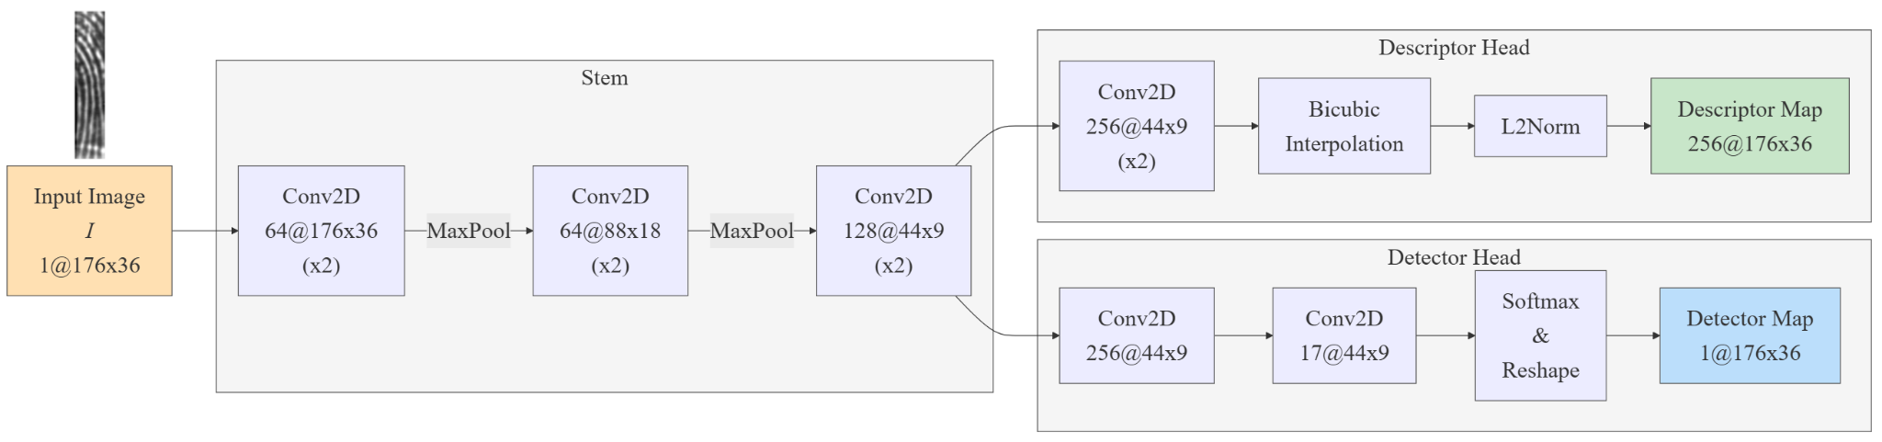

Detector: High-Coverage Keypoint Extraction
Architecture
Superpoint backbone with stride 4 for decreasing the times of downsampling to 2
NMS(Non-Maximum Suppression) with radius 4 for having $≥$ 1 keypoint to every 4-px band
Fig. 4. Detector module architecture

Slide 8
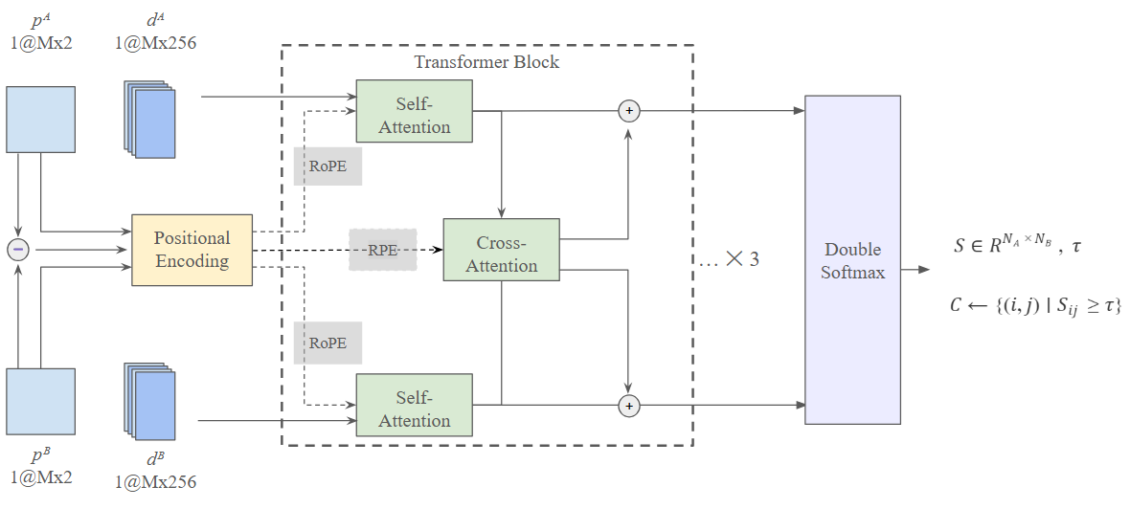

Matcher: Affine-Attentive Keypoint Matching
Role
Match keypoints and descriptors
Inputs: Keypoints $p^{A}, p^{B}∈ℝ^{N×2}$ and Descriptors $d^{A}, d^{B}∈ℝ^{N×D}$
Outputs: Similarity matrix $S∈ℝ^{N×N}$
Fig. 5. Matcher module architecture

Slide 9
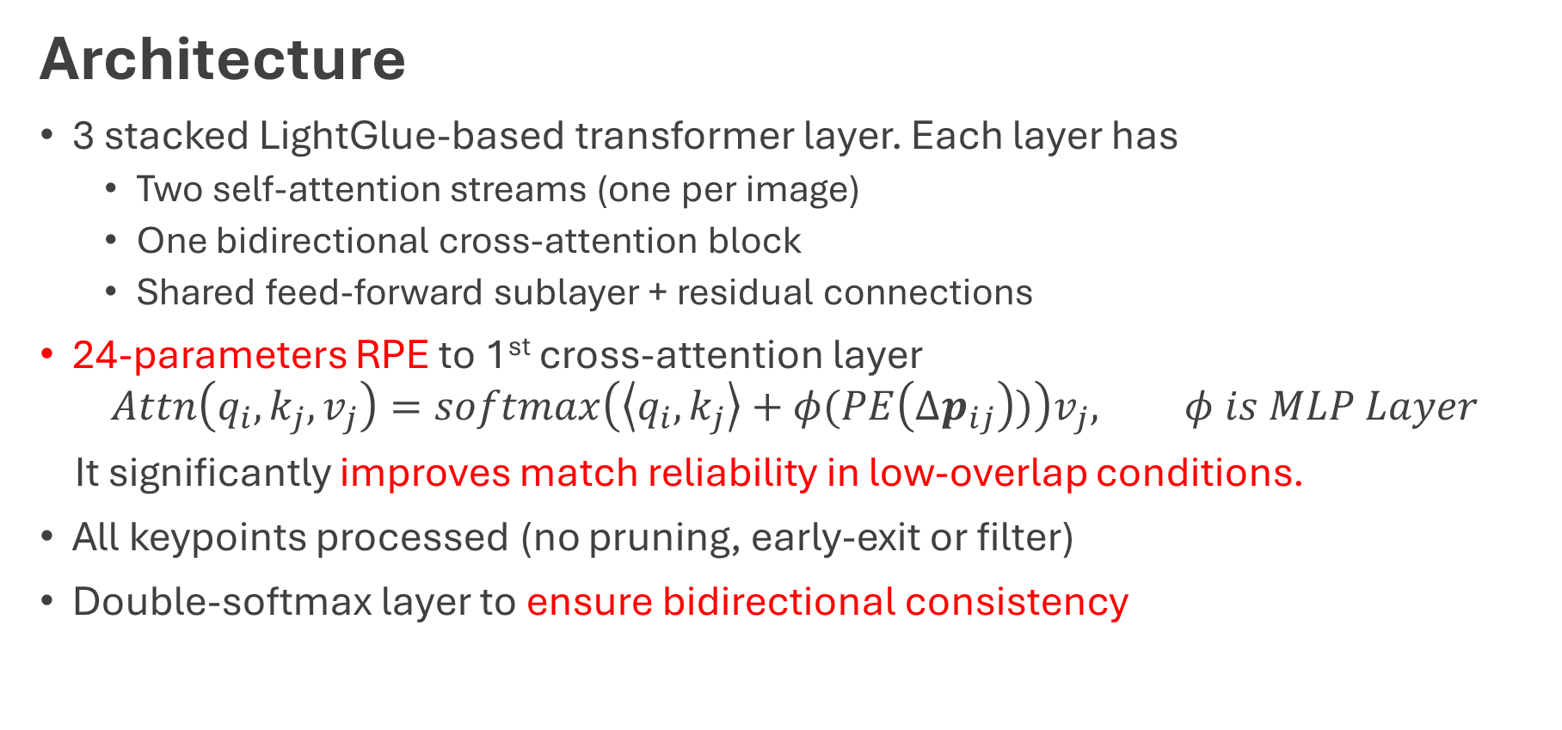
Matcher: Affine-Attentive Keypoint Matching
Architecture
3 stacked LightGlue-based transformer layer. Each layer has
Two self-attention streams (one per image)
One bidirectional cross-attention block
Shared feed-forward sublayer + residual connections
24-parameters RPE to 1st cross-attention layer
$$Attn\left(q_{i},k_{j},v_{j}\right)=softmax\left(\left\langle q_{i},k_{j}\right\rangle +φ(PE\left(Δp_{ij}\right))\right)v_{j}, φ is MLP Layer$$ It significantly improves match reliability in low-overlap conditions.
All keypoints processed (no pruning, early-exit or filter)
Double-softmax layer to ensure bidirectional consistency

Slide 10
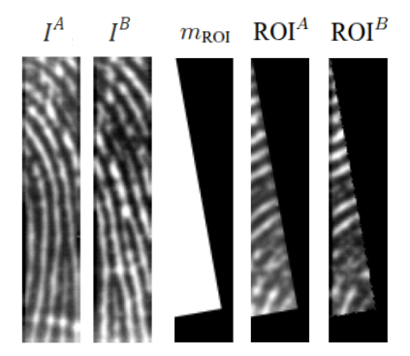
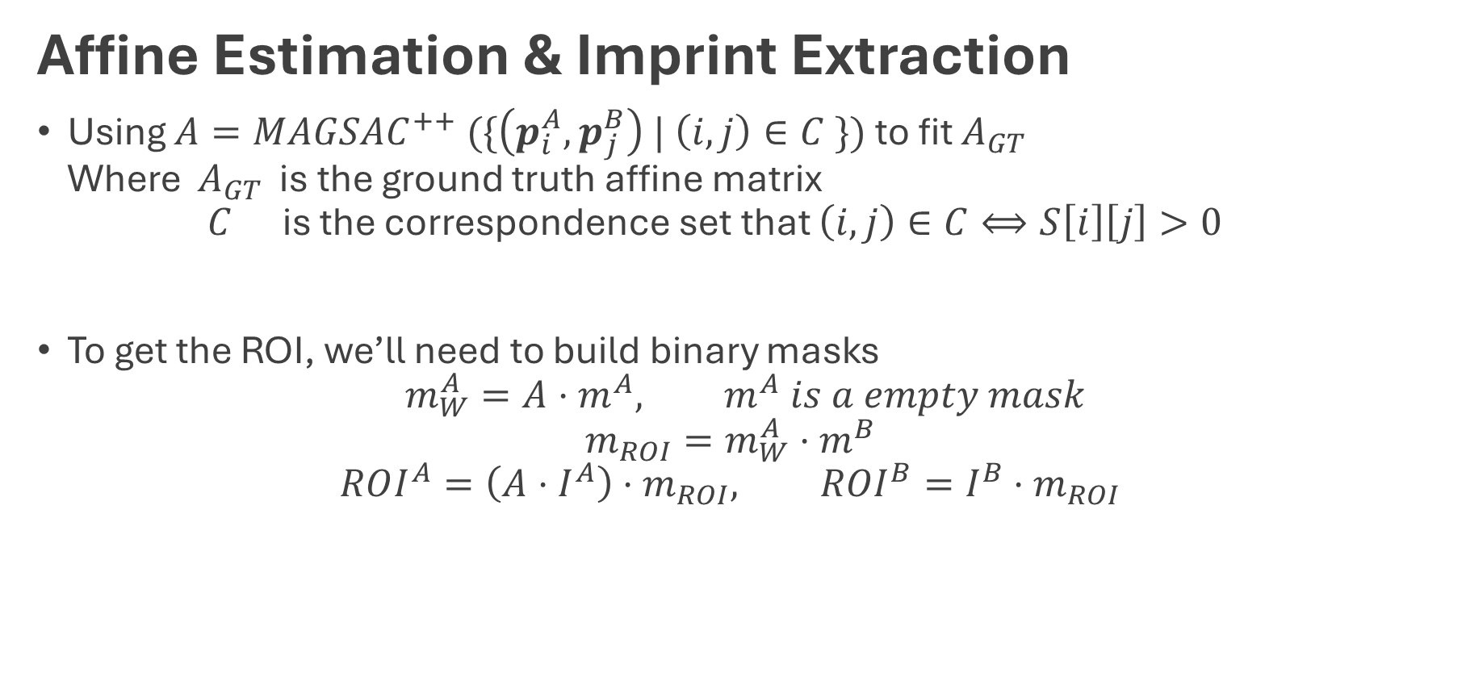
Matcher: Affine-Attentive Keypoint Matching
Affine Estimation & Imprint Extraction
Using $A=MAGSAC^{++} (\{\left(p_{i}^{A}, p_{j}^{B}\right) | \left(i, j\right)∈C \})$ to fit $A_{GT}$ Where $A_{GT}$ is the ground truth affine matrix $C$ is the correspondence set that $\left(i, j\right)∈C⟺S\left[i\right]\left[j\right]>0$
To get the ROI, we’ll need to build binary masks $m_{W}^{A}=A⋅m^{A}, m^{A} is a empty mask$ $m_{ROI}=m_{W}^{A}⋅m^{B}$ $ROI^{A}=\left(A⋅I^{A}\right)⋅m_{ROI}, ROI^{B}=I^{B}⋅m_{ROI}$
Fig. 6. Example of ROI masks

Slide 11
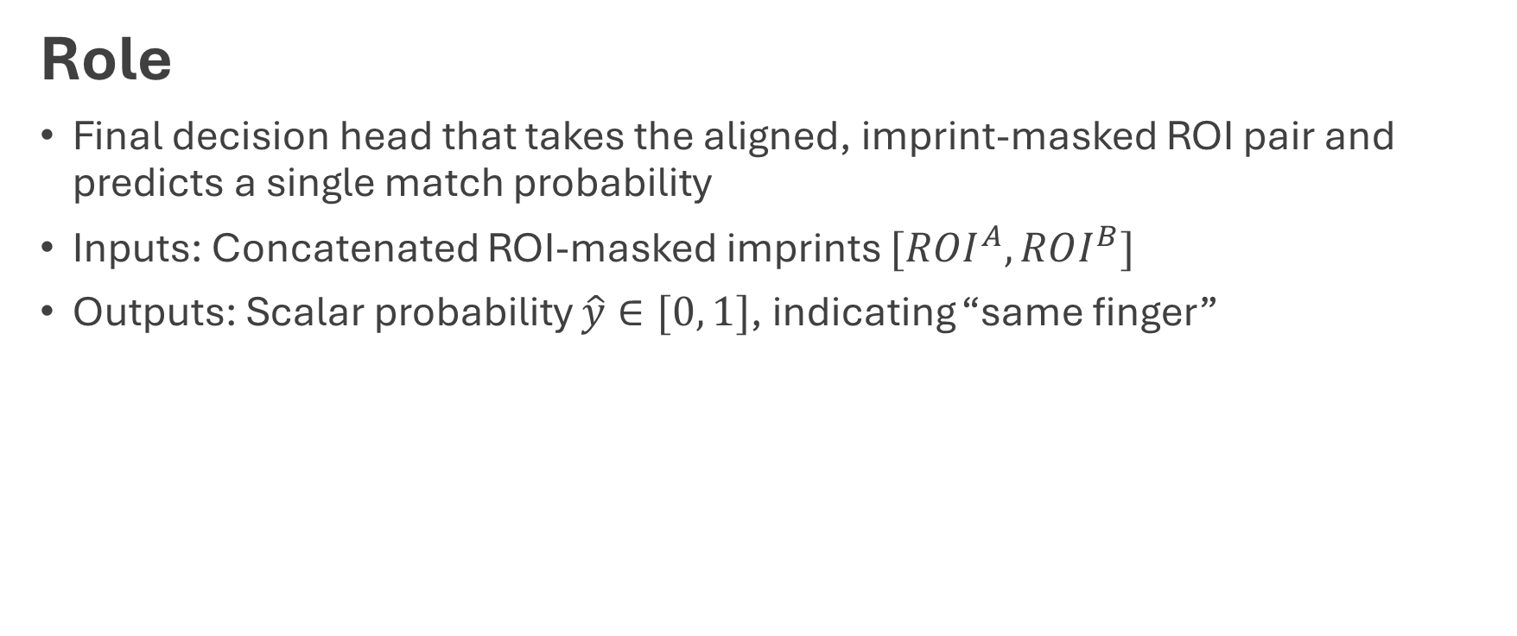
Verifier: Final Decision on Aligned ROI Pair
Role
Final decision head that takes the aligned, imprint-masked ROI pair and predicts a single match probability
Inputs: Concatenated ROI-masked imprints $[ROI^{A}, ROI^{B}]$
Outputs: Scalar probability $\hat{y}∈[0, 1]$, indicating “same finger”

Slide 12
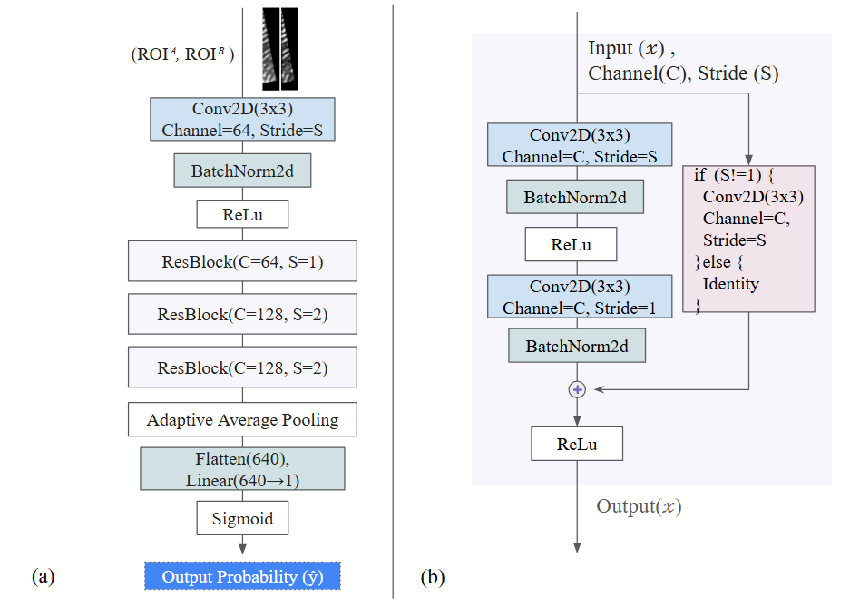
Verifier: Final Decision on Aligned ROI Pair
Architecture
Lightweight ResNet-style with a shallow network
Operates strictly on the ROI, improving interpretability and lowering false matches
Fig. 7. Module Structure of
(a) Verifier (b) ResBlock

Slide 13
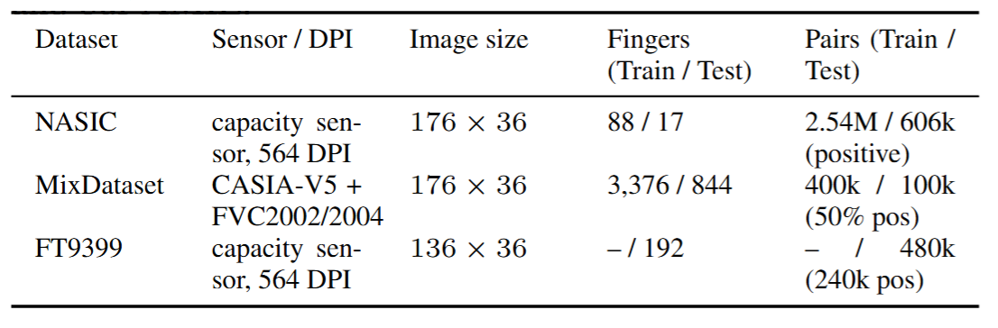
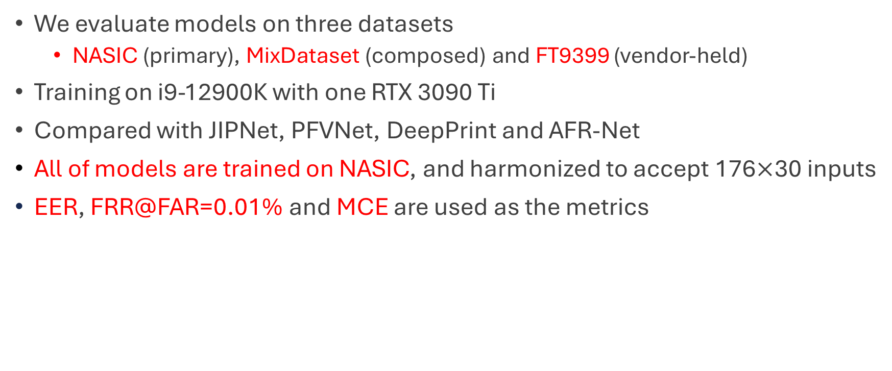
Experiment – Dataset & Settings
We evaluate models on three datasets
NASIC (primary), MixDataset (composed) and FT9399 (vendor-held)
Training on i9-12900K with one RTX 3090 Ti
Compared with JIPNet, PFVNet, DeepPrint and AFR-Net
All of models are trained on NASIC, and harmonized to accept 176$×$30 inputs
EER, FRR@FAR=0.01% and MCE are used as the metrics
Table 1. Information of each dataset

Slide 14
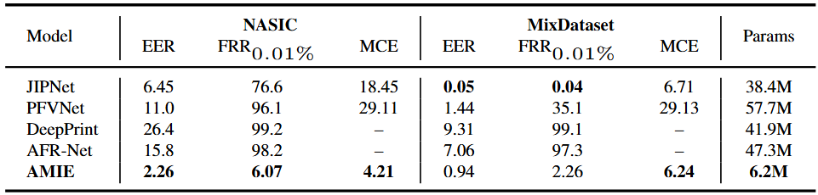
Experiment – Result
AMIE is over six times more compact than any other baselines
AMIE provides state-of-the-art accuracy, efficiency, and robustness across both challenging real and synthetic benchmarks.
Table 2. Performance of each model on different dataset

Slide 15
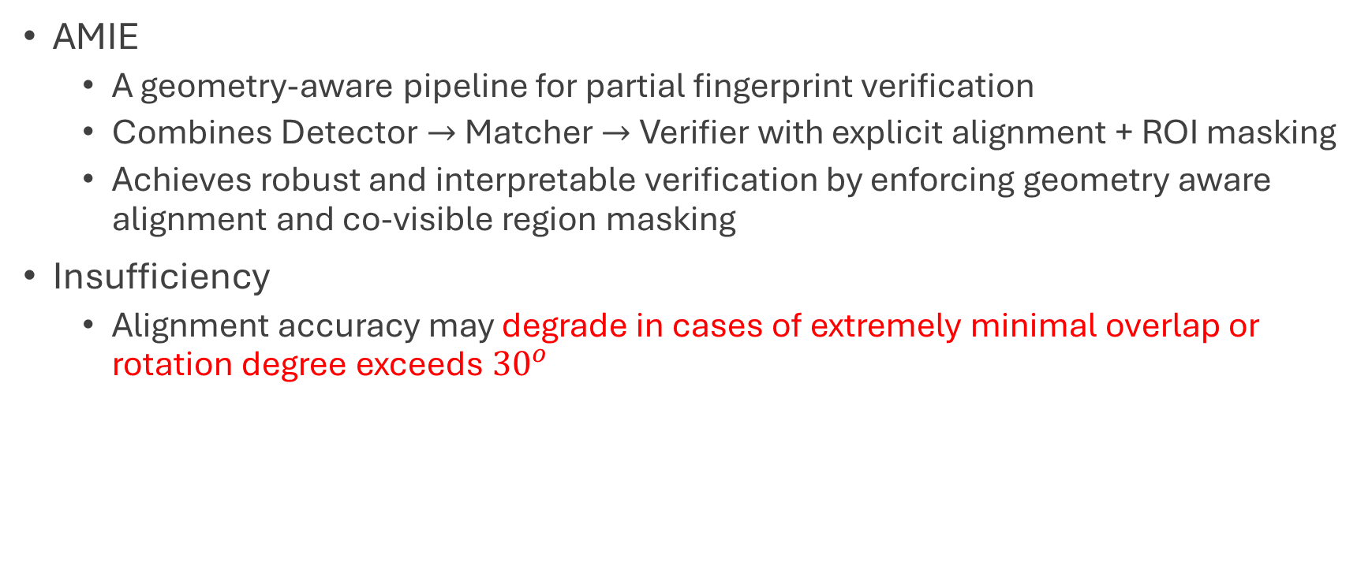
Conclusion
AMIE
A geometry-aware pipeline for partial fingerprint verification
Combines Detector$→$Matcher$→$Verifier with explicit alignment + ROI masking
Achieves robust and interpretable verification by enforcing geometry aware alignment and co-visible region masking
Insufficiency
Alignment accuracy may degrade in cases of extremely minimal overlap or rotation degree exceeds ${30}^{ο}$

