Slide 1
10/07 個人咪挺 KD 初步訓練結果

Slide 2
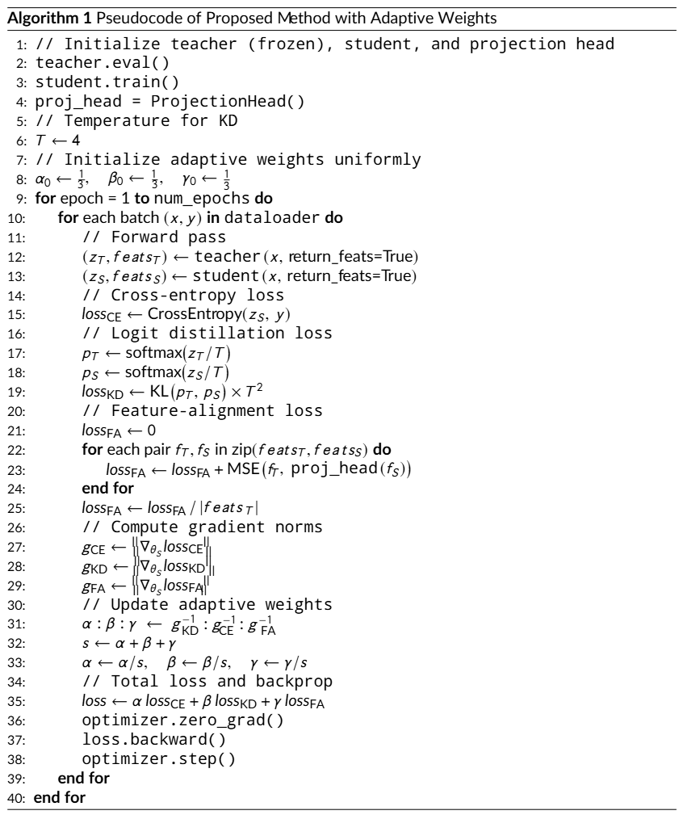
Recall

Slide 3
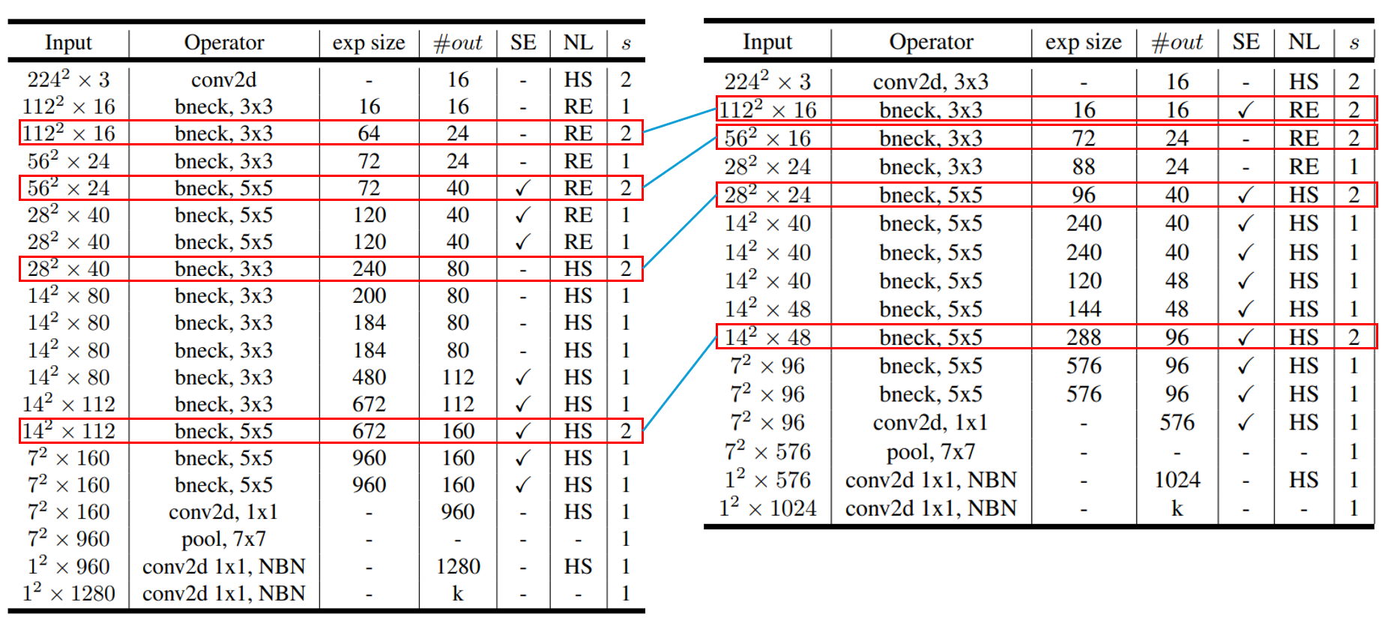
Recall

Slide 4
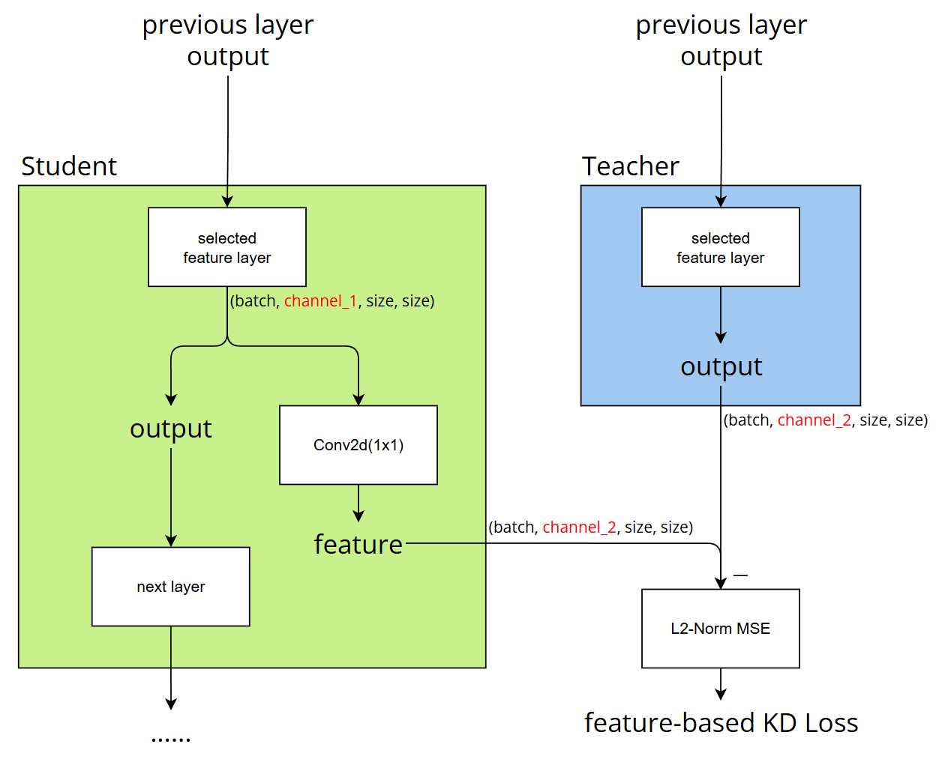
Structure
-

Slide 5
Train Setting
I5-10500 + 2080Ti
Random seed = 42
Adam(lr = 1e-4) + BCEWithLogitsLoss
ABCD Dataset as training set (0.8 for training and 0.2 for validating)
Google Dataset as testing set
Epochs = 50
Teacher Model：MobileNet V3 Large (epoch70)

Slide 6
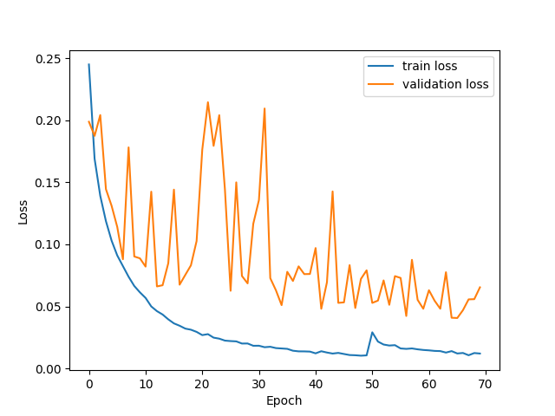
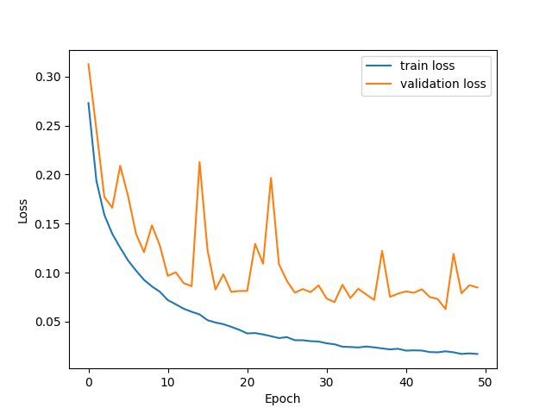
Loss Curve（Without KD）
Teacher
Student

Slide 7
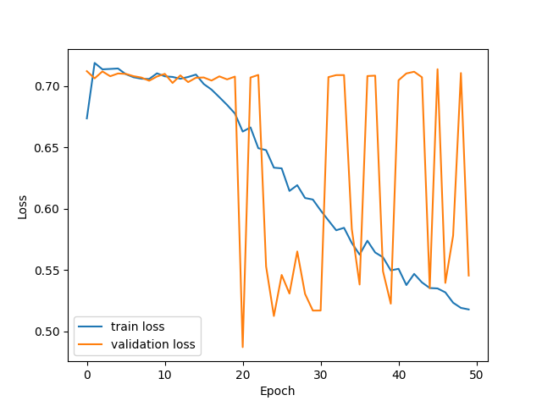
Loss Curve（With feature-based KD）
Teacher
Student

Slide 8
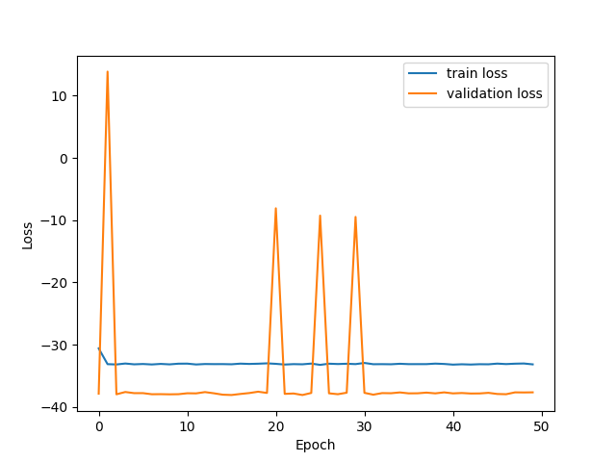
Loss Curve（With logit-based KD）
Teacher
Student

Slide 9
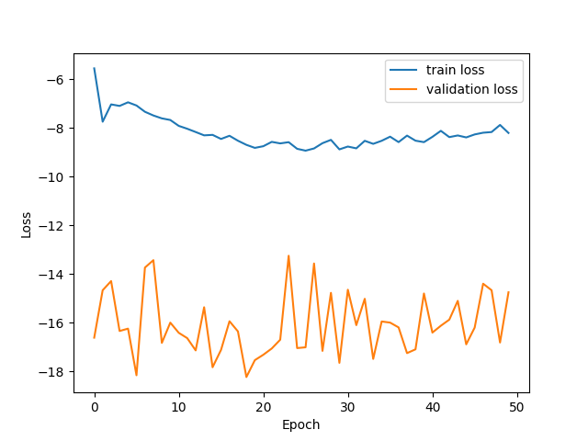
Loss Curve（Full KD）
Teacher
Student

Slide 10
Metrics
Model | Teacher | Student | Feature KD | Logit KD | Full KD
TDR@FDR = 1% | 78.73% | 64.71% | 67.87% | 56.11% | 64.71%
Accuracy | 94.66% | 84.55% | 92.04% | 9.51% | 9.51%

