Slide 1
10/28 個人咪挺
KD成果

Slide 2
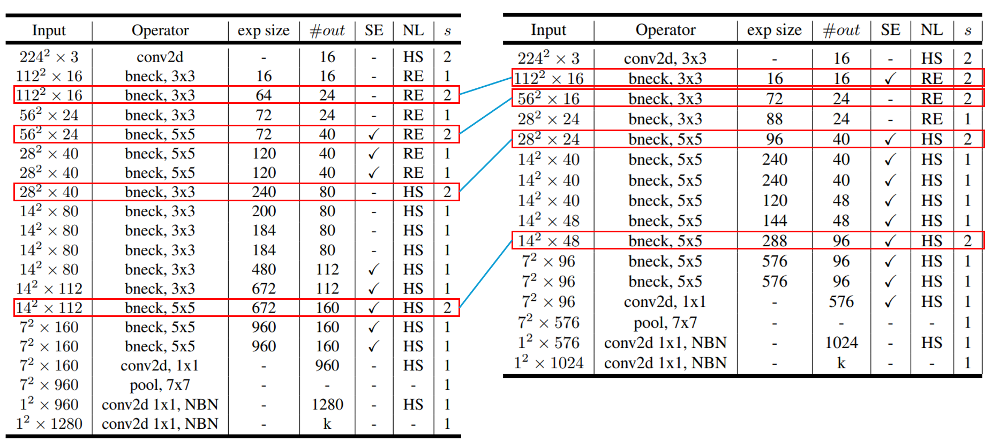
Recall

Slide 3
Train Setting
I5-10500 + 2080Ti
Random seed = 42
Adam(lr = 1e-4) + BCELoss
ABCD Dataset as training set (0.8 for training and 0.2 for validating)
Google Dataset as testing set
Output Dimension from 1 to 2
Teacher model is trained with 200 epochs

Slide 4
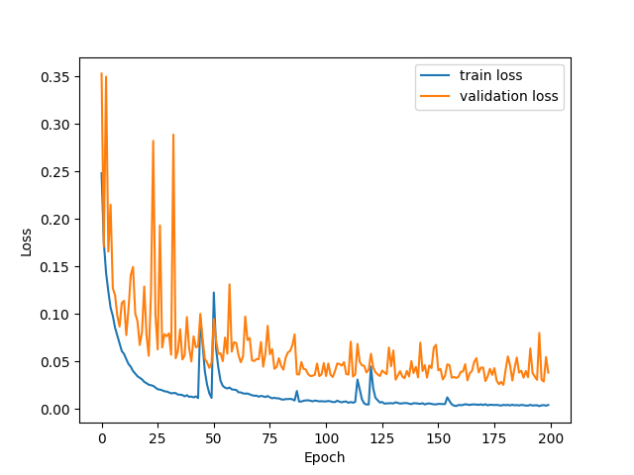
Loss Curve (Teacher)

Slide 5
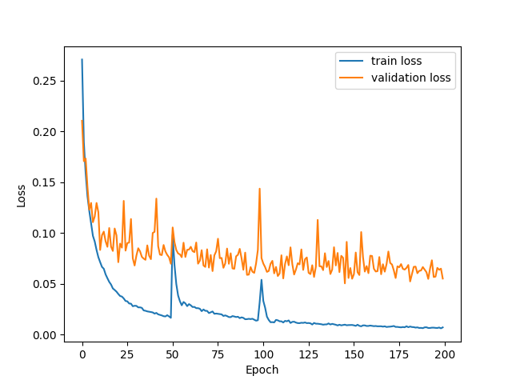
Loss Curve (Student w/o KD)

Slide 6
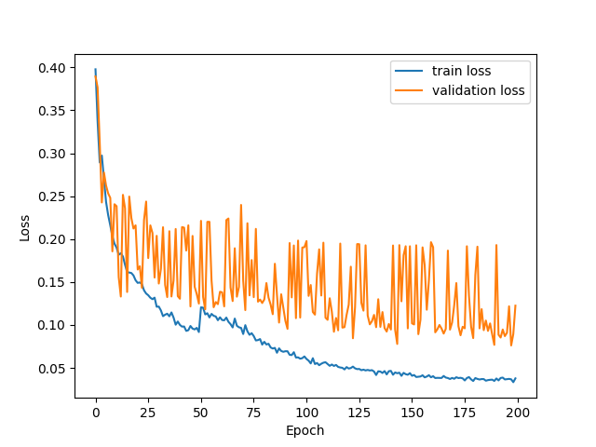
Loss Curve (Student w/ KD)

Slide 7
Metrics
 | 50 | 75 | 100 | 125 | 150 | 175 | 200
Teacher | 61.09% | 65.16% | 88.24% | 72.85% | 85.97% | 76.92% | 84.62%
Student | 64.71% | 47.96% | 60.18% | 75.11% | 69.68% | 70.59% | 78.28%
KD | 64.71% | 57.92% | 76.02% | 74.66% | 76.02% | 70.59% | 76.92%

