Slide 1
9/9個人咪挺
Knowledge Distillation from ResNet to MobileNet for Accurate On-Device Face Recognition

Slide 2
Outline
Introduction
Method
Experiment
Conclusion

Slide 3
Introduction
Published on AIPA
Compress a 283MB ResNet teacher into a 7.2MB MobileNet student
Introduce Adaptive Feature Logit Distillation (AFL-KD)

Slide 4
Outline
Introduction
Method
Experiment
Conclusion

Slide 5
Method
Use deep ResNet as teacher and lightweight MobileNet as student
Including 3 components
Logit value distillation
Alignment of intermediate features
Adaptive loss weighting

Slide 6

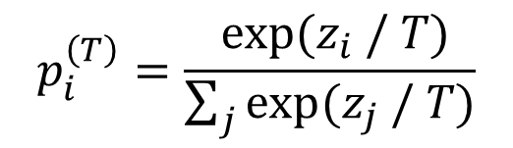
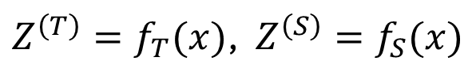
Logit value distillation
Let the input image be $x$ The output of teacher and student be
To reveal the dark knowledge of teacher, authors soften both output distribution by where temperature $T>1$
$Z^{\left(T\right)}=f_{T}(x)$, $Z^{\left(S\right)}=f_{S}(x)$
$$p_{i}^{\left(T\right)}=\frac{ exp⁡(z_{i} / T)}{\sum_{j}{exp⁡(z_{j} / T)}}$$

Slide 7

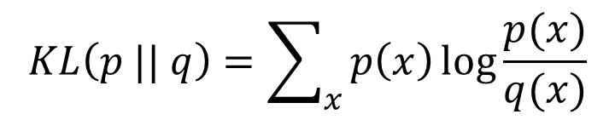

Logit value distillation
After that, student then guided to mimic these softened probabilities by minimizing where $T^{2}$ factor balances the gradient magnitudes and $TL(⋅ || ⋅)$ denotes the Kullback-Leibler divergence
$$ℒ_{KD}=T^{2}⋅KL(p_{T}^{\left(T\right)} || p_{T}^{\left(S\right)})$$
$$KL\left(p || q\right)=\sum_{x}{p\left(x\right)\log{\frac{p(x)}{q(x)}}}$$

Slide 8
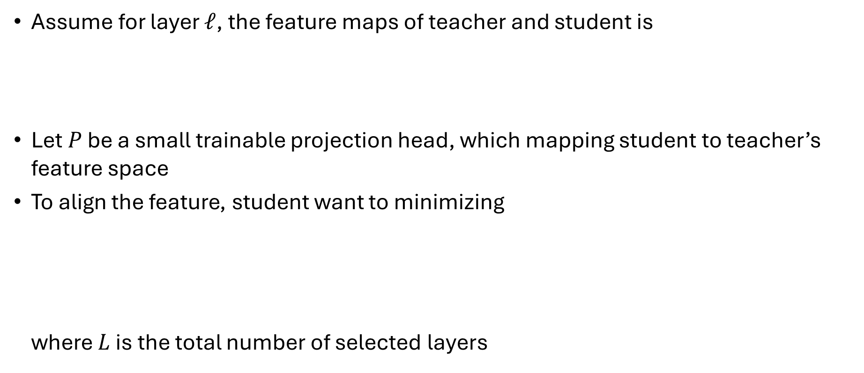
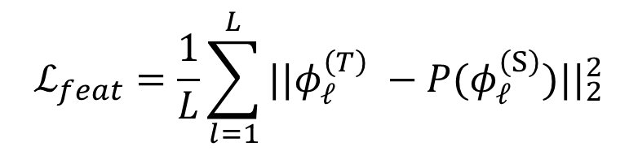
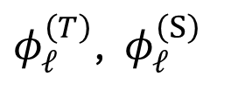
Alignment of intermediate features
Assume for layer $𝓁$, the feature maps of teacher and student is
Let $P$ be a small trainable projection head, which mapping student to teacher’s feature space
To align the feature, student want to minimizing where $L$ is the total number of selected layers
$φ_{𝓁}^{\left(T\right)}$, $φ_{𝓁}^{\left(S\right)}$
$$ℒ_{feat}=\frac{1}{L}\sum_{l=1}^{L}{||φ_{𝓁}^{\left(T\right)} −P(φ_{𝓁}^{\left(S\right)})||_{2}^{2}}$$

Slide 9


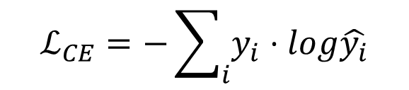
Adaptive loss weighting
To ensure correct classification, authors use standard CE loss
At the end, the total loss will become where $α+β+γ=1$ and all of them are dynamic
$$ℒ_{CE}=−\sum_{i}{y_{i}⋅log\hat{y_{i}}}$$
$${ℒ=αℒ_{CE}+βℒ_{KD}+γℒ}_{feat}$$

Slide 10
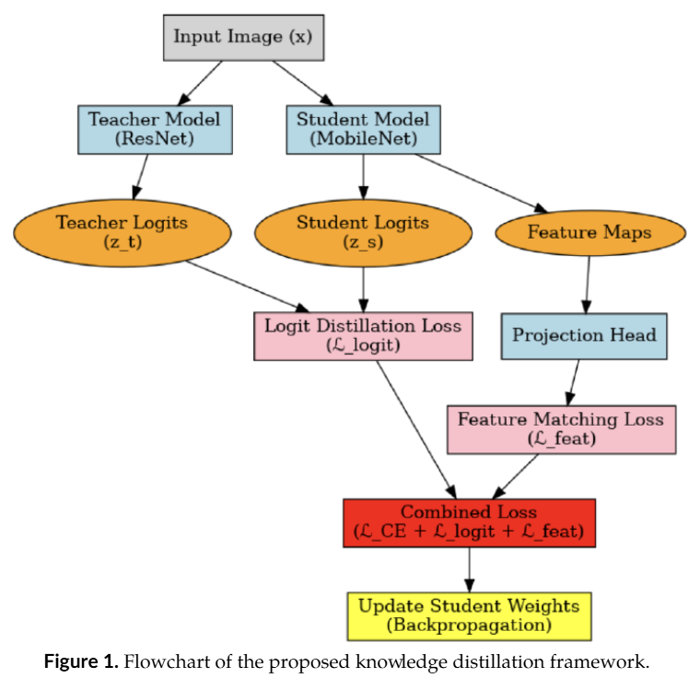
Flowchart

Slide 11
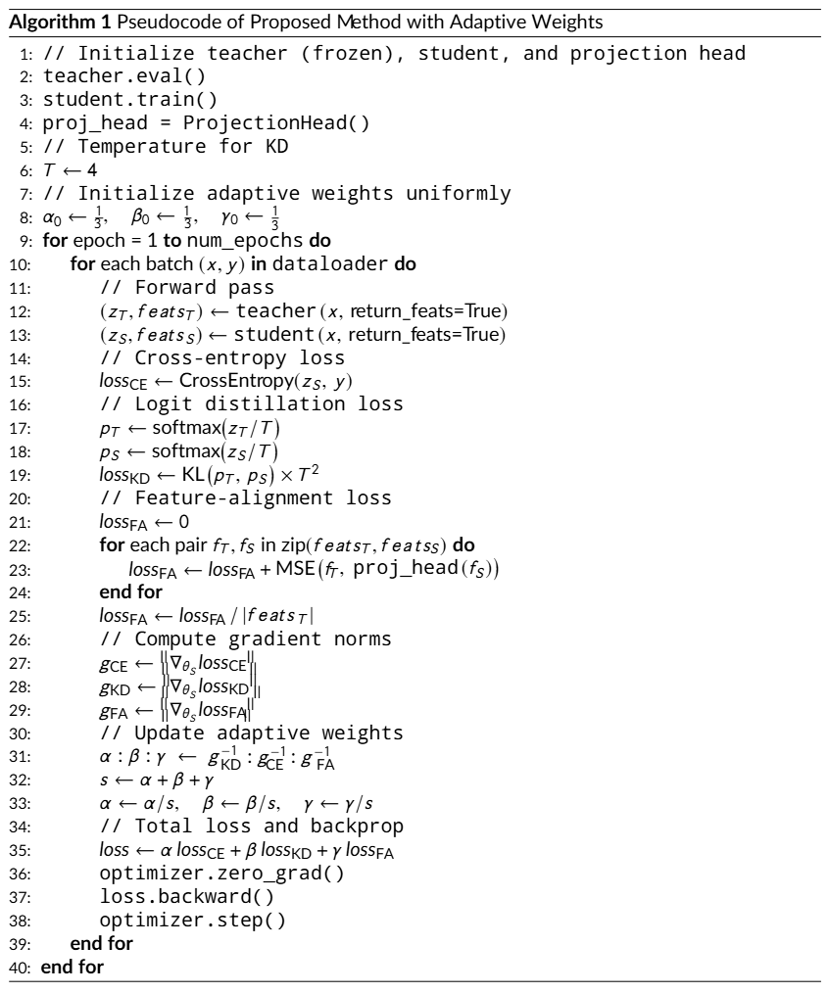
Algorithm

Slide 12
Outline
Introduction
Method
Experiment
Conclusion

Slide 13
Experiment
All face images were detected by MTCNN and resized to (112, 112)
Teacher model is a pre-trained ResNet with ArcFace output head
Student model is a MobileNet backbone augmented by a lightweight projection head
All models are trained with CASIA-WebFace dataset, leveraging eight GTX 4090 GPU
Measure the performance by Accuracy, Precision, Recall and F1-score

Slide 14
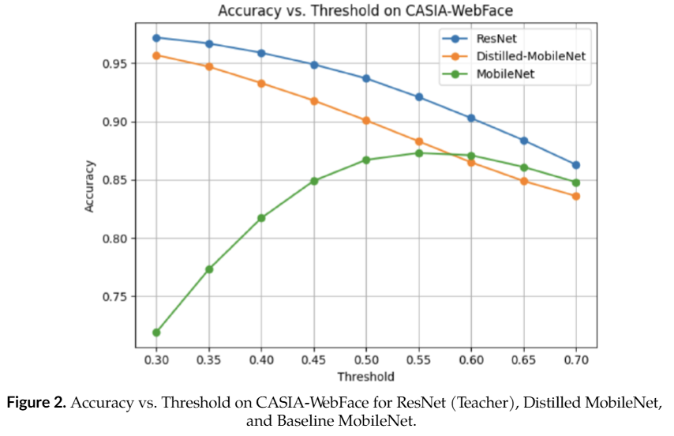
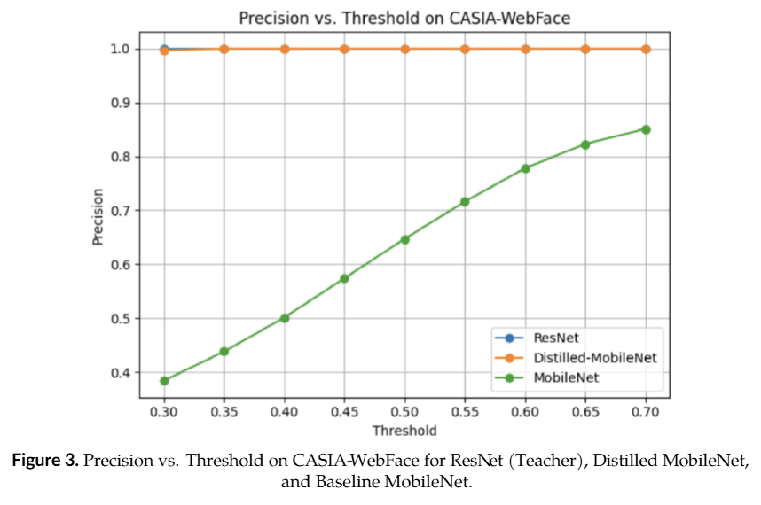
Result

Slide 15
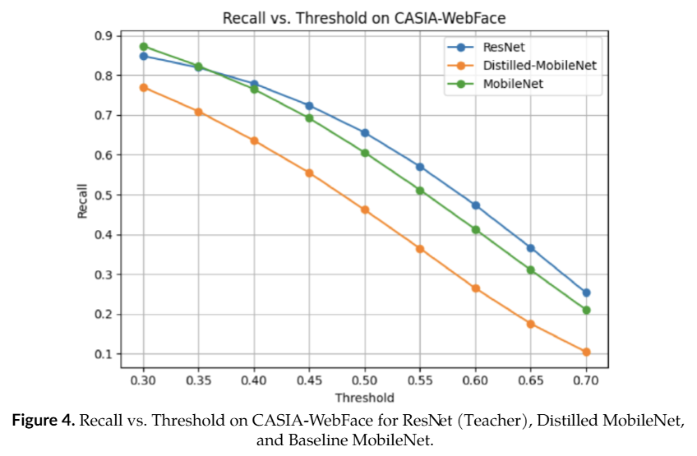
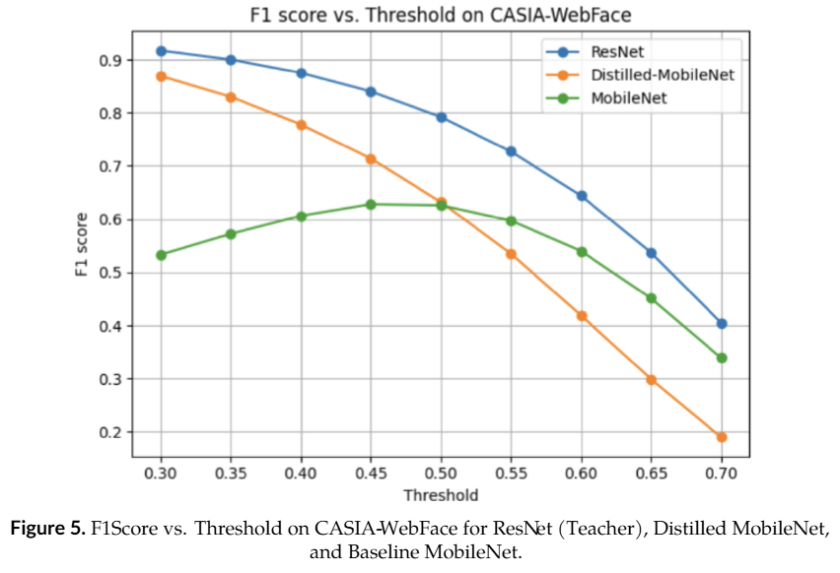
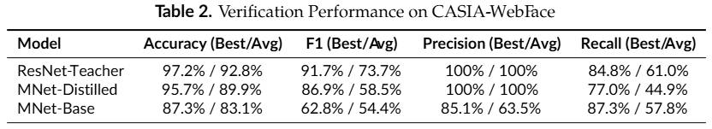
Result

Slide 16
Outline
Introduction
Method
Experiment
Conclusion

Slide 17
Conclusion
AFL-KD closes most of the teacher-student gap (only 1.5pp drop in accuracy) while achieving 39x compression and no additional inference cost

