Slide 1
Tenstorrent Progress Report 7/7 林家逸

Slide 2
Outline
Running code on device
Register control and Data Flow within the Compute Kernels
Compute APIs
Fast dispatch
SPMD in Metalium

Slide 3
Introduction of TT-Metalium
Tenstorrent’s SDK for developing applications on the Tensix Processor
The API design resembles OpenCL, providing C++ interfaces for both high-level operations and direct hardware control
Is the base layer for Tenstorrent’s software stack. TT-NN, TT-MLIR and TT-Forge are built on top of TT-Metal

Slide 4
Process of Executing Code
Initialize and open a device
Allocate memory buffers for input and output data
Transfer input data to device buffers
Compile data movement and compute kernels
Allocate circular buffers for inter-kernel data communication
Configure runtime parameters for kernel execution
Enqueue kernels for execution
Synchronize and wait for kernel completion
Retrieve computational results from output buffers

Slide 5
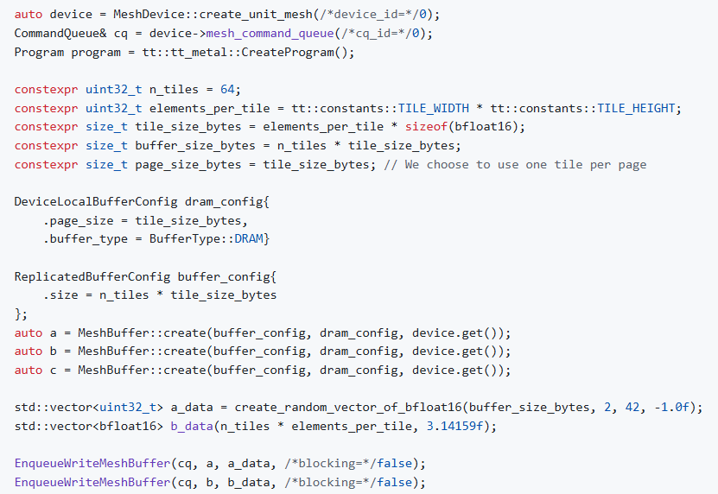
Initialize and Allocate the Necessary Buffers
In TT-Metalium, everything belongs to a mesh. This design enables seamless scaling from one chip to multiple chips

Slide 6
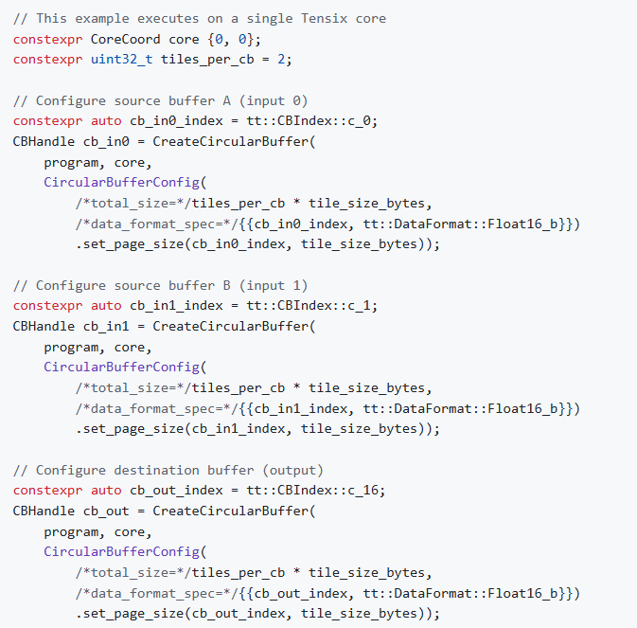
Allocate the Circular Buffers
Each circular buffer is configured to
Hold two or more tiles worth of data
Enable the reader kernel to fetch new data while the compute kernel processes the previous tile
Increasing the number of tiles per circular buffer can further enhance performance, but still need to carefully evaluate memory usage constraints and recognize the diminishing returns associated with larger buffer sizes

Slide 7
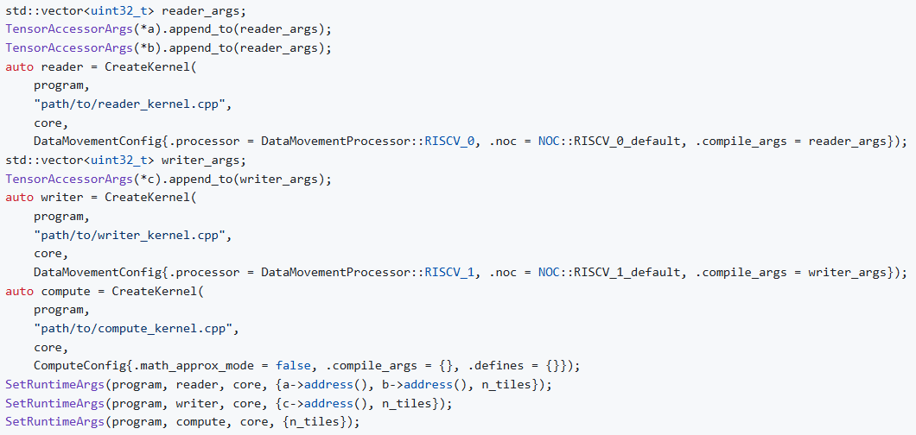
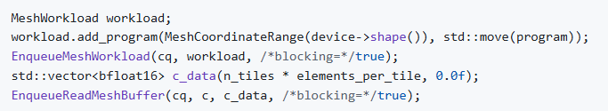
Compile the Kernels of Data Movement & Computation

Slide 8
Outline
Running code on device
Register control and Data Flow within the Compute Kernels
Compute APIs
Fast dispatch
SPMD in Metalium

Slide 9
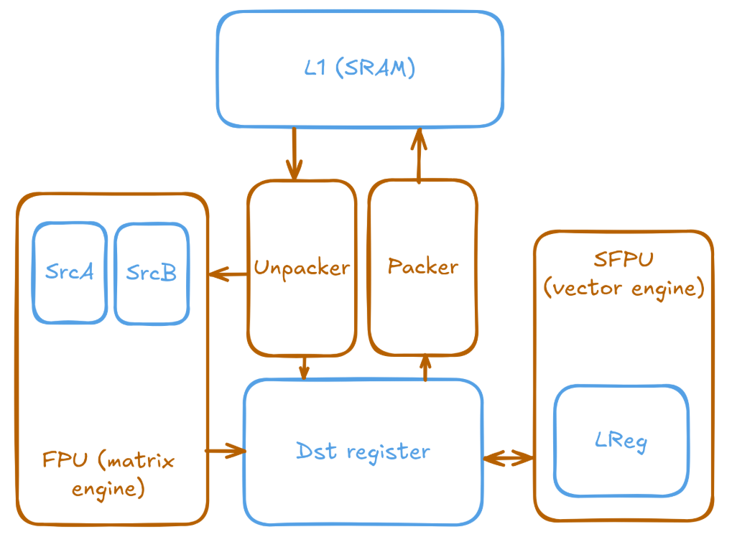
Layout & Data Flow of Tensix Tile
The unpack core
Moves data from L1 SRAM into registers
The math core
Issues instructions to the SFPU and FPU
The pack core
Writes data back to L1
SrcA and SrcB
Hold the source data for the matrix engine
Dst
Holds the result for matrix and vector engine operations
Serves as input for the vector engine
LReg
Holds the internal state of the vector engine

Slide 10
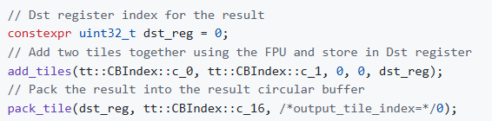
FPU
Operate directly on circular buffers and handle register management automatically
Adding two files together

Slide 11
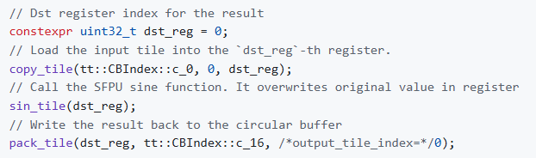
SFPU
Need to explicit move data between buffers and registers
Data need to be moved into the Dst register before invoking the SFPU
Compute the value of sine

Slide 12
Outline
Running code on device
Register control and Data Flow within the Compute Kernels
Compute APIs
Fast dispatch
SPMD in Metalium

Slide 13
Why is another abstract layer needed
Maintaining kernel code compatibility
Performance across different hardware generations
Without an abstraction like compute API, developers would need to write kernels directly for specific hardware, and this may create several problems
Code Brittleness
Kernels written for Grayskull won’t work on Wormhole or Blackhole
Maintenance Overhead
Each new hardware generation requires rewriting and re-validating kernels
Metalium supports custom vectorized computation implementations, developers should note that vector width and hardware-specific details vary between processor generations

Slide 14
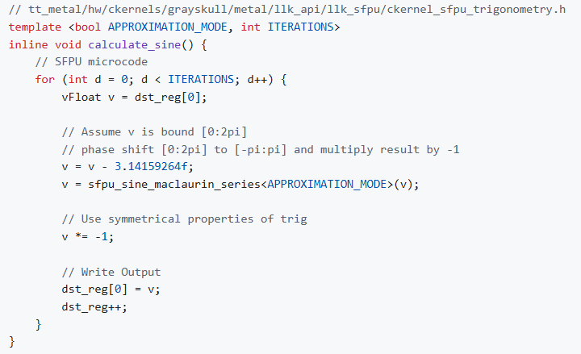
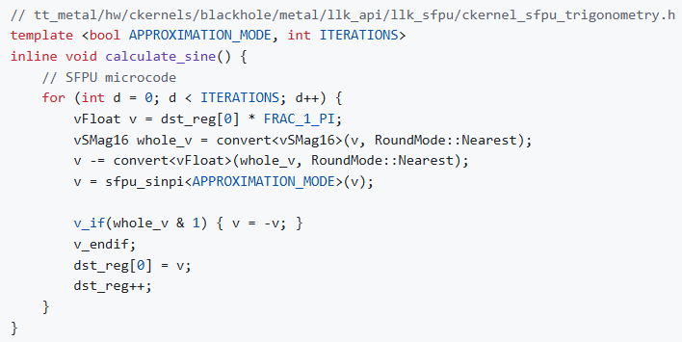
Example – sine_tile
Grayskull processors
Blackhole/Wormhole processors

Slide 15
Outline
Running code on device
Register control and Data Flow within the Compute Kernels
Compute APIs
Fast dispatch
SPMD in Metalium

Slide 16
What is dispatch
The process of sending tasks from Host CPU to device

Slide 17

Fast Dispatch
Implements asynchronous command queuing by dedicating one RISC-V core per queue on the device to process queued operations
In runtime, Tenstorrent assigns one RISC-V core per command queue for processing, and this core is typically placed on an unused Ethernet tile
Minimizes impact on computational performance
For any core to access any other core
Tenstorrent’s command queue architecture enforces strict in-order execution due to the performance characteristics of the Baby RISC-V cores
To enable overlapping computation and data transfer operations, each device provides two dedicated command queues
Queue 0 handles computational workloads
Queue 1 manages data transfer operations
Synchronization between queues is achieved through an event-based mechanism

Slide 18
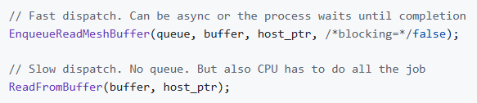
Fast Dispatch vs. Slow Dispatch
Fast Dispatch
Stores command sequences in host memory and allows the device to fetch and execute them independently
It’s recommended to use for production workloads
Slow Dispatch
Forces the host CPU to actively manage all operations, including data transfers to and from the device
It should be used only for debugging when suspecting the dispatch mechanism itself is malfunctioning

Slide 19
Outline
Running code on device
Register control and Data Flow within the Compute Kernels
Compute APIs
Fast dispatch
SPMD in Metalium

Slide 20
What is SPMD
Single Program, Multiple Data (SPMD) is a common parallel computing model used in framework like OpenMP, CUDA and OpenCL
Multiple processing units execute the same program but operate on different portions of data
While Metalium supports SPMD, developers can choose alternative approaches when beneficial
For complex operations requiring specialized behavior, Metalium also supports Multiple Program, Multiple Data (MPMD) execution, where different Tensix cores run entirely different programs

Slide 21
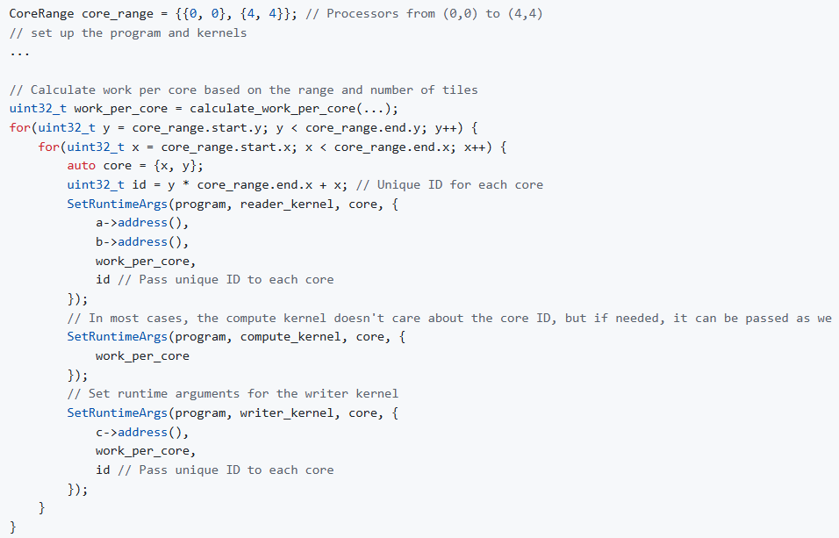
Properties of Metalium’s SPMD
Metalium does not provide built-in thread and global work size identification mechanisms. Instead, developers explicitly specify the data range each Tensix core processes by passing different runtime arguments to each core before kernel execution

Slide 22
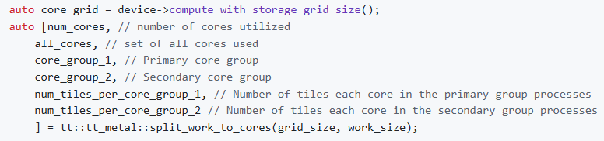
Properties of Metalium’s SPMD
Metalium provides the tt::tt_metal::split_work_to_cores utility function to distribute work across available cores for SPMD execution
The function takes the total number of tiles and available cores, then calculates how to divide the work when it cannot be evenly distributed
The function returns two groups of cores
A primary group that handles more tiles per core
A secondary group that handles fewer, along with the tile count for each group

Slide 23
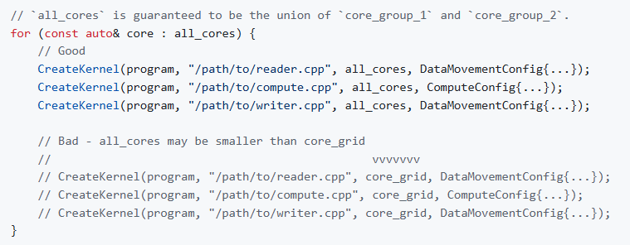
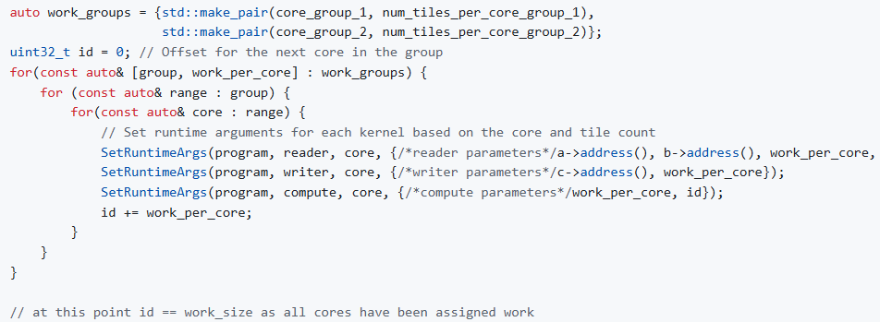
Warning of Metalium’s SPMD
Only create kernels on cores that have been assigned work
This can cause undefined behavior or crashes if kernels are created but runtime arguments are not set on the core
Developers should iterate over all cores and set the runtime arguments for each kernel according to the assigned core group and tile count. The sum of tiles processed by all cores must match the original workload
If a core is not part of either group (can happen due to not enough work or other reasons), its runtime arguments MUST be set such the kernel does nothing (a no-op). Leaving runtime arguments uninitialized will lead to undefined behavior and issues during execution

