Slide 1
Tenstorrent Progress Report 7/14 林家逸

Slide 2
Outline
distributed program dispatch
distributed eltwise add

Slide 3
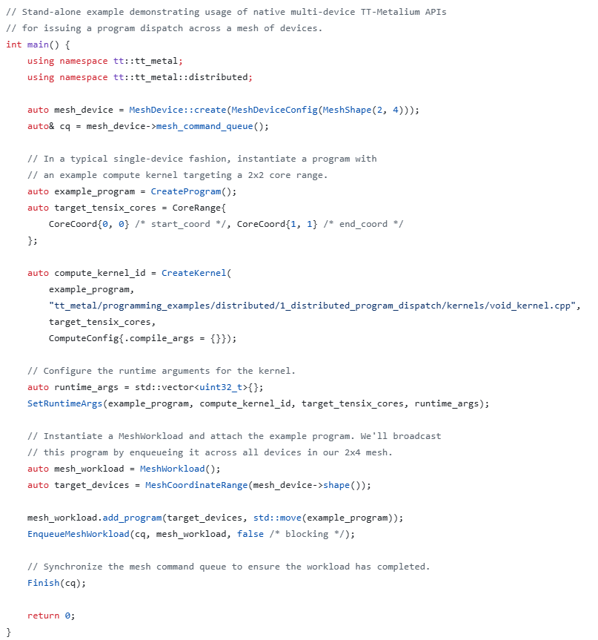
Distributed Program Dispatch
Demonstrates multi-device program dispatch across eight devices (Wormhole chips) arranged in a 2 × 4 mesh
The kernel has no data input or output and performs no numerical computation; it only prints a debug message

Slide 4
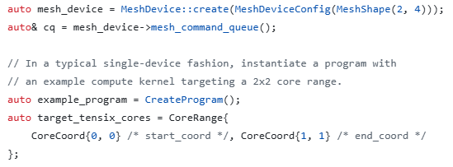
code snippet
Creates a logical mesh containing eight devices arranged as two rows and four columns
Create an empty TT-Metal Program for a single device
It describes what should run on 1 device, including kernels, target Tensix cores, circular buffers and compile-time/runtime arguments
Define a rectangular 2×2 range of Tensix cores inside each device

Slide 5
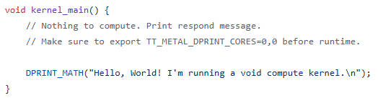
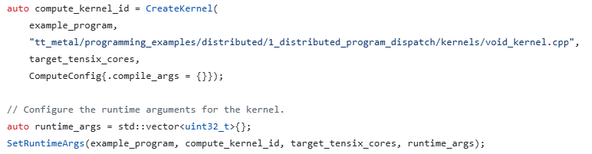
code snippet
Add void_kernel.cpp as a compute kernel in example_program
No compile-time arguments are required in this example
Assign runtime arguments to the compute kernel
The argument vector is empty because void_kernel.cpp doesn’t require any input parameters
SetRuntimeArgs applies the same runtime arguments to the kernel on every core in target_tensix_cores

Slide 6
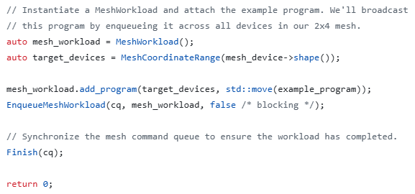
code snippet
Create a mesh workload described which devices run each Program
Assign the program to all devices
Submit the workload asynchronously

Slide 7
Outline
distributed program dispatch
distributed eltwise add

Slide 8
Distributed Eltwise Add
The example demonstrates distributed element-wise addition across a 2x4 mesh of devices:
Allocating distributed buffers that automatically shard data across the mesh
Initializing and distributing input data to each device's local memory
Executing a distributed compute kernel that performs element-wise addition in parallel across all devices
Gathering and validating the results from the distributed computation
Each device receives one 32x32 BF16 tile and compute the addition independently

Slide 9
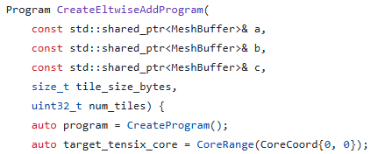
code snippet – Eltwise Add Program
This function constructs the program that will run on one device
a, b, c are the distributed input/output buffer tile_size_bytes is the size of one BF16 tile num_tiles is the number of tiles processed by each device
Create an empty single-device program and setup latterly
Define one Tensix core on each device

Slide 10
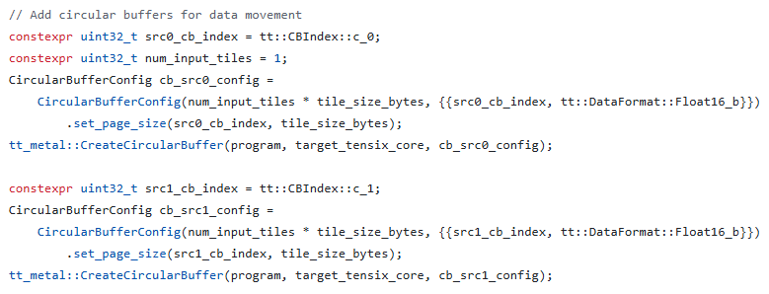
code snippet – Eltwise Add Program
Create the circular buffer for input A/B, its configuration is
Circular buffer ID : c_0 / c_1
Capacity : 1 tile
Page size : 1 tile
Data format : BF16

Slide 11

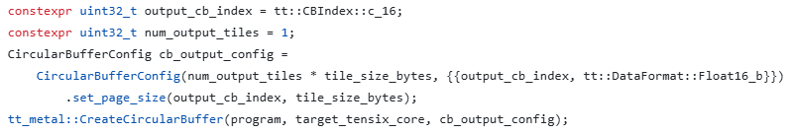
code snippet – Eltwise Add Program
Create the circular buffer for output C, its configuration is
Circular buffer ID : c_16
Capacity : 1 tile
Page size : 1 tile
Data format : BF16

Slide 12
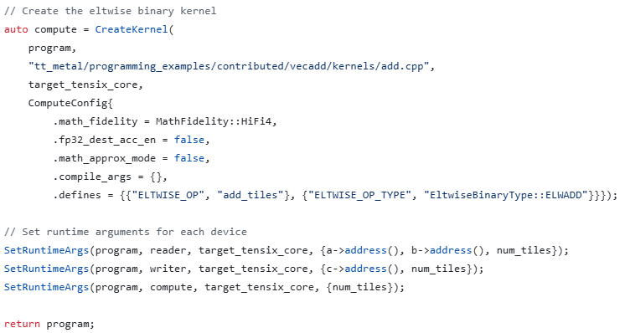
code snippet – Eltwise Add Program
Create the compute kernel
HiFi4: High math fidelity
FP32 destination accumulation is disabled
Approximate math mode is disabled
The selected element-wise operation is addition
Set runtime arguments for the 3 kernels and return the completed program

Slide 13
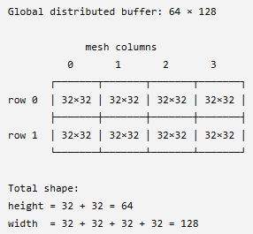
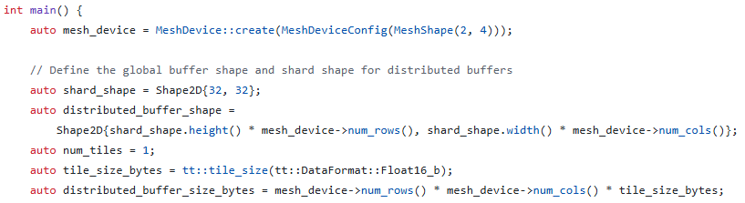
code snippet – Main function
Define each resource the main function will use
Eight devices (Wormhole chips) arranged in a 2 × 4 mesh
Each data distributed to one devices has 32x32 BF16 elements

Slide 14
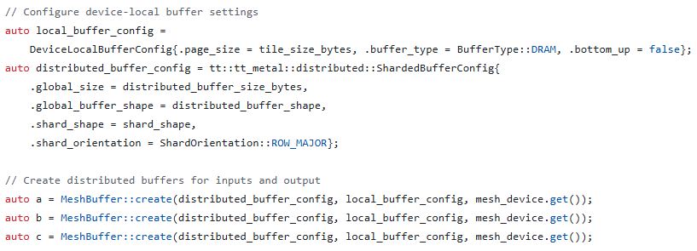
code snippet – Main function
Configure the local/global distributed buffers
Create distributed input and output buffers

Slide 15
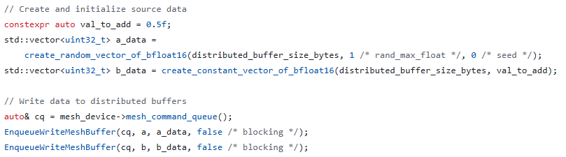
code snippet – Main function
Generate the input data on the host
Write the global input data to the mesh

Slide 16
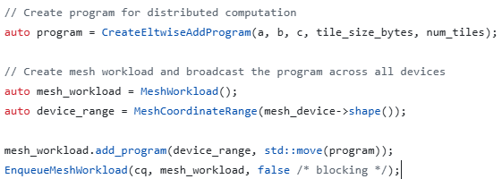
code snippet – Main function
Use the introduced function to create the single-device addition program
Create a mesh workload
Broadcast the program to all devices
Each device executes local C tile = local A tile + local B tile
This is an SPMD-style execution model

Slide 17
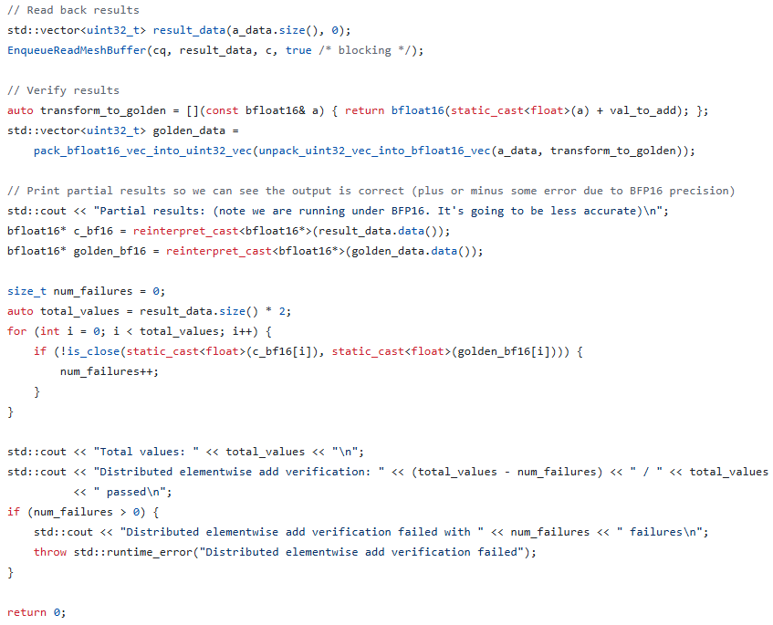
code snippet – Main function
Read the distributed result back to the host
Compare the device result with the expected result
Print the verification result
Report an error if verification fails

