Slide 1
7/14 個人咪挺 Results of adding logit loss

Slide 2
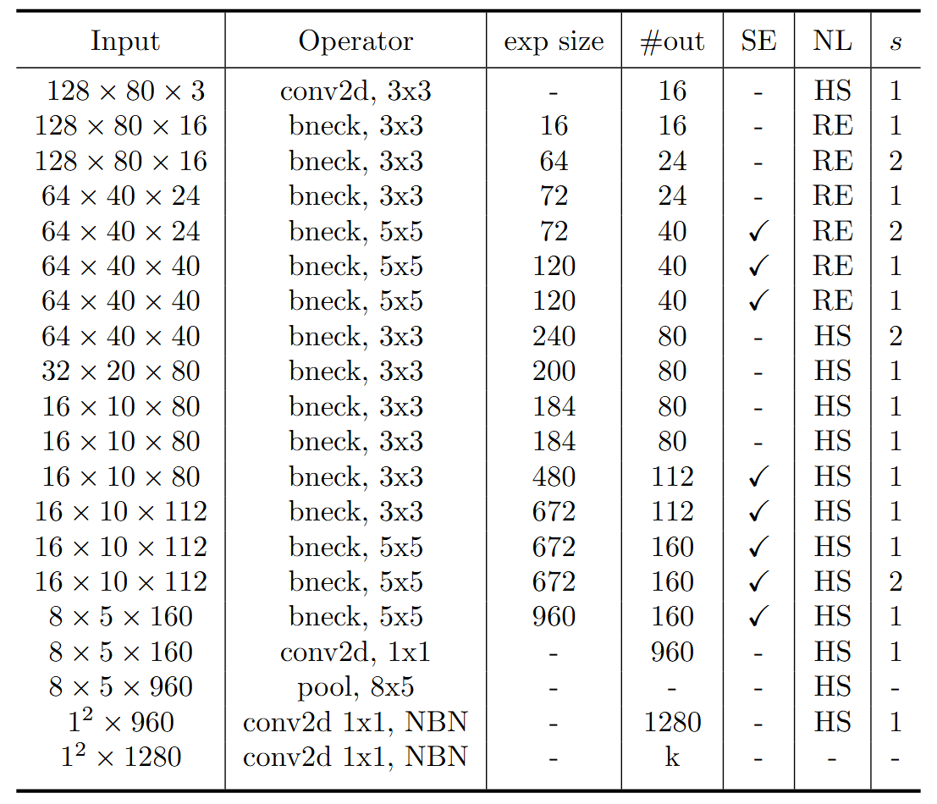
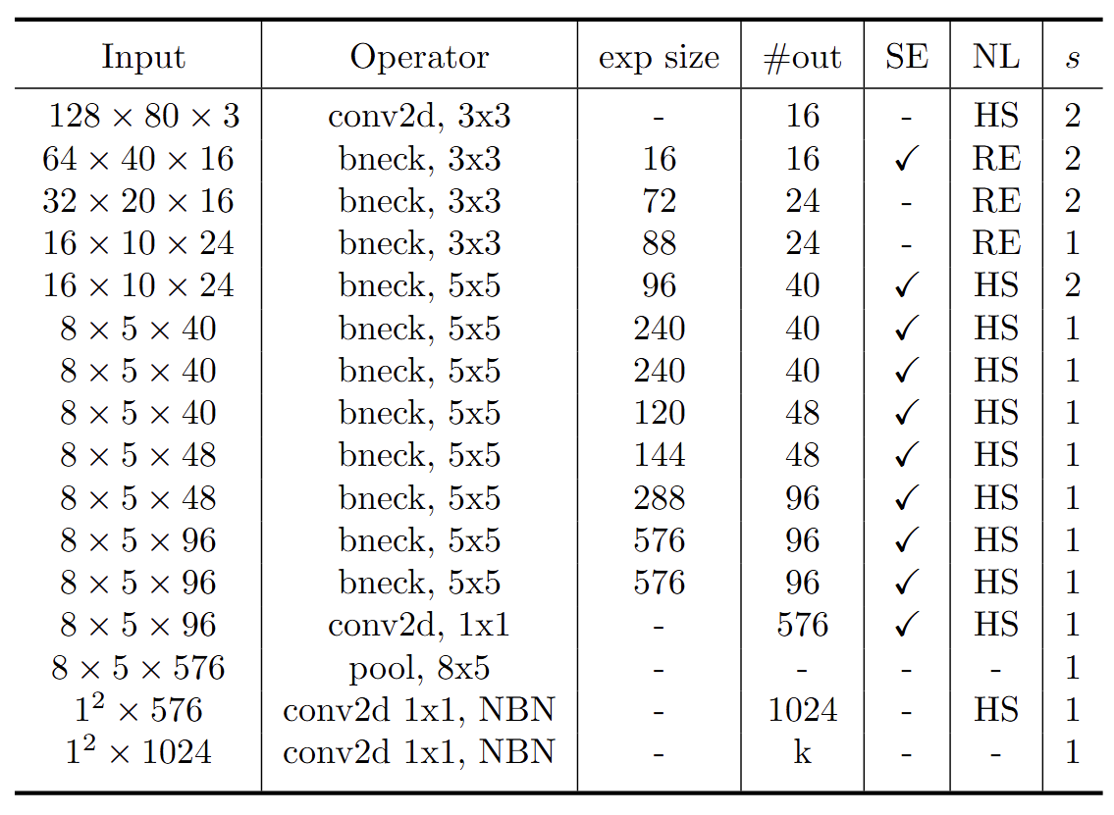
Modified MobileNet Model Structure
MobileNet V3 Large
MobileNet V3 Small
Blue: Selected layer to do MGD-1layer Red: The layer we modified stride number

Slide 3
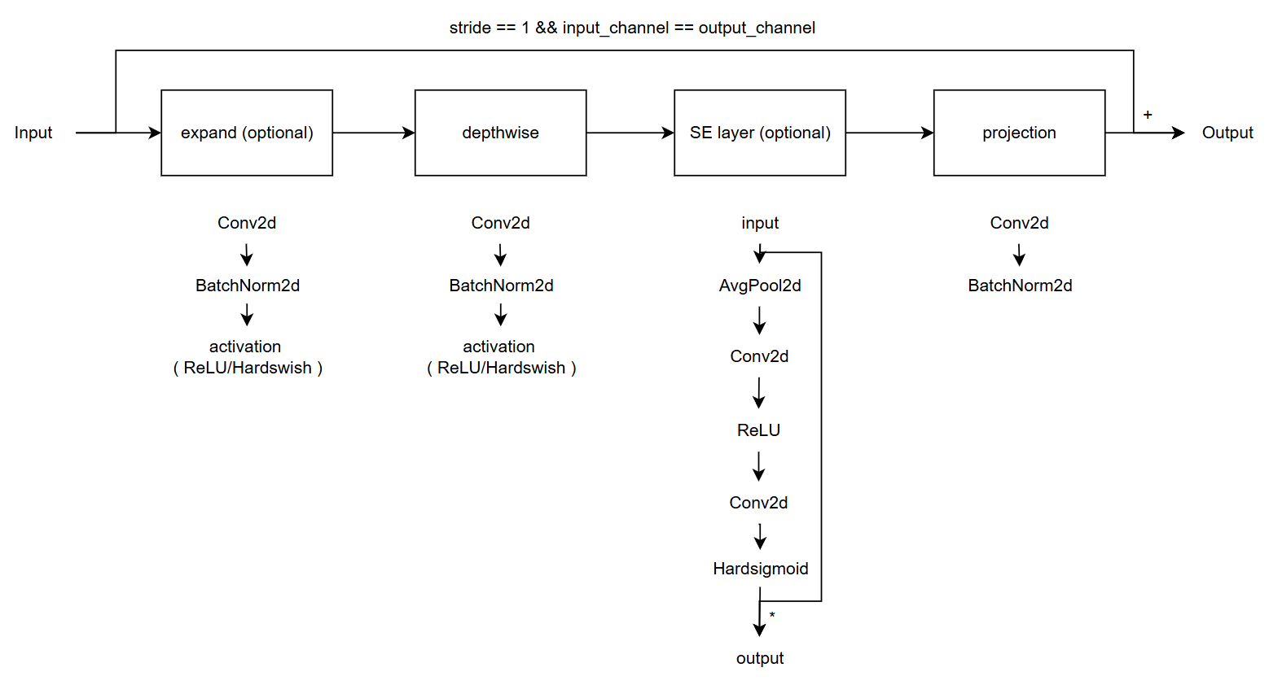
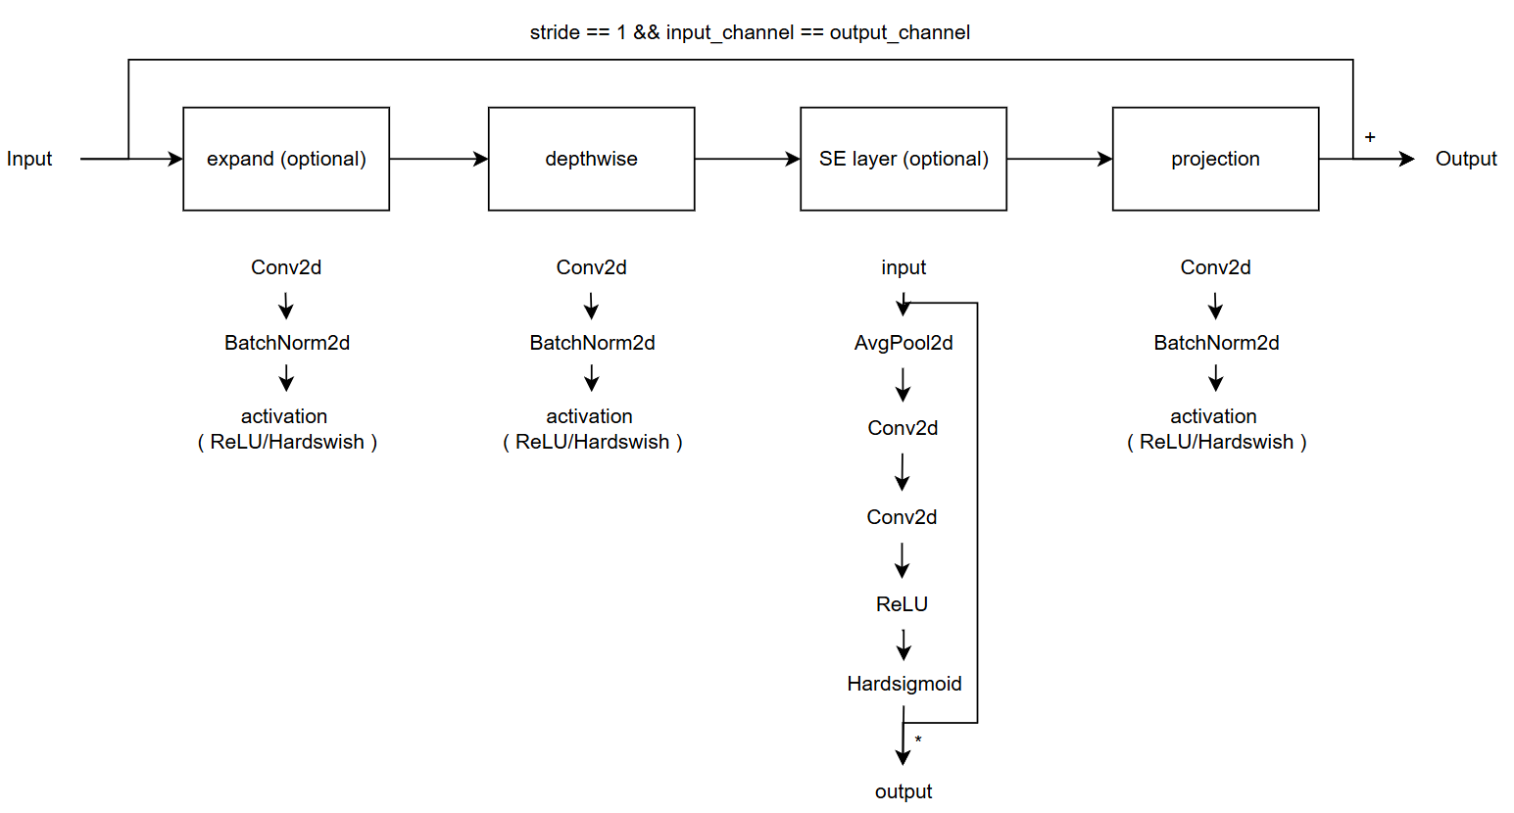
Modified vs. Custom Bneck Structure
Change the ordering of SE layer forward pass
Add an activation function in the end of projection
Modified
( Only change part of torchvision model )
Custom
( Re-write the model with some mistake )
( Used in previous time )

Slide 4
Current Model Type
Original MobileNet V3 (5-stage downsampling)
Modified MobileNet V3 (4-stage downsampling)
Custom MobileNet V3, change SE forward
Custom MobileNet V3, change projection
Custom MobileNet V3, change both
Model | Original | Modified | Custom, change SE | custom, change projection | Custom, change both
# Params | 1.52 M | 1.52 M | 1.52 M | 1.52 M | 1.52 M
MAC | 13..76 M | 23.59 M | 23.6 M | 23.63 M | 23.63 M

Slide 5

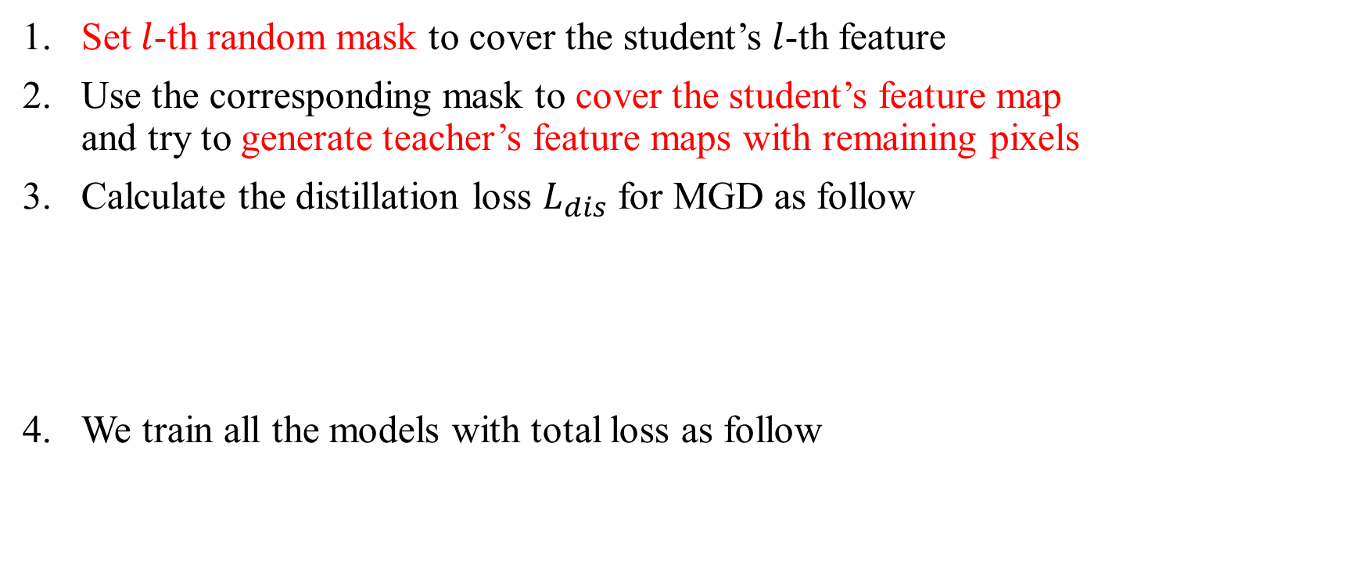
Recall – MGD Process
Set $l$-th random mask to cover the student’s $l$-th feature
Use the corresponding mask to cover the student’s feature map and try to generate teacher’s feature maps with remaining pixels
Calculate the distillation loss $L_{dis}$ for MGD as follow
We train all the models with total loss as follow

Slide 6
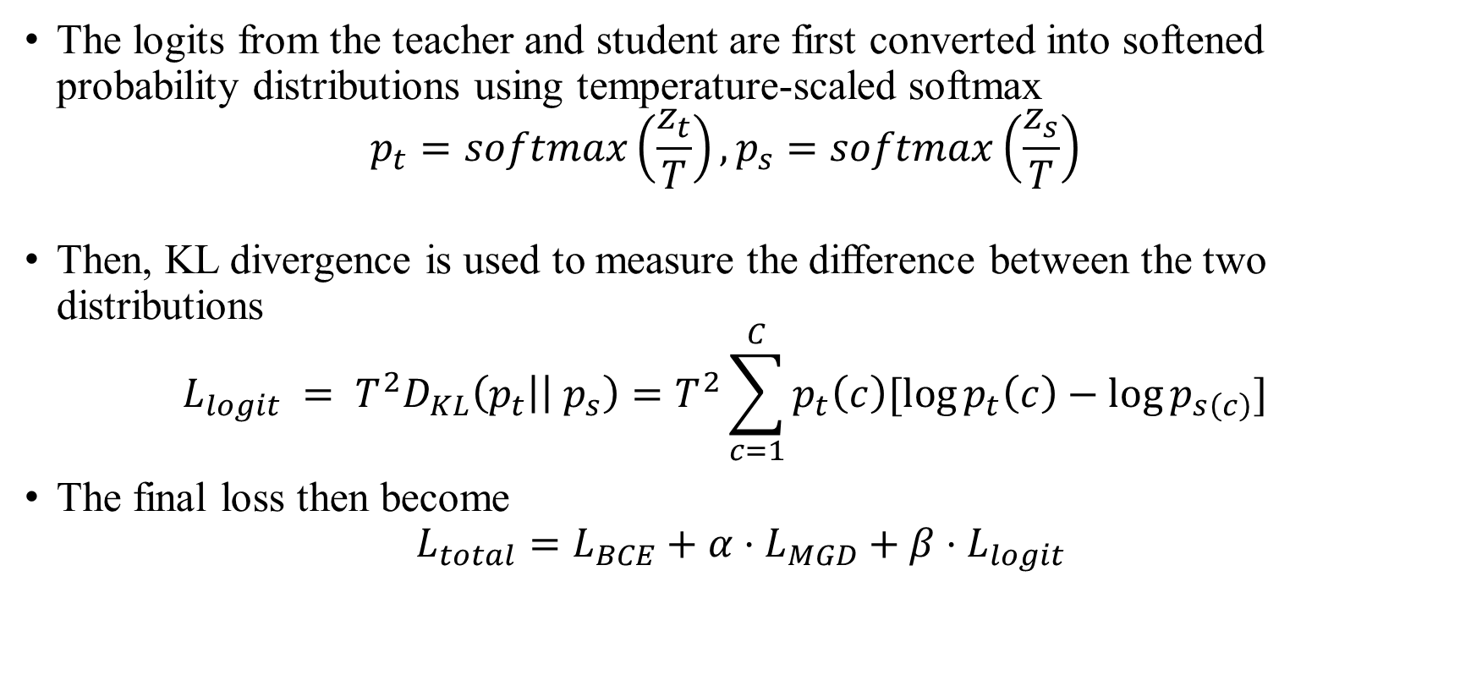
Logit Loss
The logits from the teacher and student are first converted into softened probability distributions using temperature-scaled softmax $p_{t}=softmax\left(\frac{z_{t}}{T}\right), p_{s}=softmax\left(\frac{z_{s}}{T}\right)$
Then, KL divergence is used to measure the difference between the two distributions $L_{logit} = T^{2}D_{KL}\left(p_{t}\right|\left| p_{s}\right)=T^{2}\sum_{c=1}^{C}{p_{t}\left(c\right)[\log{p_{t}\left(c\right)}−\log{p_{s\left(c\right)}}]}$
The final loss then become $L_{total}=L_{BCE}+α{⋅L}_{MGD}+ β⋅L_{logit}$

Slide 7
Train Setting I.
I5-10500 + 2080Ti
Random seed = 42
lr = 0.01, alpha = 0.01, lambda_mgd = 0.15
reduce_tail = True, hd = 128, width_mult = [0.5, 0.45]
beta = 1
ABCD Dataset as training set (0.8 for training and 0.2 for validating)
Google Dataset as testing set
Custom MobileNet_V3_Large, change both as teacher model
Modified MobileNet_V3_Small as student model

Slide 8
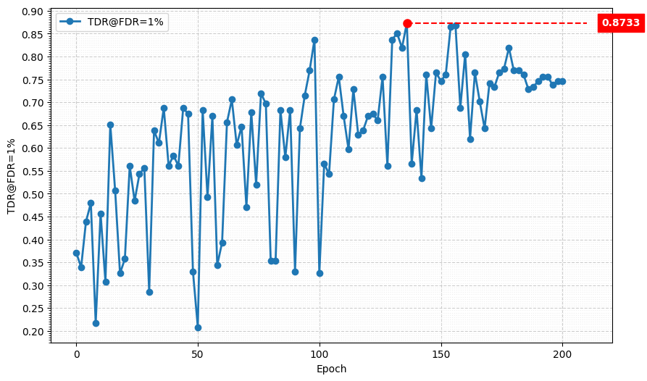
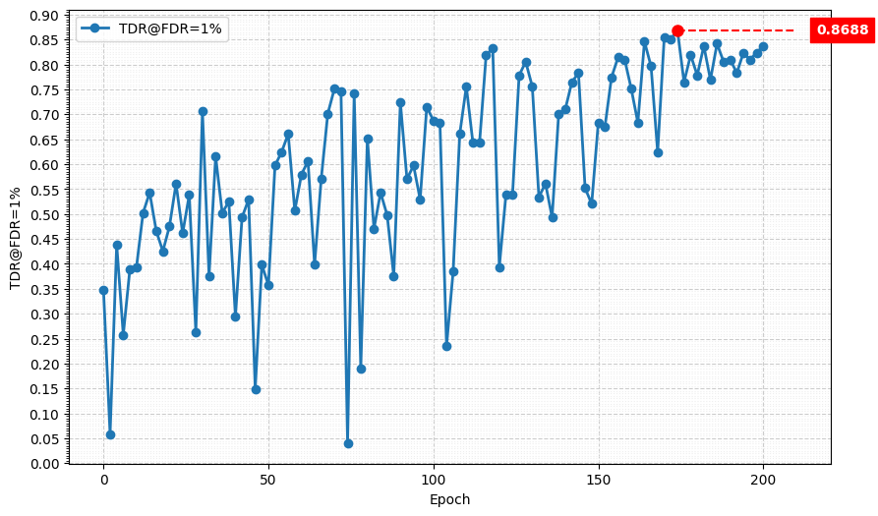
Metric Curve (TDR@FDR=1%)
wm = 0.5
wm = 0.45
Model | TDR@FDR=1% | ACE | APCER | BPCER | In Epoch
wm = 0.5 | 87.33% | 4.63% | 5.88% | 3.38% | 136
wm = 0.45 | 86.88% | 3.99% | 4.98% | 3.00% | 174

Slide 9
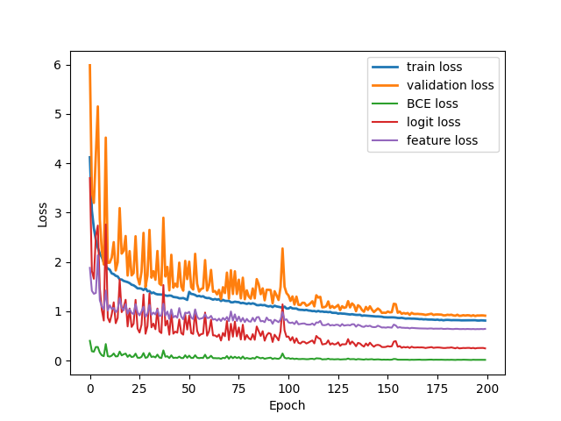
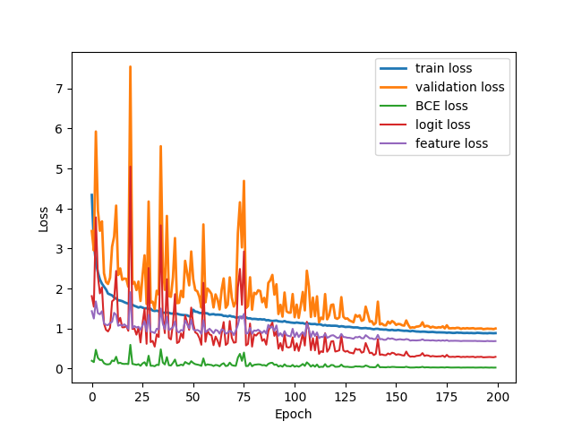
Validation Loss Curve (TDR@FDR=1%)
wm = 0.5
wm = 0.45
We suspect that the performance drop is caused by the logit loss being too high

Slide 10
Train Setting II.
I5-10500 + 2080Ti
Random seed = 42
lr = 0.01, alpha = 0.01, lambda_mgd = 0.15
reduce_tail = True, hd = 128, width_mult = [0.5, 0.45]
beta = [0.1, 0.01]
ABCD Dataset as training set (0.8 for training and 0.2 for validating)
Google Dataset as testing set
Custom MobileNet_V3_Large, change both as teacher model
Modified MobileNet_V3_Small as student model

Slide 11
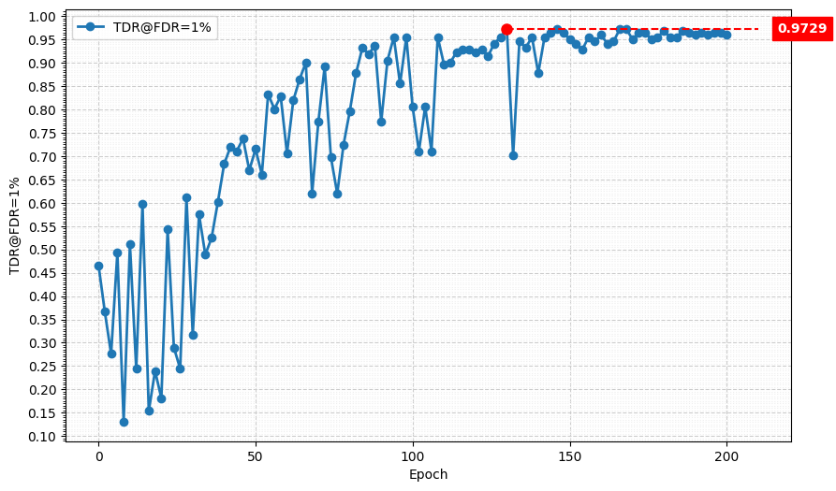
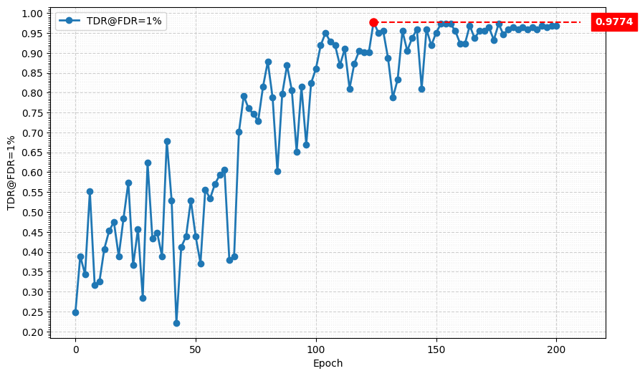
Metric Curve (TDR@FDR=1%, beta = 0.1)
wm = 0.5
wm = 0.45
Model | TDR@FDR=1% | ACE | APCER | BPCER | In Epoch
wm = 0.5 | 97.29% | 1.86% | 2.71% | 1.00% | 130
wm = 0.45 | 97.74% | 1.54% | 2.26% | 0.81% | 124

Slide 12
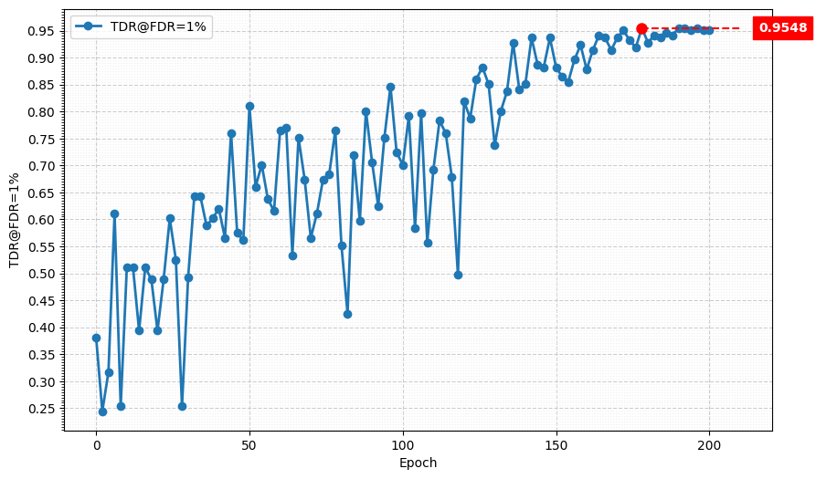
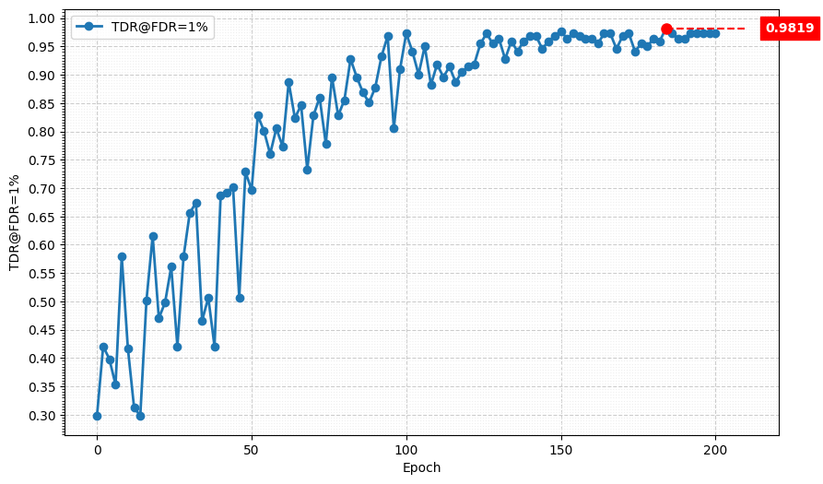
Metric Curve (TDR@FDR=1%, beta = 0.01)
wm = 0.5
wm = 0.45
Model | TDR@FDR=1% | ACE | APCER | BPCER | In Epoch
wm = 0.5 | 95.48% | 2.18% | 2.26% | 2.09% | 178
wm = 0.45 | 98.19% | 1.40% | 1.81% | 1.00% | 184

Slide 13
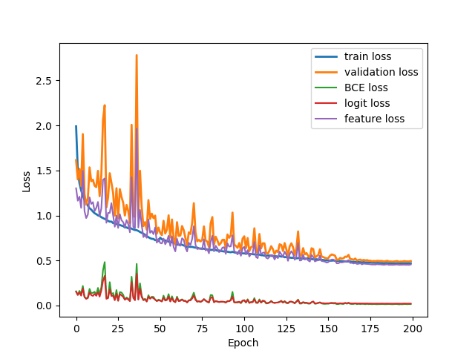
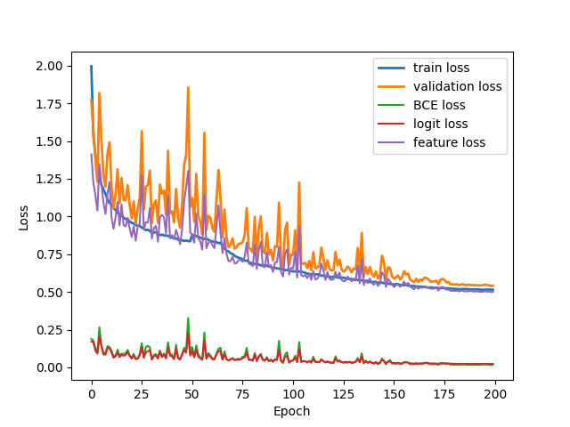
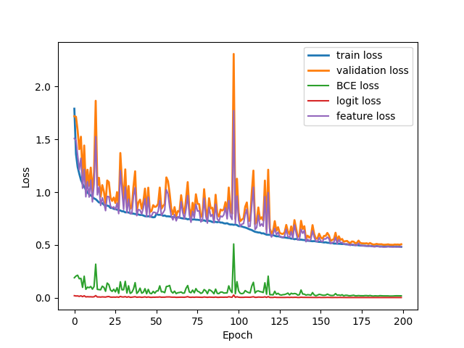
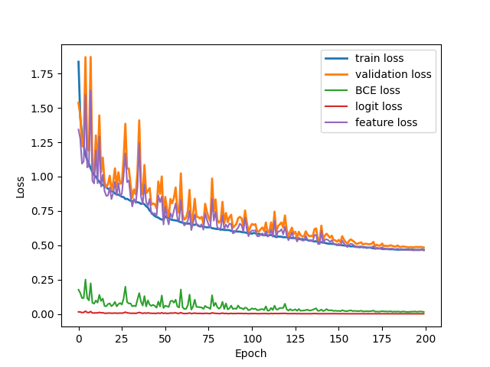
Validation Loss Curve (TDR@FDR=1%)
beta = 0.1
beta = 0.01
wm = 0.5
wm = 0.45

Slide 14
Result Matrix
Model | hd = 128, wm = 1.0 w/ reduced_tail | hd = 128, wm = 0.75 w/ reduced_tail | hd = 128, wm = 0.5 w/ reduced_tail | hd = 128, wm = 0.45 w/ reduced_tail
# params | 475.95 K | 306.41 K (-35.6%) | 150.78 K (-68.3%) | 130.36 K (-72.6%)
MAC | 10.07 M | 7.41 M (-26.4%) | 3.68 M (-63.5%) | 3.31 M (-67.1%)
Model | TDR@FDR=1% | ACE | APCER | BPCER | In Epoch
SPEC | ≥ 85.11% | < 3.489% | < 6.033% | < 0.956%
Custom MobileNetV3-Large, changed both | 98.64% | 1.02% | 0.90% | 1.14% | 104
Original MobileNetV3-Small | 84.16% | 5.36% | 6.33% | 4.38% | 154
Custom MobileNetV3-Large, changed both Original MobileNetV3-Small, hd=128, wm=0.5, w/ rt w/o logit loss | 99.10% | 0.93% | 0.90% | 0.95% | 172
Custom MobileNetV3-Large, changed both Original MobileNetV3-Small, hd=128, wm=0.45, w/ rt w/o logit loss | 98.19% | 1.20% | 1.36% | 1.05% | 152
Custom MobileNetV3-Large, changed both Original MobileNetV3-Small, hd=128, wm=0.5, w/ rt w/ logit loss, beta = 0.1 | 97.29% | 1.86% | 2.71% | 1.00% | 130
Custom MobileNetV3-Large, changed both Original MobileNetV3-Small, hd=128, wm=0.45, w/ rt w/ logit loss, beta = 0.01 | 98.19% | 1.40% | 1.81% | 1.00% | 184

