Slide 1
Tenstorrent Progress Report 7/21 林家逸

Slide 2
Outline
Try to run the example code in server

Slide 3
Steps
Download VPN and connect to server 140.96.81.22 with port 22
Activate the environment of Tenstorrent
Enter into the container
Modified the example code of distributed (since we only have 2 Mesh)
Execute the modified example code

Slide 4
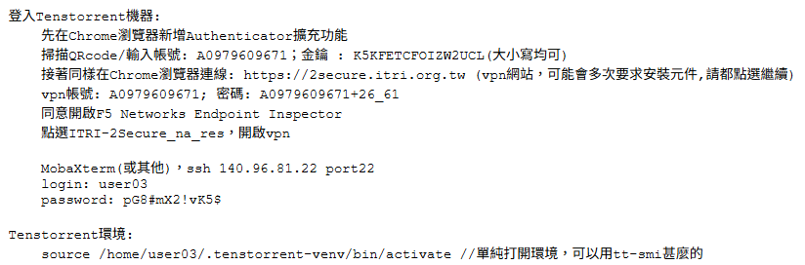
Step – 1 & 2
Follow the instructions in README.md

Slide 5
Step – 3
Press Ctrl + Shift + P and select Perferences: Open Remote Settings (JSON)
Add “dev.containers.dockerPath”: “podman”
Run the container with command podman start {container_name}
Press Ctrl + Shift + P and select Dev Containers: Attach to Running Container…
Select the container that we just started up, and it should connect to the container with vscode

Slide 6

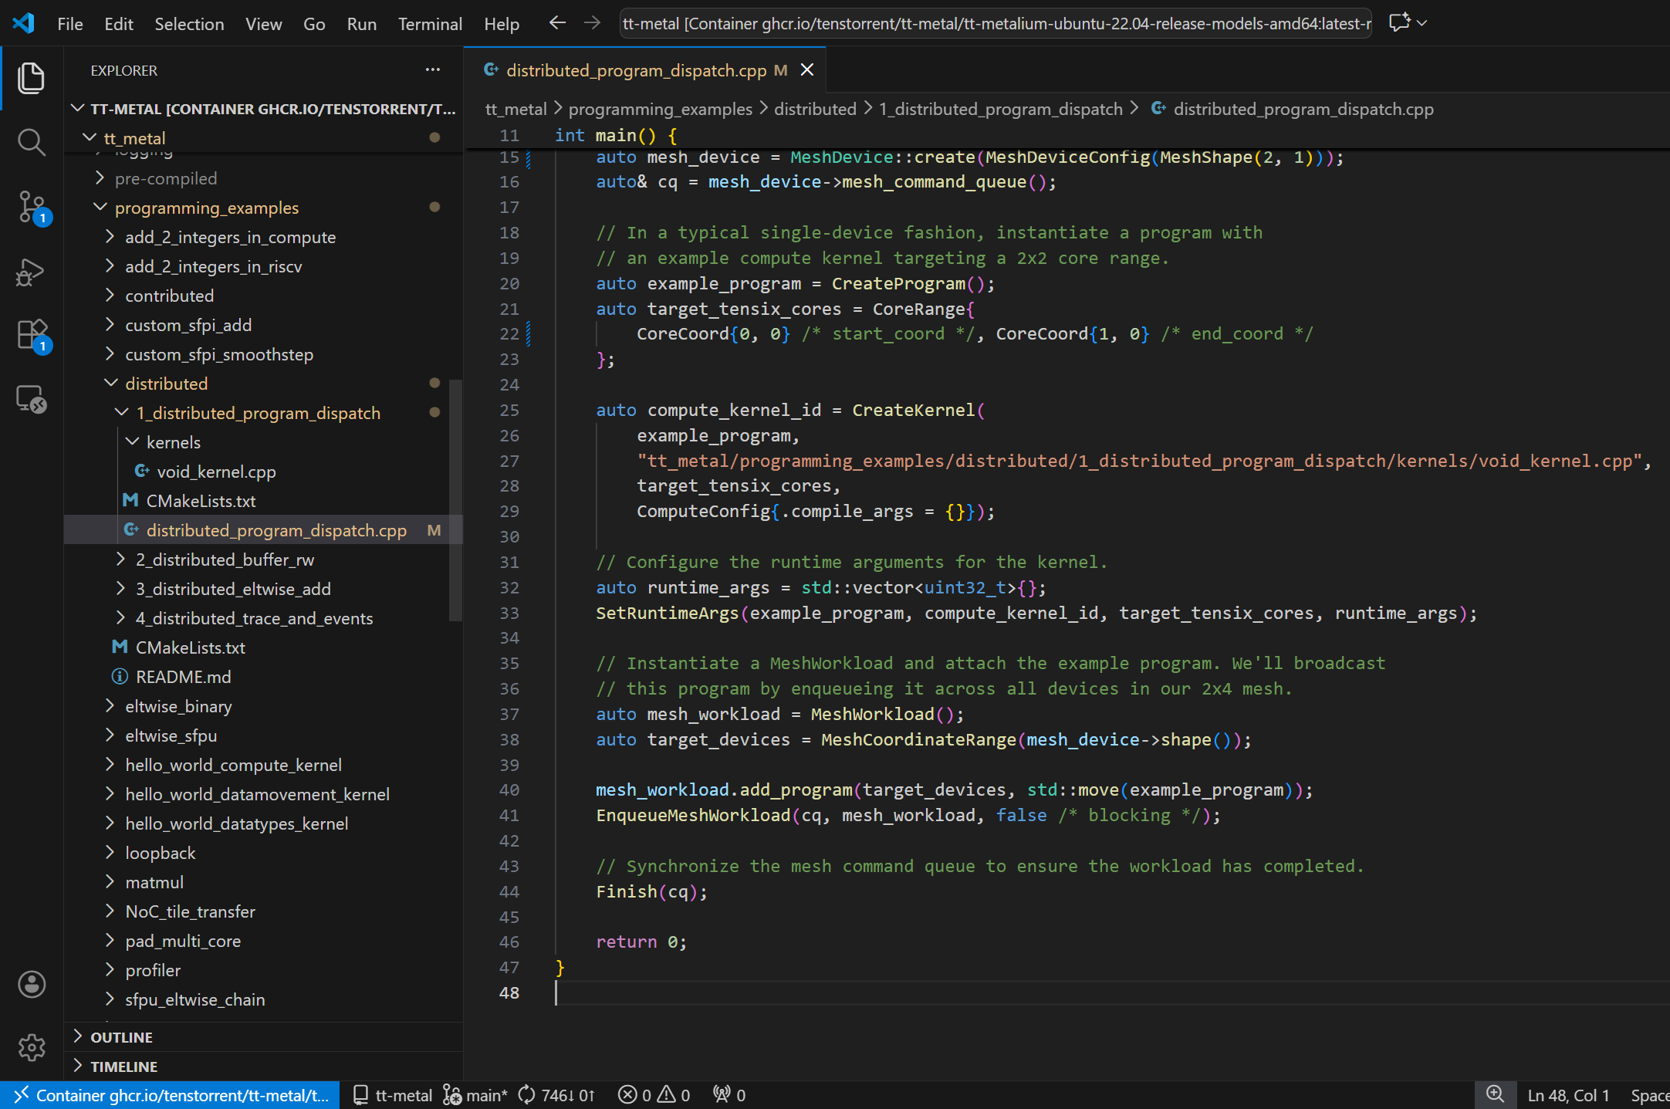
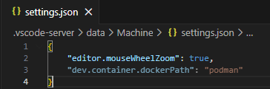
Step – 3

Slide 7
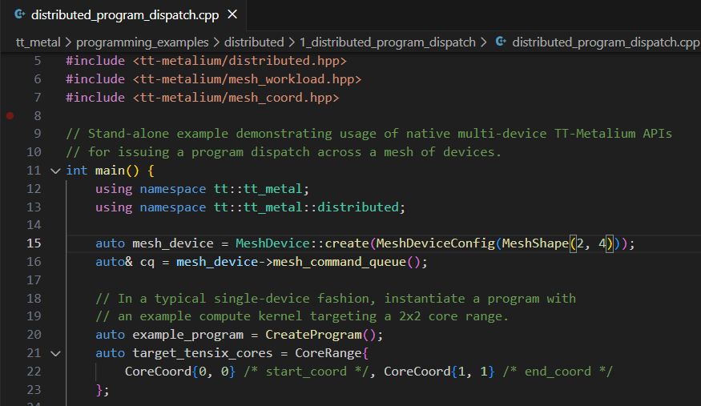
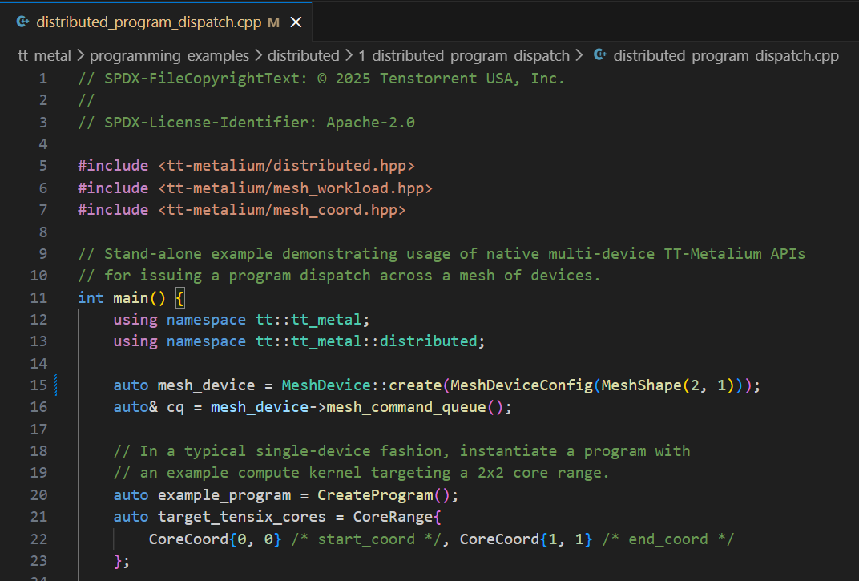
Step - 4
The original example code sets the mesh_device with MeshShape(2, 4), but it only has 2 Wormhole chip with MeshShape(2, 1) in this server

Slide 8
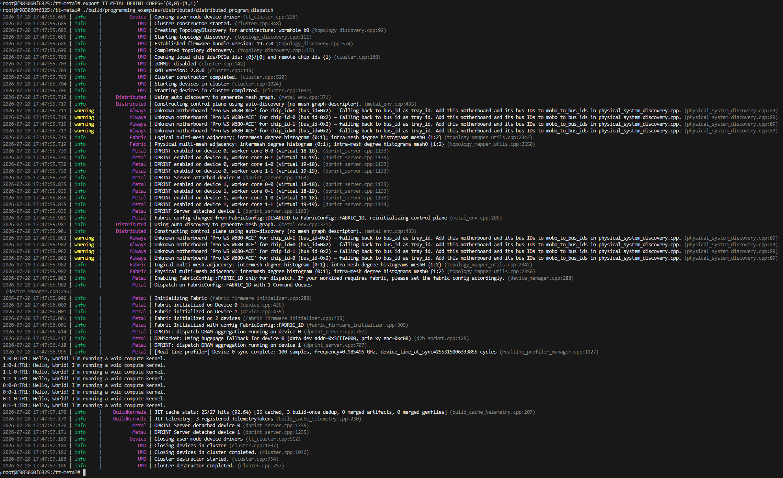
Step - 5

