Slide 1
Tenstorrent Progress Report 7/28 林家逸

Slide 2
Outline
Try to run the example code with profiler in server

Slide 3
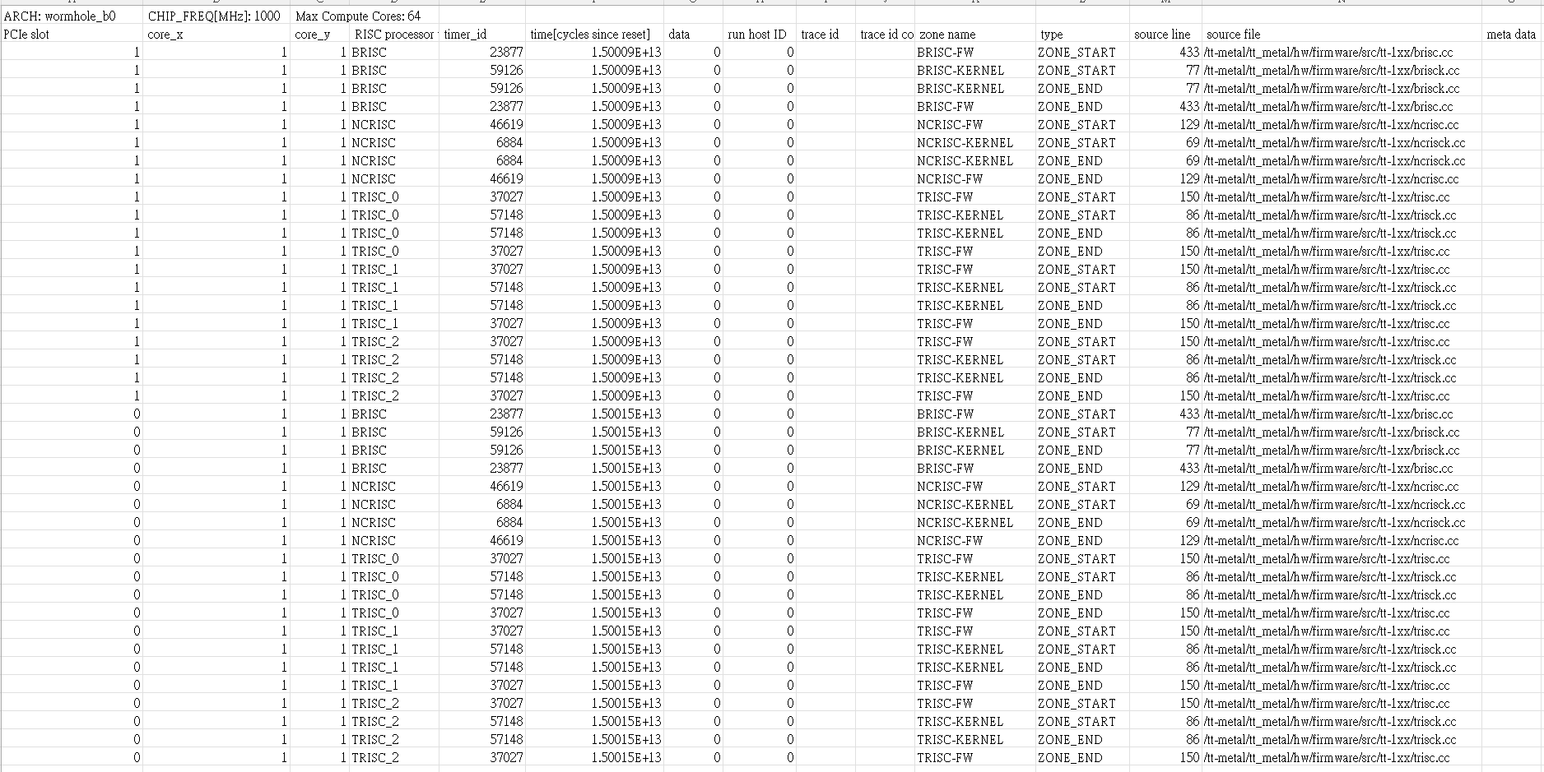
Executed Command
TT_METAL_DEVICE_PROFILER=1 python3 -m tracy --web-app-port=9080 ./build/programming_examples/metal_example_vecadd_multi_core

Slide 4

Result
Calculate the $duration=ZONE_END timestamp −ZONE_START timestamp$
From the result, we can find that this two chip are balanced in this example (distributed_eltwise_add)

