Slide 1
Tenstorrent Progress Report 8/4 林家逸

Slide 2
Outline
Introduce the operator supported in TT-NN
Matrix Related
Element-wise Related
Reduction & Data Movement Related
Loss, Convolution and Pooling Related
Normalization Related
Others
Reference

Slide 3
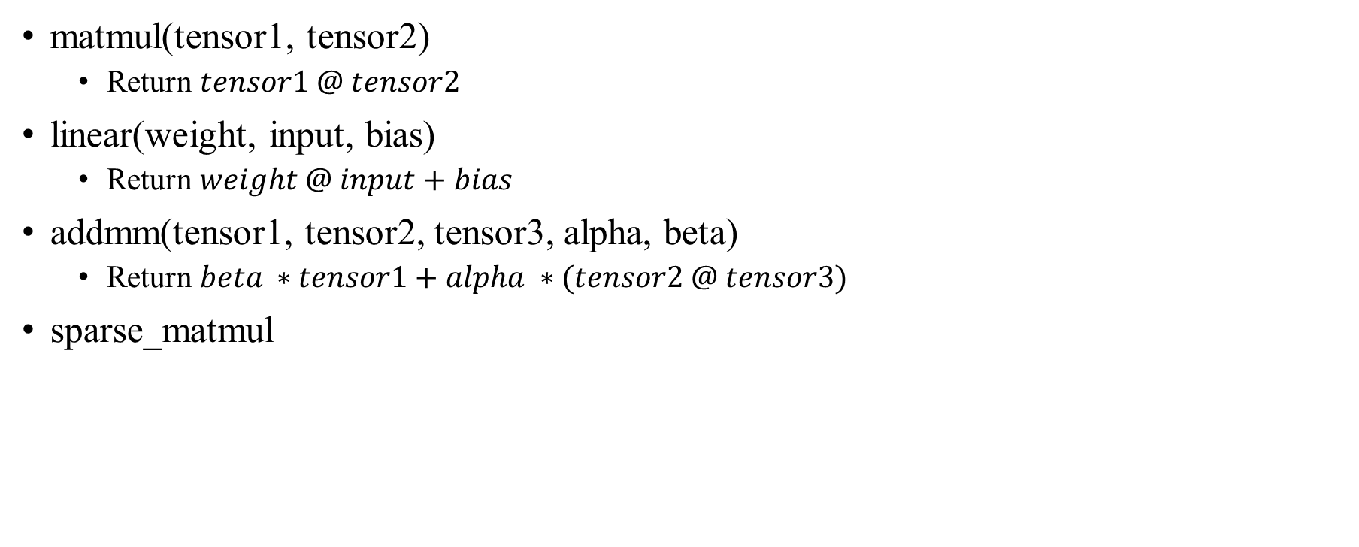
Matrix Related
matmul(tensor1, tensor2)
Return $tensor1 @ tensor2$
linear(weight, input, bias)
Return $weight @ input+bias$
addmm(tensor1, tensor2, tensor3, alpha, beta)
Return $beta ∗tensor1+alpha ∗(tensor2 @ tensor3)$
sparse_matmul

Slide 4
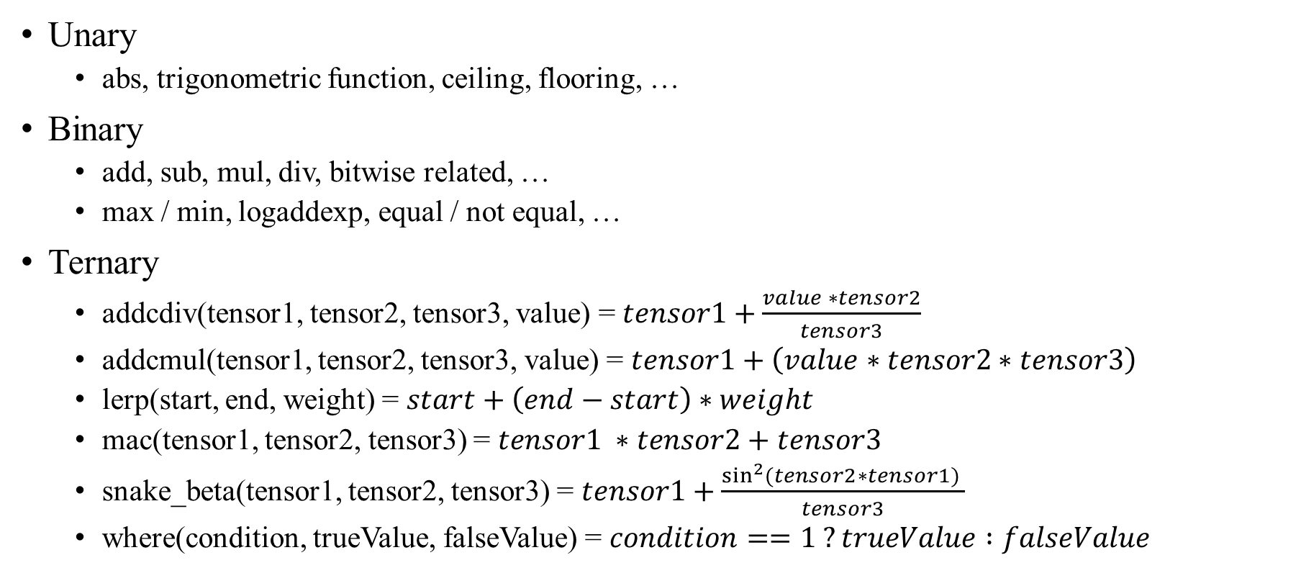
Element-wise Related
Unary
abs, trigonometric function, ceiling, flooring, …
Binary
add, sub, mul, div, bitwise related, …
max / min, logaddexp, equal / not equal, …
Ternary
addcdiv(tensor1, tensor2, tensor3, value) = $tensor1+\frac{value ∗tensor2}{tensor3}$
addcmul(tensor1, tensor2, tensor3, value) = $tensor1+\left(value∗tensor2∗tensor3\right)$
lerp(start, end, weight) = $start+\left(end−start\right)∗weight$
mac(tensor1, tensor2, tensor3) = $tensor1 ∗tensor2+tensor3$
snake_beta(tensor1, tensor2, tensor3) = $tensor1+\frac{\sin^{2}{(tensor2∗tensor1)} }{tensor3}$
where(condition, trueValue, falseValue) = $condition==1 ?trueValue :falseValue$

Slide 5
Reduction & Data Movement Related
Reduction
argmax / argmin, max / min / mean / std
cumprod / cumsum, ema
sampling, topk
…
Data Movement
slice, concat, expand, squeeze, reshape
nonzero, repeat
permute, sort
…

Slide 6
Loss, Convolution and Pooling Related
Loss
l1_loss
mse_loss
Convolution
conv1d
conv2d
conv_transpose2d
conv3d (experimental)
Pooling
avg_pool2d / adaptive_avg_pool2d / global_avg_pool2d
max_pool2s / adaptive_max_pool2d

Slide 7
Normalization Related
batch_norm
group_norm
layer_norm
rms_norm
softmax
scale_mask_softmax
…

Slide 8
Others
Quantization
Embedding
Transformer
CCL
Backward
…

Slide 9
Reference
SPEC
APIs — TT-NN&trade; documentation
Implementation
tt-metal/ttnn/cpp/ttnn/operations at main · tenstorrent/tt-metal

