Slide 1
Tenstorrent Progress Report 8/4 林家逸

Slide 2
Outline
Implement simplest self-attention by tt-Metal
Analysis by tracy

Slide 3
Project Architecture
attention/
kernels/
compute/
self_attention.cpp
dataflow/
reader.cpp
writer.cpp
CMakeLists.txt
self-attention.cpp

Slide 4
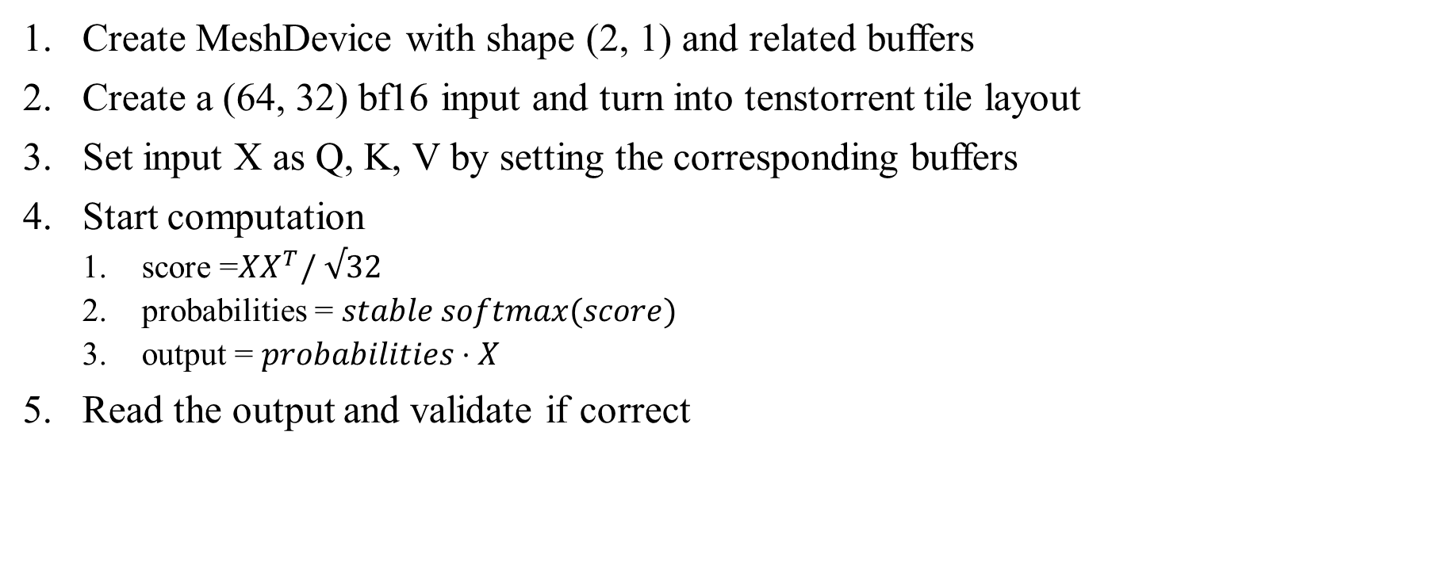
Pseudo Code
Create MeshDevice with shape (2, 1) and related buffers
Create a (64, 32) bf16 input and turn into tenstorrent tile layout
Set input X as Q, K, V by setting the corresponding buffers
Start computation
score =$XX^{T}/ √32$
probabilities = $stable softmax(score)$
output = $probabilities⋅X$
Read the output and validate if correct

Slide 5
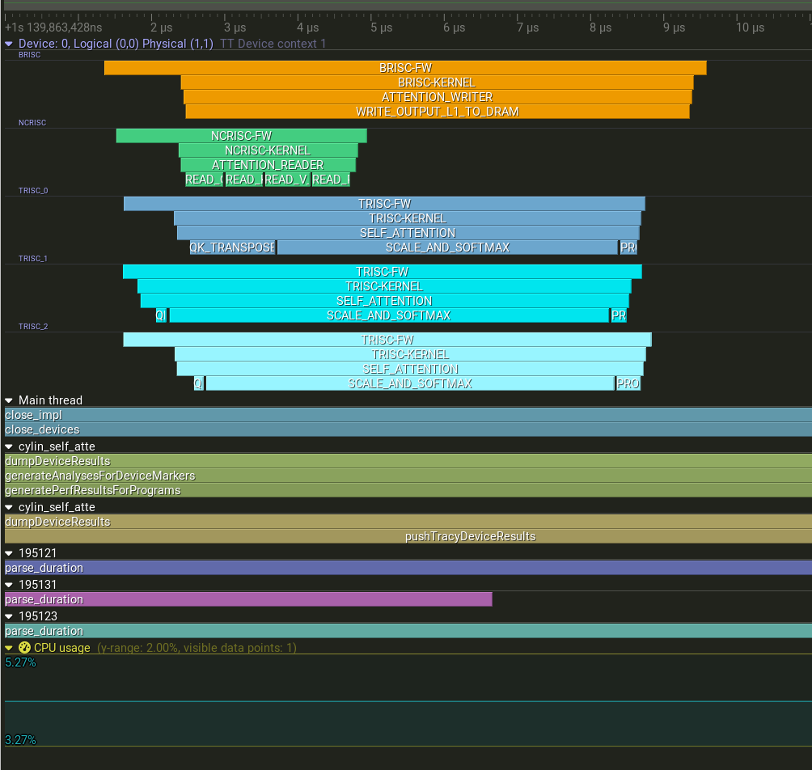
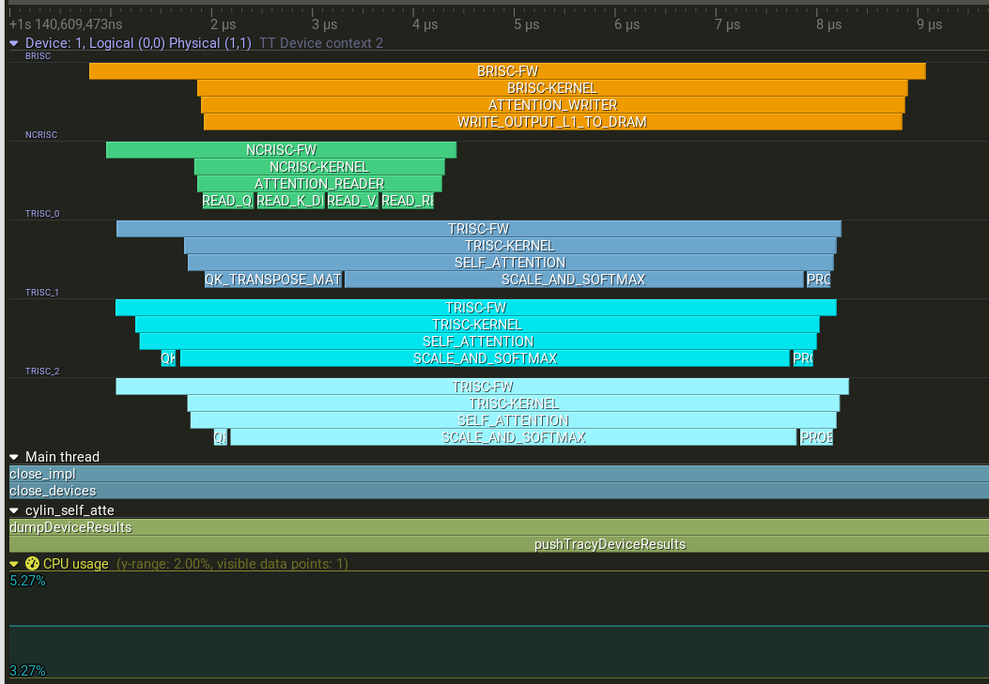
Result

