Slide 1
11/11 個人咪挺
KD成果討論（二）

Slide 2
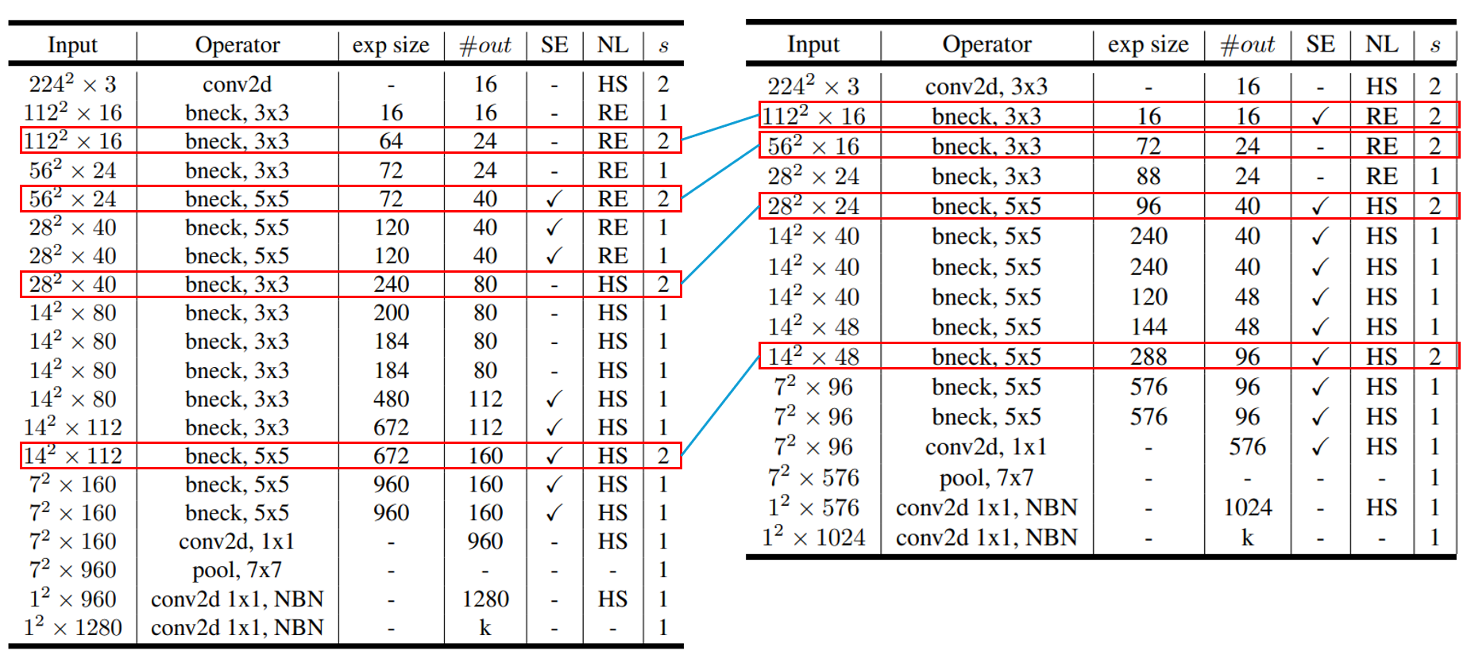
Recall

Slide 3
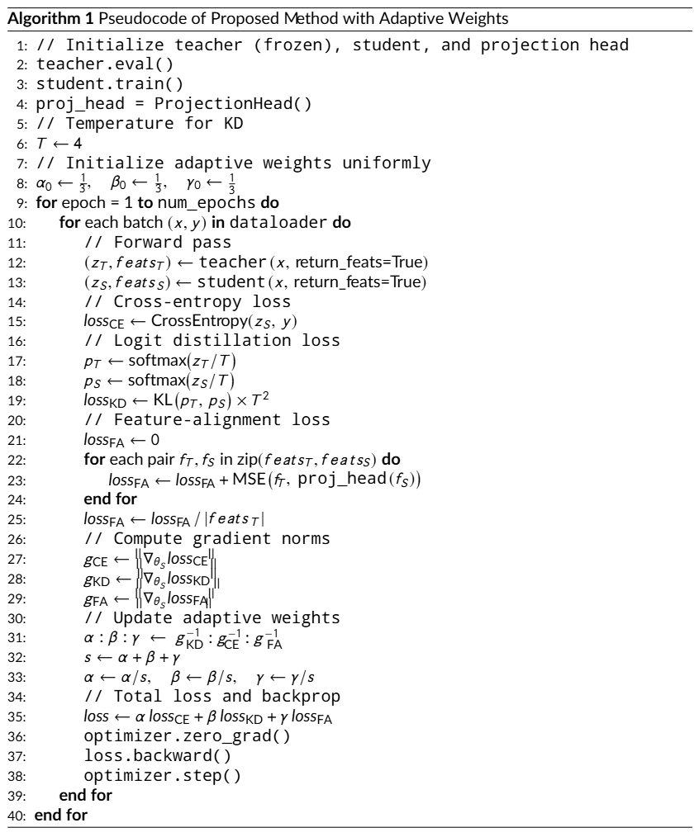
Recall

Slide 4
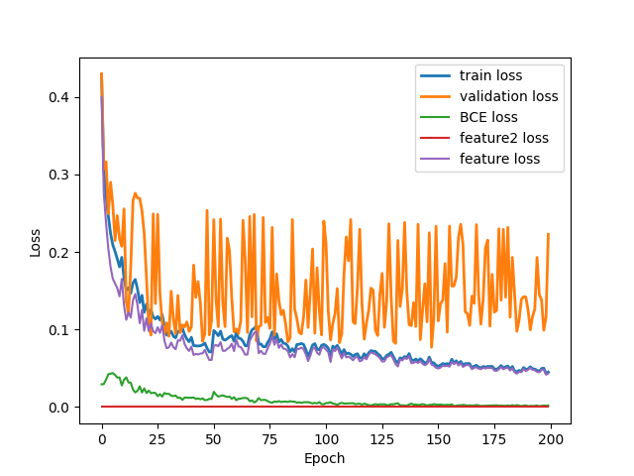
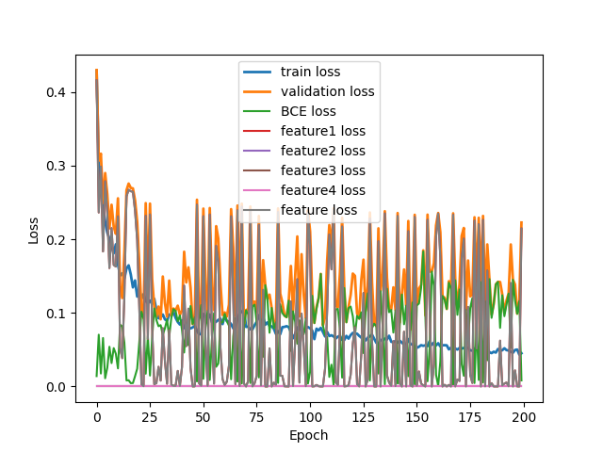
Loss Curve (feature, layer 2)
Train
Validate

Slide 5
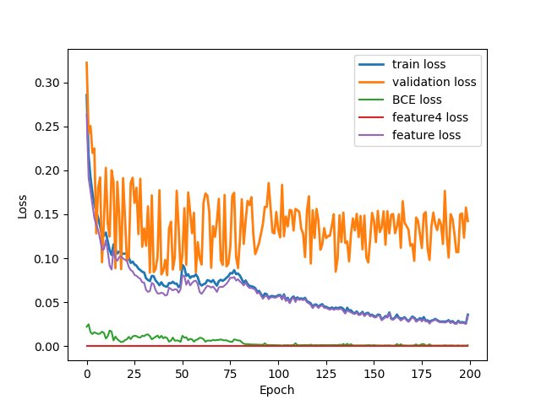
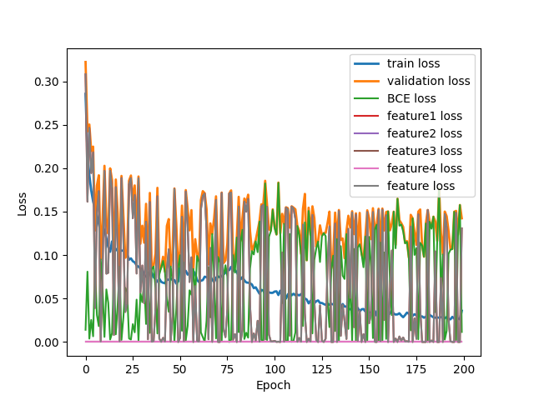
Loss Curve (feature, layer 4)
Train
Validate

Slide 6
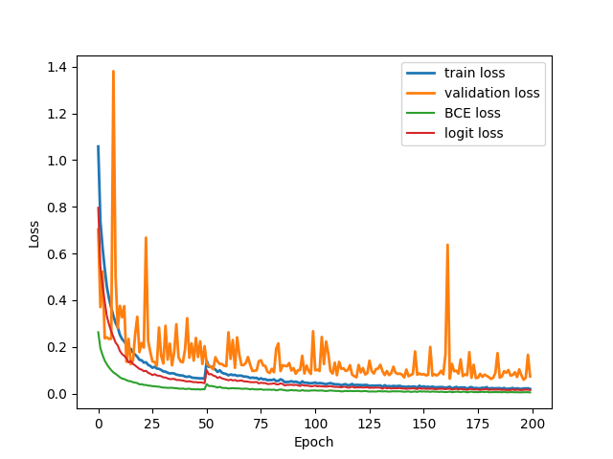
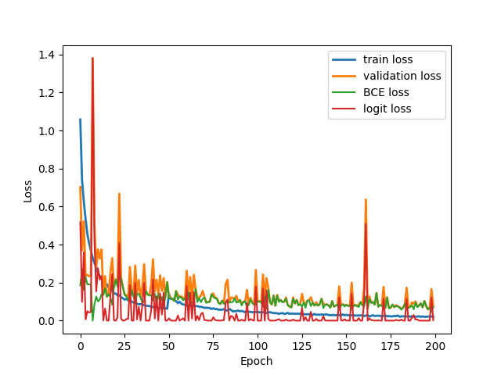
Loss Curve (logit)
Train
Validate

Slide 7
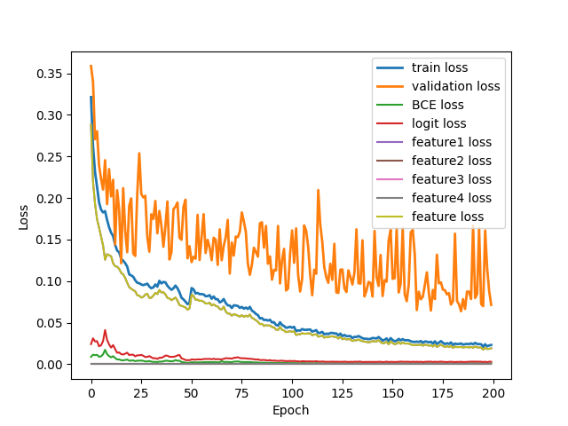
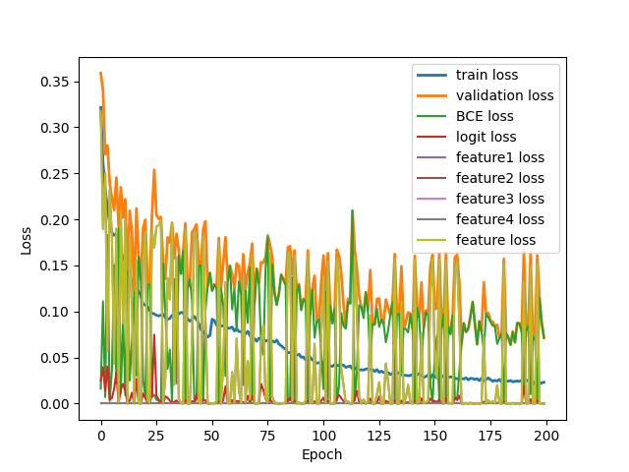
Loss Curve (both, layer 4)
Train
Validate

Slide 8
Assumption
Projection head wasn’t trained well
Conv2d(1x1) doesn’t suit to be projection head
  Maybe try nn.Linear() ?
Pick the wrong feature layer
  Maybe try other feature layers ?
MobileNet_V3_Small doesn’t have well generalize ability
  Since the BCELoss in validation is also fluctuate violently

