Slide 1
9/9個人咪挺
Knowledge Distillation from ResNet to MobileNet for Accurate On-Device Face Recognition

Slide 2
Outline
Introduction
Method
Experiment
Conclusion

Slide 3
Outline
Introduction
Method
Experiment
Conclusion

Slide 4
Method
Use deep ResNet as teacher and lightweight MobileNet as student
Including 3 components
Logit value distillation
Alignment of intermediate features
Adaptive loss weighting

Slide 5

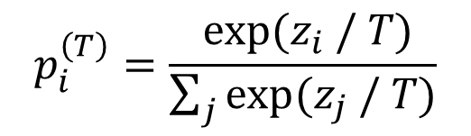
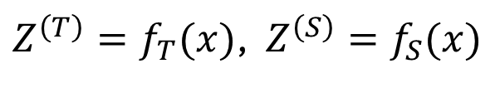
Logit value distillation
Let the input image be $x$ The output of teacher and student be
To reveal the dark knowledge of teacher, authors soften both output distribution by where temperature $T>1$
$Z^{\left(T\right)}=f_{T}(x)$, $Z^{\left(S\right)}=f_{S}(x)$
$$p_{i}^{\left(T\right)}=\frac{ exp⁡(z_{i} / T)}{\sum_{j}{exp⁡(z_{j} / T)}}$$

Slide 6

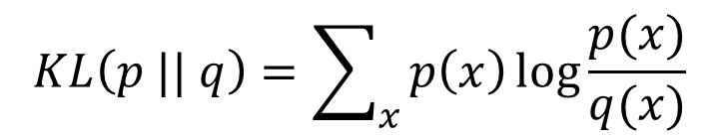

Logit value distillation
After that, student then guided to mimic these softened probabilities by minimizing where $T^{2}$ factor balances the gradient magnitudes and $TL(⋅ || ⋅)$ denotes the Kullback-Leibler divergence
$$ℒ_{KD}=T^{2}⋅KL(p_{T}^{\left(T\right)} || p_{T}^{\left(S\right)})$$
$$KL\left(p || q\right)=\sum_{x}{p\left(x\right)\log{\frac{p(x)}{q(x)}}}$$

Slide 7
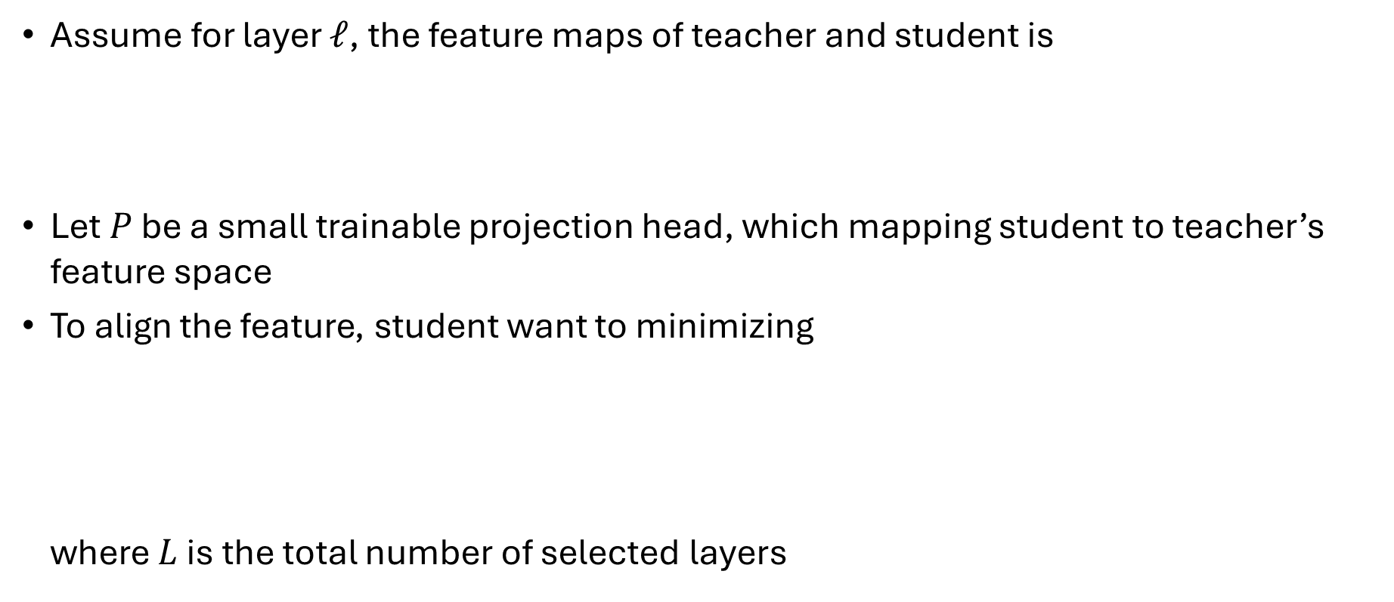
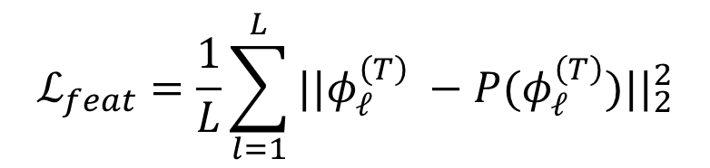
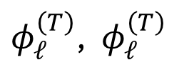
Alignment of intermediate features
Assume for layer $𝓁$, the feature maps of teacher and student is
Let $P$ be a small trainable projection head, which mapping student to teacher’s feature space
To align the feature, student want to minimizing where $L$ is the total number of selected layers
$φ_{𝓁}^{\left(T\right)}$, $φ_{𝓁}^{\left(T\right)}$
$$ℒ_{feat}=\frac{1}{L}\sum_{l=1}^{L}{||φ_{𝓁}^{\left(T\right)} −P(φ_{𝓁}^{\left(T\right)})||_{2}^{2}}$$

Slide 8


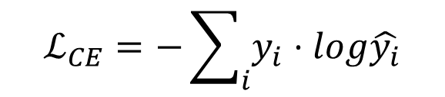
Adaptive loss weighting
To ensure correct classification, authors use standard CE loss
At the end, the total loss will become where $α+β+γ=1$ and all of them are dynamic
$$ℒ_{CE}=−\sum_{i}{y_{i}⋅log\hat{y_{i}}}$$
$${ℒ=αℒ_{CE}+βℒ_{KD}+γℒ}_{feat}$$

Slide 9
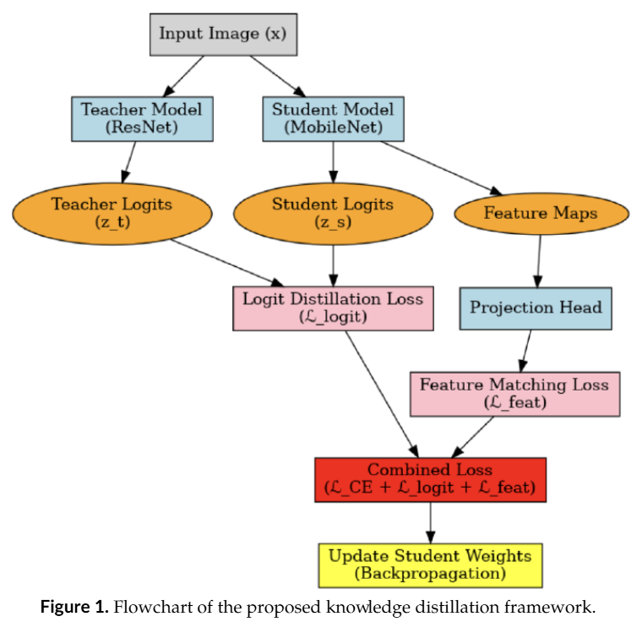
Flowchart

Slide 10
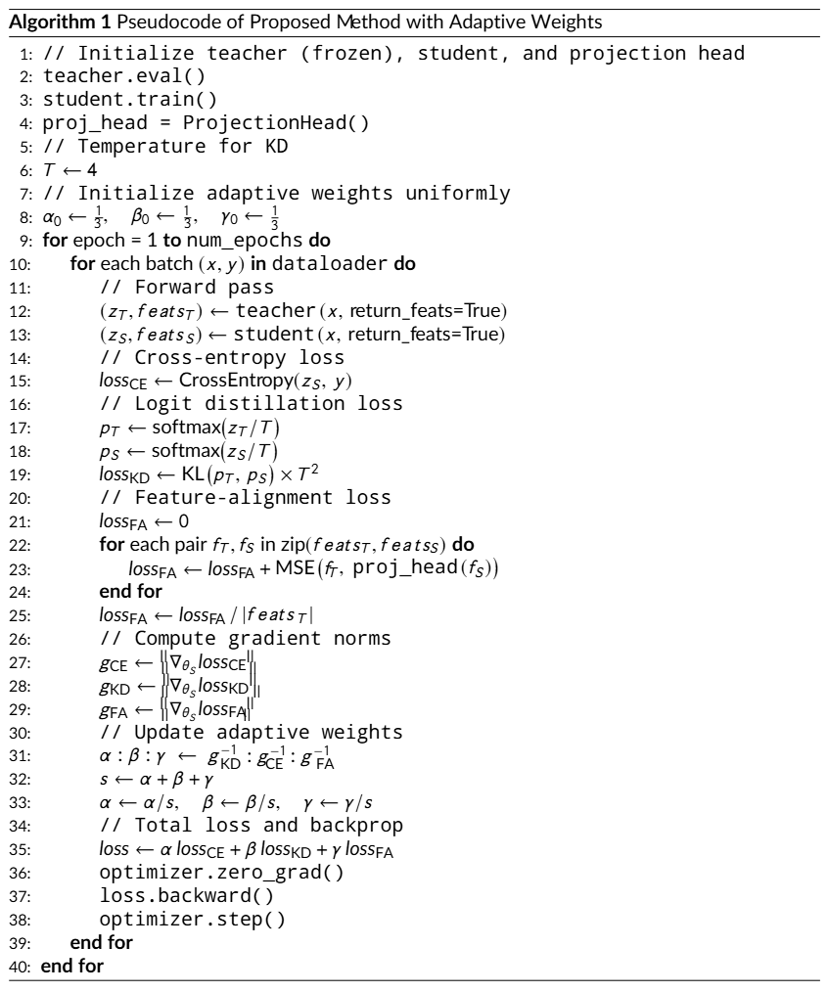
Algorithm

Slide 11
Outline
Introduction
Method
Experiment
Conclusion

Slide 12
Experiment
All face images were detected by MTCNN and resized to (112, 112)
Teacher model is a pre-trained ResNet with ArcFace output head
Student model is a MobileNet backbone augmented by a lightweight projection head
All models are trained with CASIA-WebFace dataset, leveraging eight GTX 4090 GPU
Measure the performance by Accuracy, Precision, Recall and F1-score

Slide 13
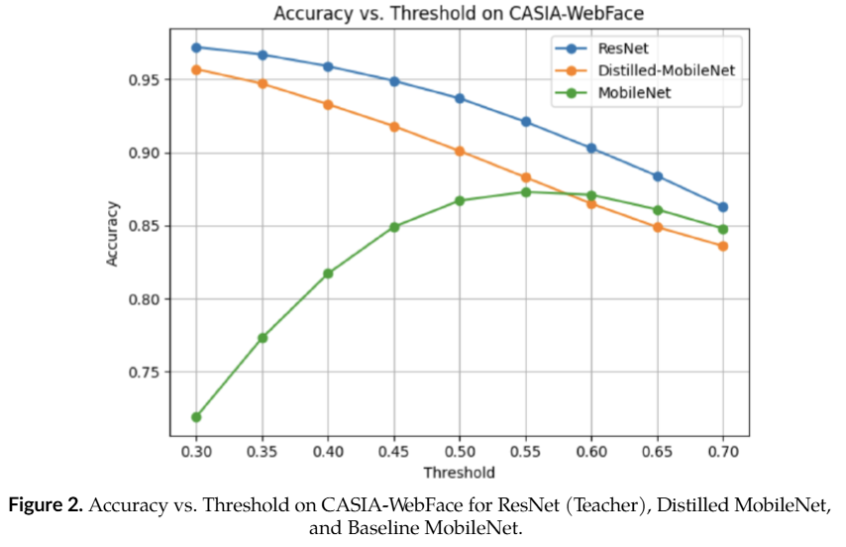
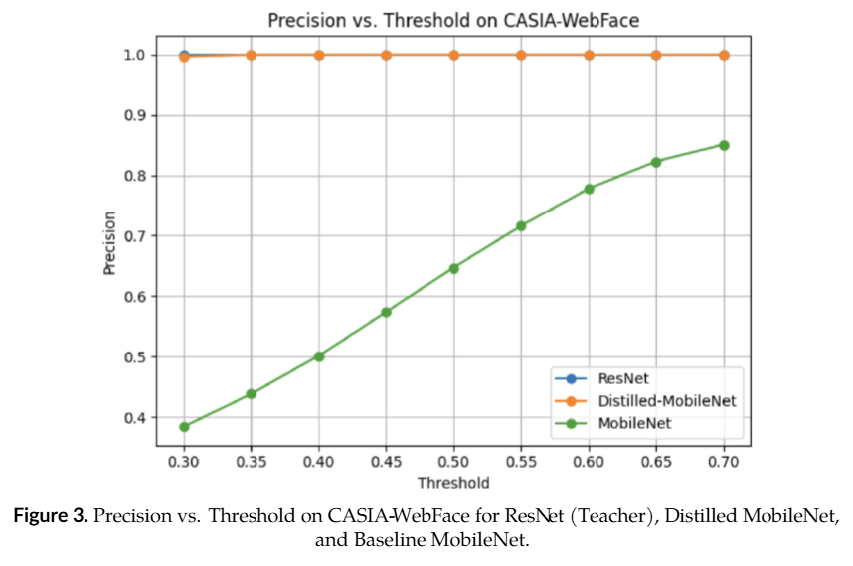
Result

Slide 14
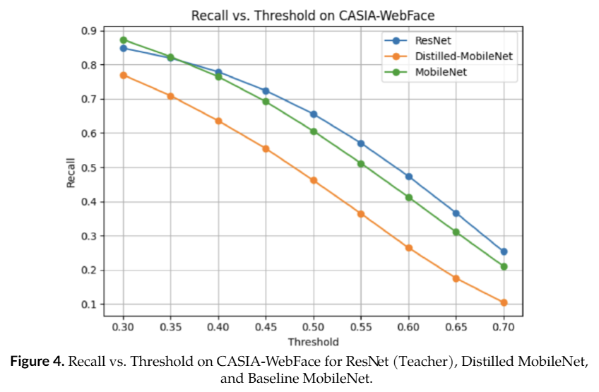
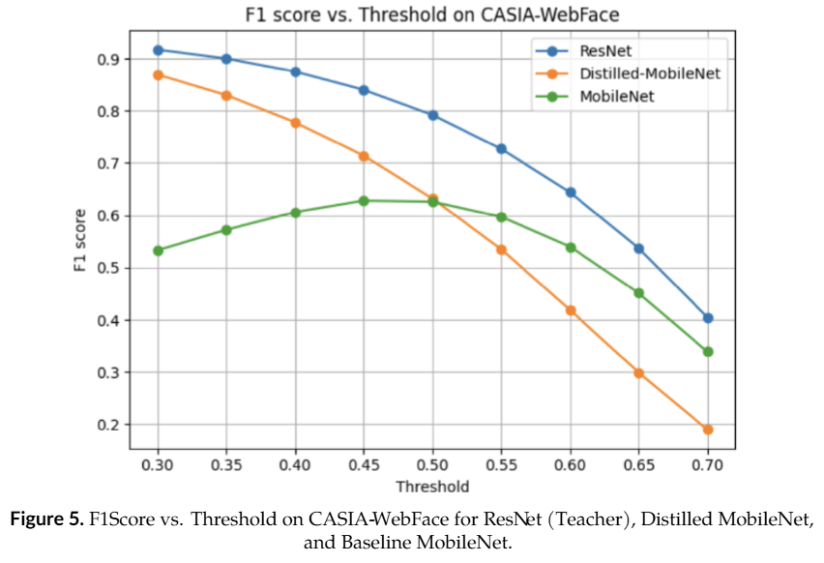
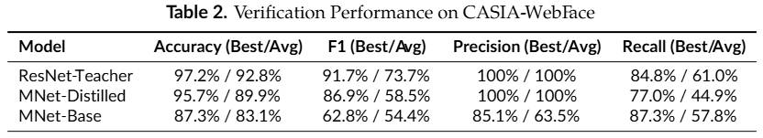
Result

Slide 15
Outline
Introduction
Method
Experiment
Conclusion

