Slide 1
11/25 個人咪挺
KD with static factors（二）

Slide 2
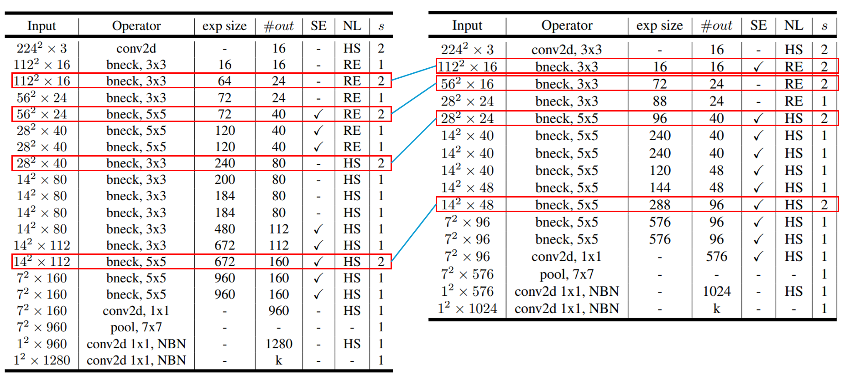
Recall
Teacher
Student

Slide 3
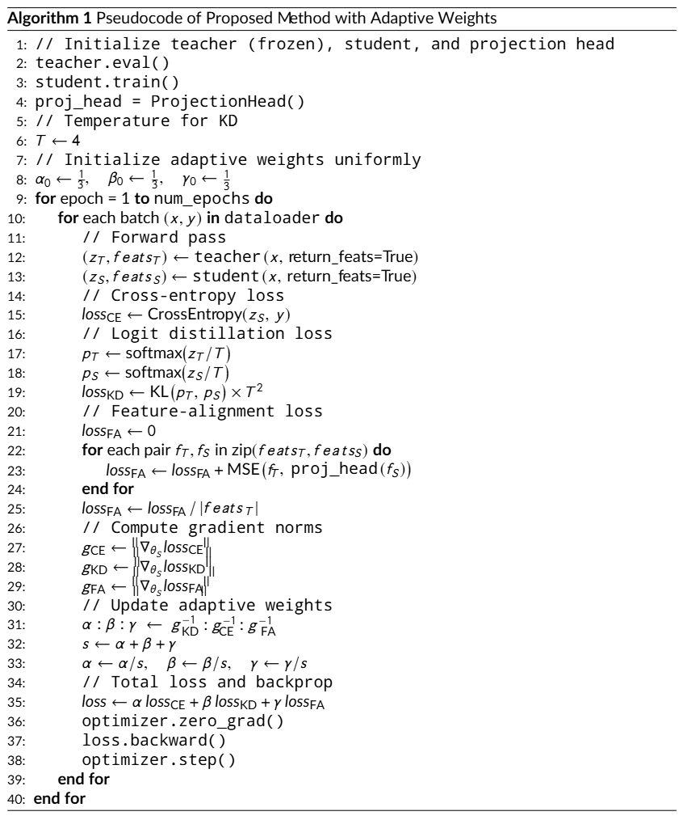
Recall

Slide 4
Train Setting
I5-10500 + 2080Ti
Random seed = 42
Adam(lr = 1e-4) + BCELoss
ABCD Dataset as training set (0.8 for training and 0.2 for validating)
Google Dataset as testing set
MobileNet_V3_Large as teacher model
MobileNet_V3_Small as student model
Teacher model is trained with 200 epochs

Slide 5
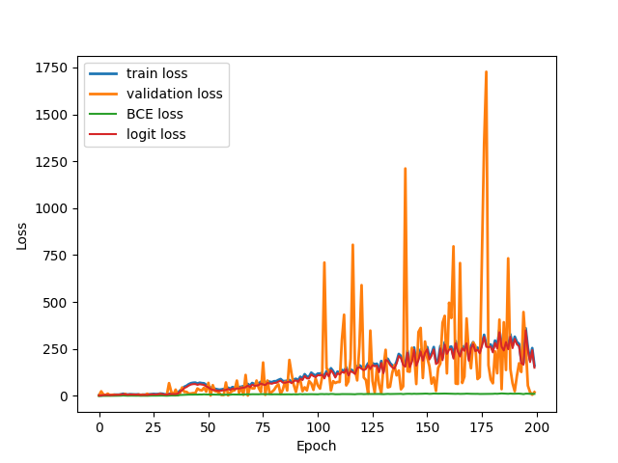
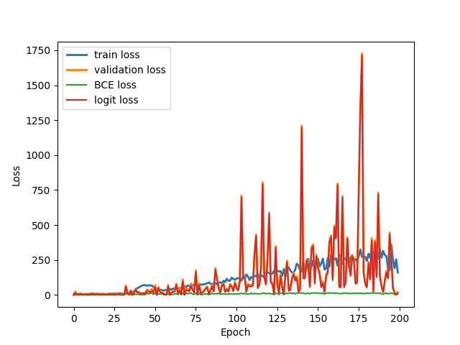
Loss Curve (logit)
Train
Validate
temp = 4.0
factor[“BCE”] = factor[“logit”] = 1/2

Slide 6
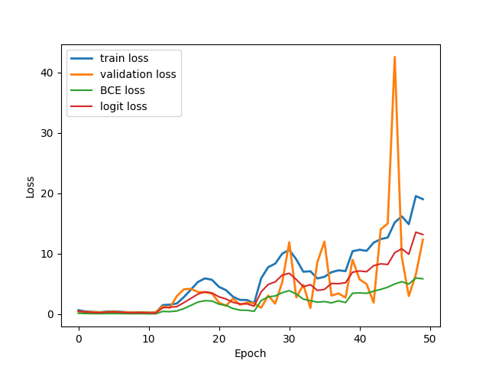
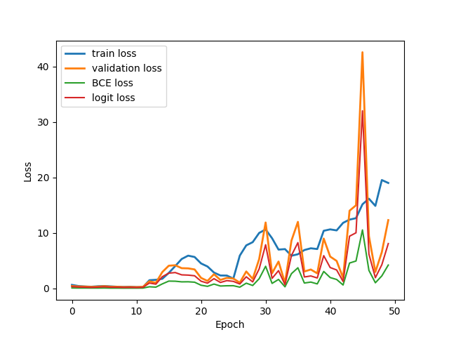
Loss Curve (logit)
Train
Validate
temp = 2.0
factor[“BCE”] = factor[“logit”] = 1/2

Slide 7
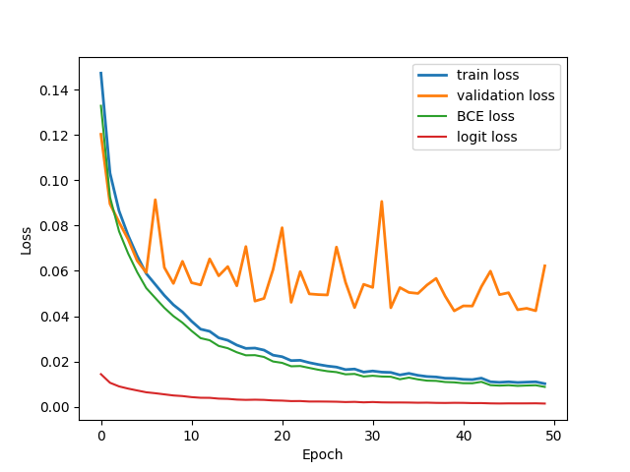
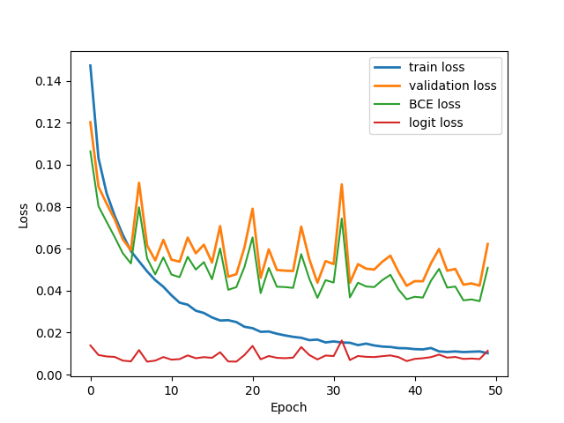
Loss Curve (logit)
Train
Validate
temp = 0.25
factor[“BCE”] = factor[“logit”] = 1/2

Slide 8
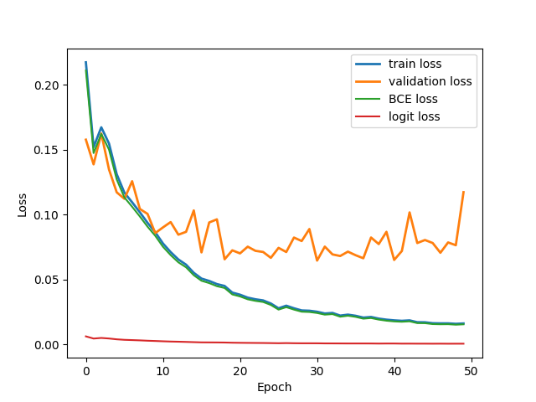
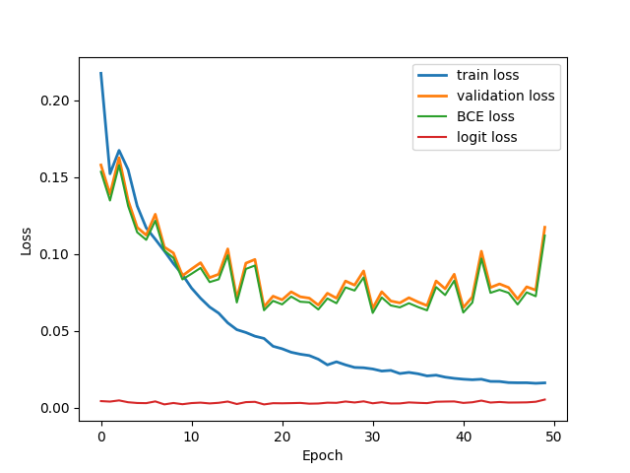
Loss Curve (logit)
Train
Validate
temp = 0.25
factor[“BCE”] = 0.8, factor[“logit”] = 0.2

Slide 9
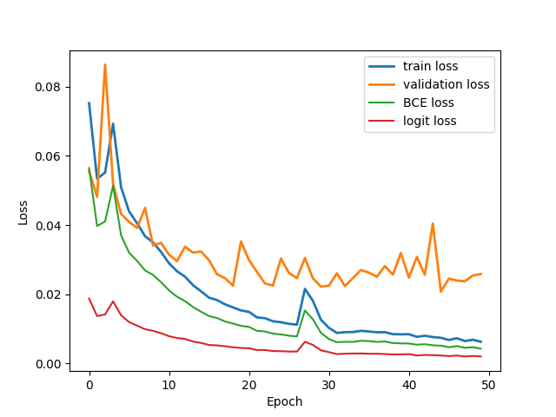
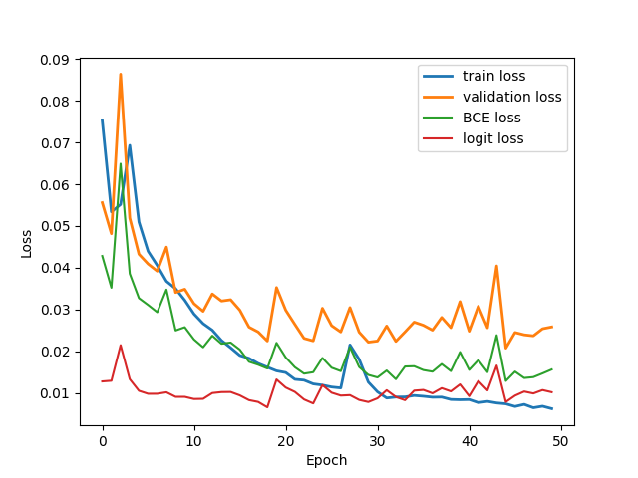
Loss Curve (logit)
Train
Validate
temp = 0.25
factor[“BCE”] = 0.2, factor[“logit”] = 0.8

Slide 10
Result Metric (TDR@FDR=1%)
Model | TDR@FDR=1%
Teacher | 84.62%
Student | 64.71% （Epoch = 50的時候）
temp = 2.0 factor[“BCE”] = factor[“logit”] = 1/2 | 20.36%
temp = 0.25 factor[“BCE”] = factor[“logit”] = 1/2 | 48.42%
temp = 0.25 factor[“BCE”] = 0.8, factor[“logit”] = 0.2 | 41.63%
temp = 0.25 factor[“BCE”] = 0.2, factor[“logit”] = 0.8 | 67.42%

