Slide 1
3/31 個人咪挺 The result of MGD with multiple feature layers

Slide 2
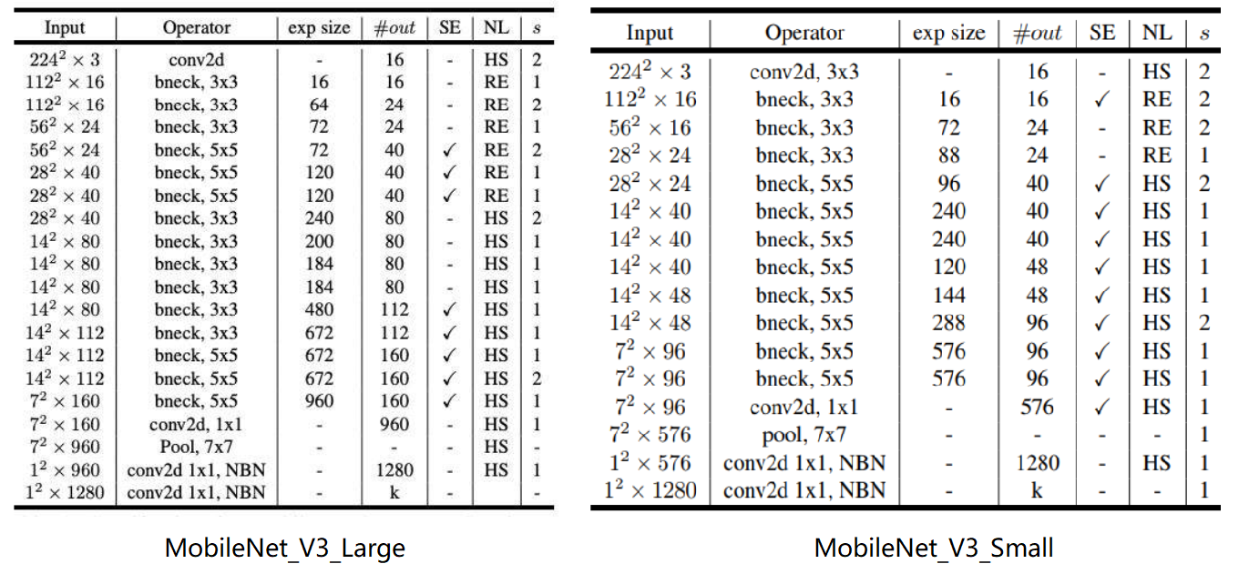
Notation
stride2[0]
128x80
1
128x80
stride2[0]
128x80
64x40
stride2[1]
stride2[1]
128x80
64x40
32x20
stride2[2]
stride2[2]
64x40
16x10
32x20
16x10
stride2[3]
32x20
8x5
stride2[3]
32x20
16x10
8x5
16x10
8x5
16x10
8x5
16x10
8x5
1
stride2[4]
16x10
8x5
16x10
stride2[4]
16x10
8x5
8x5
8x5
8x5
8x5
8x5
8x5
8x5

Slide 3
Recall – Result Metric (MMAC)
Teacher:
MobileNet V3 Large
Student:
MobileNet V3 Small
Model (Test image size) | MACs (Approx. inference time)
Teacher, torchvision version (3x224x224) | 230.04M MAC (136.93 ms)
Teacher, handwrite version (3x224x224) | 230.93M MAC (137.46 ms)
Teacher, torchvision version (3x128x80) | 51.05M MAC (30.39 ms)
Teacher, handwrite version (3x128x80) | 51.24M MAC (30.50 ms)
Teacher, handwrite version, stride2[0] (3x128x80) | 189.02M MAC (112.51 ms)
Teacher, handwrite version, stride2[1] (3x128x80) | 171.57M MAC (102.125 ms)
Teacher, handwrite version, stride2[2] (3x128x80) | 153.8M MAC (91.55 ms)
Teacher, handwrite version, stride2[3] (3x128x80) | 133.03M MAC (79.18 ms)
Teacher, handwrite version, stride2[4] (3x128x80) | 78.1M MAC (76.49 ms)
Model (Test image size) | MACs (Approx. inference time)
Student, torchvision version (3x224x224) | 59.89M MAC (35.65 ms)
Student, handwrite version (3x224x224) | 60.07M MAC (35.76 ms)
Student, torchvision version (3x128x80) | 13.76M MAC (8.19 ms)
Student, handwrite version (3x128x80) | 13.8M MAC (8.21 ms)
Student, handwrite version, stride2[0] (3x128x80) | 49.23M MAC (29.30 ms)
Student, handwrite version, stride2[1] (3x128x80) | 45.66M MAC (27.18 ms)
Student, handwrite version, stride2[2] (3x128x80) | 41.82M MAC (24.89 ms)
Student, handwrite version, stride2[3] (3x128x80) | 36.51M MAC (21.73 ms)
Student, handwrite version, stride2[4] (3x128x80) | 23.63M MAC (14.07 ms)

Slide 4
Modified Model Structure
stride2[0]
128x80
1
128x80
128x80
64x40
128x80
64x40
32x20
64x40
16x10
32x20
16x10
32x20
8x5
32x20
16x10
8x5
16x10
8x5
16x10
8x5
16x10
8x5
1
stride2[4]
16x10
8x5
16x10
16x10
8x5
8x5
8x5
8x5
8x5
8x5
8x5
8x5
Red: The layer we modified
Blue: The layers we selected to compute MGD Loss

Slide 5

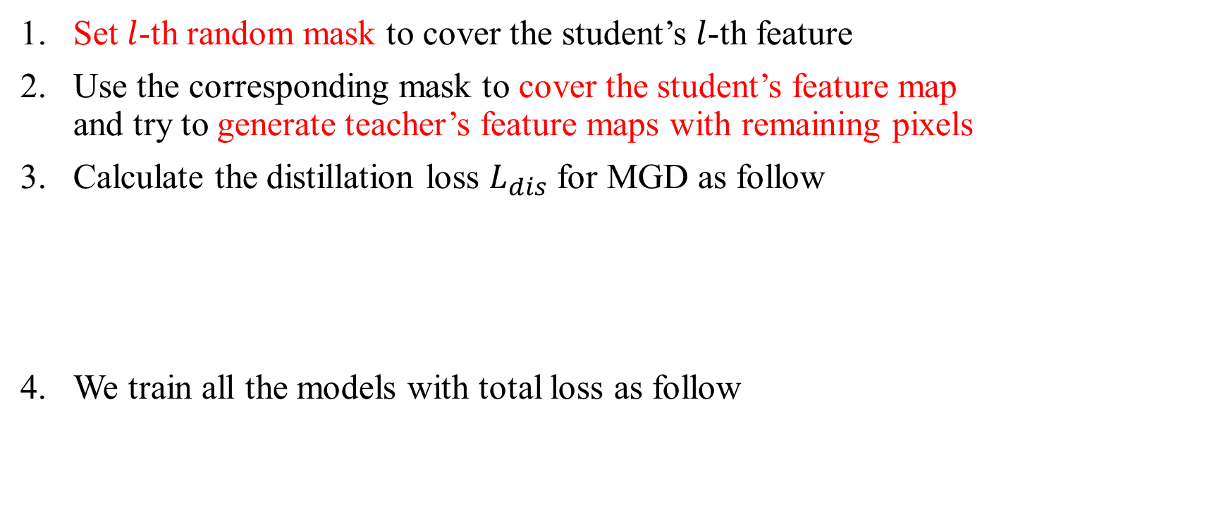
Recall – MGD Process
Set $l$-th random mask to cover the student’s $l$-th feature
Use the corresponding mask to cover the student’s feature map and try to generate teacher’s feature maps with remaining pixels
Calculate the distillation loss $L_{dis}$ for MGD as follow
We train all the models with total loss as follow

Slide 6
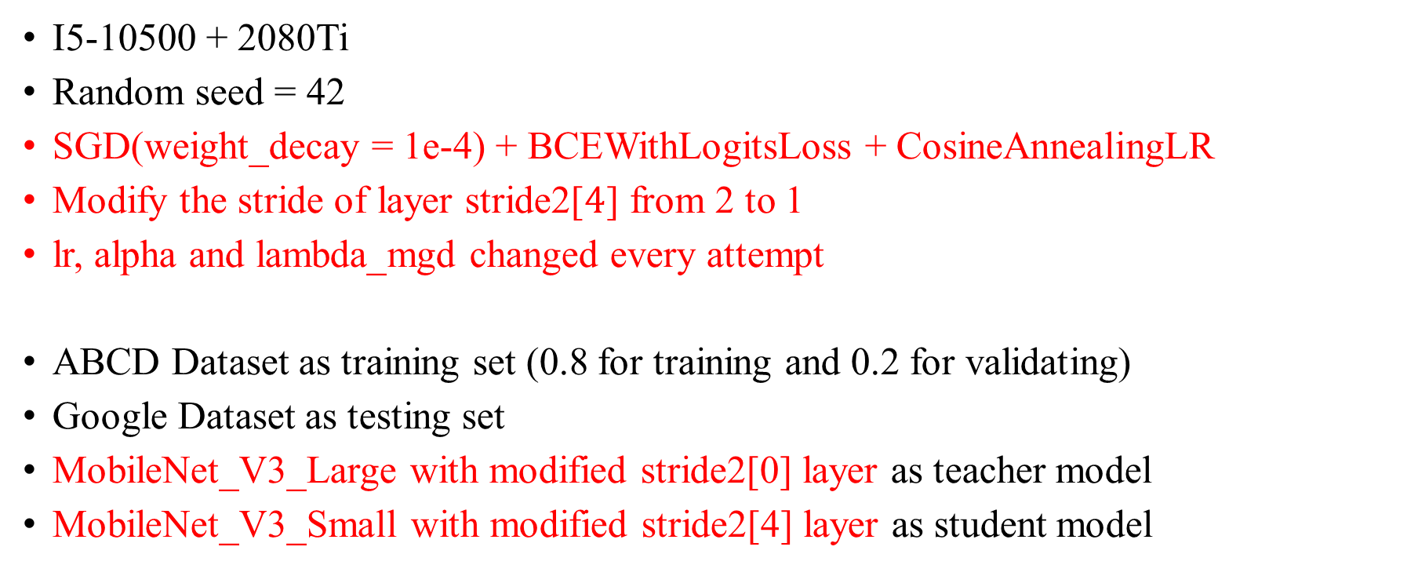
Train Setting
I5-10500 + 2080Ti
Random seed = 42
SGD(weight_decay = 1e-4) + BCEWithLogitsLoss + CosineAnnealingLR
Modify the stride of layer stride2[$4$] from 2 to 1
lr, alpha and lambda_mgd changed every attempt
ABCD Dataset as training set (0.8 for training and 0.2 for validating)
Google Dataset as testing set
MobileNet_V3_Large with modified stride2[0] layer as teacher model
MobileNet_V3_Small with modified stride2[4] layer as student model

Slide 7
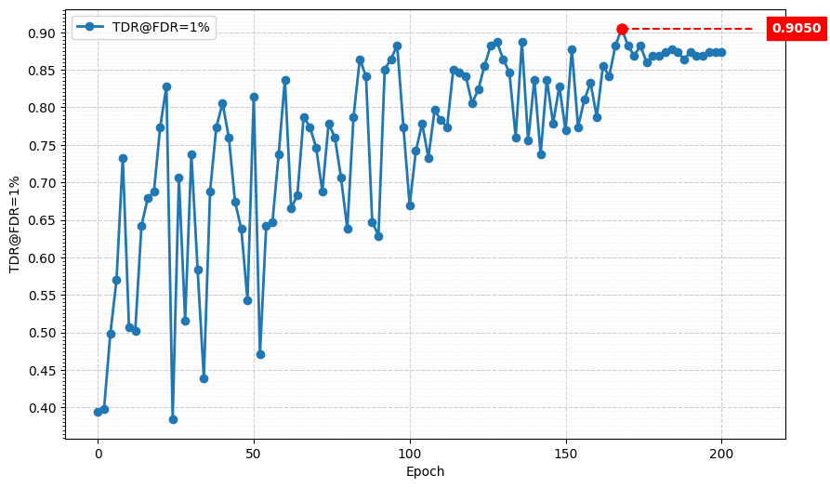
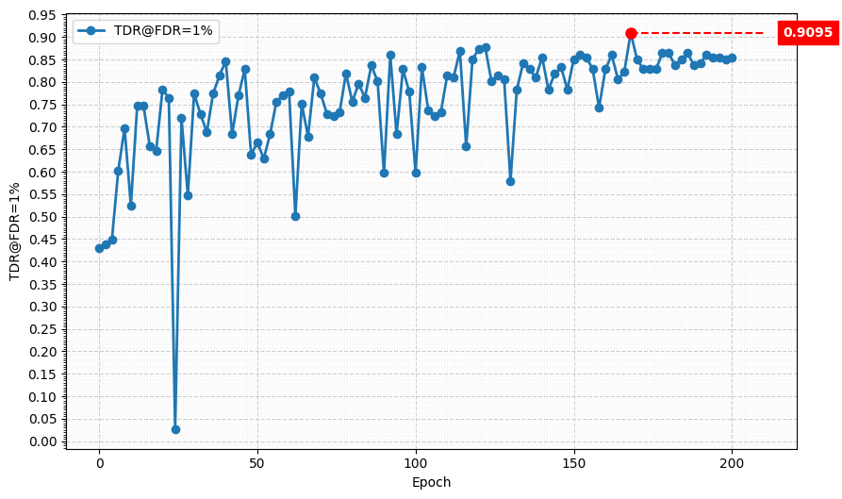
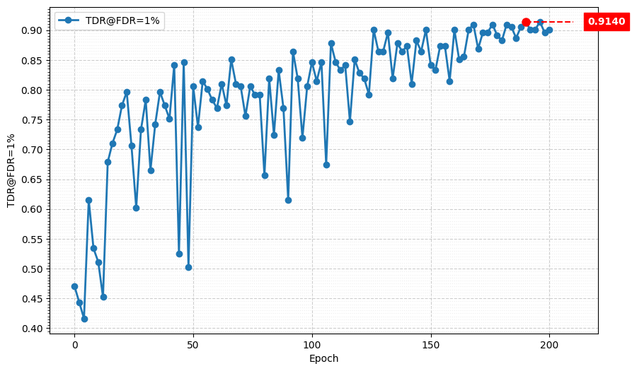
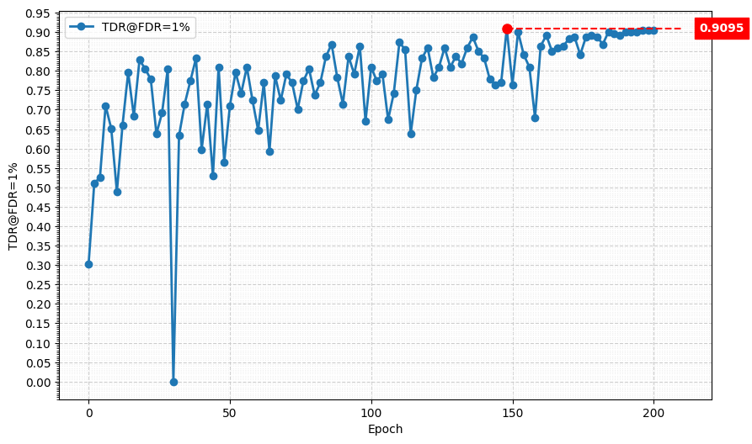
Metric Curve (TDR@FDR=1%)
lr = 0.01
alpha = 0.01
lambda_mgd = 0.1
lr = 0.01
alpha = 0.01
lambda_mgd = 0.05
lr = 0.01
alpha = 0.005
lambda_mgd = 0.1
lr = 0.01
alpha = 0.01
lambda_mgd = 0.2

Slide 8
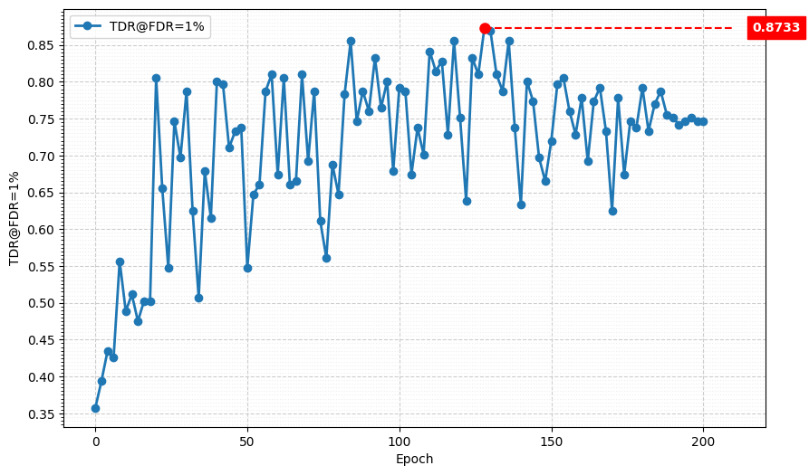
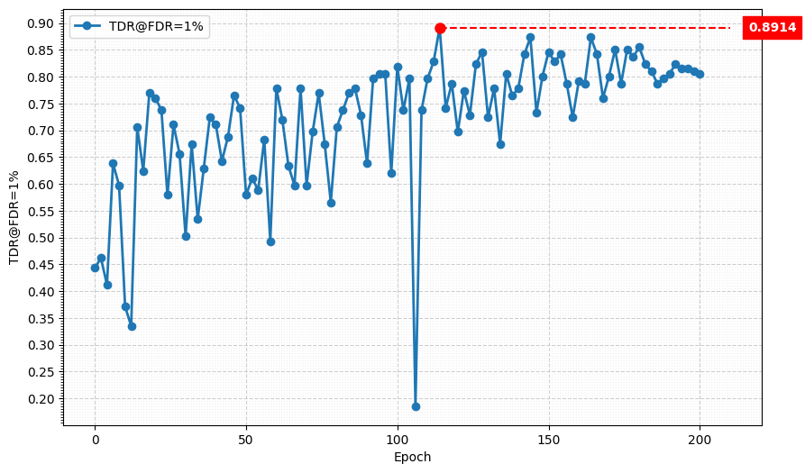
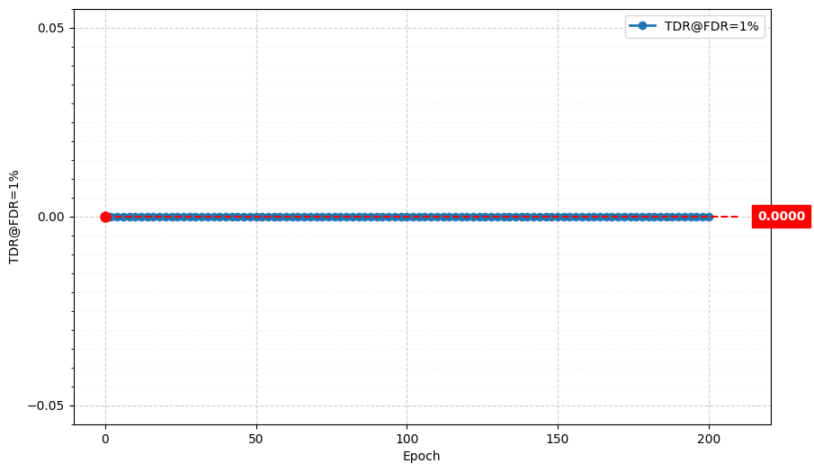
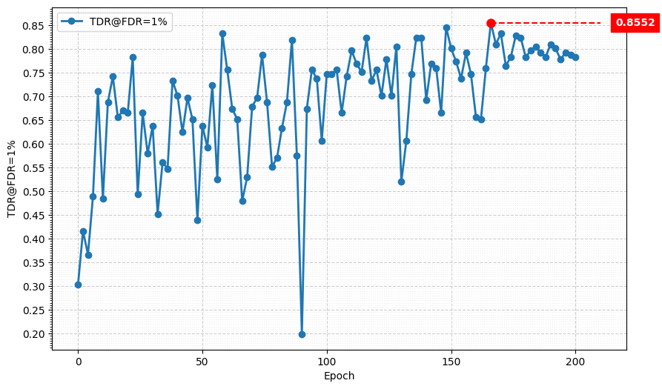
Metric Curve (TDR@FDR=1%)
lr = 0.01
alpha = 0.01
lambda_mgd = 0.01
lr = 0.02
alpha = 0.0075
lambda_mgd = 0.3
lr = 0.01
alpha = 0.015
lambda_mgd = 0.2
lr = 0.02
alpha = 0.0075
lambda_mgd = 0.15

Slide 9
Result Metric (TDR@FDR=1%)
Model | TDR@FDR=1% | ACE | APCER | BPCER | In Epoch
Teacher, stride2[0] | 98.64% | 1.02% | 0.9% | 1.14% | 104
Student, stride2[4] | 82.81% | 5.09% | 6.33% | 3.85% | 156
MGD 1 layer lr = 0.01, alpha = 0.01, lambda_mgd = 0.15 | 99.55% | 0.70% | 0.45% | 0.95% | 174
MGD 2 layer lr = 0.02, alpha = 0.0075, lambda_mgd = 0.1 | 99.55% | 0.65% | 0.45% | 0.86% | 188
MGD 3 layer lr = 0.02, alpha = 0.005, lambda_mgd = 0.075 | 91.40% | 4.25% | 6.79% | 1.71% | 190
Teacher:
MobileNet V3 Large
Student:
MobileNet V3 Small

Slide 10
Next
Give up tuning hyperparameters on 3-layers MGD
Try to search papers about what will happen when changing the input channel size
Change the input channel from 3 to 1

