Slide 1
4/15 個人咪挺 The result of MGD with HLCFN3S as teacher

Slide 2
Recall – Result Metric (MMAC)
Teacher:
MobileNet V3 Large
Student:
MobileNet V3 Small
Model (Test image size) | MACs (Approx. inference time)
Teacher, torchvision version (3x224x224) | 230.04M MAC (136.93 ms)
Teacher, handwrite version (3x224x224) | 230.93M MAC (137.46 ms)
Teacher, torchvision version (3x128x80) | 51.05M MAC (30.39 ms)
Teacher, handwrite version (3x128x80) | 51.24M MAC (30.50 ms)
Teacher, handwrite version, stride2[0] (3x128x80) | 189.02M MAC (112.51 ms)
Teacher, handwrite version, stride2[1] (3x128x80) | 171.57M MAC (102.125 ms)
Teacher, handwrite version, stride2[2] (3x128x80) | 153.8M MAC (91.55 ms)
Teacher, handwrite version, stride2[3] (3x128x80) | 133.03M MAC (79.18 ms)
Teacher, handwrite version, stride2[4] (3x128x80) | 78.1M MAC (76.49 ms)
Model (Test image size) | MACs (Approx. inference time)
Student, torchvision version (3x224x224) | 59.89M MAC (35.65 ms)
Student, handwrite version (3x224x224) | 60.07M MAC (35.76 ms)
Student, torchvision version (3x128x80) | 13.76M MAC (8.19 ms)
Student, handwrite version (3x128x80) | 13.8M MAC (8.21 ms)
Student, handwrite version, stride2[0] (3x128x80) | 49.23M MAC (29.30 ms)
Student, handwrite version, stride2[1] (3x128x80) | 45.66M MAC (27.18 ms)
Student, handwrite version, stride2[2] (3x128x80) | 41.82M MAC (24.89 ms)
Student, handwrite version, stride2[3] (3x128x80) | 36.51M MAC (21.73 ms)
Student, handwrite version, stride2[4] (3x128x80) | 23.63M MAC (14.07 ms)

Slide 3
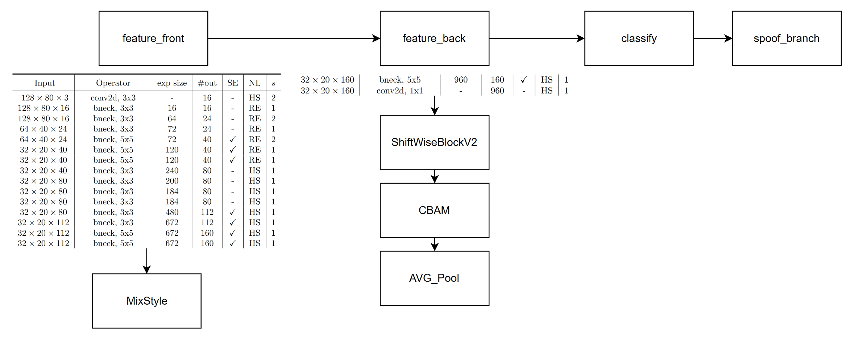
Model Structure (teacher)
Blue: Selected layer to do MGD-1layer
Orange: Selected layer to do MGD-2layers

Slide 4
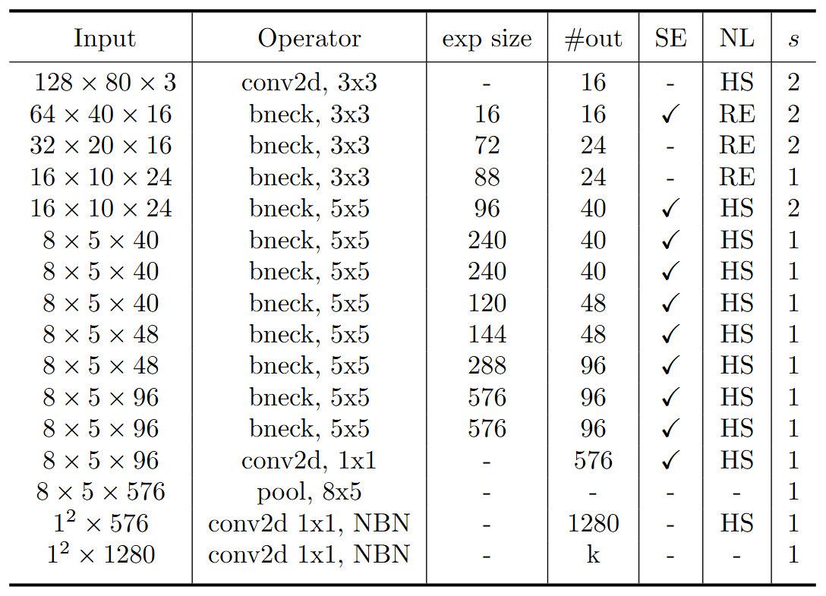
Model Structure (student)
stride2[0]
stride2[1]
stride2[2]
stride2[3]
stride2[4]
Blue: Selected layer to do MGD-1layer
Orange: Selected layer to do MGD-2layers

Slide 5

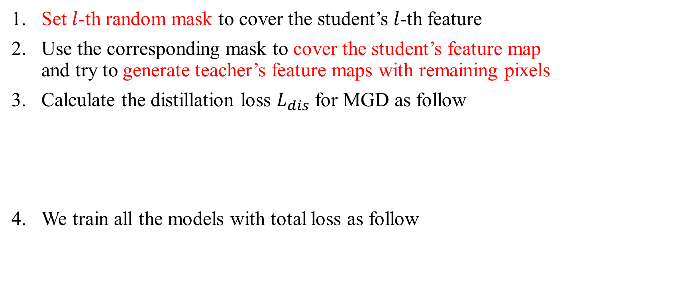
Recall – MGD Process
Set $l$-th random mask to cover the student’s $l$-th feature
Use the corresponding mask to cover the student’s feature map and try to generate teacher’s feature maps with remaining pixels
Calculate the distillation loss $L_{dis}$ for MGD as follow
We train all the models with total loss as follow

Slide 6
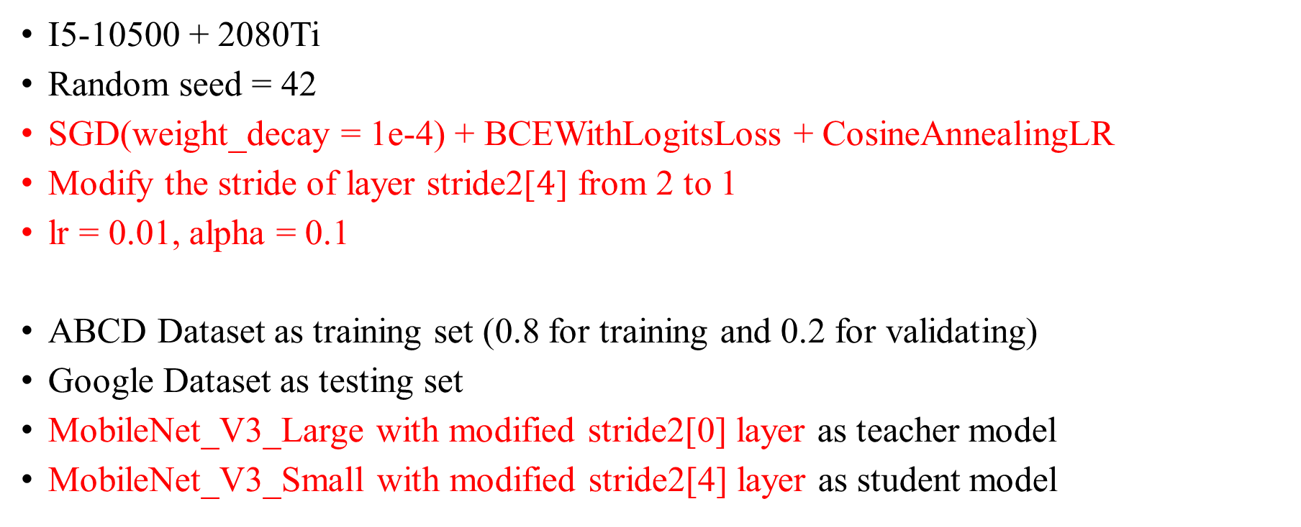
Train Setting (1 layer)
I5-10500 + 2080Ti
Random seed = 42
SGD(weight_decay = 1e-4) + BCEWithLogitsLoss + CosineAnnealingLR
Modify the stride of layer stride2[$4$] from 2 to 1
lr = 0.01, alpha = 0.1
ABCD Dataset as training set (0.8 for training and 0.2 for validating)
Google Dataset as testing set
MobileNet_V3_Large with modified stride2[0] layer as teacher model
MobileNet_V3_Small with modified stride2[4] layer as student model

Slide 7
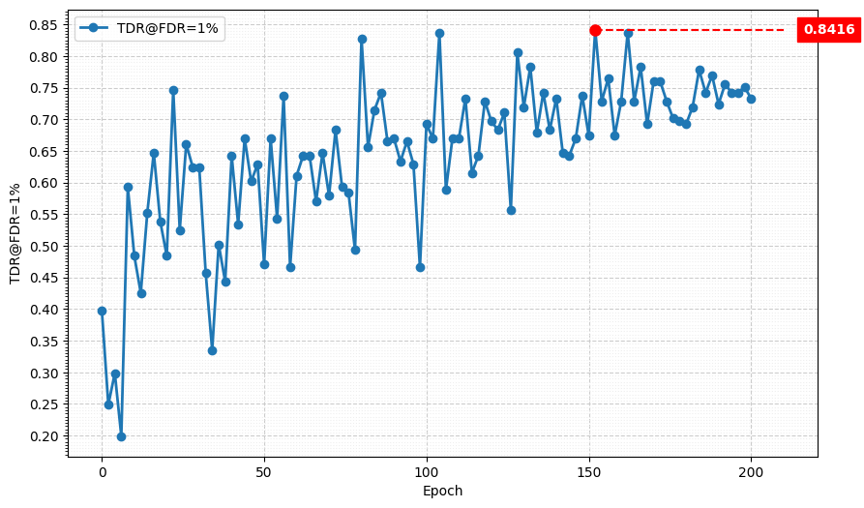
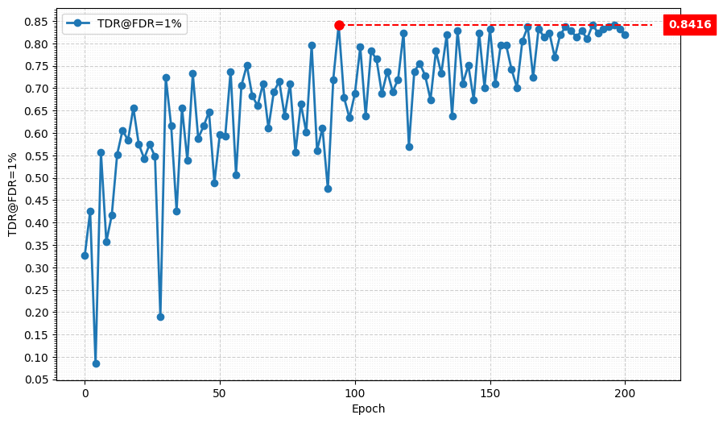
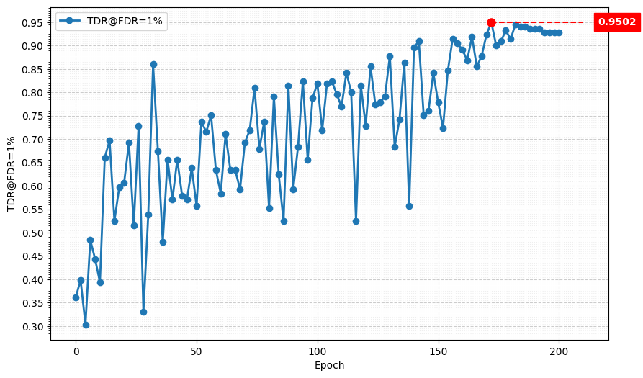
Metric Curve (TDR@FDR=1%)
lambda_mgd = 0.15
lambda_mgd = 0.075
lambda_mgd = 0.1

Slide 8
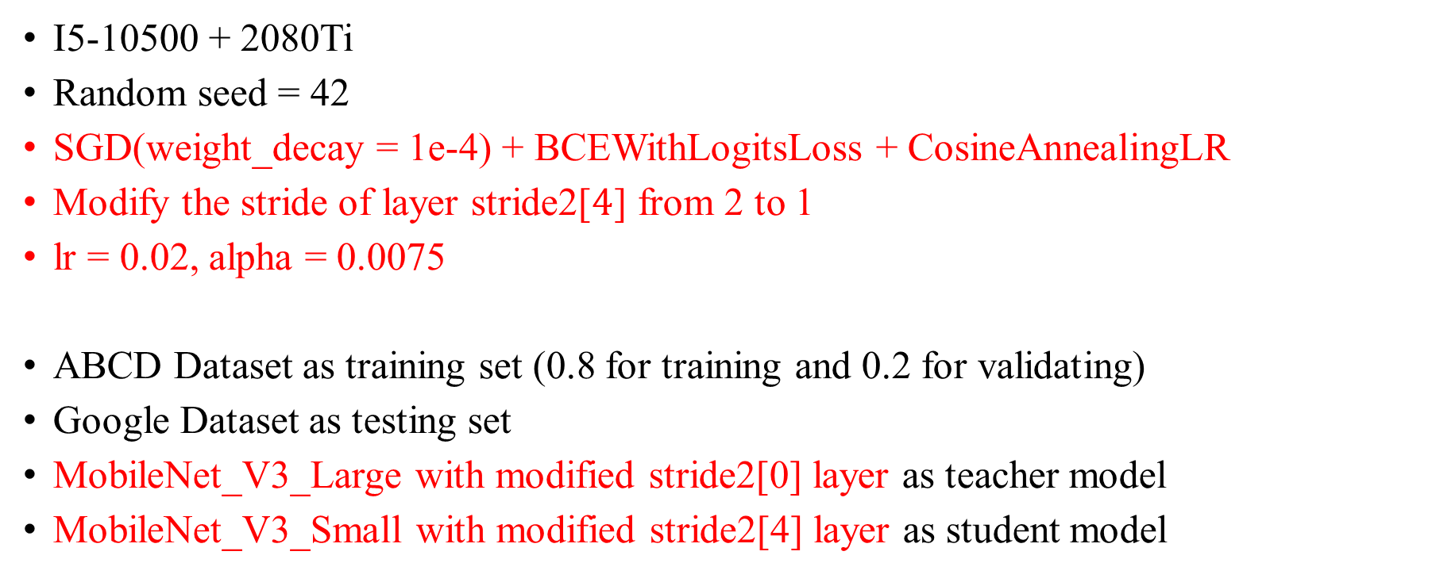
Train Setting (2 layers)
I5-10500 + 2080Ti
Random seed = 42
SGD(weight_decay = 1e-4) + BCEWithLogitsLoss + CosineAnnealingLR
Modify the stride of layer stride2[$4$] from 2 to 1
lr = 0.02, alpha = 0.0075
ABCD Dataset as training set (0.8 for training and 0.2 for validating)
Google Dataset as testing set
MobileNet_V3_Large with modified stride2[0] layer as teacher model
MobileNet_V3_Small with modified stride2[4] layer as student model

Slide 9
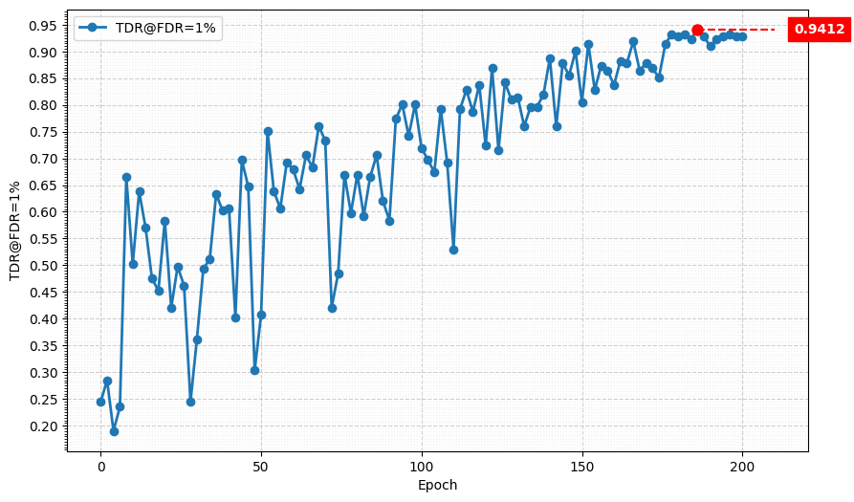
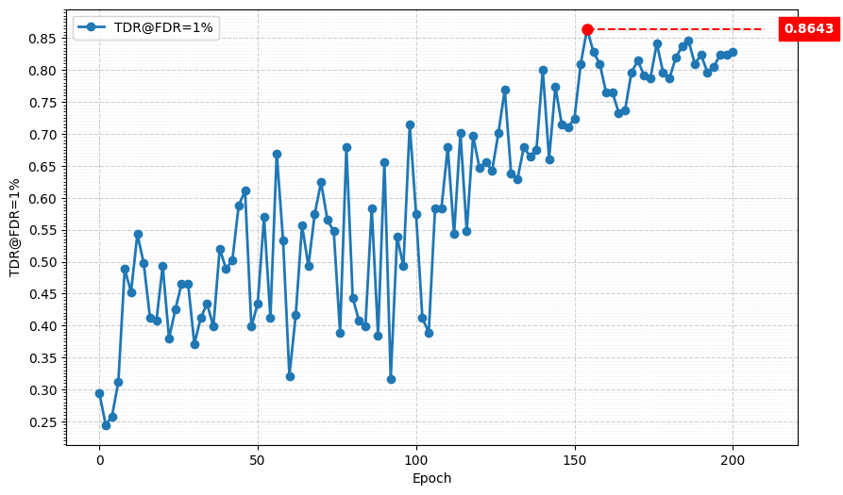
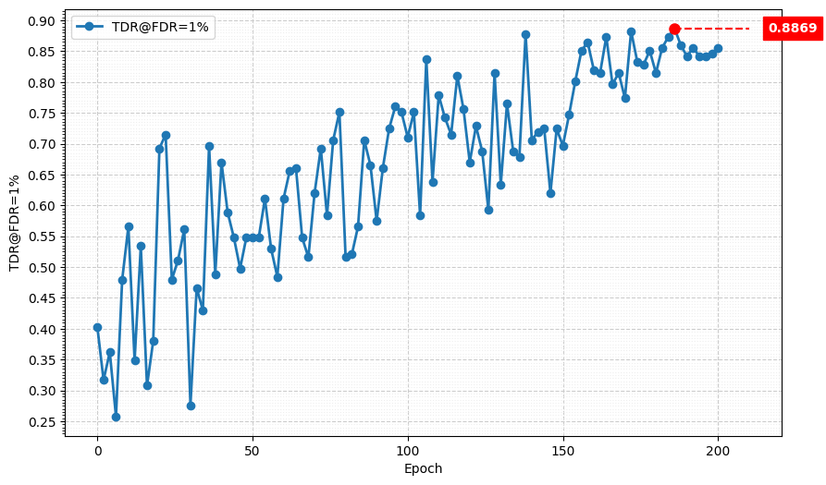
Metric Curve (TDR@FDR=1%)
lambda_mgd = 0.1
lambda_mgd = 0.125
lambda_mgd = 0.075

Slide 10
Result Metric
Model | TDR@FDR=1% | ACE | APCER | BPCER | In Epoch
MobileNet V3 Large, stride2[0] | 98.64% | 1.02% | 0.9% | 1.14% | 104
HLCFN3S | 94.57% | 3.10% | 5.43% | 0.76% | -
Student, stride2[4] | 82.81% | 5.09% | 6.33% | 3.85% | 156
MGD 1 layer, MobileNet V3 Large lr = 0.01, alpha = 0.01, lambda_mgd = 0.15 | 99.55% | 0.70% | 0.45% | 0.95% | 174
MGD 1 layer, HLCFN3S lr = 0.01, alpha = 0.1, lambda_mgd = 0.1 | 95.02% | 2.94% | 3.17% | 2.71% | 172
MGD 2 layer, MobileNet V3 Large lr = 0.02, alpha = 0.0075, lambda_mgd = 0.1 | 99.55% | 0.65% | 0.45% | 0.86% | 188
MGD 2 layer, HLCFN3S lr = 0.02, alpha = 0.0075, lambda_mgd = 0.1 | 94.12% | 3.05% | 3.62% | 2.47% | 186
Student:
MobileNet V3 Small

