Slide 1
4/20 個人咪挺 The result of MGD with HLCFN3S as teacher

Slide 2
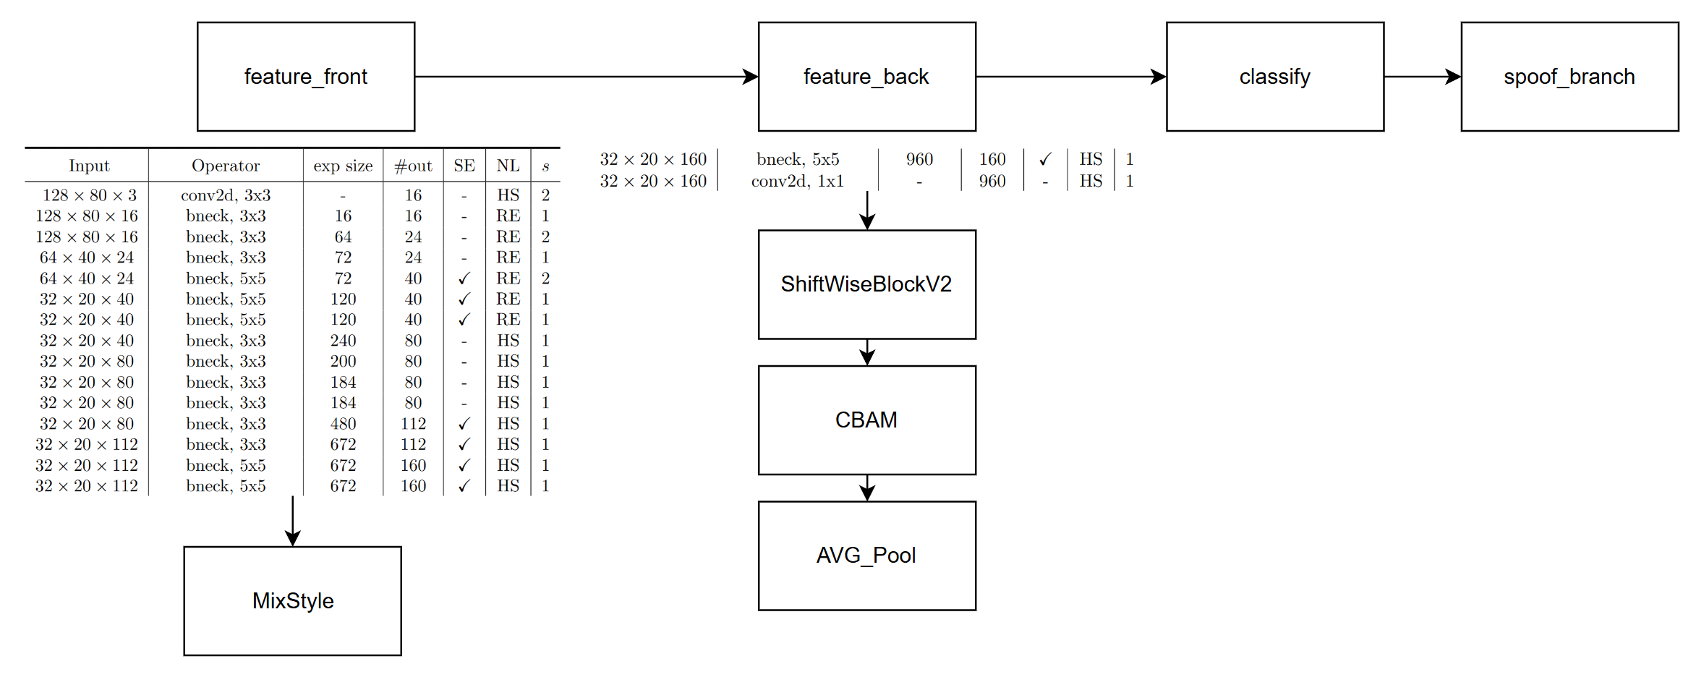
Model Structure (teacher)
Blue: Selected layer to do MGD-1layer
Orange: Selected layer to do MGD-2layers

Slide 3
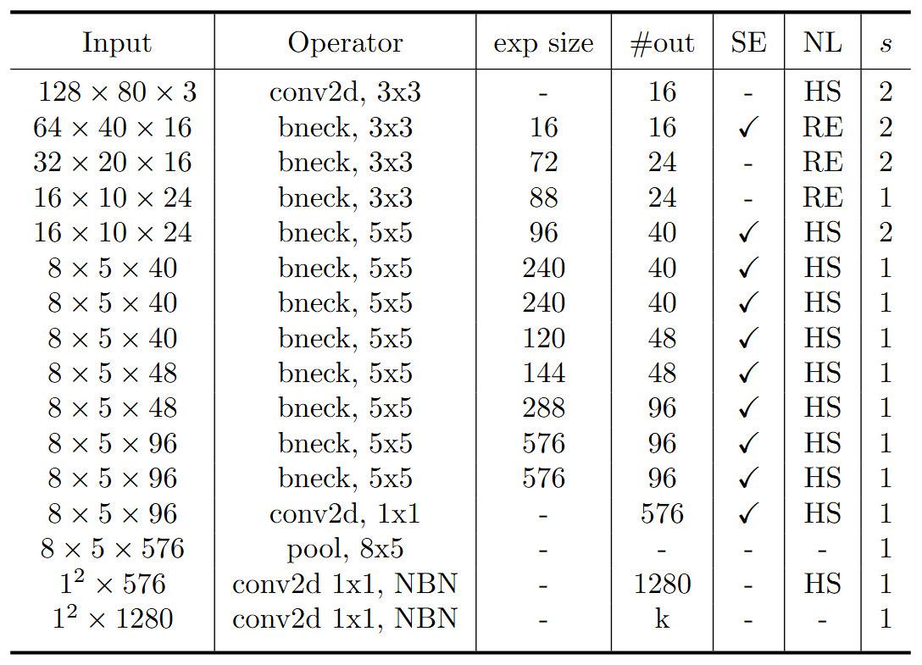
Model Structure (student)
stride2[0]
stride2[1]
stride2[2]
stride2[3]
stride2[4]
Blue: Selected layer to do MGD-1layer
Orange: Selected layer to do MGD-2layers

Slide 4

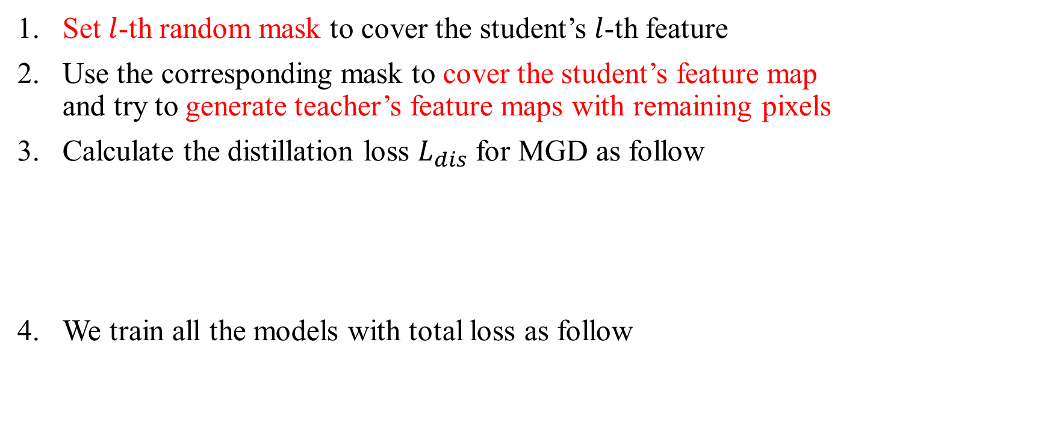
Recall – MGD Process
Set $l$-th random mask to cover the student’s $l$-th feature
Use the corresponding mask to cover the student’s feature map and try to generate teacher’s feature maps with remaining pixels
Calculate the distillation loss $L_{dis}$ for MGD as follow
We train all the models with total loss as follow

Slide 5
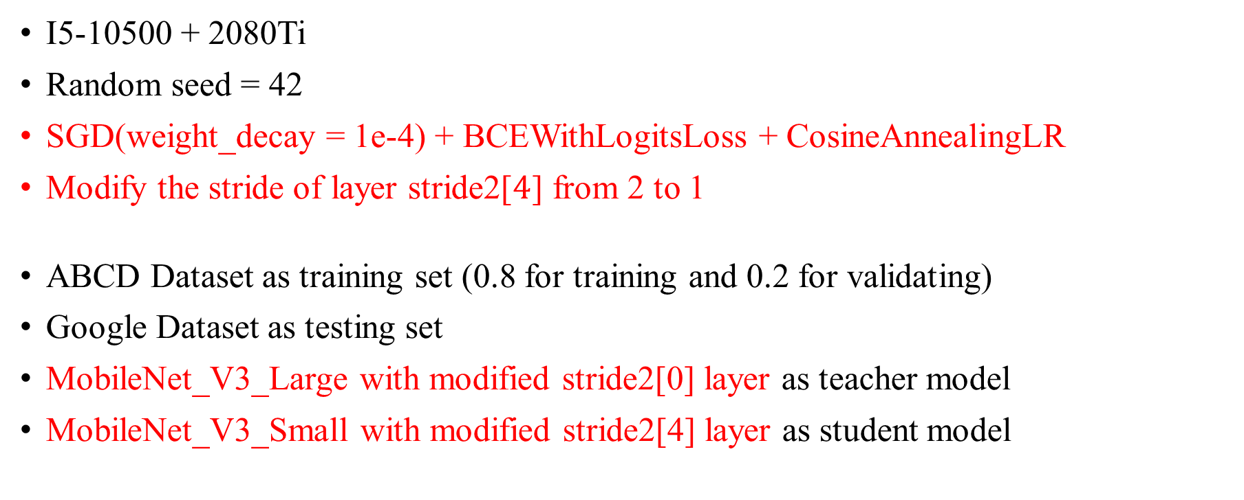
Train Setting (1 layer)
I5-10500 + 2080Ti
Random seed = 42
SGD(weight_decay = 1e-4) + BCEWithLogitsLoss + CosineAnnealingLR
Modify the stride of layer stride2[$4$] from 2 to 1
ABCD Dataset as training set (0.8 for training and 0.2 for validating)
Google Dataset as testing set
MobileNet_V3_Large with modified stride2[0] layer as teacher model
MobileNet_V3_Small with modified stride2[4] layer as student model

Slide 6
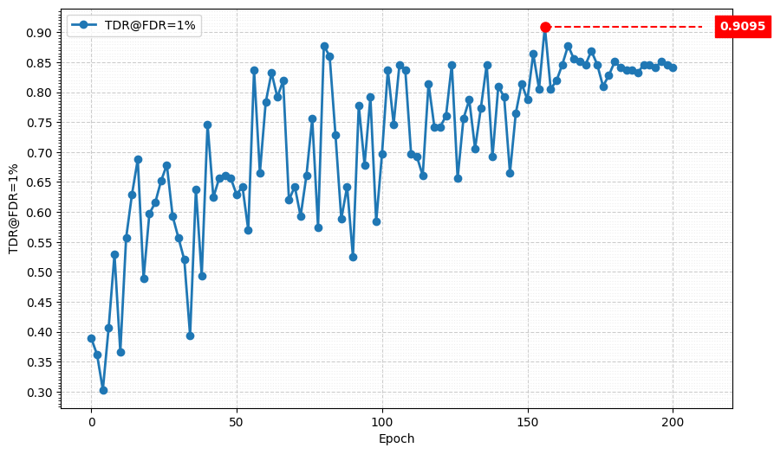
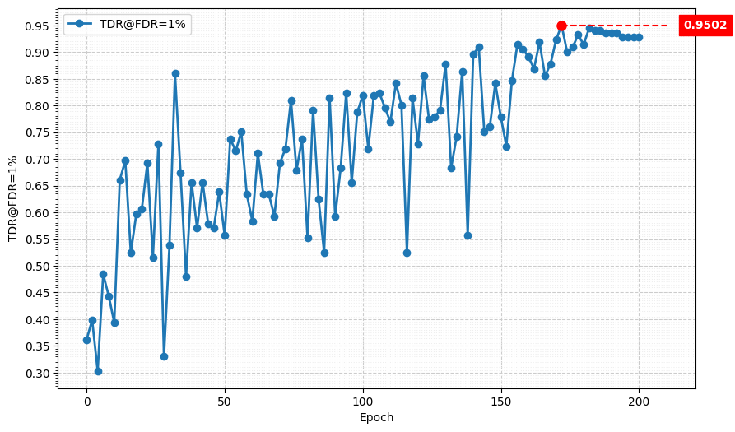
Metric Curve (TDR@FDR=1%, compare)
4 stride2-layers
lr = 0.01
alpha = 0.1
lambda_mgd = 0.1
5 stride2-layers
lr = 0.01
alpha = 0.1
lambda_mgd = 0.1

Slide 7
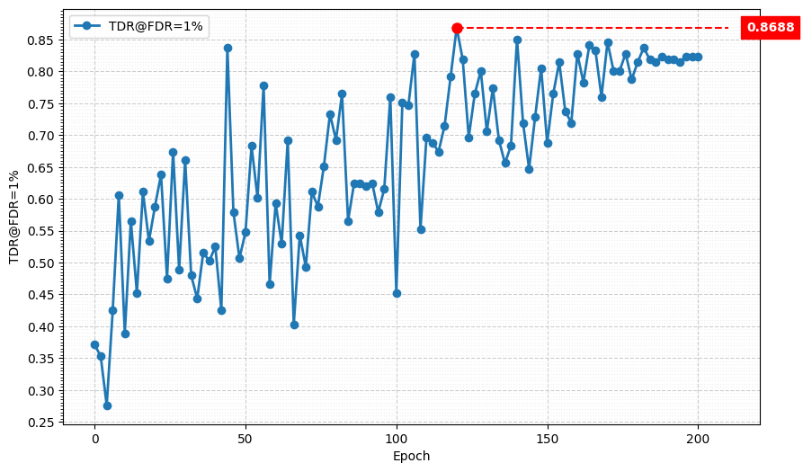
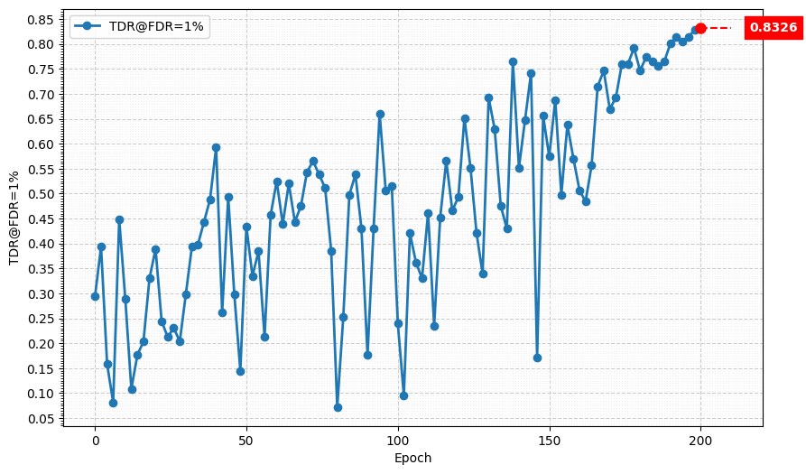
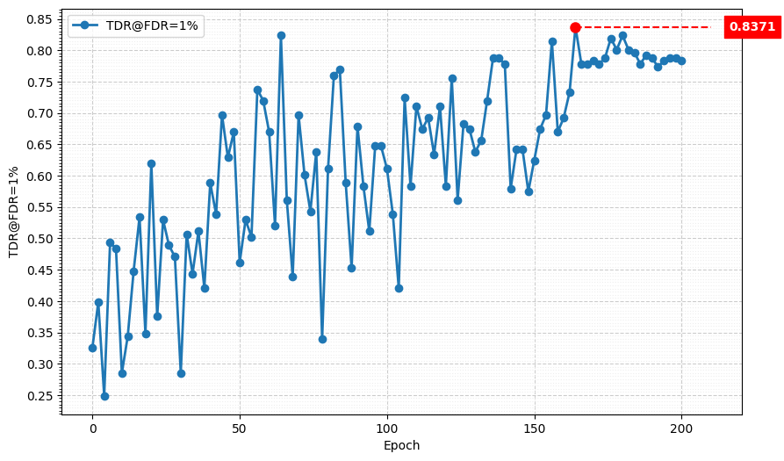
Metric Curve (TDR@FDR=1%, 4 stride2-layers)
lr = 0.01
alpha = 0.01
lambda_mgd = 0.125
lr = 0.01
alpha = 0.01
lambda_mgd = 0.15
lr = 0.2
alpha = 0.05
lambda_mgd = 0.1

Slide 8
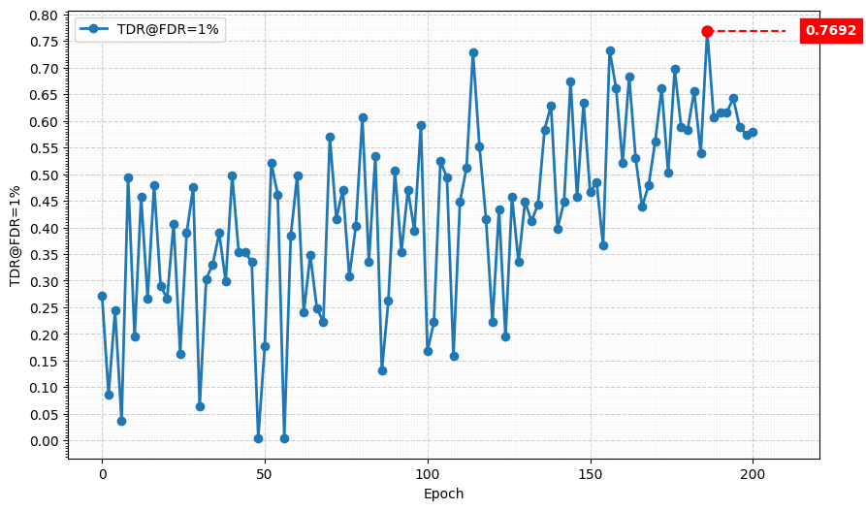
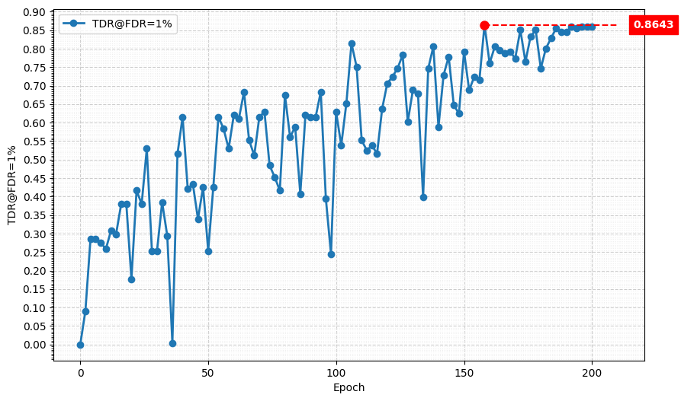
Metric Curve (TDR@FDR=1%, 5 stride2-layers)
lr = 0.02
alpha = 0.1
lambda_mgd = 0.1
lr = 0.2
alpha = 0.01
lambda_mgd = 0.1

Slide 9
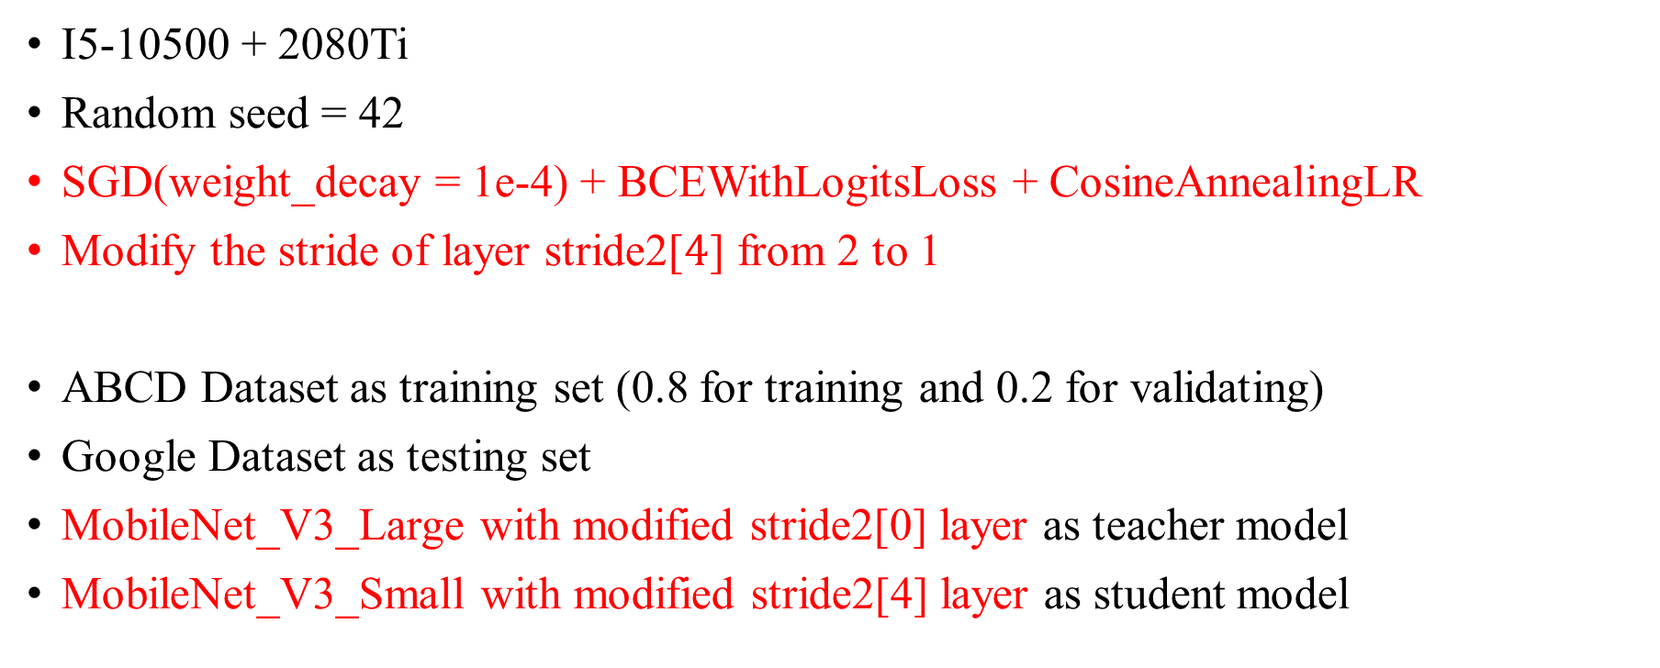
Train Setting (2 layers)
I5-10500 + 2080Ti
Random seed = 42
SGD(weight_decay = 1e-4) + BCEWithLogitsLoss + CosineAnnealingLR
Modify the stride of layer stride2[$4$] from 2 to 1
ABCD Dataset as training set (0.8 for training and 0.2 for validating)
Google Dataset as testing set
MobileNet_V3_Large with modified stride2[0] layer as teacher model
MobileNet_V3_Small with modified stride2[4] layer as student model

Slide 10
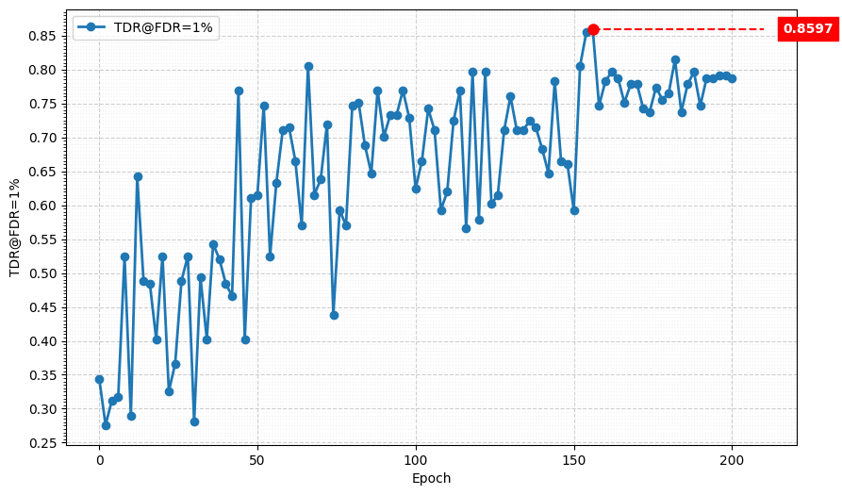
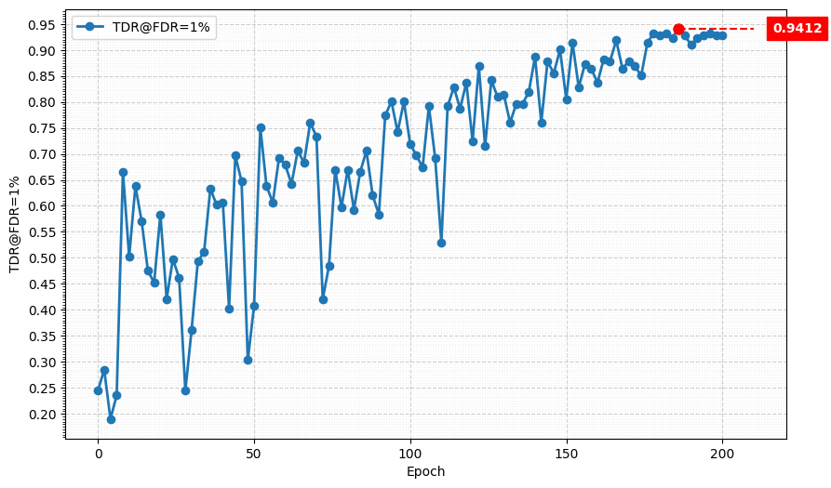
Metric Curve (TDR@FDR=1%, compare)
4 stride2-layers
lr = 0.02
alpha = 0.0075
lambda_mgd = 0.1
5 stride2-layers
lr = 0.02
alpha = 0.0075
lambda_mgd = 0.1

Slide 11
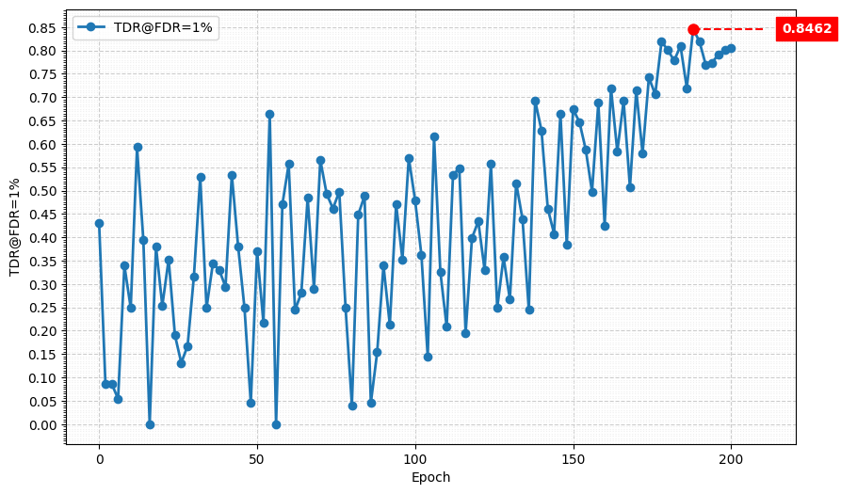
Metric Curve (TDR@FDR=1%, 4 stride2-layers)
lr = 0.2
alpha = 0.0125
lambda_mgd = 0.08

Slide 12
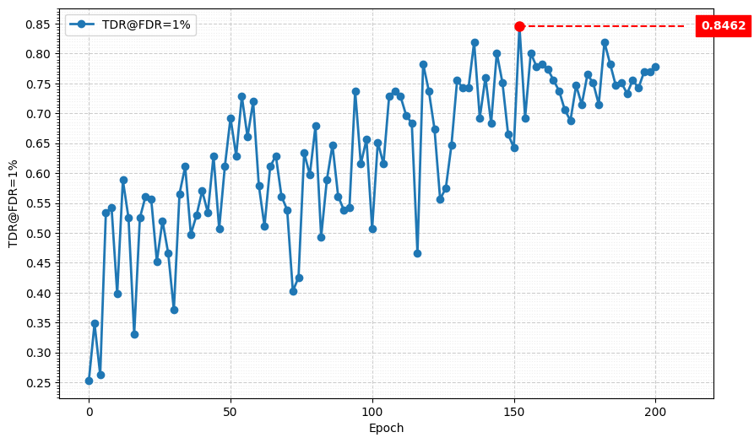
Metric Curve (TDR@FDR=1%, 5 stride2-layers)
lr = 0.02
alpha = 0.0075
lambda_mgd = 0.125

Slide 13
Result Metric
Student:
MobileNet V3 Small
Model | TDR@FDR=1% | ACE | APCER | BPCER | In Epoch
MobileNet V3 Large, stride2[0] | 98.64% | 1.02% | 0.9% | 1.14% | 104
HLCFN3S | 94.57% | 3.10% | 5.43% | 0.76% | -
Student, stride2[4] | 82.81% | 5.09% | 6.33% | 3.85% | 156
MGD 1 layer, MobileNet V3 Large lr = 0.01, alpha = 0.01, lambda_mgd = 0.15 | 99.55% | 0.70% | 0.45% | 0.95% | 174
MGD 1 layer, HLCFN3S, student w/ 4 stride2-layers lr = 0.01, alpha = 0.1, lambda_mgd = 0.1 | 95.02% | 2.94% | 3.17% | 2.71% | 172
MGD 1 layer, HLCFN3S, student w/ 5 stride2-layers lr = 0.01, alpha = 0.1, lambda_mgd = 0.1 | 90.95% | 3.80% | 4.98% | 2.62% | 156
MGD 2 layer, MobileNet V3 Large lr = 0.02, alpha = 0.0075, lambda_mgd = 0.1 | 99.55% | 0.65% | 0.45% | 0.86% | 188
MGD 2 layer, HLCFN3S, student w/ 4 stride2-layers lr = 0.02, alpha = 0.0075, lambda_mgd = 0.1 | 94.12% | 3.05% | 3.62% | 2.47% | 186
MGD 2 layer, HLCFN3S, student w/ 5 stride2-layers lr = 0.02, alpha = 0.0075, lambda_mgd = 0.1 | 85.97% | 5.39% | 4.07% | 6.71% | 156

