Slide 1
5/5 個人咪挺

Slide 2
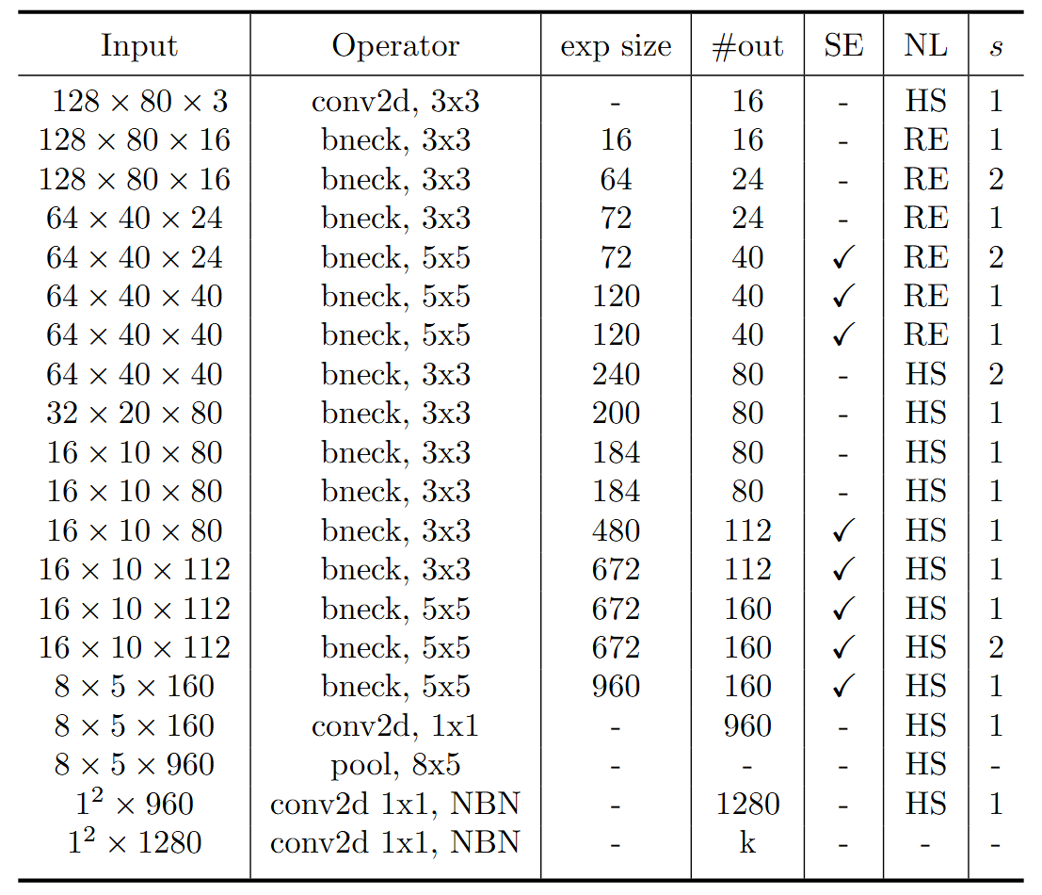
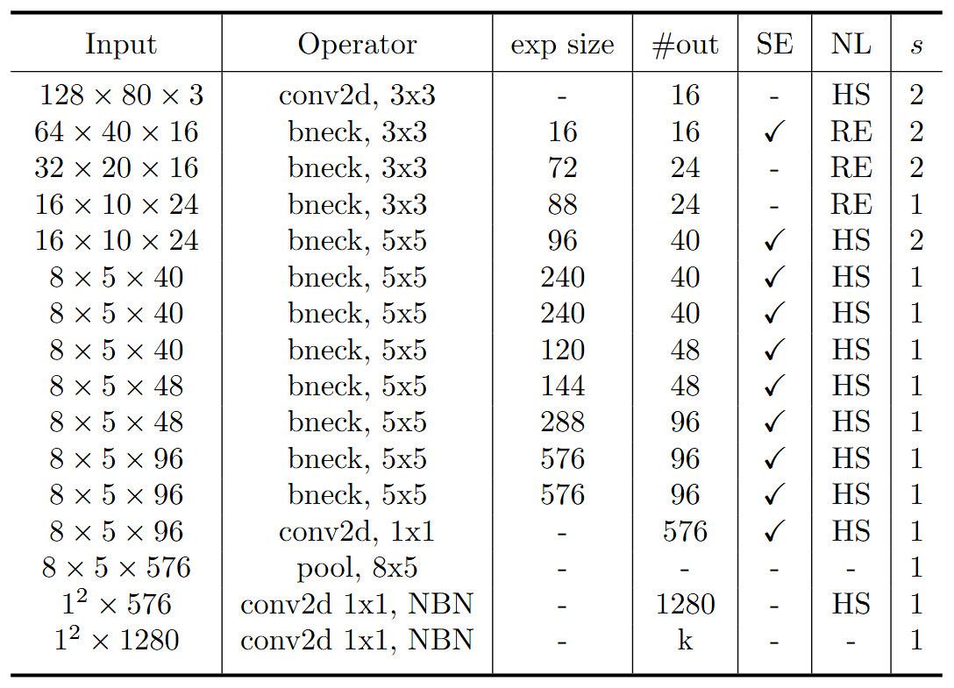
Model Structure
stride2[0]
stride2[1]
stride2[2]
stride2[3]
stride2[4]
MobileNet V3 Large
MobileNet V3 Small
Blue: Selected layer to do MGD-1layer

Slide 3
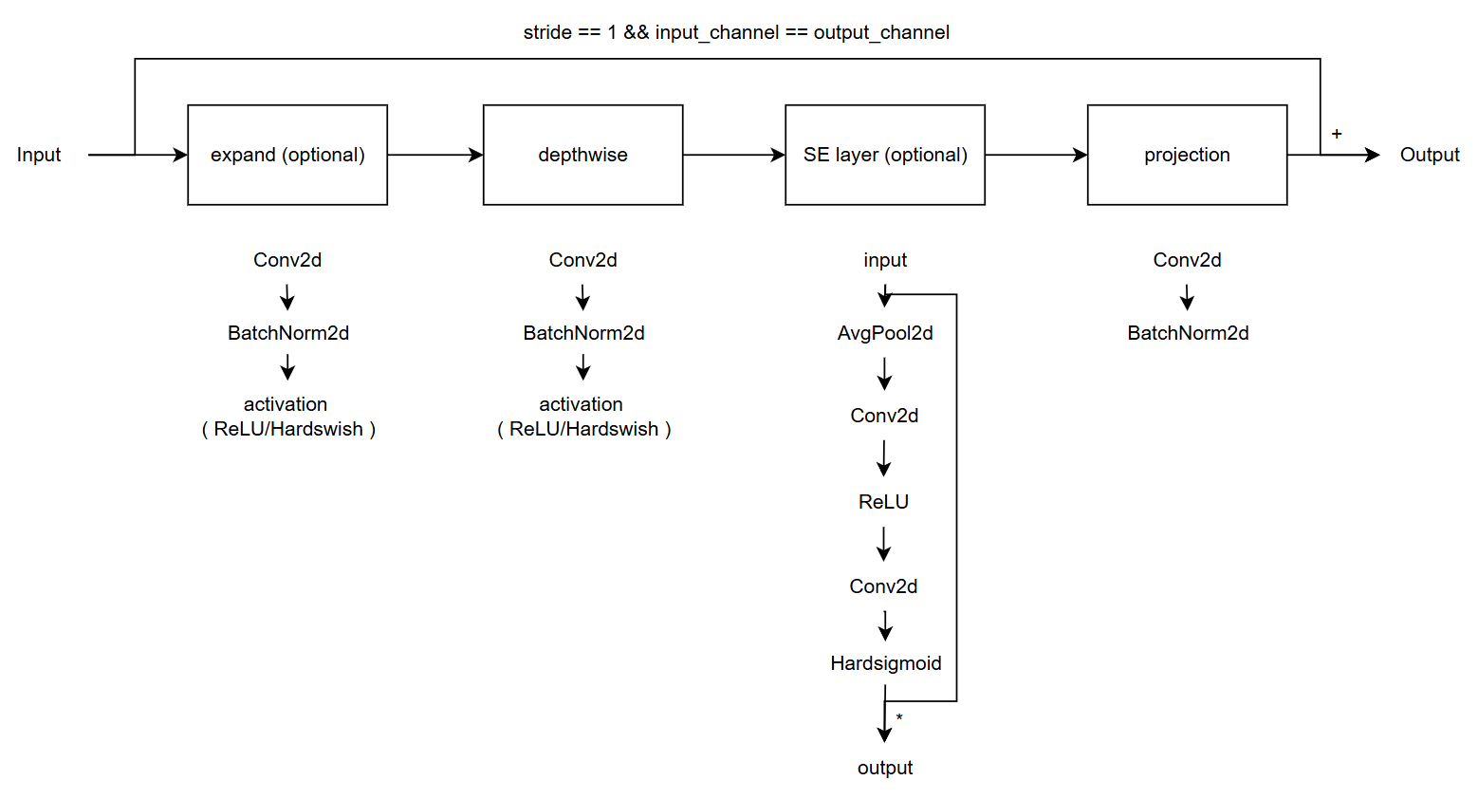
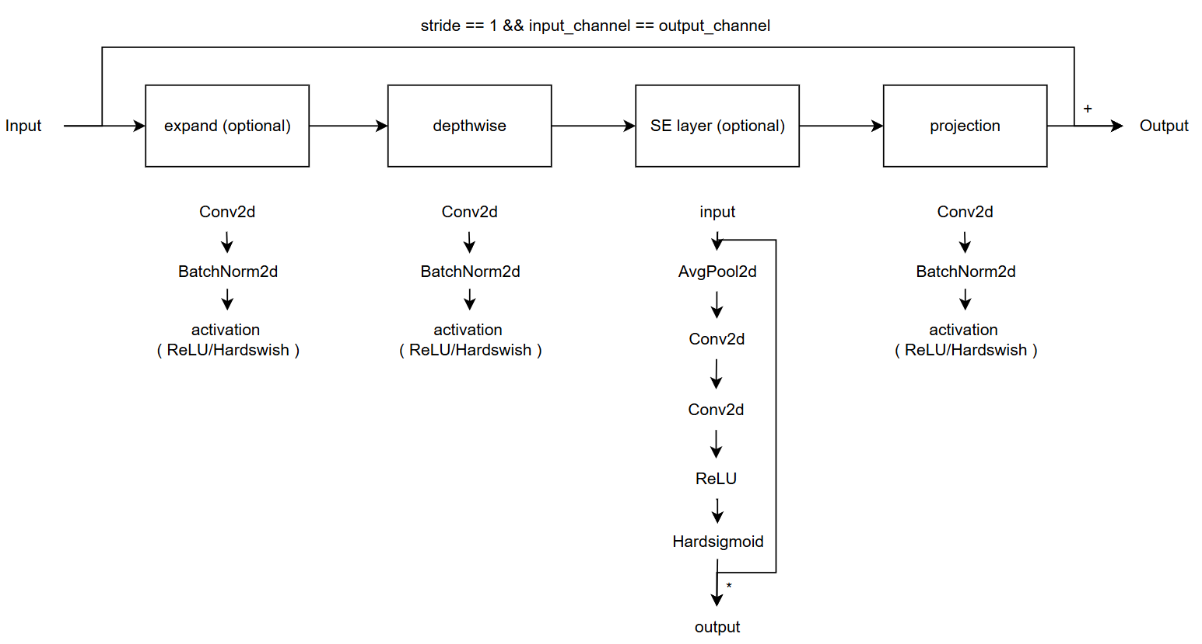
Modified V.S. Custom
Modified
( Only change part of torchvision model )
Custom
( Re-write the model with some mistake )
( Used in previous time )

Slide 4

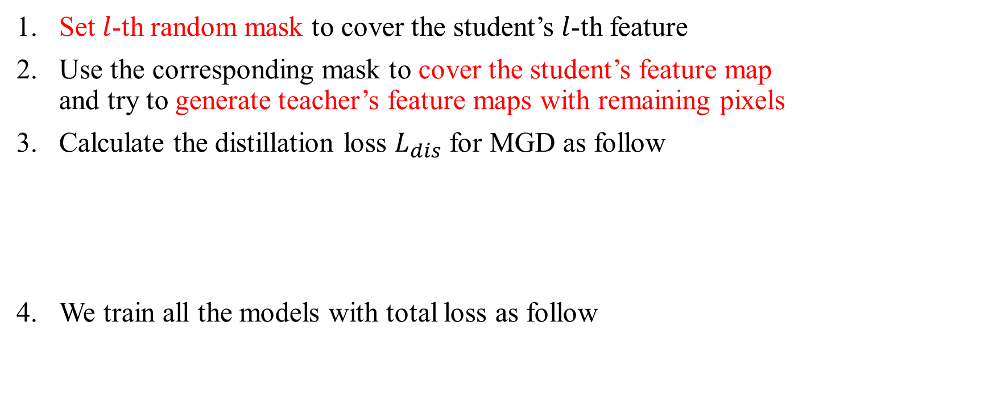
Recall – MGD Process
Set $l$-th random mask to cover the student’s $l$-th feature
Use the corresponding mask to cover the student’s feature map and try to generate teacher’s feature maps with remaining pixels
Calculate the distillation loss $L_{dis}$ for MGD as follow
We train all the models with total loss as follow

Slide 5
Train Setting (Baseline)
I5-10500 + 2080Ti
Random seed = 42
ABCD Dataset as training set (0.8 for training and 0.2 for validating)
Google Dataset as testing set
Modified MobileNet_V3_Large as teacher model
Modified MobileNet_V3_Small as student model

Slide 6
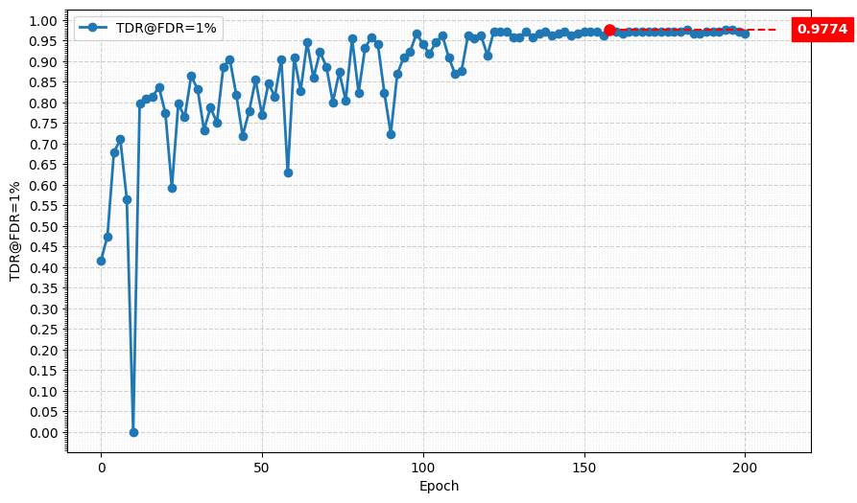
Metric Curve (TDR@FDR=1%)

Slide 7
Train Setting (1 layer)
I5-10500 + 2080Ti
Random seed = 42
SGD(weight_decay = 1e-4) + BCEWithLogitsLoss + CosineAnnealingLR
ABCD Dataset as training set (0.8 for training and 0.2 for validating)
Google Dataset as testing set
Modified MobileNet_V3_Large as teacher model
Modified MobileNet_V3_Small as student model

Slide 8
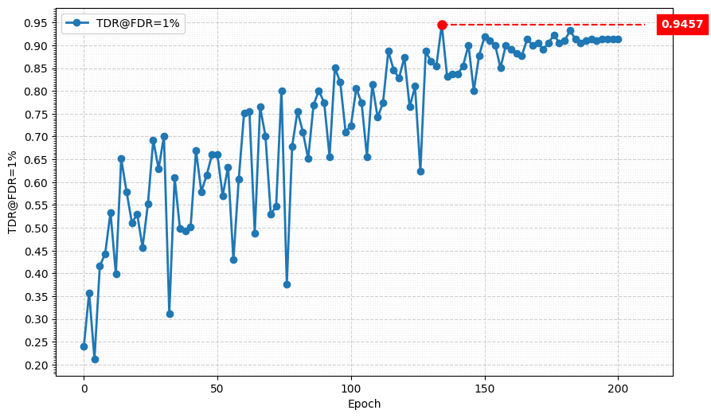
Metric Curve (TDR@FDR=1%)

Slide 9
Result Metric
Model | TDR@FDR=1% | ACE | APCER | BPCER | In Epoch
SPEC | ≥ 85.11% | < 3.489% | < 6.033% | < 0.956%
Custom MobileNet V3 Large, stride2[0] | 98.64% | 1.02% | 0.9% | 1.14% | 104
Modified MobileNet V3 Large, stride2[0] | 97.74% | 1.56% | 2.26% | 0.86% | 158
HLCFN3S | 94.57% | 3.10% | 5.43% | 0.76% | -
Custom MobileNet V3 Small, stride2[4] | 82.81% | 5.09% | 6.33% | 3.85% | 156
MGD 1 layer, Custom MobileNet V3 Large | 99.55% | 0.70% | 0.45% | 0.95% | 174
MGD 1layer, Modified MobileNet V3 Large | 94.57% | 2.73% | 4.07% | 1.38% | 134
MGD 1 layer, HLCFN3S | 91.40% | 3.63% | 4.98% | 2.28% | 228

