Slide 1
5/12 個人咪挺 The effect of custom layers

Slide 2
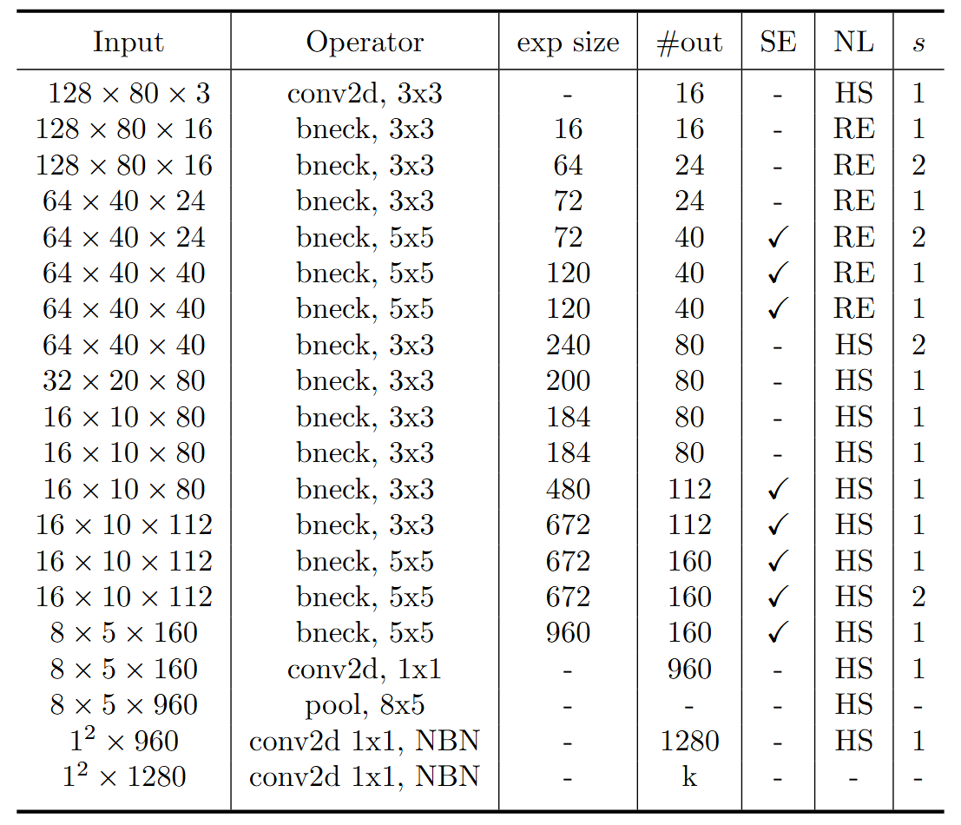
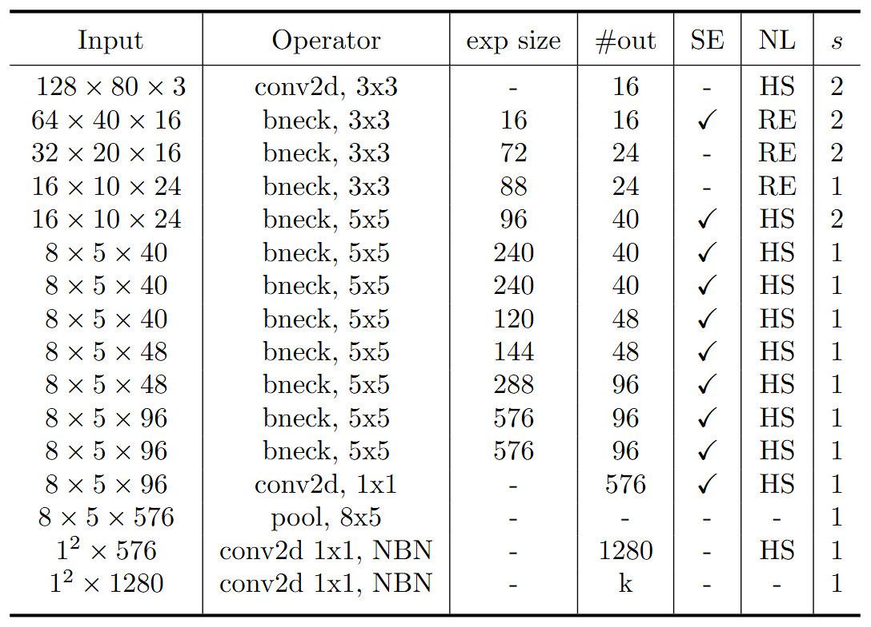
Model Structure
stride2[0]
stride2[1]
stride2[2]
stride2[3]
stride2[4]
MobileNet V3 Large
MobileNet V3 Small
Blue: Selected layer to do MGD-1layer

Slide 3
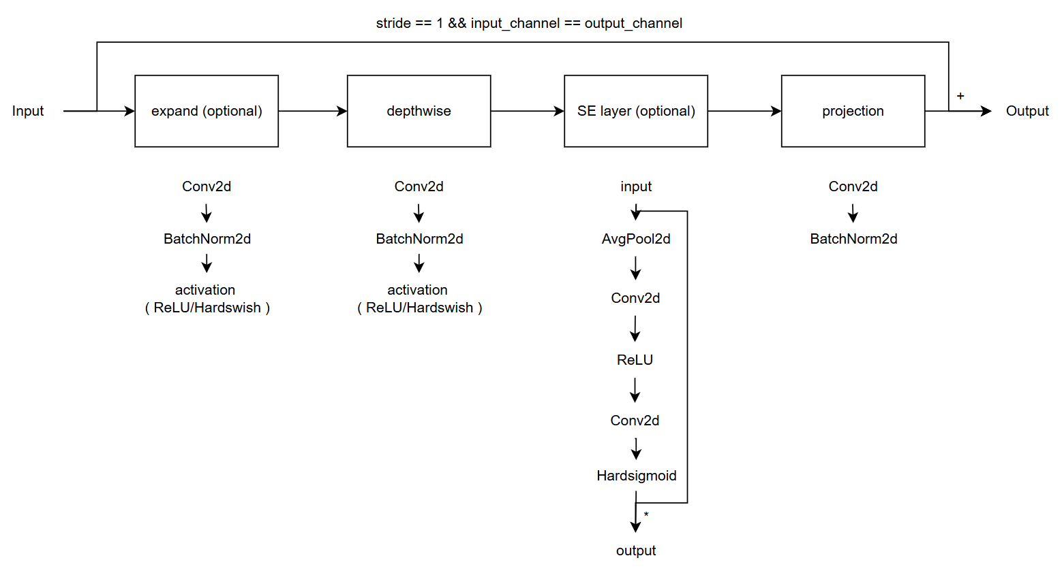
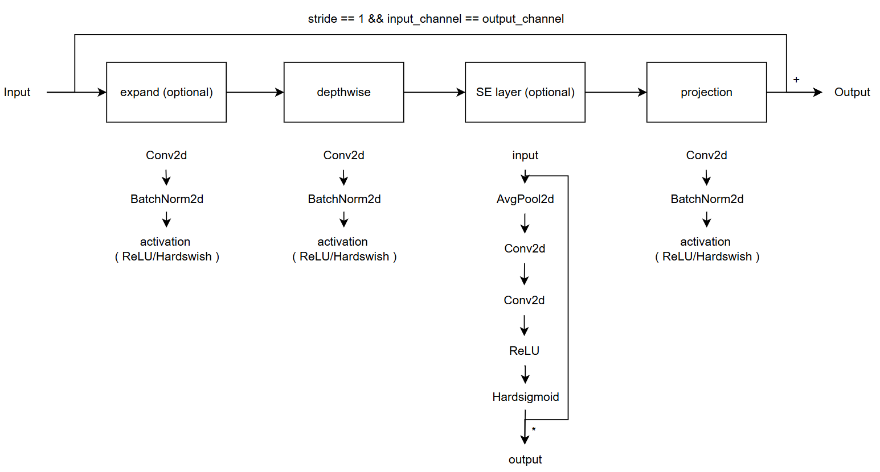
Modified V.S. Custom
Modified
( Only change part of torchvision model )
Custom
( Re-write the model with some mistake )
( Used in previous time )

Slide 4
Train Setting (Origin SE layer)
I5-10500 + 2080Ti
Random seed = 42
lr = 0.01
ABCD Dataset as training set (0.8 for training and 0.2 for validating)
Google Dataset as testing set
Modified MobileNet_V3_Large as teacher model
Modified MobileNet_V3_Small as student model

Slide 5
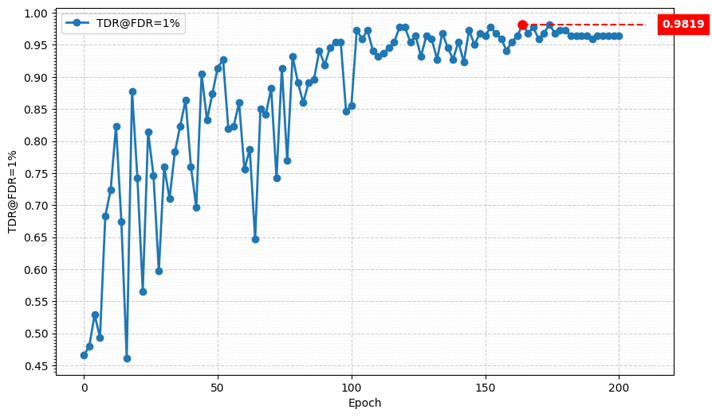
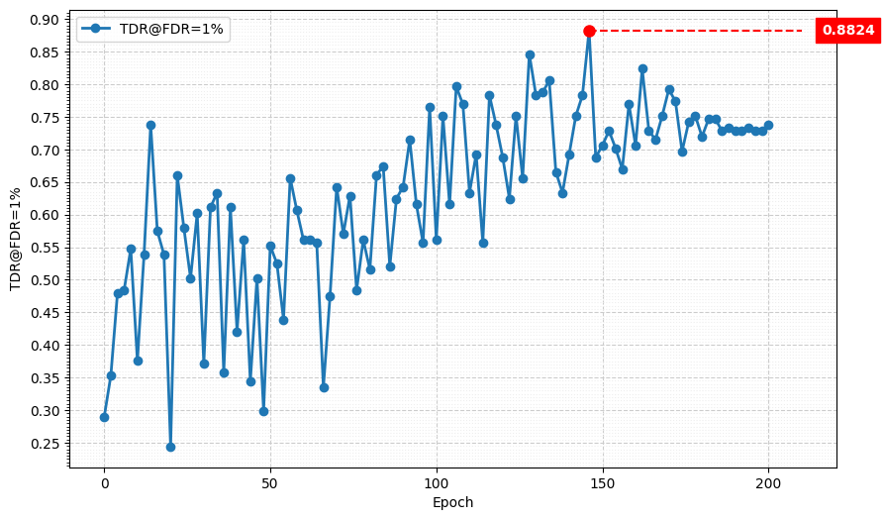
Metric Curve (TDR@FDR=1%)
Student
Teacher

Slide 6
Train Setting (Origin Projection layer)
I5-10500 + 2080Ti
Random seed = 42
lr = 0.01
ABCD Dataset as training set (0.8 for training and 0.2 for validating)
Google Dataset as testing set
Modified MobileNet_V3_Large as teacher model
Modified MobileNet_V3_Small as student model

Slide 7
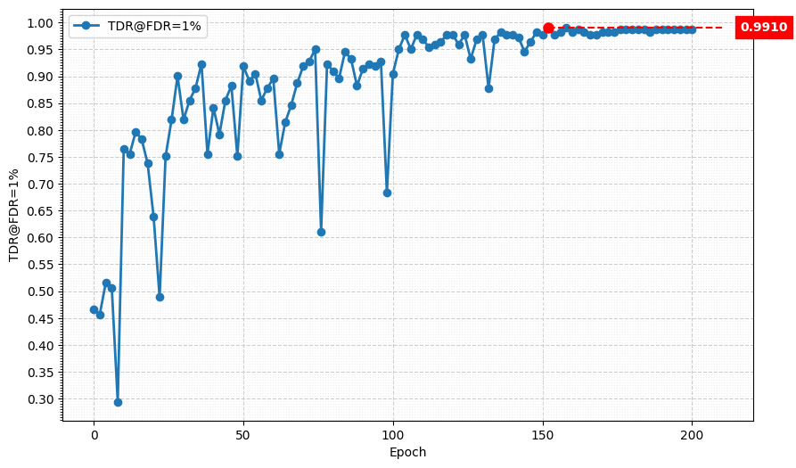
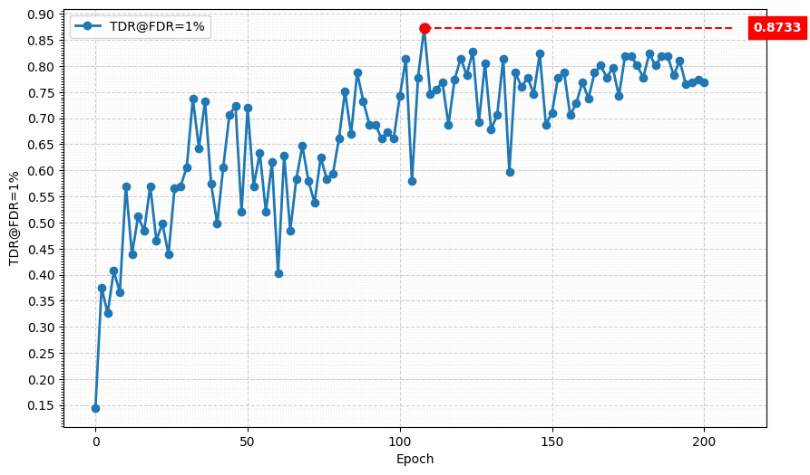
Metric Curve (TDR@FDR=1%)
Student
Teacher

Slide 8
Result Metric
Model | TDR@FDR=1% | ACE | APCER | BPCER | In Epoch
SPEC | ≥ 85.11% | < 3.489% | < 6.033% | < 0.956%
Modified MobileNet V3 Large, stride2[0] | 97.74% | 1.56% | 2.26% | 0.86% | 158
Custom MobileNet V3 Large, origin SE layer, stride2[0] | 98.19% | 1.29% | 1.81% | 0.76% | 164
Custom MobileNet V3 Large, origin projection layer, stride2[0] | 99.10% | 0.76% | 0.90% | 0.62% | 152
Custom MobileNet V3 Large, stride2[0] | 98.64% | 1.02% | 0.9% | 1.14% | 104
HLCFN3S | 94.57% | 3.10% | 5.43% | 0.76% | -
Modified MobileNet V3 Small, stride2[4] | 90.95% | 4.04% | 5.88% | 2.19% | 160
Custom MobileNet V3 Small w/ origin SE layer, stride2[4] | 88.24% | 4.87% | 6.79% | 2.95% | 146
Custom MobileNet V3 Small w/ origin projection layer, stride2[4] | 87.33% | 5.43% | 6.33% | 4.52% | 108
Custom MobileNet V3 Small, stride2[4] | 82.81% | 5.09% | 6.33% | 3.85% | 156
MGD 1layer, Custom MobileNet V3 Large | 99.55% | 0.70% | 0.45% | 0.95% | 174
MGD 1layer, Modified MobileNet V3 Large | 94.57% | 2.73% | 4.07% | 1.38% | 134
MGD 1 layer, HLCFN3S | 91.40% | 3.63% | 4.98% | 2.28% | 228

Slide 9
Effects of changed layer & Estimations
Effect
Changed SE forward weakens channel suppression and may preserve more information.
Extra projection activation breaks MobileNetV3’s linear bottleneck assumption. It adds non-linearity, which may help representation but can also distort residual features.
Estimation
Teacher benefits from the changed SE forward, suggesting that preserved channel information helps spoof/live classification. However, removing the extra projection activation gives the best performance.
Student relies more on effective channel suppression. Changed SE may preserve noisy channels, while extra activation may partially compensate for limited model capacity.

