Slide 1
5/20 團體咪挺 The effect of custom layers and KD results

Slide 2
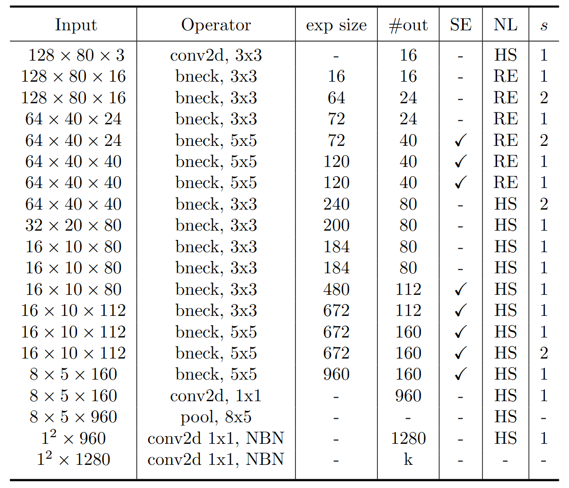
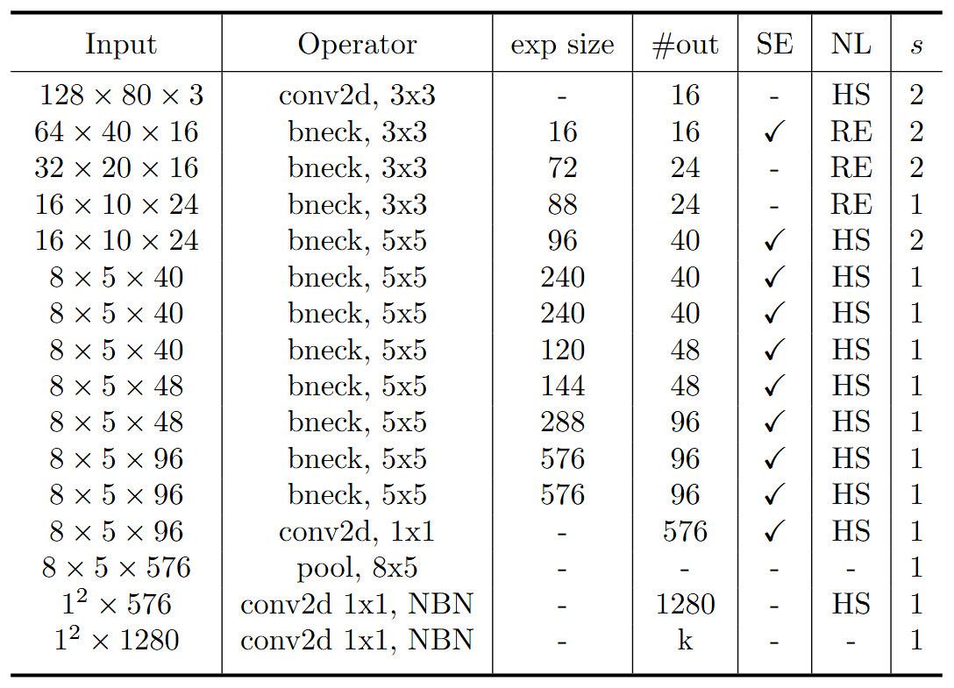
Modified MobileNet Model Structure
MobileNet V3 Large
MobileNet V3 Small
Blue: Selected layer to do MGD-1layer Red: The layer we modified stride number

Slide 3
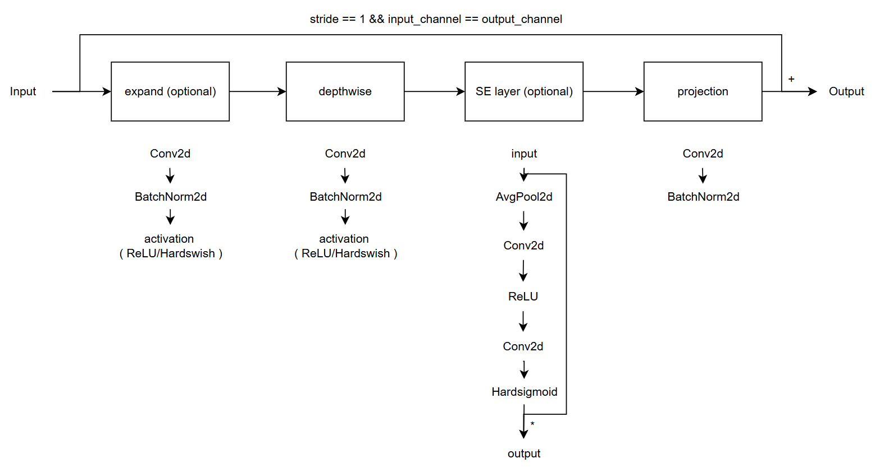
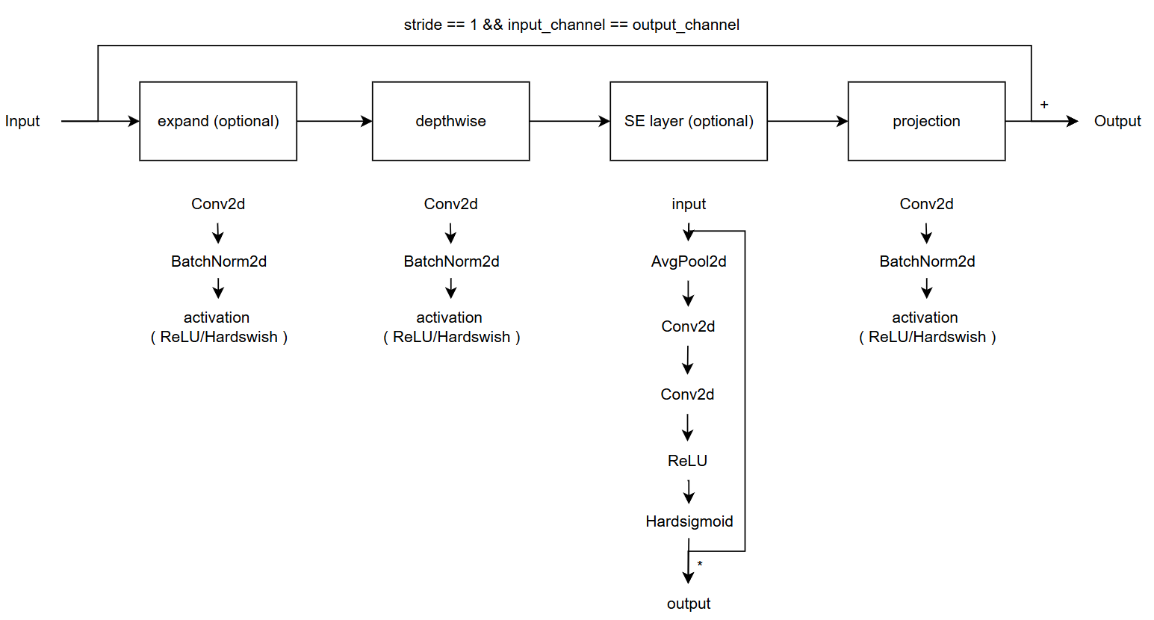
Modified vs. Custom Bneck Structure
Change the ordering of SE layer forward pass
Add an activation function in the end of projection
Modified
( Only change part of torchvision model )
Custom
( Re-write the model with some mistake )
( Used in previous time )

Slide 4
Current Model Type
Modified MobileNet V3
Custom MobileNet V3, change SE forward
Custom MobileNet V3, change projection
Custom MobileNet V3, change both

Slide 5
Train Setting
I5-10500 + 2080Ti
Random seed = 42
lr = 0.01
ABCD Dataset as training set (0.8 for training and 0.2 for validating)
Google Dataset as testing set

Slide 6
Result Metric
Model | TDR@FDR=1% | ACE | APCER | BPCER | In Epoch
SPEC | ≥ 85.11% | < 3.489% | < 6.033% | < 0.956%
Modified MobileNet V3 Large | 97.74% | 1.56% | 2.26% | 0.86% | 158
Custom MobileNet V3 Large, change projection | 98.19% | 1.29% | 1.81% | 0.76% | 164
Custom MobileNet V3 Large, change SE layer | 99.10% | 0.76% | 0.90% | 0.62% | 152
Custom MobileNet V3 Large, change both | 98.64% | 1.02% | 0.9% | 1.14% | 104
HLCFN3S | 94.57% | 3.10% | 5.43% | 0.76% | -
Modified MobileNet V3 Small | 90.95% | 4.04% | 5.88% | 2.19% | 160
Custom MobileNet V3 Small, change projection | 88.24% | 4.87% | 6.79% | 2.95% | 146
Custom MobileNet V3 Small, change SE layer | 87.33% | 5.43% | 6.33% | 4.52% | 108
Custom MobileNet V3 Small, change both | 82.81% | 5.09% | 6.33% | 3.85% | 156

Slide 7
Analysis effect of change SE layer
p1: 1st percentile of sorted output
p5: 5th percentile of sorted output
p95: 95th percentile of sorted output
p99: 99th percentile of sorted output
We register hooks on the first and last bneck blocks (bneck[0] and bneck[-1]) to analyze how modifying the SE layer's forward pass affects the output distribution.
Model & layer | p1 | p5 | p95 | p99 | mean | std | median | % < 0.5 | % within 0.5 ± 1e-6
No change, bneck[0] | 0.1486 | 0.2231 | 0.5473 | 0.5712 | 0.4561 | 0.0912 | 0.4861 | 66.25% | 0.01%
No change, bneck[-1] | 0.4868 | 0.4926 | 0.5063 | 0.5200 | 0.4996 | 0.0061 | 0.4997 | 57.92% | 0.33%
change, bneck[0] | 0.5 | 0.5 | 0.5592 | 0.6430 | 0.5145 | 0.0270 | 0.5020 | 0% | 44.84%
change, bneck[-1] | 0.5 | 0.5 | 0.5072 | 0.5327 | 0.5018 | 0.0071 | 0.5 | 0% | 51.16%
MobileNet V3 Large
Model & layer | p1 | p5 | p95 | p99 | mean | std | median | % < 0.5 | % within 0.5 ± 1e-6
No change, bneck[0] | 0.2682 | 0.3063 | 0.5717 | 0.6192 | 0.4386 | 0.0896 | 0.4187 | 67.23% | 0%
No change, bneck[-1] | 0.4937 | 0.4971 | 0.5032 | 0.5077 | 0.4999 | 0.0024 | 0.4999 | 57.35% | 0.73%
change, bneck[0] | 0.5 | 0.5 | 0.6738 | 0.7294 | 0.5514 | 0.0590 | 0.5367 | 0% | 38.05%
chnage, bneck[-1] | 0.5 | 0.5 | 0.5064 | 0.5162 | 0.5014 | 0.0051 | 0.5 | 0% | 51.32%
MobileNet V3 Small

Slide 8

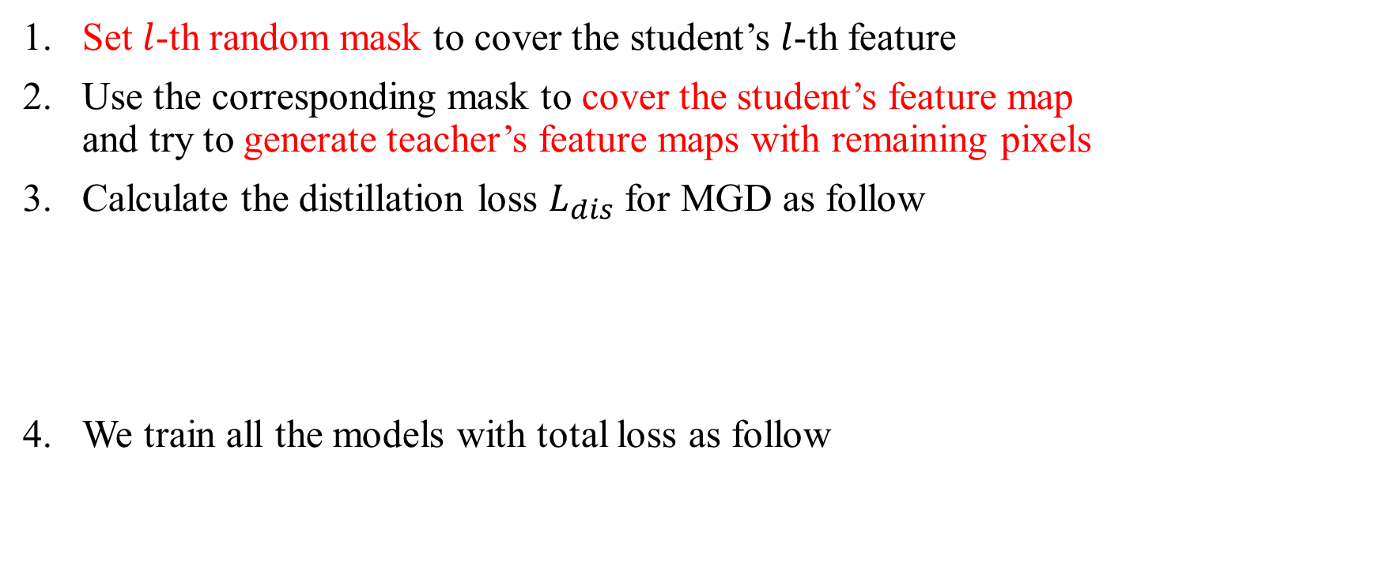
Recall – MGD Process
Set $l$-th random mask to cover the student’s $l$-th feature
Use the corresponding mask to cover the student’s feature map and try to generate teacher’s feature maps with remaining pixels
Calculate the distillation loss $L_{dis}$ for MGD as follow
We train all the models with total loss as follow

Slide 9
Train Setting
I5-10500 + 2080Ti
Random seed = 42
lr = 0.01, lambda_mgd = 0.15
ABCD Dataset as training set (0.8 for training and 0.2 for validating)
Google Dataset as testing set
Custom MobileNet_V3_Large, change SE layer as teacher model
Custom MobileNet_V3_Small, change SE layer as student model

Slide 10
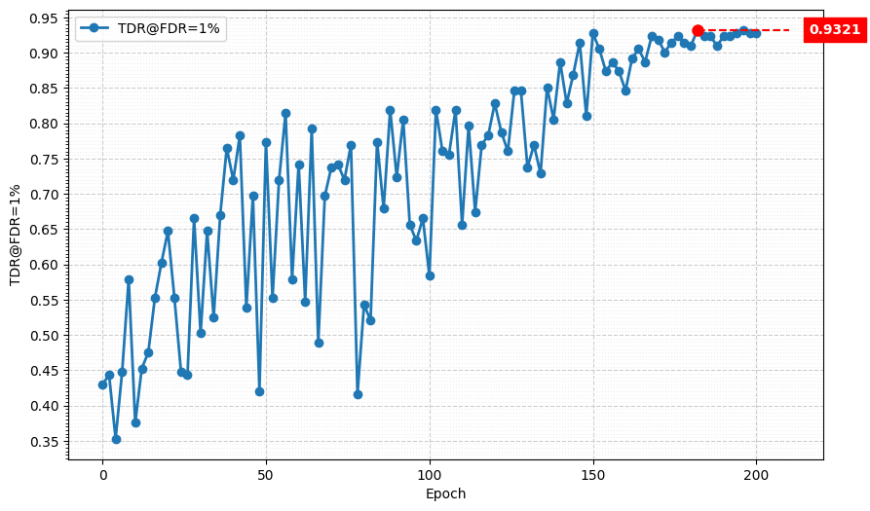
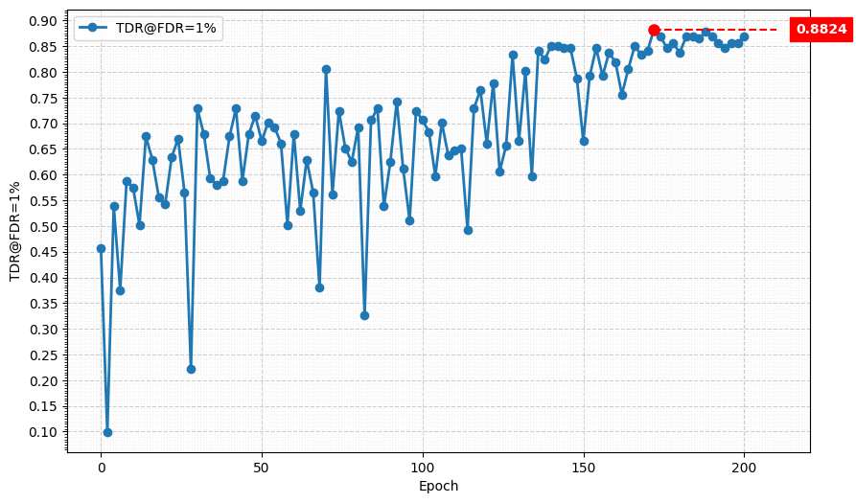
Metric Curve (TDR@FDR=1%)
alpha = 0.001
alpha = 0.01

Slide 11
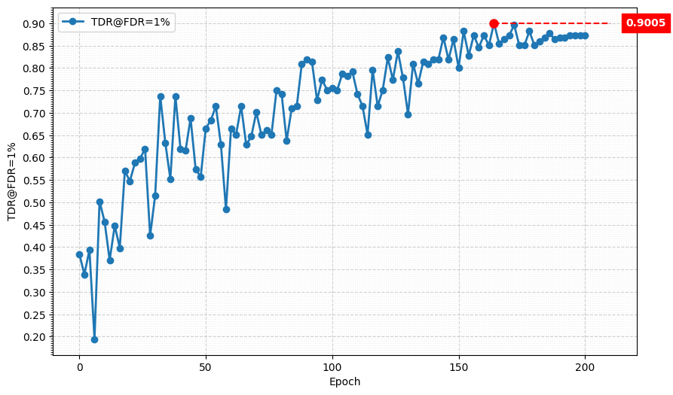
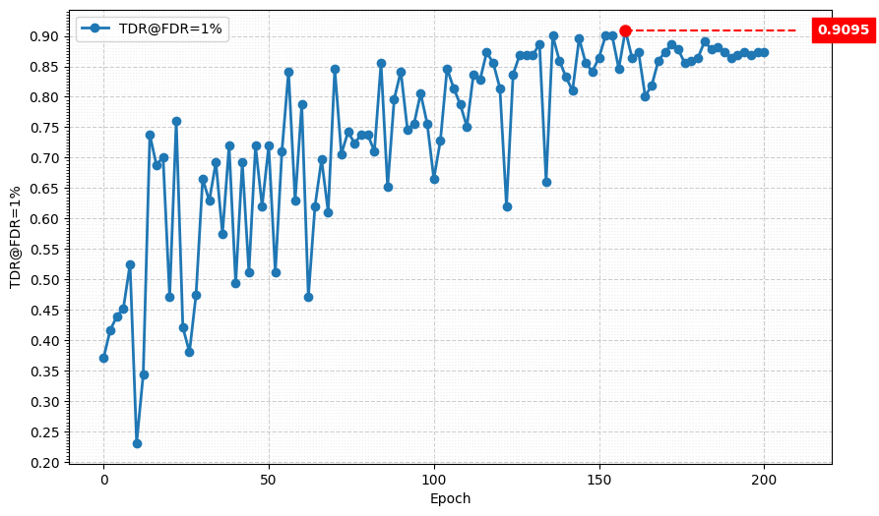
Metric Curve (TDR@FDR=1%)
alpha = 0.015
alpha = 0.005

Slide 12
Result Metric
Model | TDR@FDR=1% | ACE | APCER | BPCER | In Epoch
SPEC | ≥ 85.11% | < 3.489% | < 6.033% | < 0.956%
MGD 1layer, Custom MobileNet V3 Large | 99.55% | 0.70% | 0.45% | 0.95% | 174
MGD 1layer, Custom MobileNet V3 Large w/o extra activation function | 93.67% | 2.87% | 4.07% | 1.67% | 182

