Slide 1
5/27 個人咪挺 KD results

Slide 2
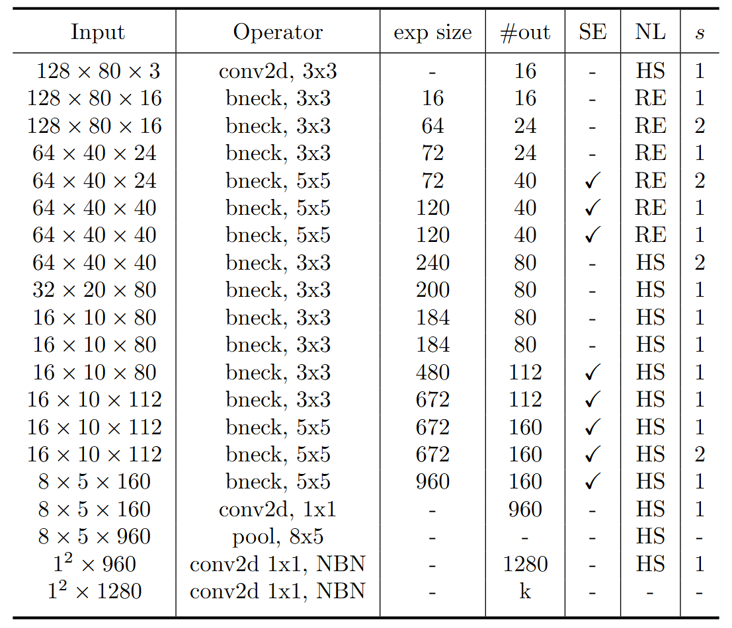
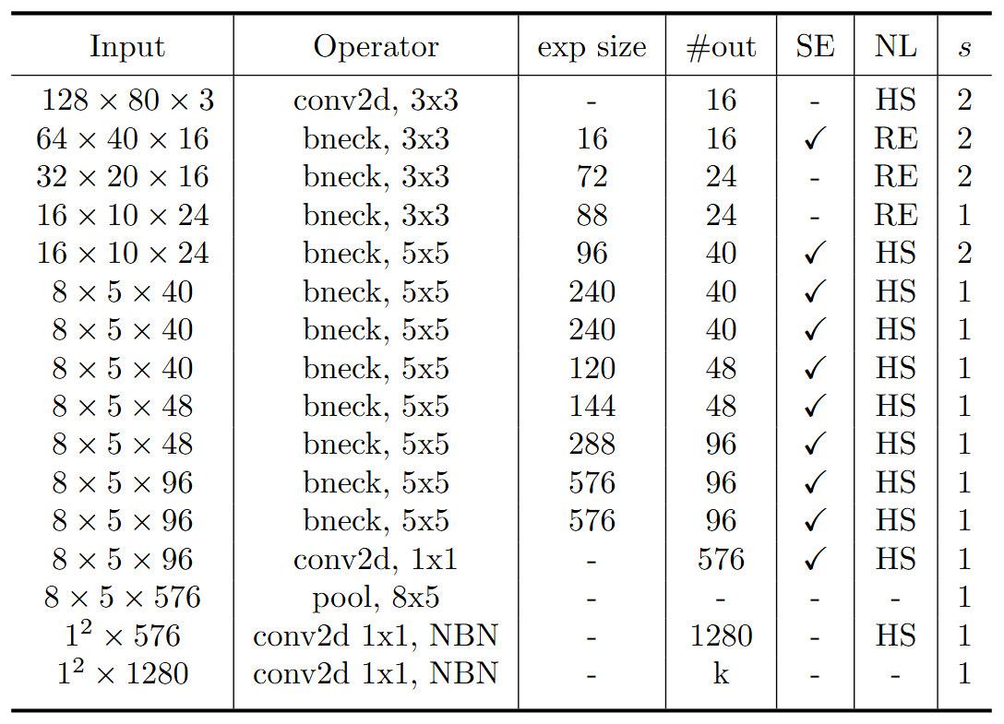
Modified MobileNet Model Structure
MobileNet V3 Large
MobileNet V3 Small
Blue: Selected layer to do MGD-1layer Red: The layer we modified stride number

Slide 3
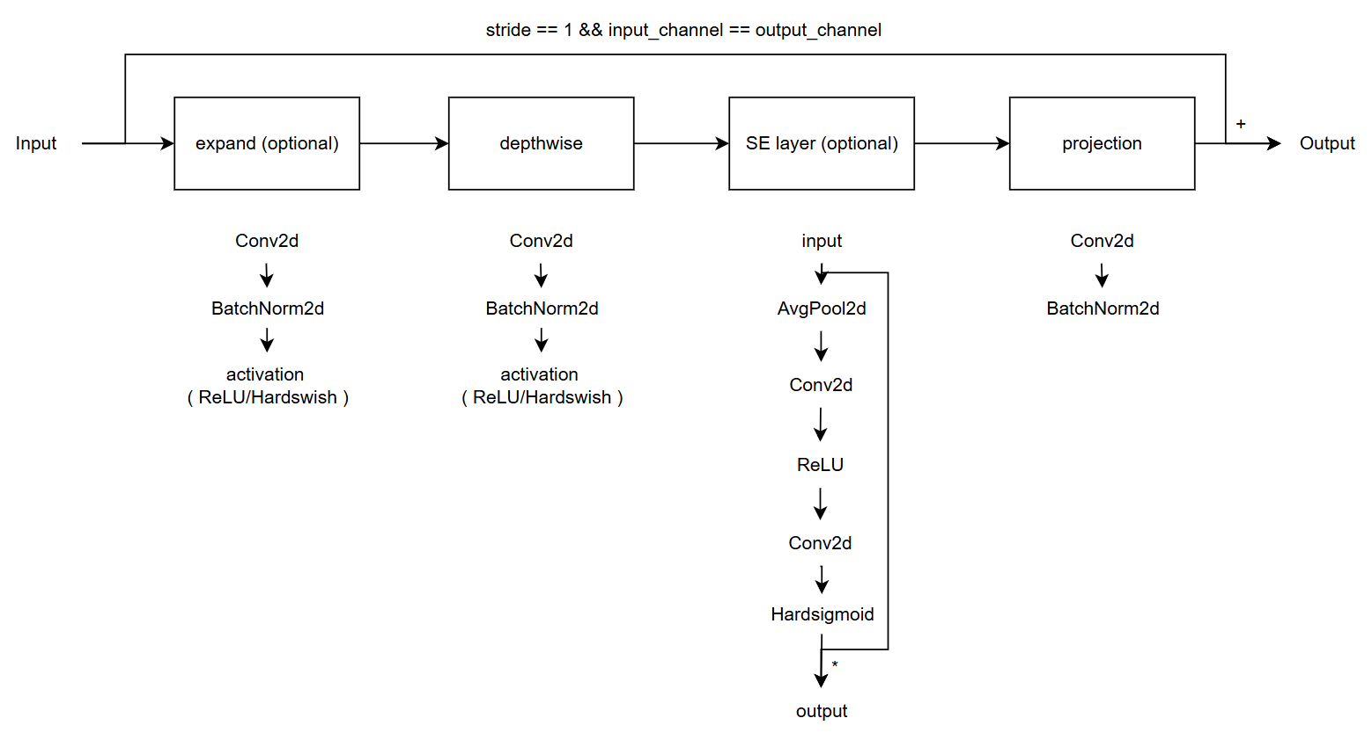
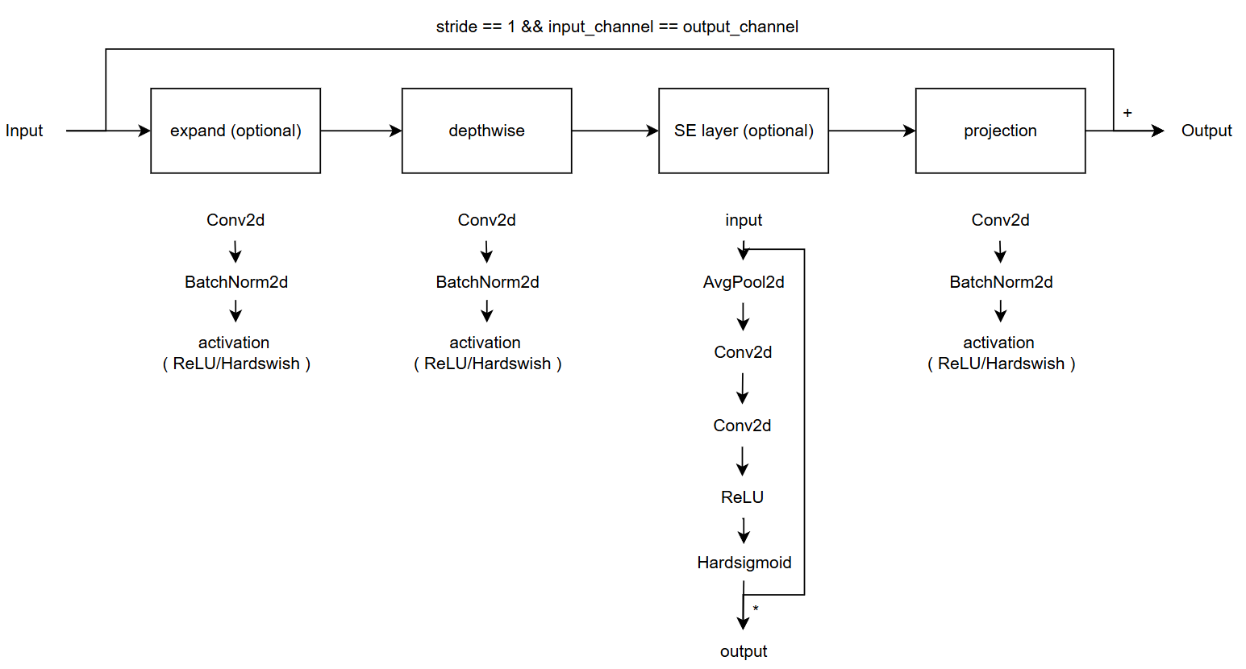
Modified vs. Custom Bneck Structure
Change the ordering of SE layer forward pass
Add an activation function in the end of projection
Modified
( Only change part of torchvision model )
Custom
( Re-write the model with some mistake )
( Used in previous time )

Slide 4
Current Model Type
Modified MobileNet V3
Custom MobileNet V3, change SE forward
Custom MobileNet V3, change projection
Custom MobileNet V3, change both

Slide 5

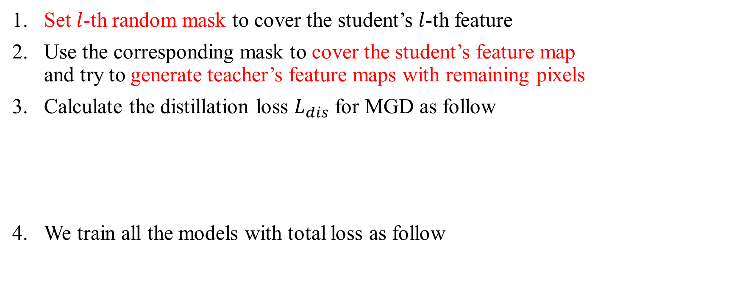
Recall – MGD Process
Set $l$-th random mask to cover the student’s $l$-th feature
Use the corresponding mask to cover the student’s feature map and try to generate teacher’s feature maps with remaining pixels
Calculate the distillation loss $L_{dis}$ for MGD as follow
We train all the models with total loss as follow

Slide 6
Train Setting
I5-10500 + 2080Ti
Random seed = 42
lr = 0.01, alpha = 0.01, lambda_mgd = 0.15
ABCD Dataset as training set (0.8 for training and 0.2 for validating)
Google Dataset as testing set
Custom MobileNet_V3_Large, change SE layer as teacher model
Custom MobileNet_V3_Small, change SE layer as student model

Slide 7
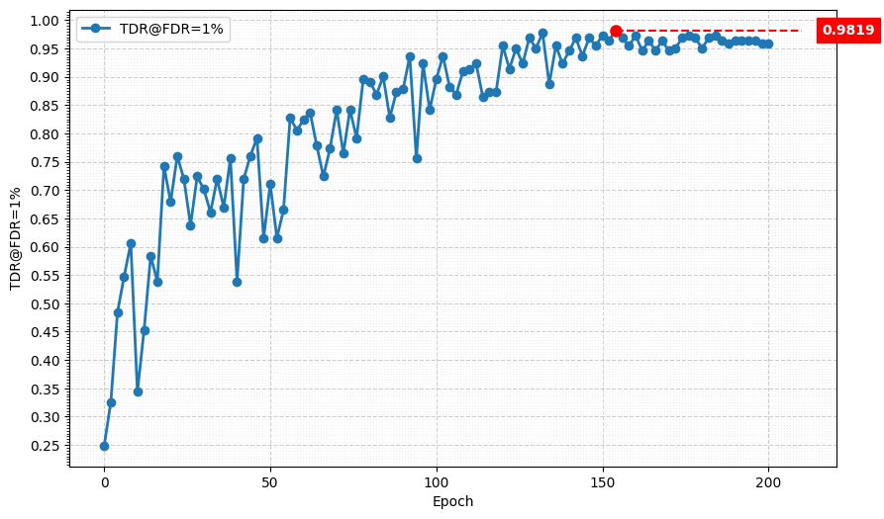
Metric Curve (TDR@FDR=1%)

Slide 8
Train Setting
I5-10500 + 2080Ti
Random seed = 42
lr = 0.01, alpha = 0.01, lambda_mgd = 0.15
ABCD Dataset as training set (0.8 for training and 0.2 for validating)
Google Dataset as testing set
Custom MobileNet_V3_Large, change SE layer as teacher model
Modified MobileNet_V3_Small, 4-stage downsampling as student model

Slide 9
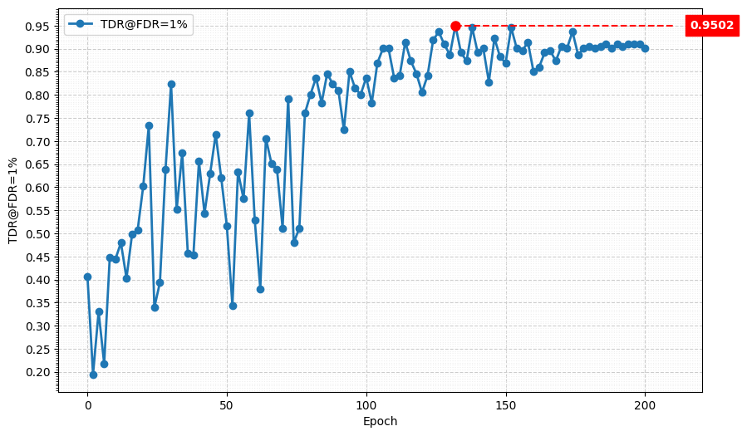
Metric Curve (TDR@FDR=1%)

Slide 10
Train Setting
I5-10500 + 2080Ti
Random seed = 42
lr = 0.01, alpha = 0.01, lambda_mgd = 0.15
ABCD Dataset as training set (0.8 for training and 0.2 for validating)
Google Dataset as testing set
Custom MobileNet_V3_Large, both as teacher model
Modified MobileNet_V3_Small, 4-stage downsampling as student model

Slide 11
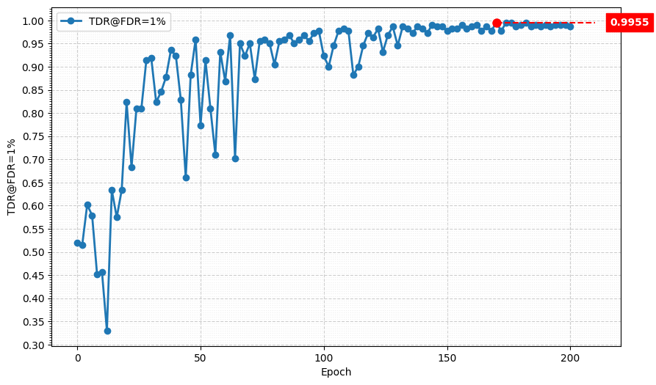
Metric Curve (TDR@FDR=1%)

Slide 12
Train Setting
I5-10500 + 2080Ti
Random seed = 42
lr = 0.01, alpha = 0.01, lambda_mgd = 0.15
ABCD Dataset as training set (0.8 for training and 0.2 for validating)
Google Dataset as testing set
Custom MobileNet_V3_Large, change SE layer as teacher model
Modified MobileNet_V3_Small, 5-stage downsampling as student model
Use bilinear interpolate to align the spacial size of student and teacher

Slide 13
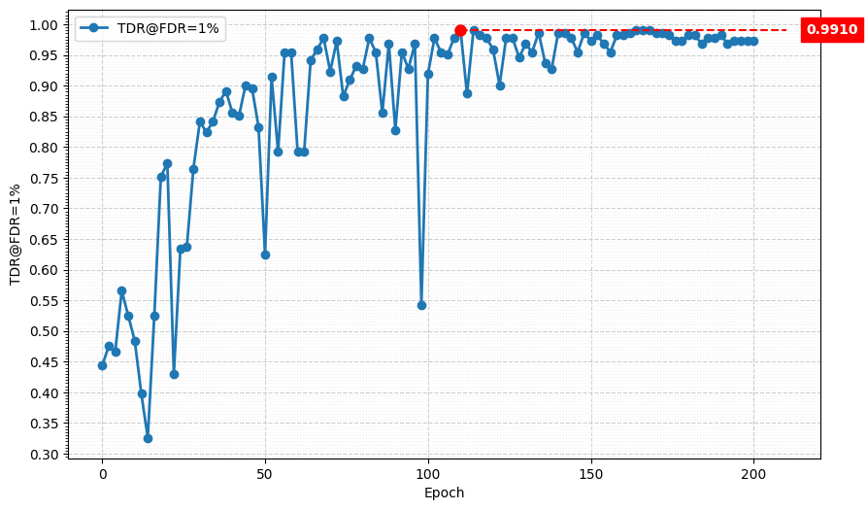
Metric Curve (TDR@FDR=1%)

Slide 14
Train Setting
I5-10500 + 2080Ti
Random seed = 42
lr = 0.01
ABCD Dataset as training set (0.8 for training and 0.2 for validating)
Google Dataset as testing set

Slide 15
Result Matrix
Model | Modified, 5-stage downsampling | Modified, 4-stage downsampling | Custom, change SE | Custom, change projection | Custom, change both
Size | 1.52 M | 1.52 M | 1.52 M | 1.52 M | 1.52 M
MAC | 13.76 M | 23.59 M | 23.6 M | 23.63 M | 23.63 M
Model | TDR@FDR=1% | ACE | APCER | BPCER | In Epoch
SPEC | ≥ 85.11% | < 3.489% | < 6.033% | < 0.956%
Custom MobileNet V3 Large, change SE layer | 99.10% | 0.76% | 0.90% | 0.62% | 152
Custom MobileNet V3 Large, change both | 98.64% | 1.02% | 0.9% | 1.14% | 104
Modified MobileNet V3 Small, 4-stage downsampling | 90.95% | 4.04% | 5.88% | 2.19% | 160
Custom MobileNet V3 Small, change SE layer | 87.33% | 5.43% | 6.33% | 4.52% | 108
MGD 1 layer Custom MobileNet V3 Large, change SE layer Custom MobileNet V3 Small, change SE layer | 98.19% | 1.23% | 1.36% | 1.09% | 154
MGD 1 layer Custom MobileNet V3 Large, change SE layer Modified MobileNet V3 Small, 4-stage downsampling | 99.55% | 0.51% | 0.45% | 0.57% | 174
MGD 1 layer Custom MobileNet V3 Large, change both Modified MobileNet V3 Small, 4-stage downsampling | 95.02% | 2.42% | 2.26% | 2.57% | 132
MGD 1 layer Custom MobileNet V3 Large, change both Modified MobileNet V3 Small, 5-stage downsampling | 99.10% | 0.74% | 0.90% | 0.57% | 110

Slide 16
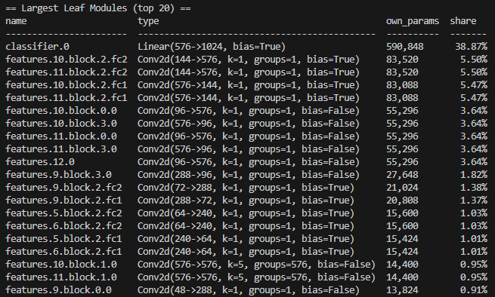
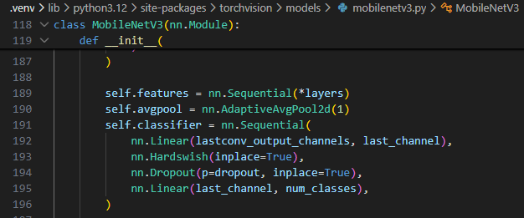
Next
Reduce the hidden dimension of classifier

