Slide 1
6/2 個人咪挺 Results of different hidden dimension of classifier

Slide 2
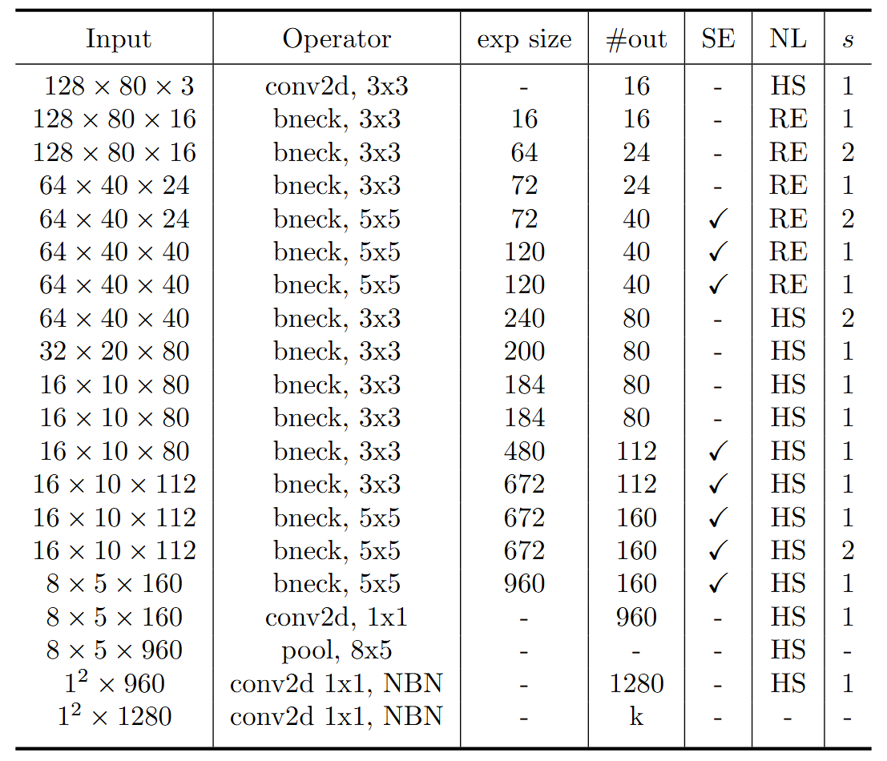
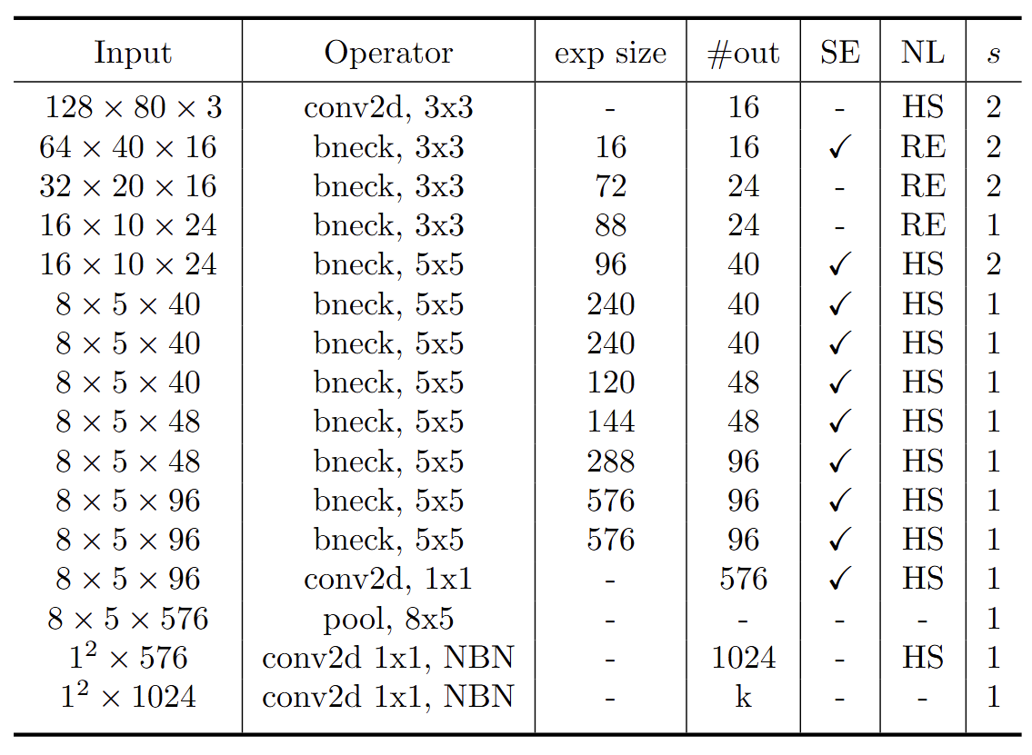
Modified MobileNet Model Structure
MobileNet V3 Large
MobileNet V3 Small
Blue: Selected layer to do MGD-1layer Red: The layer we modified stride number

Slide 3
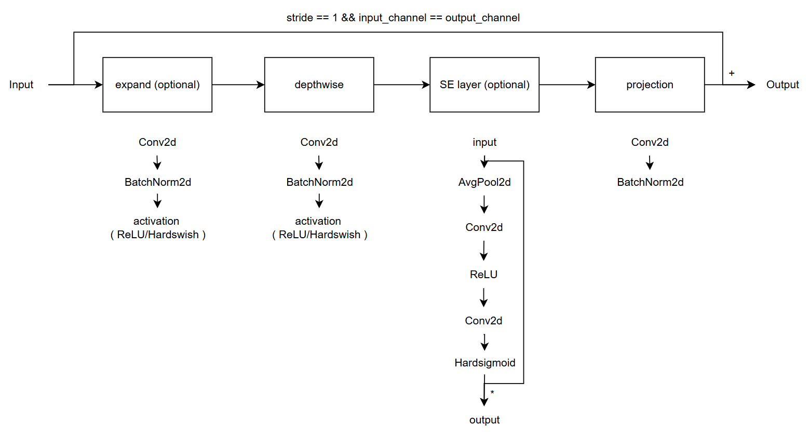
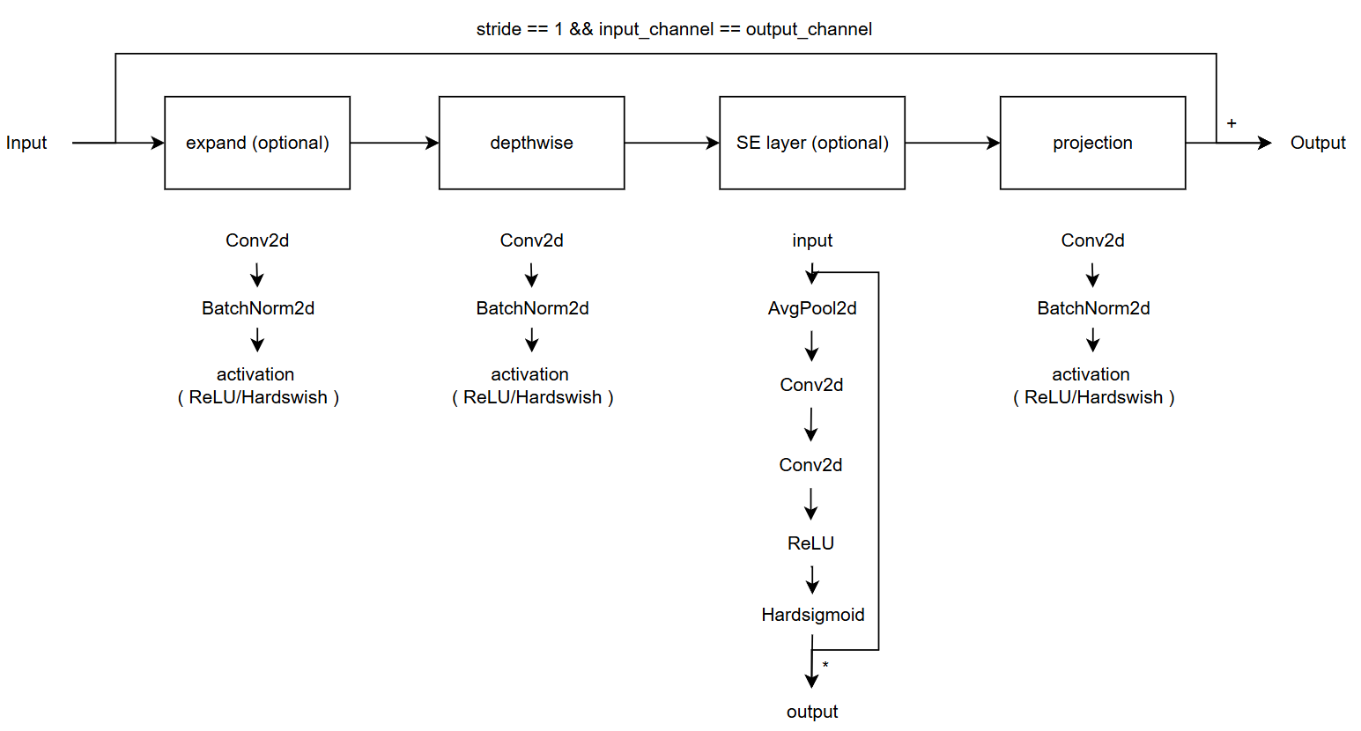
Modified vs. Custom Bneck Structure
Change the ordering of SE layer forward pass
Add an activation function in the end of projection
Modified
( Only change part of torchvision model )
Custom
( Re-write the model with some mistake )
( Used in previous time )

Slide 4
Current Model Type
Modified MobileNet V3
Custom MobileNet V3, change SE forward
Custom MobileNet V3, change projection
Custom MobileNet V3, change both

Slide 5
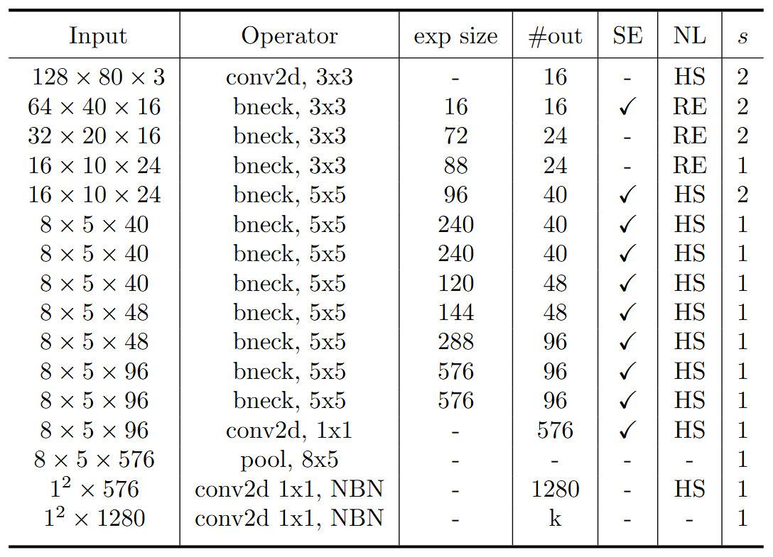
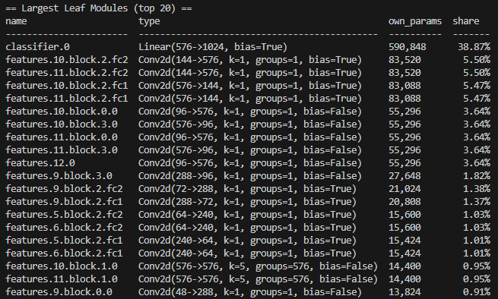
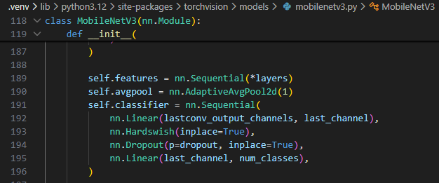
Reason of changing hidden dimension

Slide 6

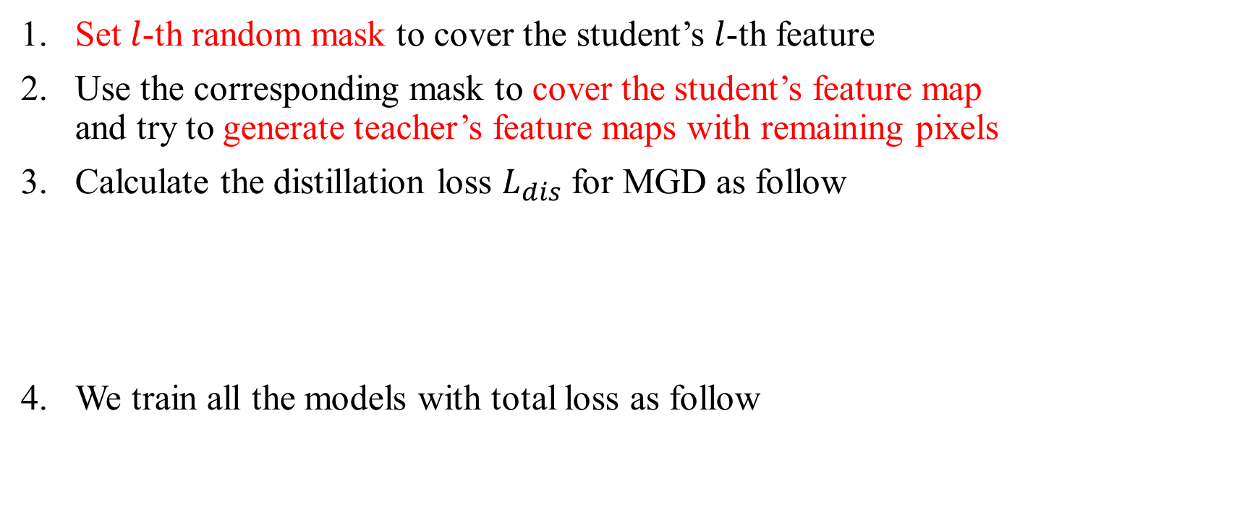
Recall – MGD Process
Set $l$-th random mask to cover the student’s $l$-th feature
Use the corresponding mask to cover the student’s feature map and try to generate teacher’s feature maps with remaining pixels
Calculate the distillation loss $L_{dis}$ for MGD as follow
We train all the models with total loss as follow

Slide 7
Train Setting I.
I5-10500 + 2080Ti
Random seed = 42
lr = 0.01 for baseline
lr = 0.01, alpha = 0.01, lambda_mgd = 0.15 for KD
Hidden dimension = 512
ABCD Dataset as training set (0.8 for training and 0.2 for validating)
Google Dataset as testing set
Custom MobileNet_V3_Large, change SE layer as teacher model
Modified MobileNet_V3_Small as student model

Slide 8
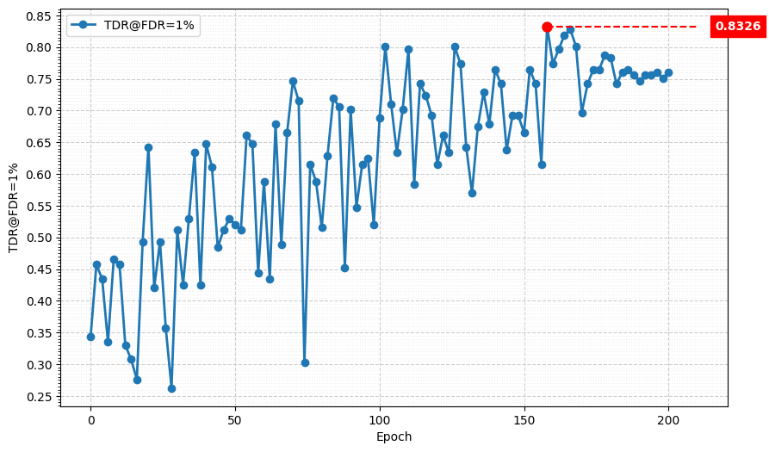
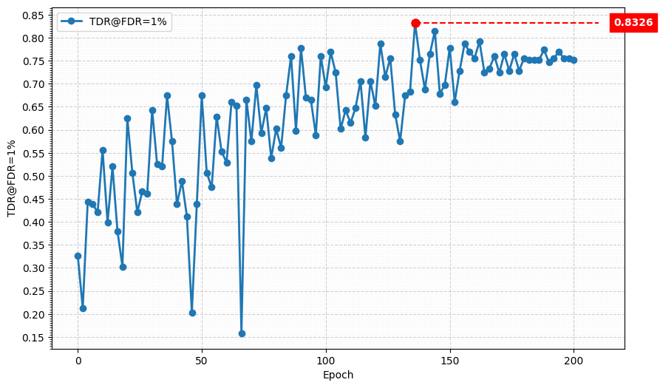
Metric Curve (TDR@FDR=1%, baseline)
Model | TDR@FDR=1% | ACE | APCER | BPCER | In Epoch
4-stage downsampling | 83.26% | 6.81% | 8.14% | 5.47% | 158
Model | TDR@FDR=1% | ACE | APCER | BPCER | In Epoch
5-stage downsampling | 83.26% | 4.57% | 3.62% | 5.52% | 134

Slide 9
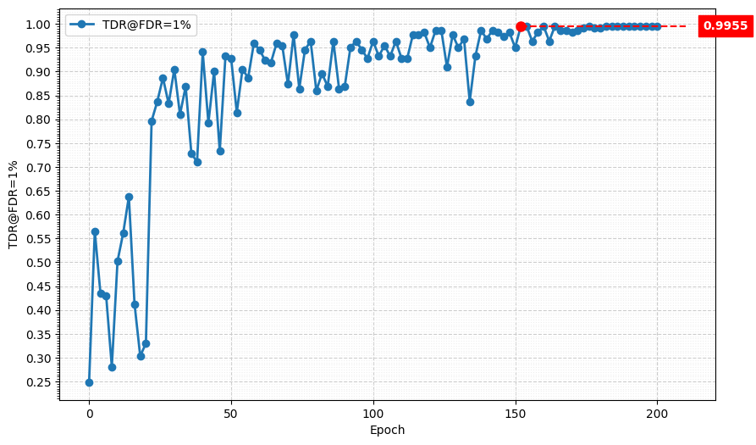
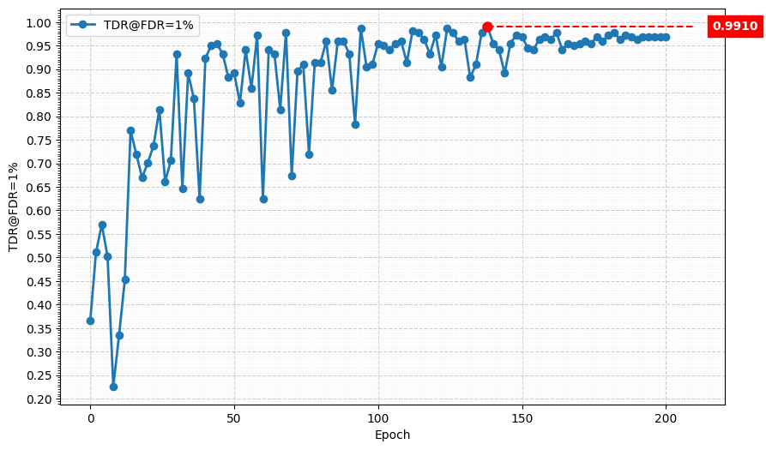
Metric Curve (TDR@FDR=1%, KD)
Model | TDR@FDR=1% | ACE | APCER | BPCER | In Epoch
Baseline, 4-stage | 83.26% | 6.81% | 8.14% | 5.47% | 158
KD, 4-stage | 99.55% | 0.56% | 0.45% | 0.67% | 176
Model | TDR@FDR=1% | ACE | APCER | BPCER | In Epoch
Baseline, 5-stage | 83.26% | 4.57% | 3.62% | 5.52% | 134
KD, 5-stage | 99.10% | 0.75% | 0.45% | 1.05% | 138

Slide 10
Train Setting II.
I5-10500 + 2080Ti
Random seed = 42
lr = 0.01 for baseline
lr = 0.01, alpha = 0.01, lambda_mgd = 0.15 for KD
Hidden dimension = 256
ABCD Dataset as training set (0.8 for training and 0.2 for validating)
Google Dataset as testing set
Custom MobileNet_V3_Large, change SE layer as teacher model
Modified MobileNet_V3_Small as student model

Slide 11
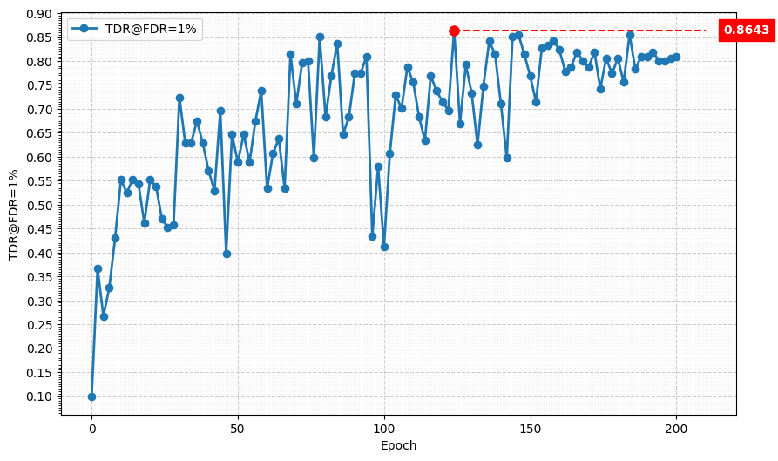
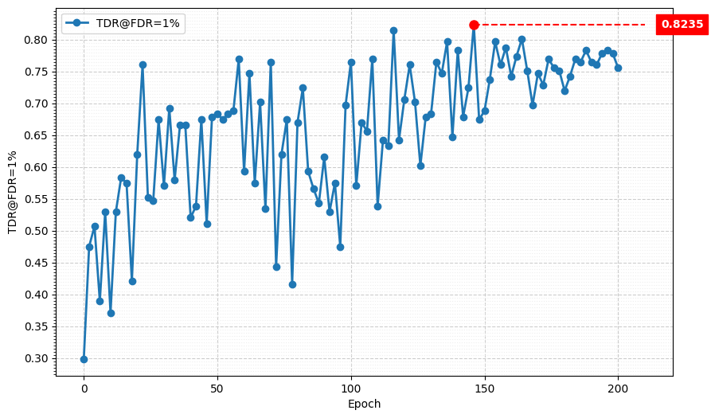
Metric Curve (TDR@FDR=1%)
Model | TDR@FDR=1% | ACE | APCER | BPCER | In Epoch
4-stage downsampling | 86.43% | 5.88% | 4.52% | 7.23% | 124
Model | TDR@FDR=1% | ACE | APCER | BPCER | In Epoch
5-stage downsampling | 82.35% | 4.97% | 5.43% | 4.52% | 146

Slide 12
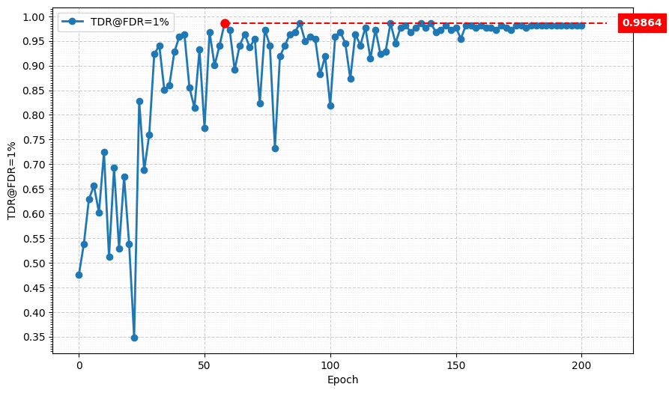
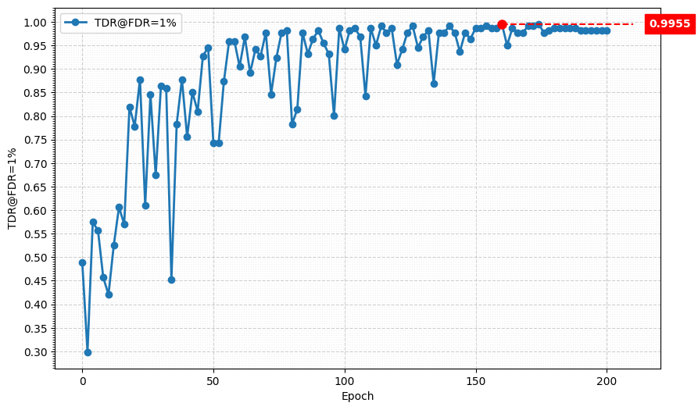
Metric Curve (TDR@FDR=1%)
Model | TDR@FDR=1% | ACE | APCER | BPCER | In Epoch
Baseline, 4-stage | 86.43% | 5.88% | 4.52% | 7.23% | 124
KD, 4-stage | 98.64% | 1.14% | 1.81% | 0.48% | 88
Model | TDR@FDR=1% | ACE | APCER | BPCER | In Epoch
Baseline, 5-stage | 82.35% | 4.97% | 5.43% | 4.52% | 146
KD, 5-stage I | 99.55% | 0.64% | 0.00% | 1.28 % | 160
KD, 5-stage II | 99.55% | 0.70% | 0.45% | 0.95% | 174

Slide 13
Result Matrix
Model | 4-stage, hd = 1024 | 5-stage, hd = 1024 | 4-stage, hd = 512 | 5-stage, hd = 512 | 4-stage, hd = 256 | 5-stage, hd = 256 | 4-stage, hd = 128 | 5-stage, hd = 128
# params | 1.52 M | 1.52 M | 1.22 M (-19.7%) | 1.22 M (-19.7%) | 1.08 M (-28.9%) | 1.08 M (-28.9%) | 1 M (-34.2%) | 1 M (-34.2%)
MAC | 23.59 M | 13.76 M | 23.3 M (-1.2%) | 13.47 M (-2.1%) | 23.15 M (-1.9%) | 13.32 M (-3.2%) | 23.08 M (-2.2%) | 13.25 M (-3.7%)
Model | TDR@FDR=1% | ACE | APCER | BPCER | In Epoch
SPEC | ≥ 85.11% | < 3.489% | < 6.033% | < 0.956%
Custom MobileNet V3 Large, change SE layer | 99.10% | 0.76% | 0.90% | 0.62% | 152
Modified MobileNet V3 Small, 4-stage downsampling | 90.95% | 4.04% | 5.88% | 2.19% | 160
MGD 1 layer Custom MobileNet V3 Large, change SE layer Modified MobileNet V3 Small, 4-stage downsampling, hd = 1024 | 99.55% | 0.51% | 0.45% | 0.57% | 174
MGD 1 layer Custom MobileNet V3 Large, change both Modified MobileNet V3 Small, 5-stage downsampling, hd = 1024 | 99.10% | 0.74% | 0.90% | 0.57% | 110
MGD 1 layer Custom MobileNet V3 Large, change SE layer Modified MobileNet V3 Small, 4-stage downsampling, hd = 512 | 99.55% | 0.56% | 0.45% | 0.67% | 176
MGD 1 layer Custom MobileNet V3 Large, change SE layer Modified MobileNet V3 Small, 5-stage downsampling, hd = 256 | 99.55% | 0.70% | 0.45% | 0.95% | 174

