Slide 1
6/10 個人咪挺 Results of different hidden dimension of classifier

Slide 2
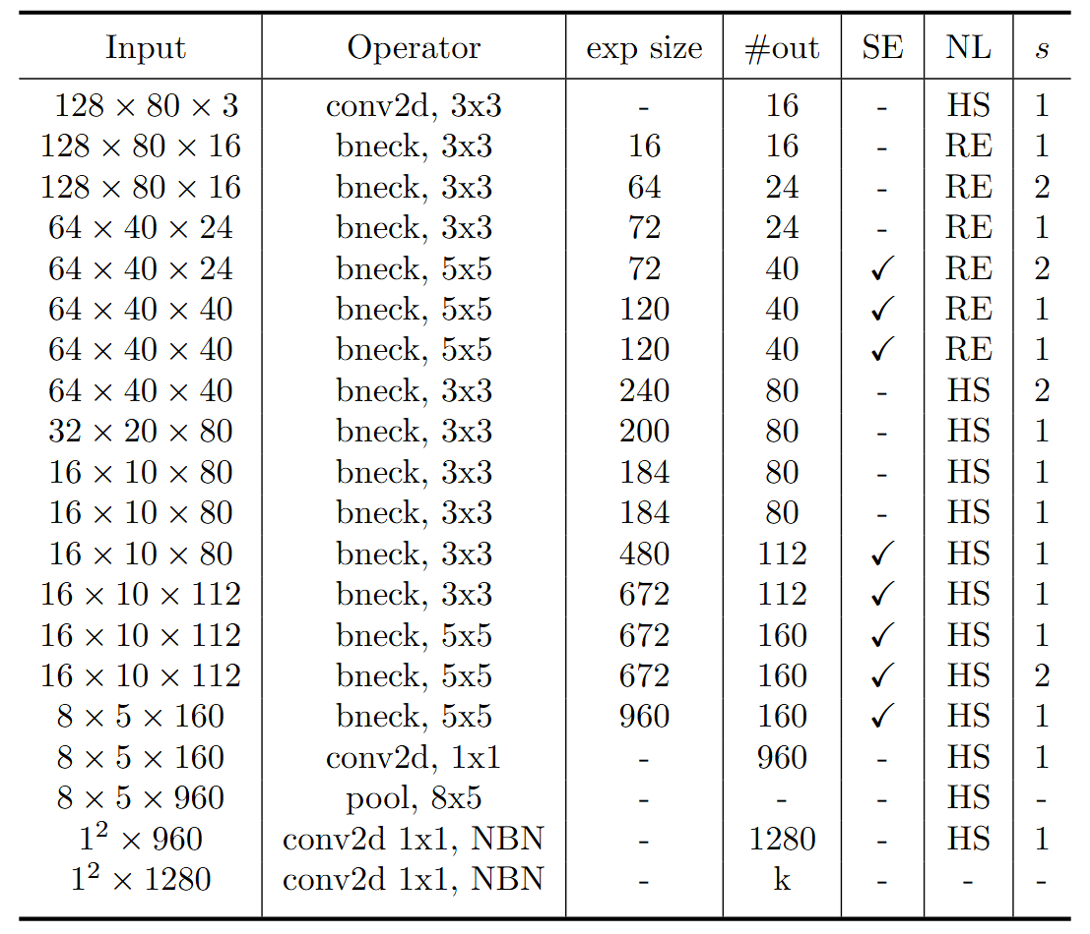
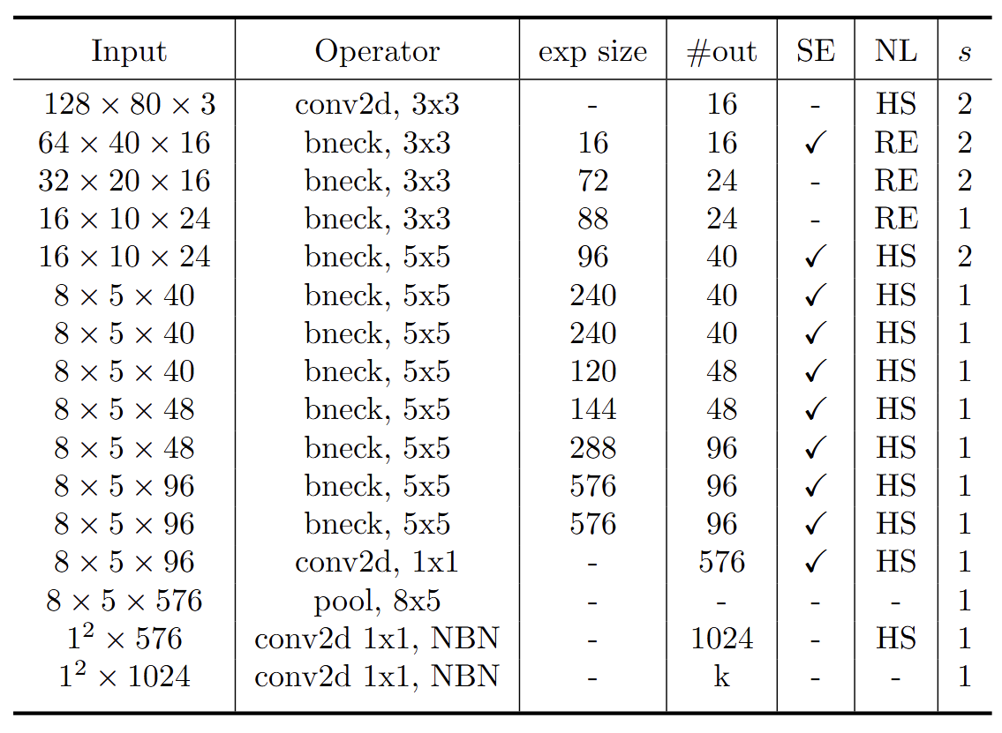
Modified MobileNet Model Structure
MobileNet V3 Large
MobileNet V3 Small
Blue: Selected layer to do MGD-1layer Red: The layer we modified stride number

Slide 3
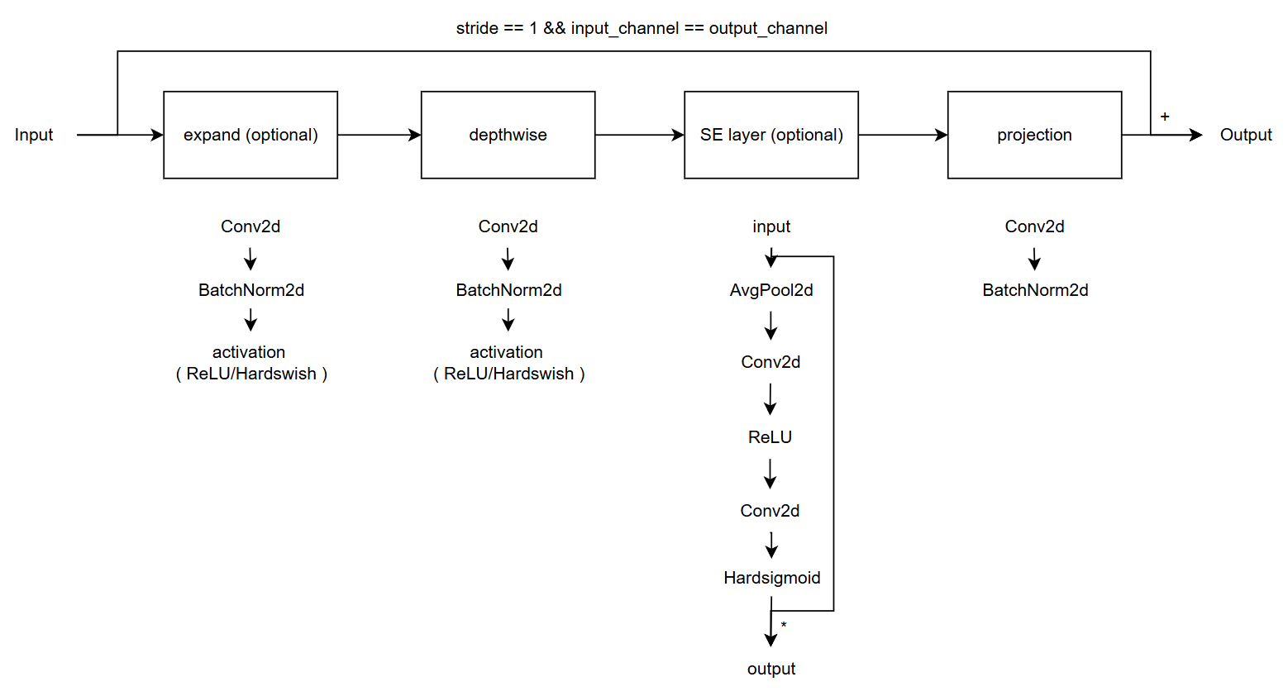
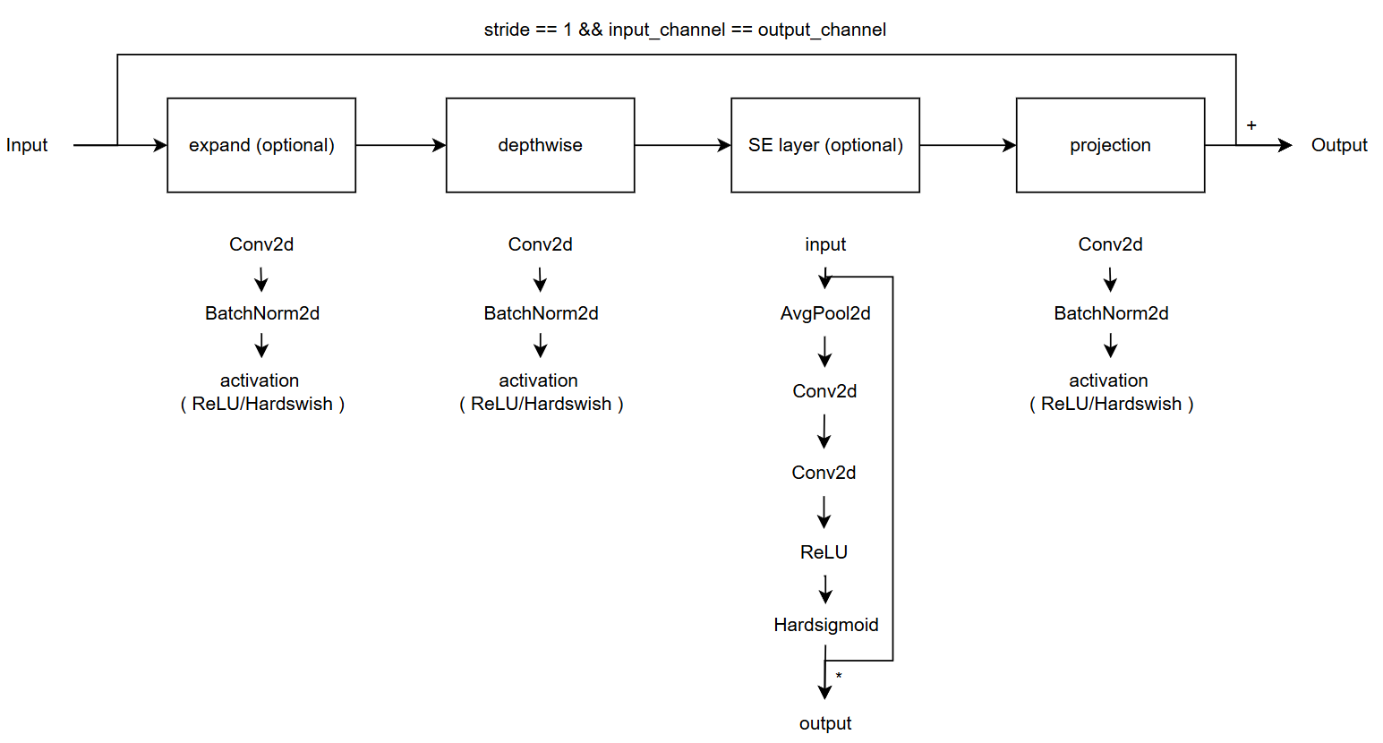
Modified vs. Custom Bneck Structure
Change the ordering of SE layer forward pass
Add an activation function in the end of projection
Modified
( Only change part of torchvision model )
Custom
( Re-write the model with some mistake )
( Used in previous time )

Slide 4
Current Model Type
Modified MobileNet V3
Custom MobileNet V3, change SE forward
Custom MobileNet V3, change projection
Custom MobileNet V3, change both

Slide 5
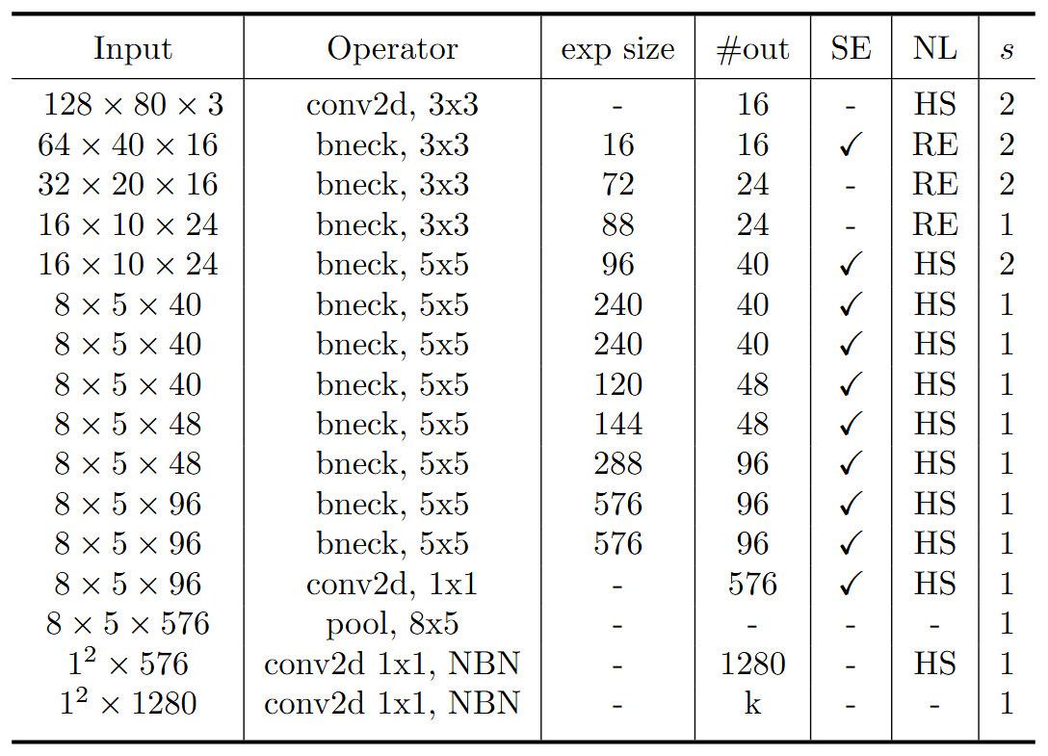
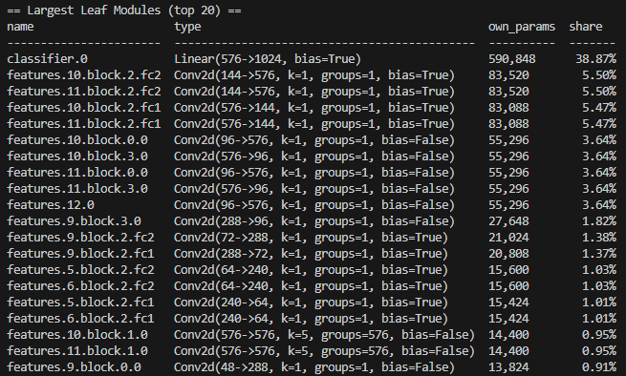
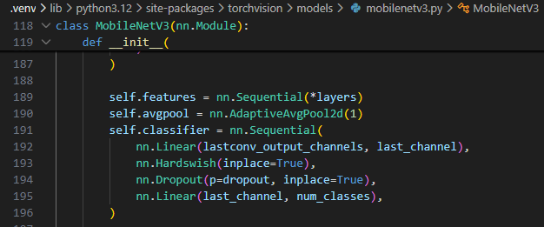
Reason of changing hidden dimension

Slide 6

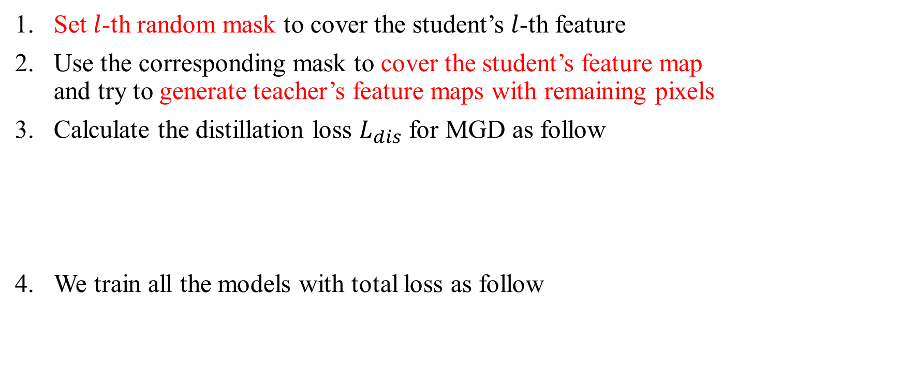
Recall – MGD Process
Set $l$-th random mask to cover the student’s $l$-th feature
Use the corresponding mask to cover the student’s feature map and try to generate teacher’s feature maps with remaining pixels
Calculate the distillation loss $L_{dis}$ for MGD as follow
We train all the models with total loss as follow

Slide 7
Train Setting I.
I5-10500 + 2080Ti
Random seed = 42
lr = 0.01 for baseline
lr = 0.01, alpha = 0.01, lambda_mgd = 0.15 for KD
Hidden dimension = 128
ABCD Dataset as training set (0.8 for training and 0.2 for validating)
Google Dataset as testing set
Custom MobileNet_V3_Large, change both as teacher model
Modified MobileNet_V3_Small as student model

Slide 8
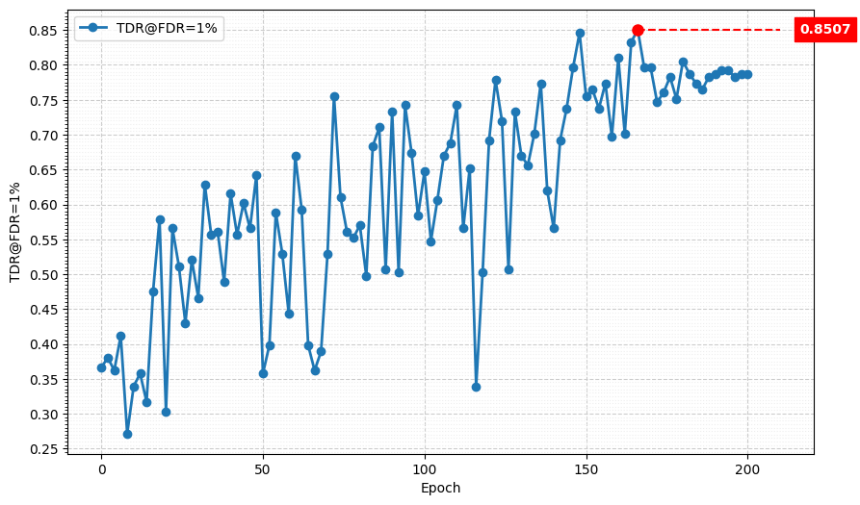
Metric Curve (TDR@FDR=1%, baseline)
Model | TDR@FDR=1% | ACE | APCER | BPCER | In Epoch
4-stage downsampling | 85.07% | 5.52% | 6.33% | 4.71% | 166
Model | TDR@FDR=1% | ACE | APCER | BPCER | In Epoch
5-stage downsampling | 85.97% | 6.03% | 4.07% | 7.99% | 158

Slide 9
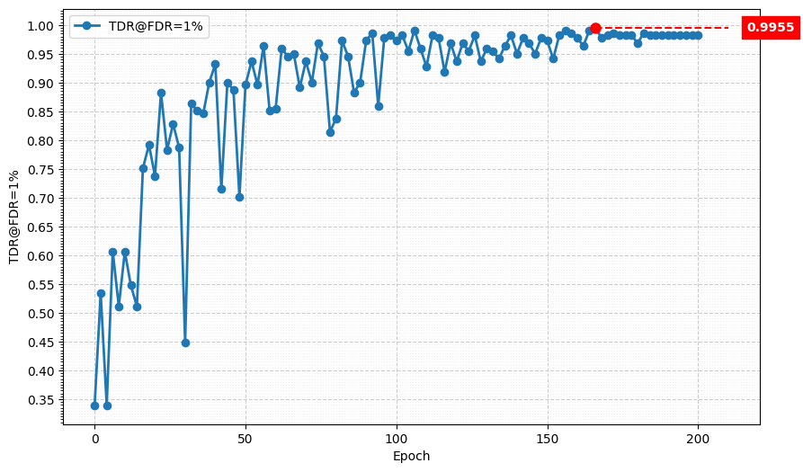
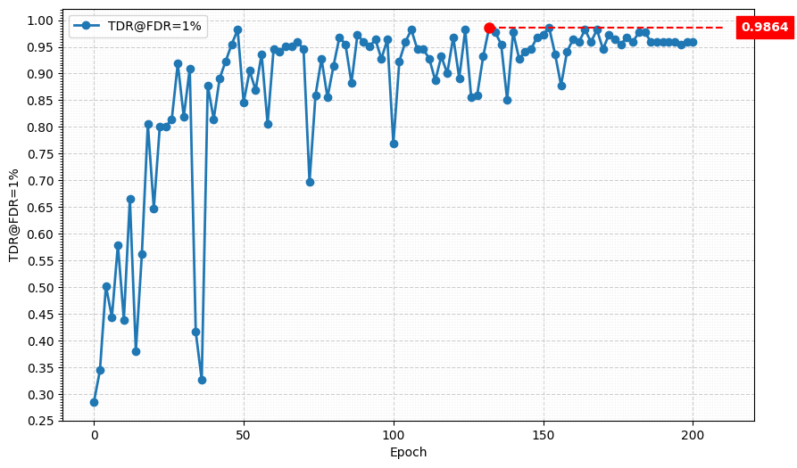
Metric Curve (TDR@FDR=1%, KD)
Model | TDR@FDR=1% | ACE | APCER | BPCER | In Epoch
Baseline, 4-stage | 85.07% | 5.52% | 6.33% | 4.71% | 166
KD, 4-stage | 99.55% | 0.68% | 0.45% | 0.90% | 166
Model | TDR@FDR=1% | ACE | APCER | BPCER | In Epoch
Baseline, 5-stage | 85.97% | 6.03% | 4.07% | 7.99% | 158
KD, 5-stage | 98.64% | 1.15% | 1.36% | 0.95% | 152

Slide 10
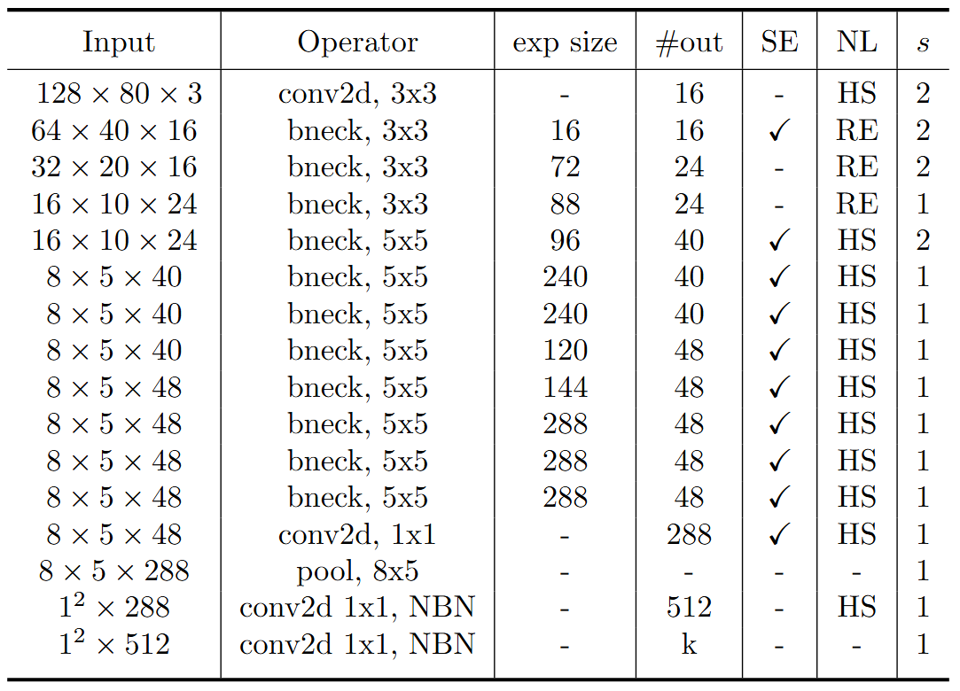
Parameter: reduced_tail
Can halve the dimension of last 3 feature layers and classifier’s hidden dimension
MobileNet V3 Small w/o reduced_tail
MobileNet V3 Small w/ reduced_tail

Slide 11
Train Setting II.
I5-10500 + 2080Ti
Random seed = 42
lr = 0.01, alpha = 0.01, lambda_mgd = 0.15, reduced_tail = True
hidden dimension = [1024, 512, 256, 128]
ABCD Dataset as training set (0.8 for training and 0.2 for validating)
Google Dataset as testing set
Custom MobileNet_V3_Large, change both as teacher model
Modified MobileNet_V3_Small as student model

Slide 12
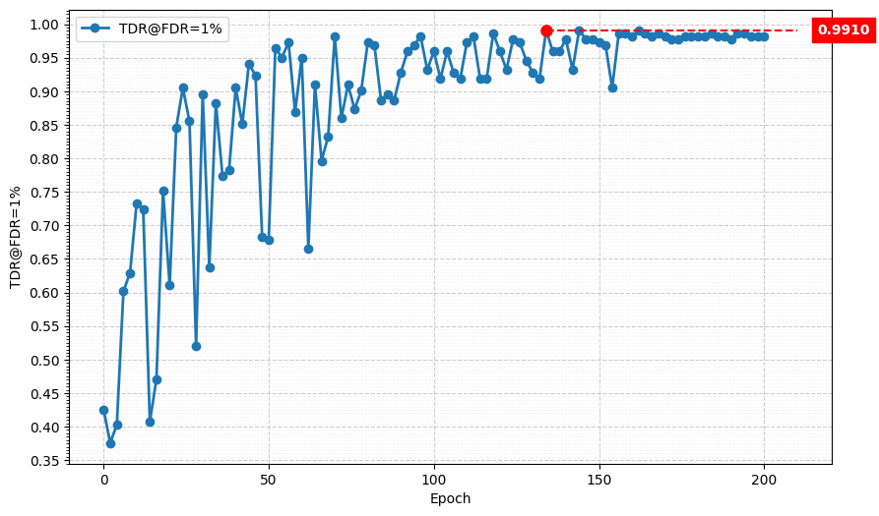
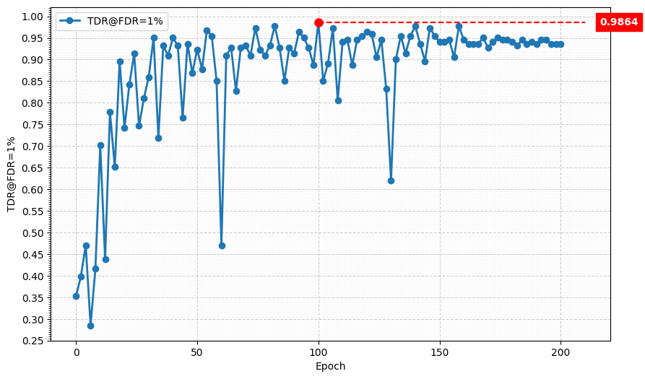
Metric Curve (TDR@FDR=1%)
Model | TDR@FDR=1% | ACE | APCER | BPCER | In Epoch
hd = 1024 w/o reduced_tail | 99.10% | 0.74% | 0.90% | 0.57% | 110
hd = 1024 w/ reduced_tail | 99.10% | 0.95% | 0.90% | 1.00% | 134
Model | TDR@FDR=1% | ACE | APCER | BPCER | In Epoch
hd = 512 w/o reduced_tail | 99.10% | 0.75% | 0.45% | 1.05% | 138
hd = 512 w/ reduced_tail | 98.64% | 1.18% | 1.36% | 1.00% | 100

Slide 13
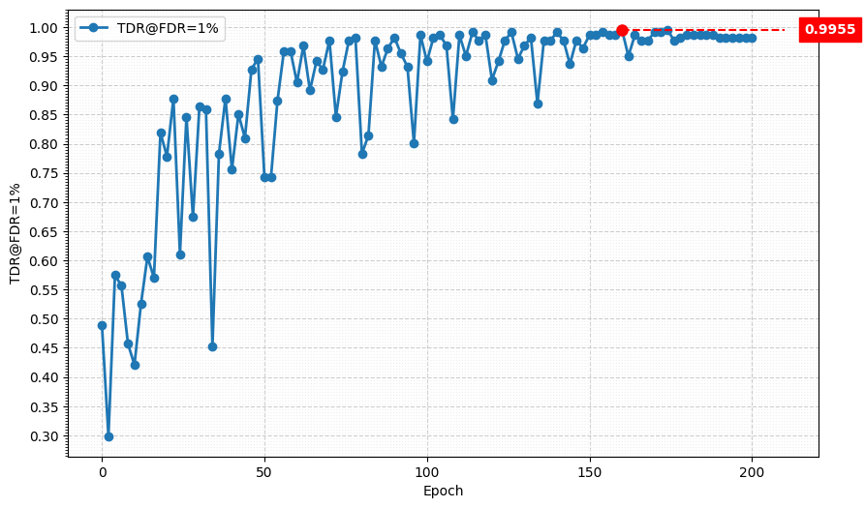
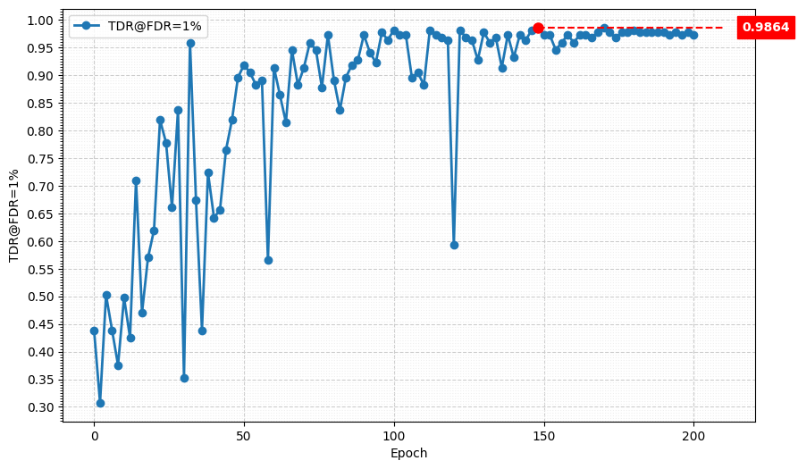
Metric Curve (TDR@FDR=1%)
Model | TDR@FDR=1% | ACE | APCER | BPCER | In Epoch
hd = 256 w/o reduced_tail | 99.55% | 0.70% | 0.45% | 0.95% | 174
hd = 256 w/ reduced_tail | 99.10% | 0.87% | 1.36% | 0.38% | 94
Model | TDR@FDR=1% | ACE | APCER | BPCER | In Epoch
hd = 128 w/o reduced_tail | 98.64% | 1.15% | 1.36% | 0.95% | 152
hd = 128 w/ reduced_tail | 98.64% | 1.13% | 1.36% | 0.90% | 170

Slide 14
Result Matrix
Model | 5-stage, hd = 1024 w/o reduced_tail | 5-stage, hd = 1024 w/ reduced_tail | 5-stage, hd = 512 w/o reduced_tail | 5-stage, hd = 512 w/ reduced_tail | 5-stage, hd = 256 w/o reduced_tail | 5-stage, hd = 256 w/ reduced_tail | 5-stage, hd = 128 w/o reduced_tail | 5-stage, hd = 128 w/ reduced_tail
# params | 1.52 M | 736.69 K (-51.5%) | 1.22 M (-19.7%) | 587.70 K (-61.3%) | 1.08 M (-28.9%) | 513.20 K (-66.2%) | 1 M (-34.2%) | 475.95 K (-68.7%)
MAC | 13.76 M | 10.33 M (-24.9%) | 13.47 M (-2.1%) | 10.18 M (-26.0%) | 13.32 M (-3.2%) | 10.11 M (-26.5%) | 13.25 M (-3.7%) | 10.07 M (-26.8%)
Model | TDR@FDR=1% | ACE | APCER | BPCER | In Epoch
SPEC | ≥ 85.11% | < 3.489% | < 6.033% | < 0.956%
Custom MobileNet V3 Large, change SE layer | 99.10% | 0.76% | 0.90% | 0.62% | 152
Modified MobileNet V3 Small, 4-stage downsampling | 90.95% | 4.04% | 5.88% | 2.19% | 160
MGD 1 layer Custom MobileNet V3 Large, change both Modified MobileNet V3 Small, 5-stage , hd = 1024, w/o rt | 99.10% | 0.74% | 0.90% | 0.57% | 110
MGD 1 layer Custom MobileNet V3 Large, change both Modified MobileNet V3 Small, 5-stage , hd = 128, w/o rt | 98.64% | 1.15% | 1.36% | 0.95% | 152
MGD 1 layer Custom MobileNet V3 Large, change both Modified MobileNet V3 Small, 5-stage , hd = 1024, w/ rt | 99.10% | 0.95% | 0.90% | 1.00% | 134
MGD 1 layer Custom MobileNet V3 Large, change both Modified MobileNet V3 Small, 5-stage , hd = 256, w/ rt | 99.10% | 0.87% | 1.36% | 0.38% | 94

