Slide 1
AMIE: Affine-Attentive Matching and Interpretive Imprint Evaluation for Partial Fingerprint Verification
Tsai-Chieh Chen*, Ching-Te Chiu* Ned Lin†, Ang Yu†, Paul Lai†, Daniel Chen† Chia-Yi Lin*
* Department of Computer Science, National Tsing Hua University, Taiwan † FocalTech Electronics Co., Ltd., Taiwan

Slide 2
Outline
Introduction
Detector: High-Coverage Keypoint Extraction
Matcher: Affine-Attentive Keypoint Matching
Verifier: Final Decision on Aligned ROI Pair
Experimental Results
Conclusion

Slide 3
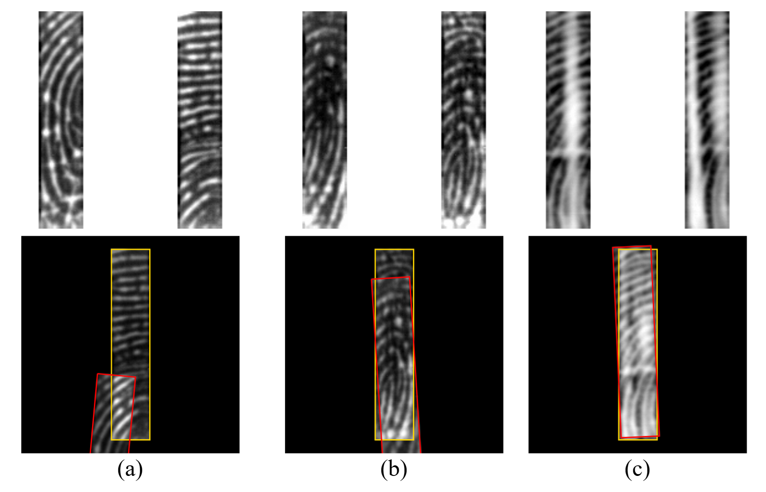
Introduction - Background
Mobile devices now use smaller sensors, capturing only partial fingerprints.
Traditional minutiae-based matchers fail on partial prints due to
Few detectable minutiae and poor overlap.
Distortions from pressure, dry/wet skin, and image degradation.
Accuracy drops sharply when ridge detail is poor.
Fig. 1. Examples of challenging partial fingerprint pairs (top) and overlap showcases (bottom)
Small overlap area + poor quality
Wet fingers causing ridge swelling
Blurry prints with slight distortion from pressure or angle

Slide 4
Introduction - Contributions
Having robustness by detecting keypoints in almost every ridge block.
SuperPoint-based Detector with stride-4 and fingerprint-specific fine-tuning.
Aligning pairs reliably under minimal overlap.
Geometry-aware attention via 24-param RPE (Relative Positional Encoding) in LightGlue
Combined with MAGSAC++ for affine fitting at low overlaps
Interpretable, CNN-free, avoids heuristic segmentation/cropping .
Affine-warped binary mask defines pixel-accurate ROI (Region of Interest, possible overlapped area).
Generalizing across different sensors without re-training.
Lightweight ResNet (1.28M parameters) classifies only the aligned, ROI-masked region

Slide 5
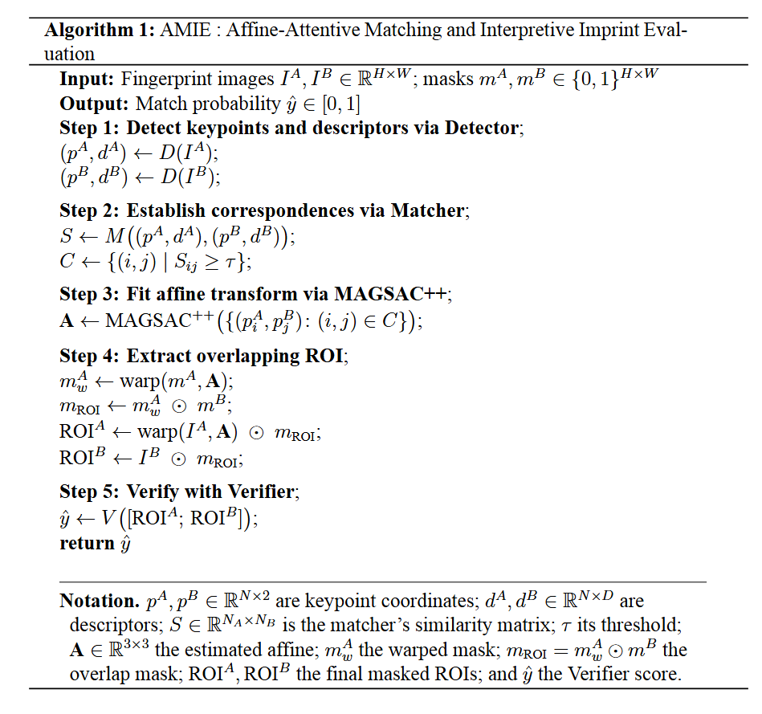
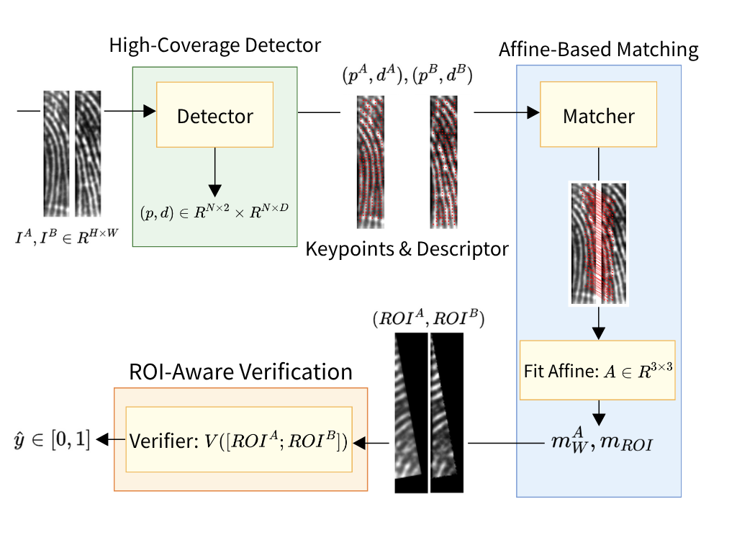
Introduction - Data flowchart
Detector
A SuperPoint-based keypoint detector for high-coverage fingerprint features.
Matcher
An affine-attentive matcher combining LightGlue with FC-GNN and followed by affine alignment via MAGSAC++ for geometry-aware attention.
A pixel-level, affine-warped binary ROI mask enabling interpretable imprint localization.
Verifier
An ROI-aware verifier based on a lightweight ResNet, operating exclusively on aligned and masked regions.
Fig. 2. Pseudo algorithm of AMIE
Fig. 3. Overview of AMIE modules and data flow

Slide 6
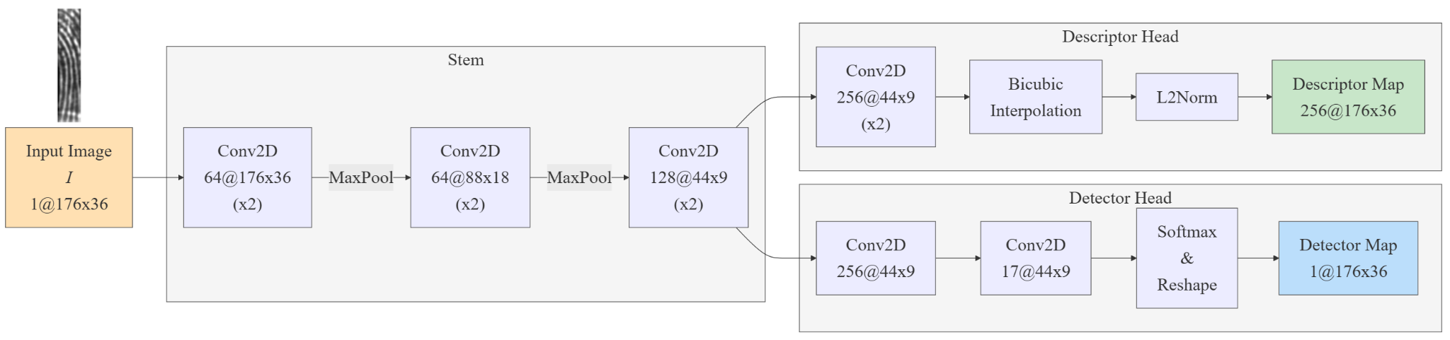

Detector: High-Coverage Keypoint Extraction
Role
Predict keypoints and descriptors for input images $I^{A},I^{B}∈ℝ^{H×W}$
Inputs: Image pair $I^{A}, I^{B}∈ℝ^{H×W}$
Outputs: Keypoints $p^{A}, p^{B}∈ℝ^{N×2}$ and Descriptors $d^{A}, d^{B}∈ℝ^{N×D}$ Where $N$is the number of top response by NMS $D$ is the descriptor dimension

Slide 7
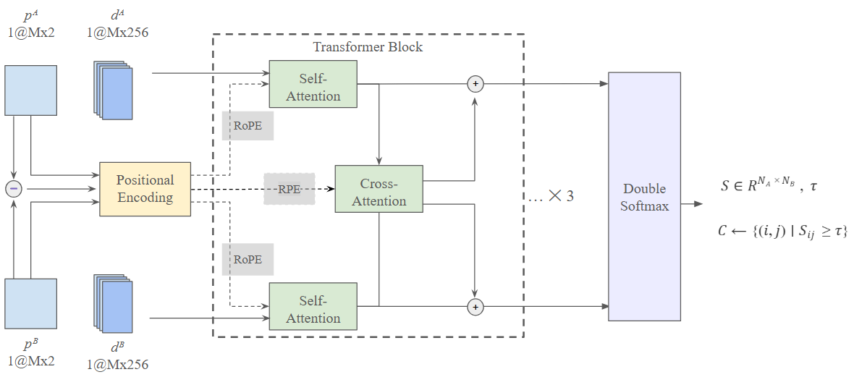

Matcher: Affine-Attentive Keypoint Matching
Role
Match keypoints and descriptors
Inputs: Keypoints $p^{A}, p^{B}∈ℝ^{N×2}$ and Descriptors $d^{A}, d^{B}∈ℝ^{N×D}$
Outputs: Similarity matrix $S∈ℝ^{N×N}$
Fig. 5. Matcher module architecture

Slide 8
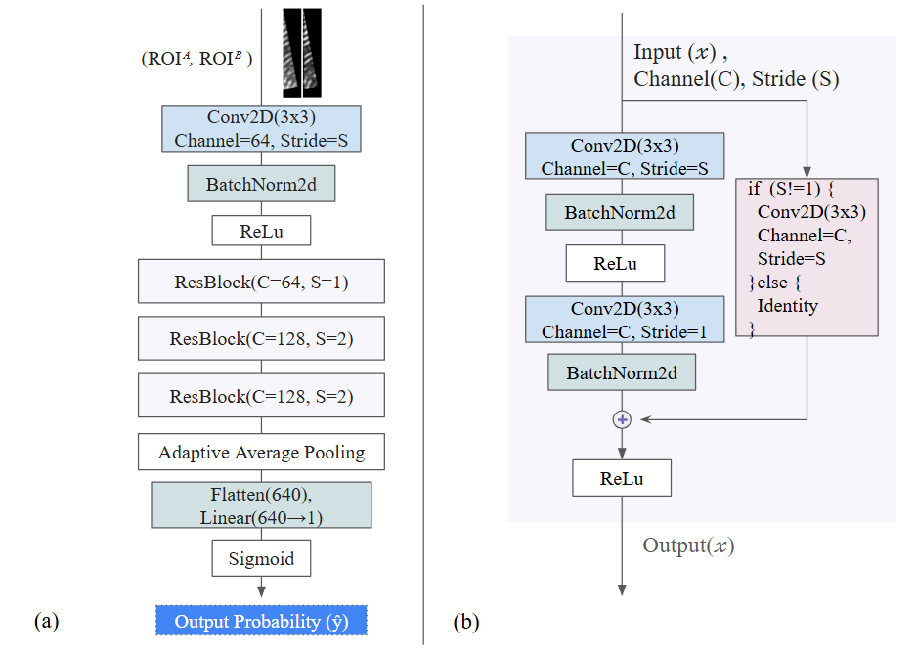
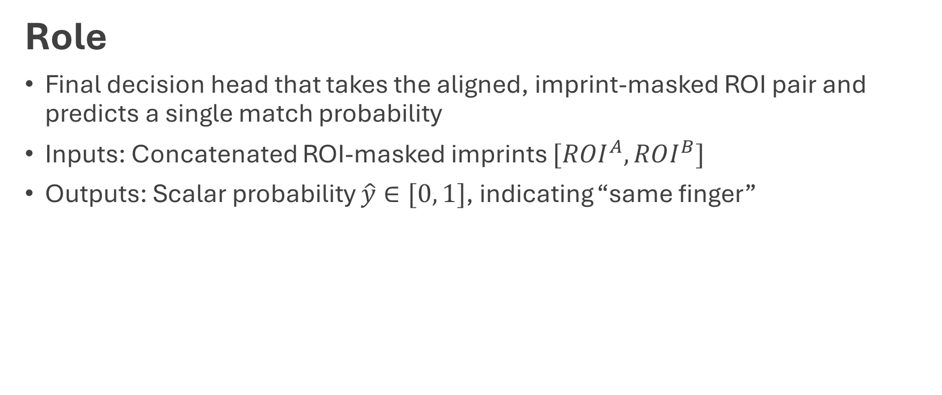
Verifier: Final Decision on Aligned ROI Pair
Role
Final decision head that takes the aligned, imprint-masked ROI pair and predicts a single match probability
Inputs: Concatenated ROI-masked imprints $[ROI^{A}, ROI^{B}]$
Outputs: Scalar probability $\hat{y}∈[0, 1]$, indicating “same finger”

Slide 9
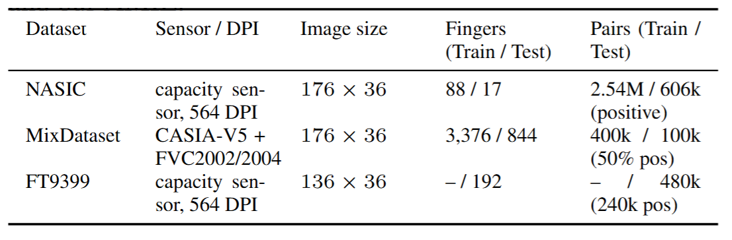
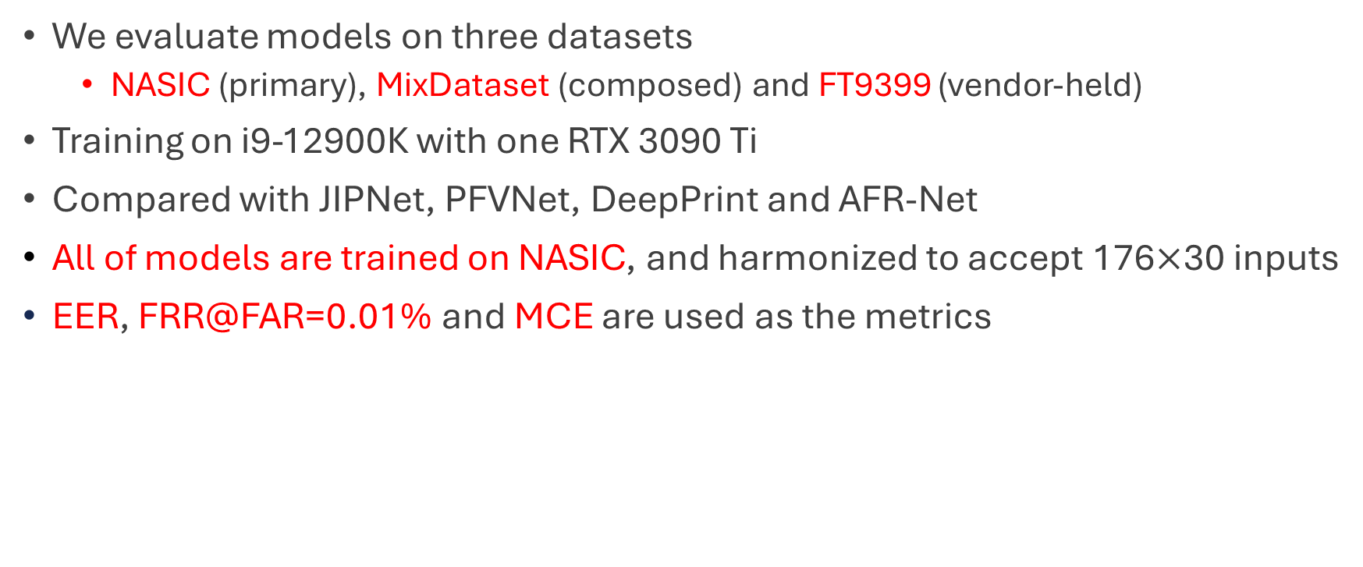
Experiment – Dataset & Settings
We evaluate models on three datasets
NASIC (primary), MixDataset (composed) and FT9399 (vendor-held)
Training on i9-12900K with one RTX 3090 Ti
Compared with JIPNet, PFVNet, DeepPrint and AFR-Net
All of models are trained on NASIC, and harmonized to accept 176$×$30 inputs
EER, FRR@FAR=0.01% and MCE are used as the metrics
Table 1. Information of each dataset

Slide 10
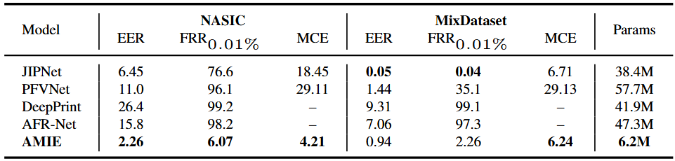
Experiment – Result
AMIE is over six times more compact than any other baselines
AMIE provides state-of-the-art accuracy, efficiency, and robustness across both challenging real and synthetic benchmarks.
Table 2. Performance of each model on different dataset

Slide 11
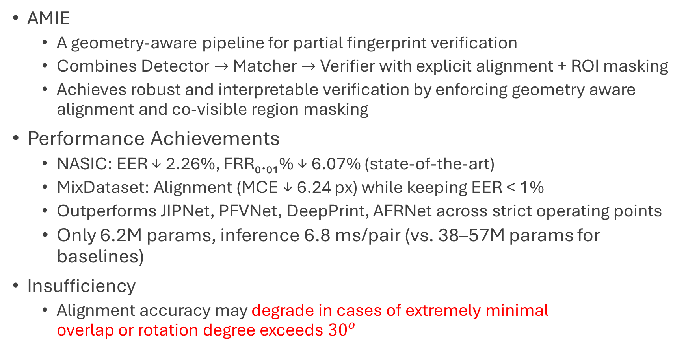
Conclusion
AMIE
A geometry-aware pipeline for partial fingerprint verification
Combines Detector$→$Matcher$→$Verifier with explicit alignment + ROI masking
Achieves robust and interpretable verification by enforcing geometry aware alignment and co-visible region masking
Performance Achievements
NASIC: EER ↓ 2.26%, FRR₀.₀₁% ↓ 6.07% (state-of-the-art)
MixDataset: Alignment (MCE ↓ 6.24 px) while keeping EER < 1%
Outperforms JIPNet, PFVNet, DeepPrint, AFRNet across strict operating points
Only 6.2M params, inference 6.8 ms/pair (vs. 38–57M params for baselines)
Insufficiency
Alignment accuracy may degrade in cases of extremely minimal overlap or rotation degree exceeds ${30}^{ο}$

