Slide 1
10/21 個人咪挺 修正訓練過程後的成果

Slide 2
Train Setting
I5-10500 + 2080Ti
Random seed = 42
Adam(lr = 1e-4) + BCELoss
ABCD Dataset as training set (0.8 for training and 0.2 for validating)
Google Dataset as testing set
Output Dimension from 1 to 2

Slide 3
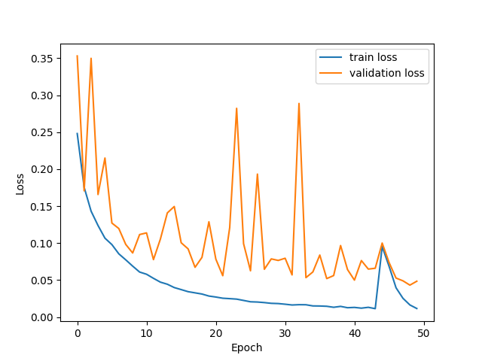
Loss Curve（Epoch 50）

Slide 4
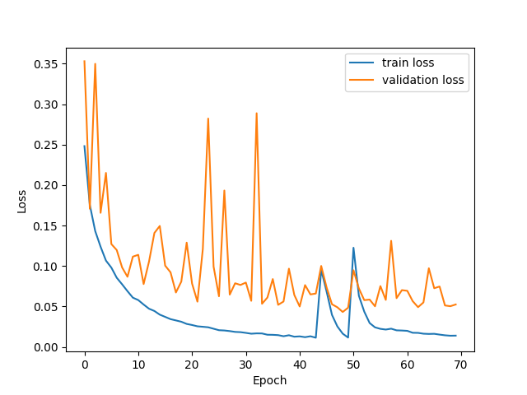
Loss Curve（Epoch 70）

Slide 5
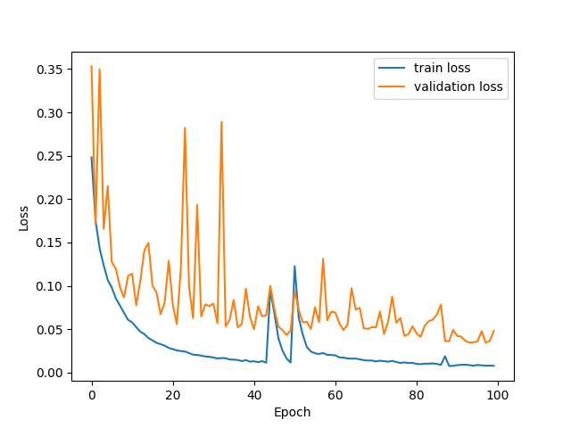
Loss Curve（Epoch 100）

Slide 6
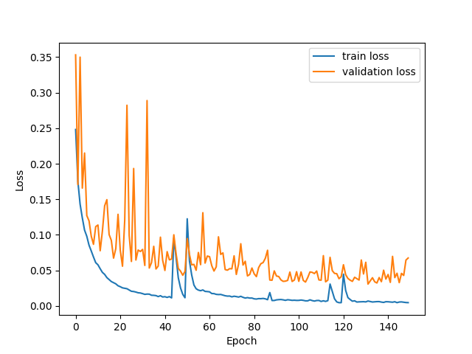
Loss Curve（Epoch 150）

Slide 7
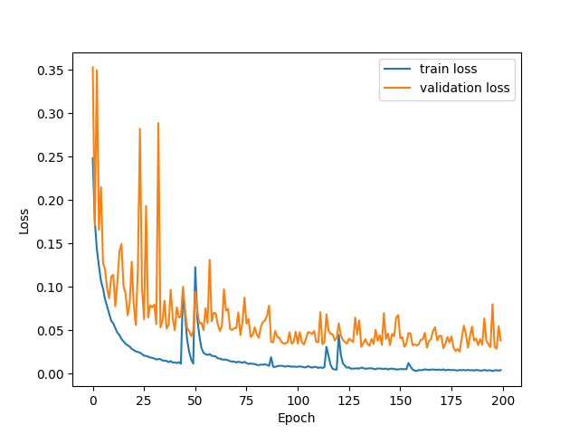
Loss Curve（Epoch 200）

Slide 8
Metrics
Model | Epoch 50 | Epoch 70 | Epoch 100 | Epoch 150 | Epoch 200
TDR@FDR = 1% | 74.21% | 61.09% | 81.90% | 63.35% | 84.62%

