Slide 1
6/30 個人咪挺 Results of different hidden dimension of classifier

Slide 2
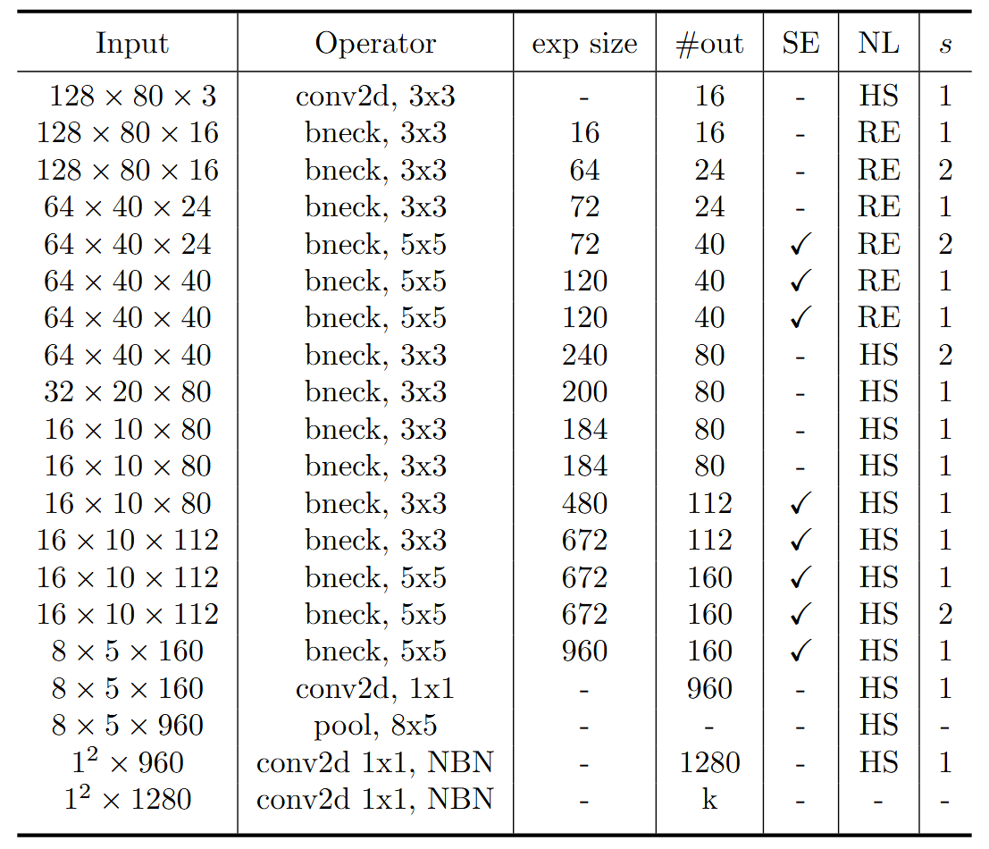
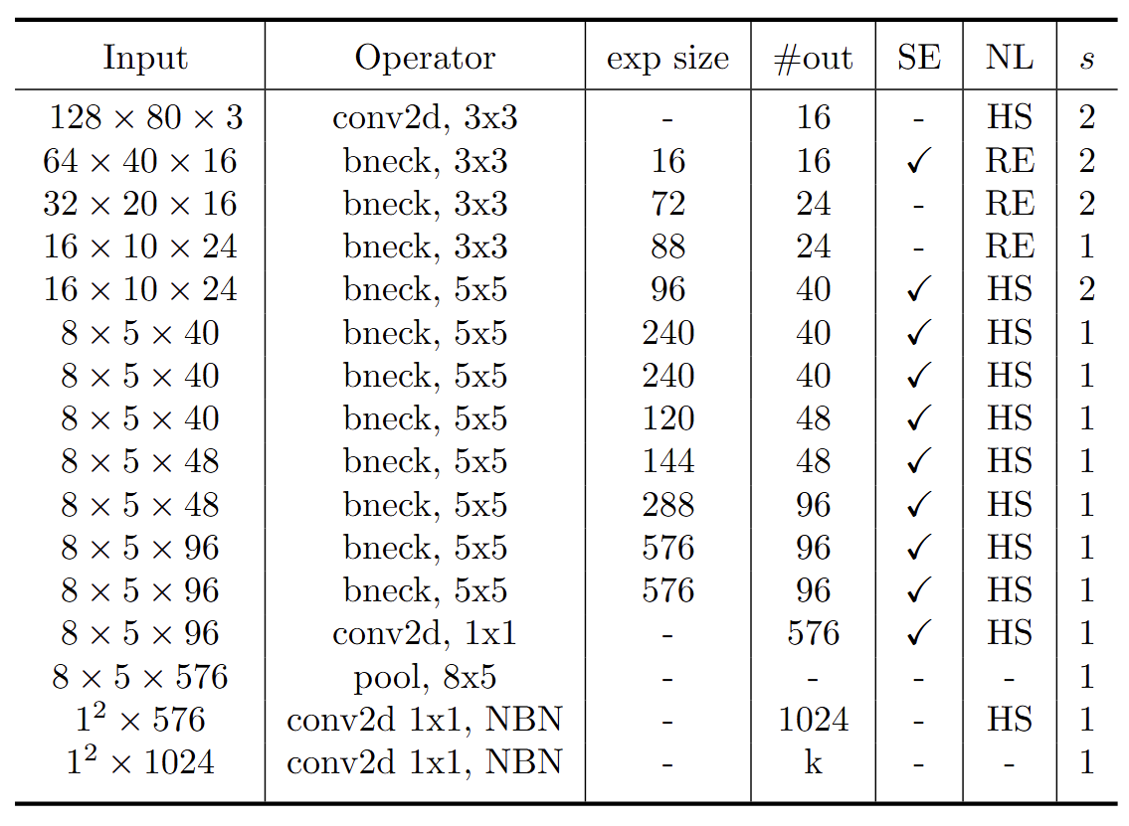
Modified MobileNet Model Structure
MobileNet V3 Large
MobileNet V3 Small
Blue: Selected layer to do MGD-1layer Red: The layer we modified stride number

Slide 3
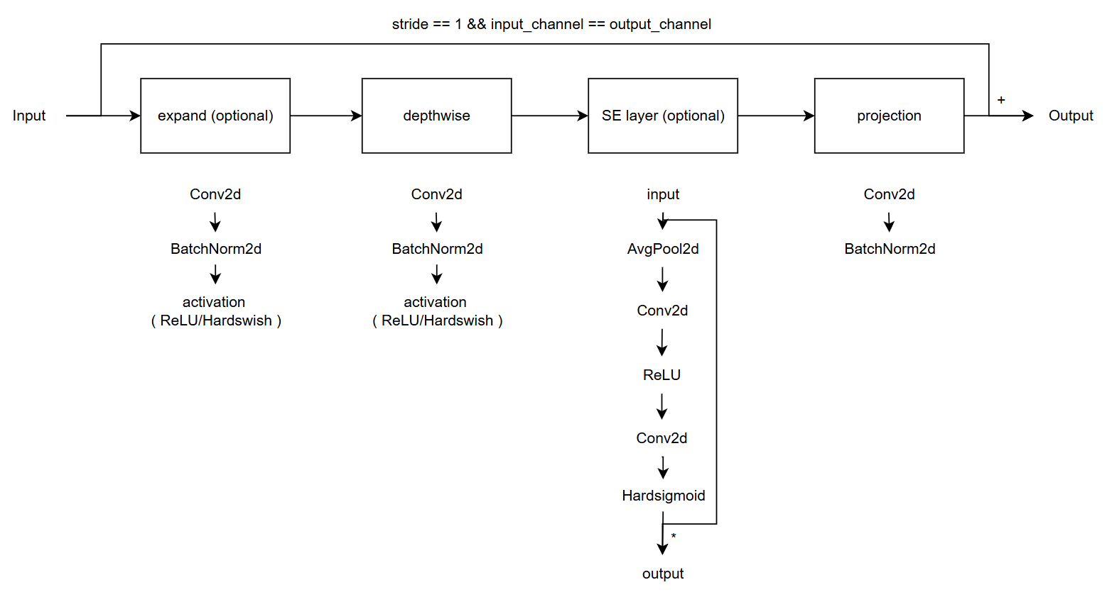
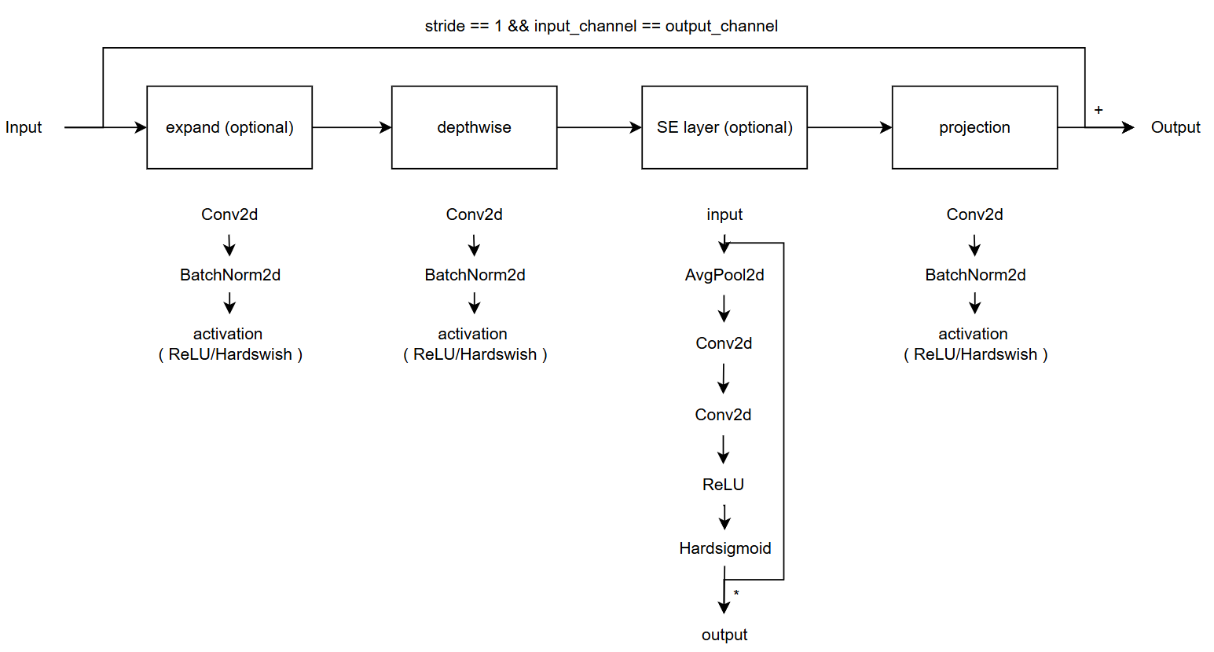
Modified vs. Custom Bneck Structure
Change the ordering of SE layer forward pass
Add an activation function in the end of projection
Modified
( Only change part of torchvision model )
Custom
( Re-write the model with some mistake )
( Used in previous time )

Slide 4
Current Model Type
Original MobileNet V3 (5-stage downsampling)
Modified MobileNet V3 (4-stage downsampling)
Custom MobileNet V3, change SE forward
Custom MobileNet V3, change projection
Custom MobileNet V3, change both
Model | Original | Modified | Custom, change SE | custom, change projection | Custom, change both
# Params | 1.52 M | 1.52 M | 1.52 M | 1.52 M | 1.52 M
MAC | 13..76 M | 23.59 M | 23.6 M | 23.63 M | 23.63 M

Slide 5

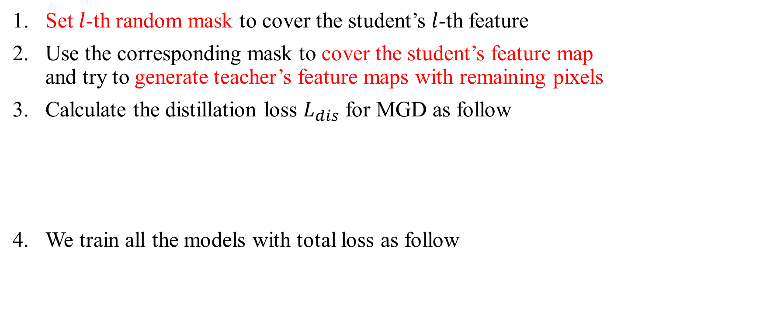
Recall – MGD Process
Set $l$-th random mask to cover the student’s $l$-th feature
Use the corresponding mask to cover the student’s feature map and try to generate teacher’s feature maps with remaining pixels
Calculate the distillation loss $L_{dis}$ for MGD as follow
We train all the models with total loss as follow

Slide 6
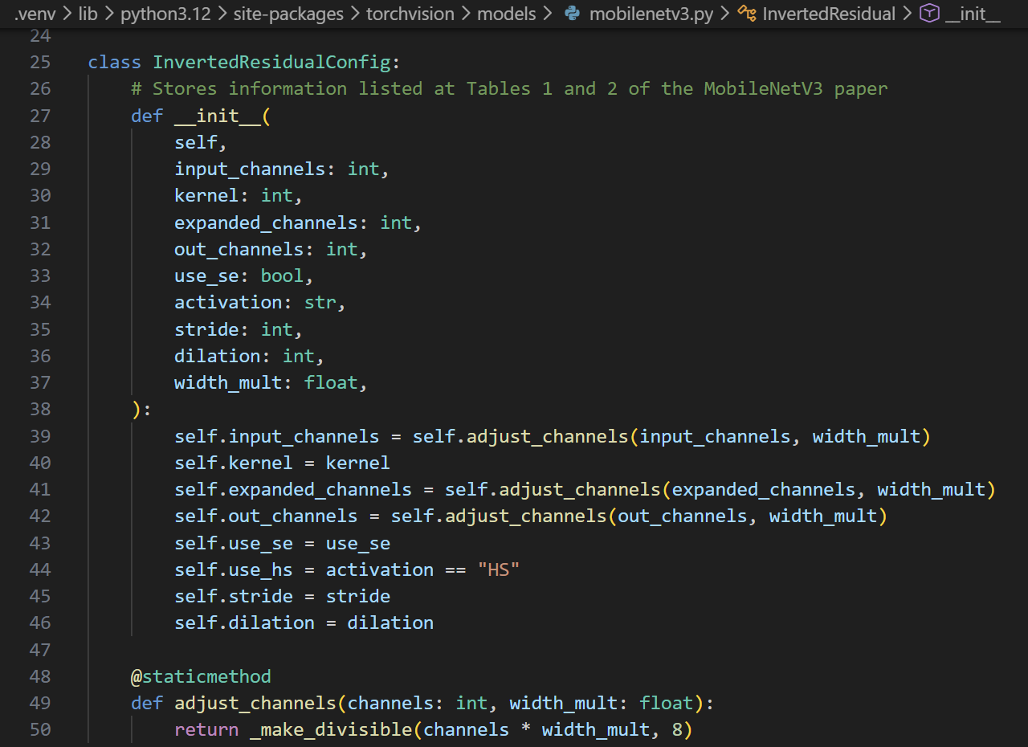
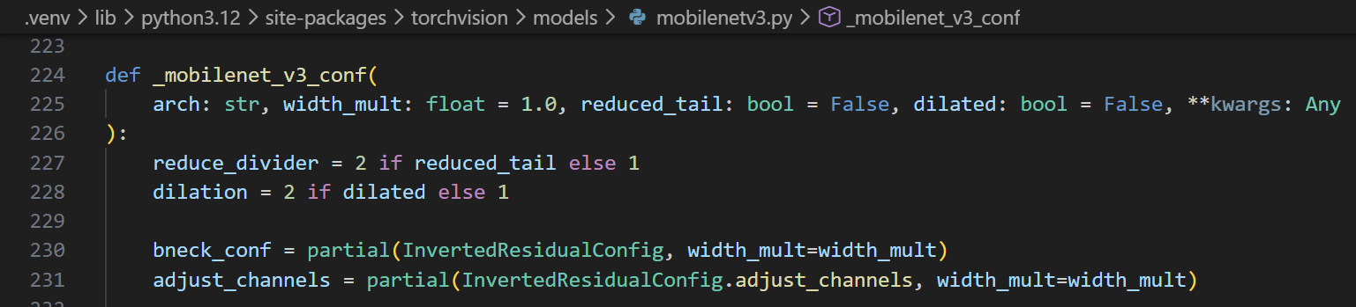
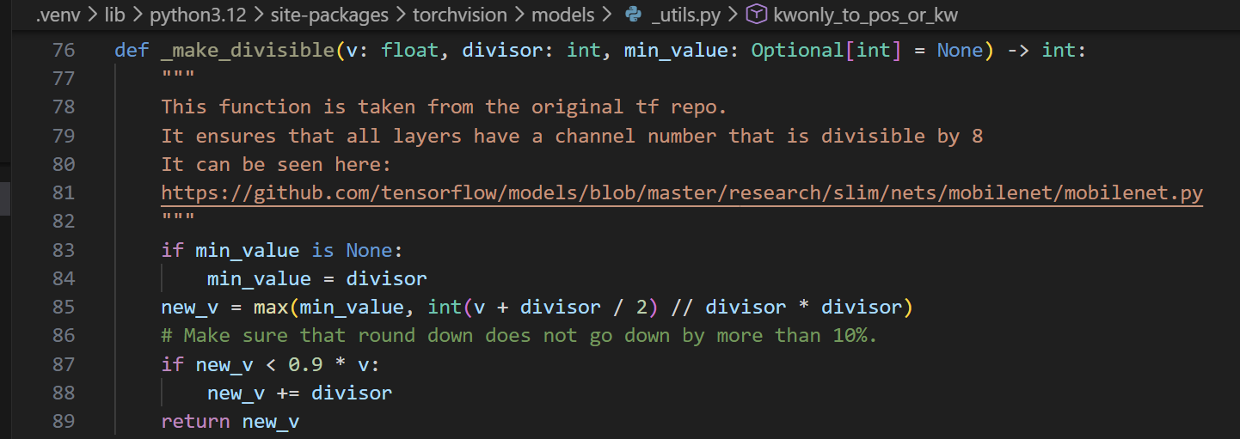
Parameter: width_mult
Scales the channel dimension and round the channels to hardware-friendly multiples of 8 while preventing them from shrinking too much

Slide 7
Train Setting I.
I5-10500 + 2080Ti
Random seed = 42
lr = 0.01 for baseline
lr = 0.01, alpha = 0.01, lambda_mgd = 0.15, reduce_tail = True, hd = 128 for KD
width_mult = [0.75, 0.5, 0.25]
ABCD Dataset as training set (0.8 for training and 0.2 for validating)
Google Dataset as testing set
Custom MobileNet_V3_Large, change both as teacher model
Modified MobileNet_V3_Small as student model

Slide 8
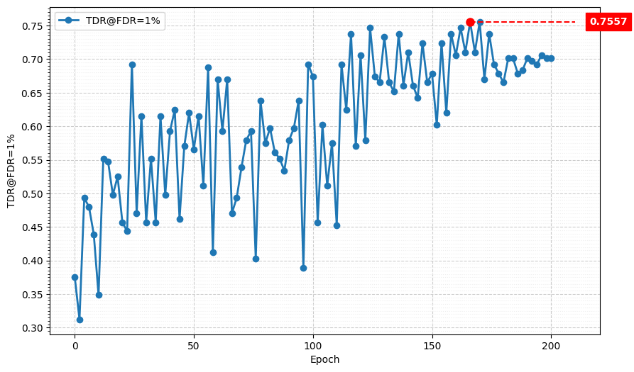
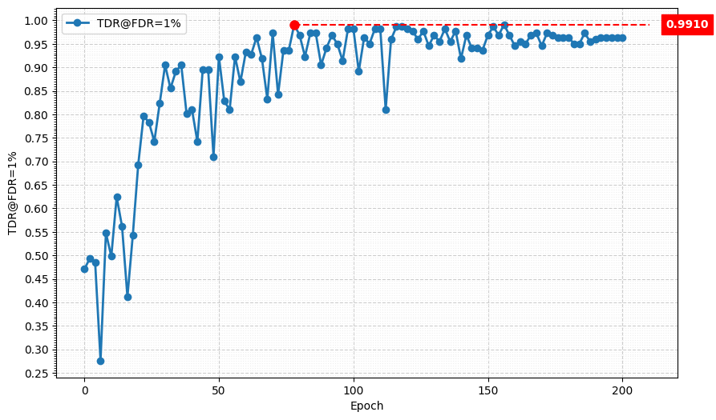
Metric Curve (TDR@FDR=1%, width_mult = 0.75)
Baseline
KD
Model | TDR@FDR=1% | ACE | APCER | BPCER | In Epoch
Baseline | 75.57% | 7.76% | 11.76% | 3.76% | 170
KD | 99.10% | 0.88% | 0.90% | 0.86% | 156

Slide 9
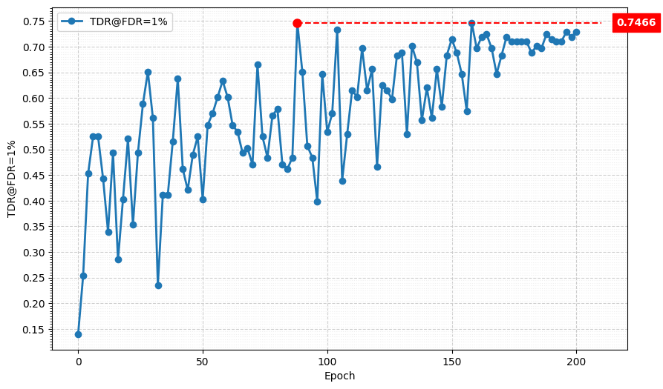
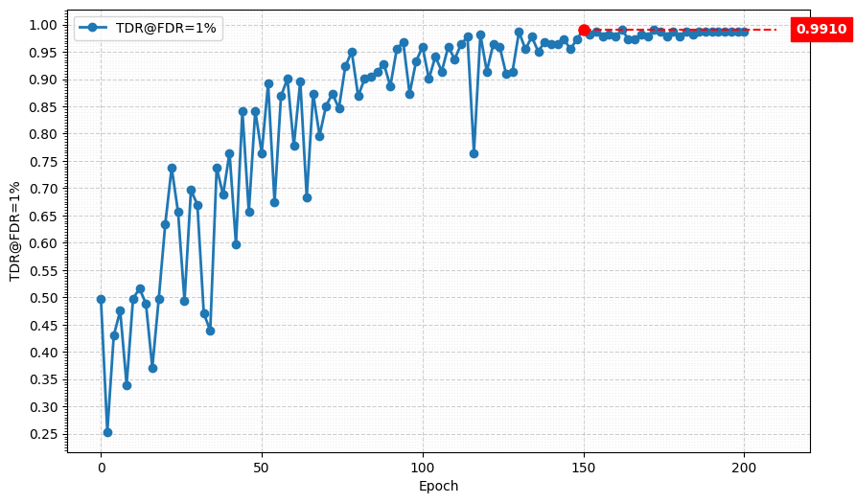
Metric Curve (TDR@FDR=1%, width_mult = 0.5)
Baseline
KD
Model | TDR@FDR=1% | ACE | APCER | BPCER | In Epoch
Baseline | 74.66% | 8.07% | 6.33% | 9.80% | 158
KD | 99.10% | 0.93% | 0.90% | 0.95% | 172

Slide 10
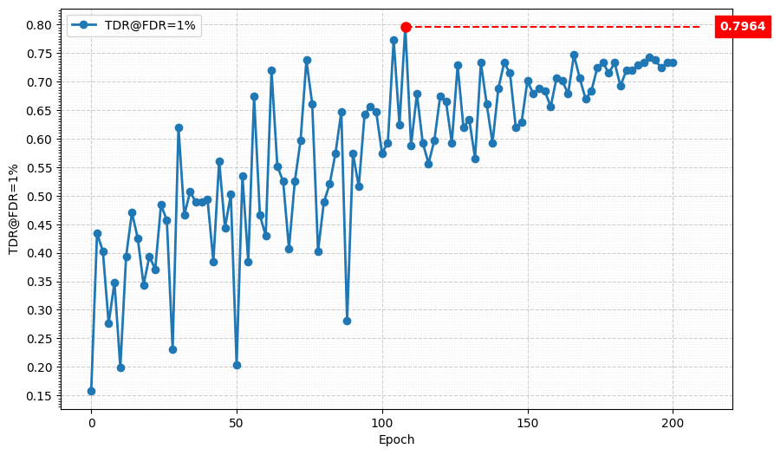
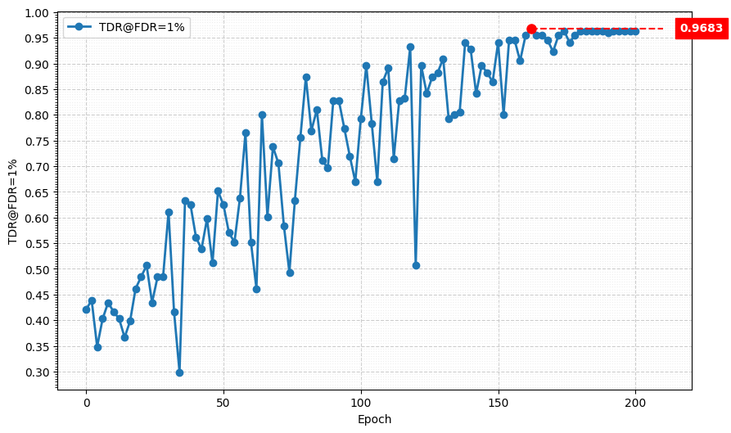
Metric Curve (TDR@FDR=1%, width_mult = 0.25)
Baseline
KD
Model | TDR@FDR=1% | ACE | APCER | BPCER | In Epoch
Baseline | 79.64% | 7.63% | 10.41% | 4.85% | 108
KD | 96.83% | 1.83% | 1.81% | 1.86% | 162

Slide 11
Result Matrix
Model | hd = 128, wm = 1.0 w/ reduced_tail | hd = 128, wm = 0.75 w/ reduced_tail | hd = 128, wm = 0.5 w/ reduced_tail | hd = 128, wm = 0.25 w/ reduced_tail
# params | 475.95 K | 306.41 K (-35.6%) | 150.78 K (-68.3%) | 60.49 K (-87.3%)
MAC | 10.07 M | 7.41 M (-26.4%) | 3.68 M (-63.5%) | 1.96 M (-80.5%)
Model | TDR@FDR=1% | ACE | APCER | BPCER | In Epoch
SPEC | ≥ 85.11% | < 3.489% | < 6.033% | < 0.956%
Custom MobileNetV3-Large, changed both | 98.64% | 1.02% | 0.90% | 1.14% | 104
Original MobileNetV3-Small | 84.16% | 5.36% | 6.33% | 4.38% | 154
Custom MobileNetV3-Large, changed both Original MobileNetV3-Small, hd=128, wm=1.0, w/ rt | 98.64% | 1.13% | 1.36% | 0.90% | 170
Custom MobileNetV3-Large, changed both Original MobileNetV3-Small, hd=128, wm=0.75, w/ rt | 99.10% | 0.88% | 0.90% | 0.86% | 156
Custom MobileNetV3-Large, changed both Original MobileNetV3-Small, hd=128, wm=0.5, w/ rt | 99.10% | 0.93% | 0.90% | 0.95% | 172

Slide 12

Summary I.
We successfully reduced the model size and MACs by 90.1% and 84.4%, respectively, by changing the hidden dimension, enabling reduced_tail, and setting width_mult = 0.5, while still meeting the SPEC requirements.
Setting width_mult = 0.25 would let the student model become too small for this task, so we then try to setting width_mult $∈$ [0.45, 0.4, 0.35, 0.3]
Model | Modified hd = 1024, wm = 1.0 w/o reduced_tail | Original hd = 1024, wm = 1.0 w/o reduced_tail | Original hd = 128, wm = 1.0 w/o reduced_tail | Original hd = 128, wm = 1.0 w/ reduced_tail | Original hd = 128, wm = 0.5 w/o reduced_tail
# Params | 1.52 M | 1.52 M (-0%) | 1 M (-34.2%) | 475.95 K (-68.7%) | 150.78 K (-90.1%)
MACs | 23.59 M | 13.76 M (-41.7%) | 13.25 M (-43.8%) | 10.07 M (-57.3%) | 3.68 M (-84.4%)
Model | TDR@FDR=1% | ACE | APCER | BPCER | In Epoch
SPEC | ≥ 85.11% | < 3.489% | < 6.033% | < 0.956%
Custom MobileNetV3-Large, changed both Original MobileNetV3-Small, hd=128, wm=0.5, w/ rt | 99.10% | 0.93% | 0.90% | 0.95% | 172

Slide 13
Train Setting I.
I5-10500 + 2080Ti
Random seed = 42
lr = 0.01, alpha = 0.01, lambda_mgd = 0.15, reduce_tail = True, hd = 128 for KD
width_mult = [0.45, 0.4, 0.35, 0.3]
ABCD Dataset as training set (0.8 for training and 0.2 for validating)
Google Dataset as testing set
Custom MobileNet_V3_Large, change both as teacher model
Modified MobileNet_V3_Small as student model

Slide 14
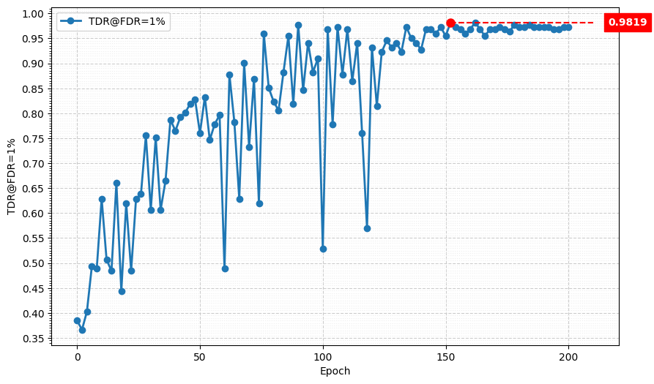
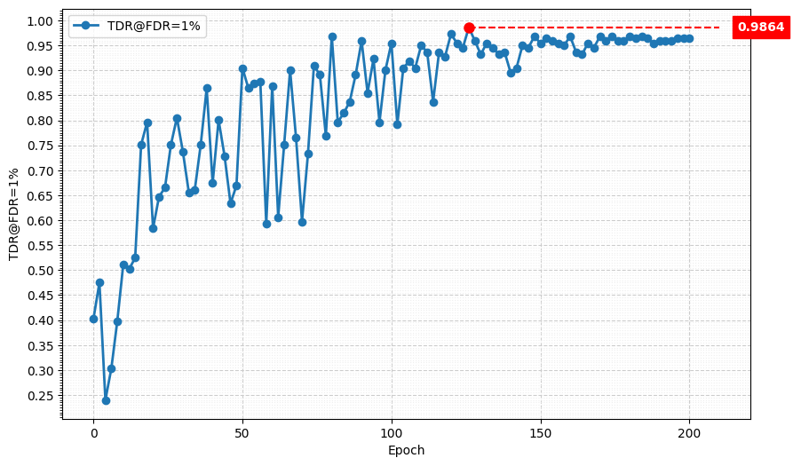
Metric Curve (TDR@FDR=1%)
width_mult = 0.45
width_mult = 0.4
Model | TDR@FDR=1% | ACE | APCER | BPCER | In Epoch
width_mult = 0.45 | 98.19% | 1.20% | 1.36% | 1.05% | 152
width_mult = 0.4 | 98.64% | 1.18% | 1.36% | 1.00% | 126

Slide 15
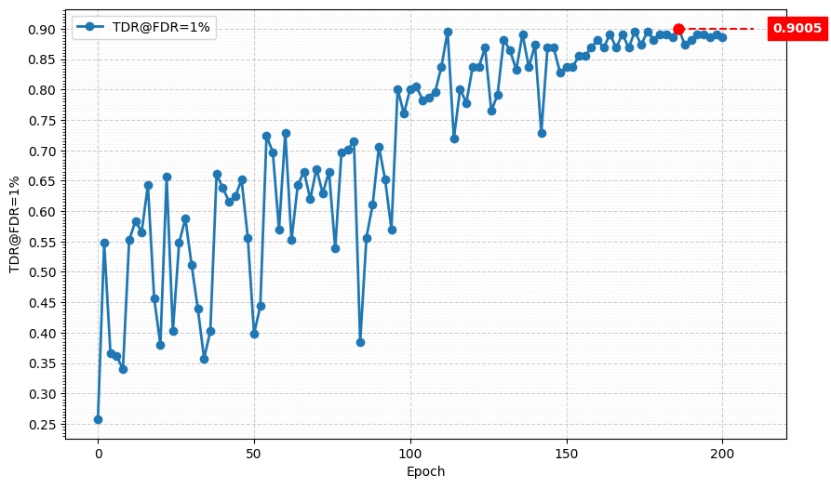
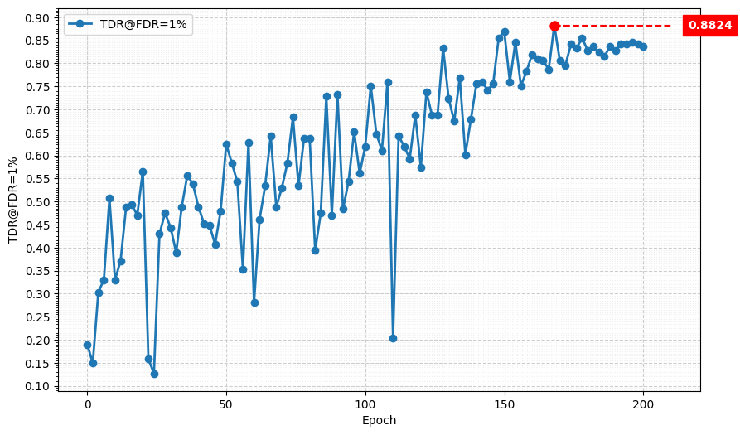
Metric Curve (TDR@FDR=1%)
width_mult = 0.35
width_mult = 0.3
Model | TDR@FDR=1% | ACE | APCER | BPCER | In Epoch
width_mult = 0.45 | 90.05% | 2.93% | 1.81% | 4.04% | 186
width_mult = 0.4 | 88.24% | 4.78% | 5.43% | 4.14% | 168

Slide 16
Summary II.
It seems that width_mult = 0.5 is the smallest number we can set to meet the SPEC
Maybe we can continue reduce the hidden dimension of classifier while setting width_mult = 0.5 to prevent the student model become too small

